Slide 1

The Future of Personality Assessment
The study of human behavioral science has undergone a significant transformation with the integration of advanced technologies and data-driven methodologies. This project aims to explore the relationship between personality traits and professional readiness, focusing on how personality insights can empower organizations and individuals alike.

Slide 2

The Rise of Behavioral Science and Technology
Data Revolution
Technological Advancements
Modern research tools allow us to collect, analyze, and interpret data with remarkable precision and at an unprecedented scale, shedding new light on human behavior and personality.
Innovative technologies like machine learning, natural language processing, and virtual assessments are transforming the way we measure and understand personality.

Slide 3
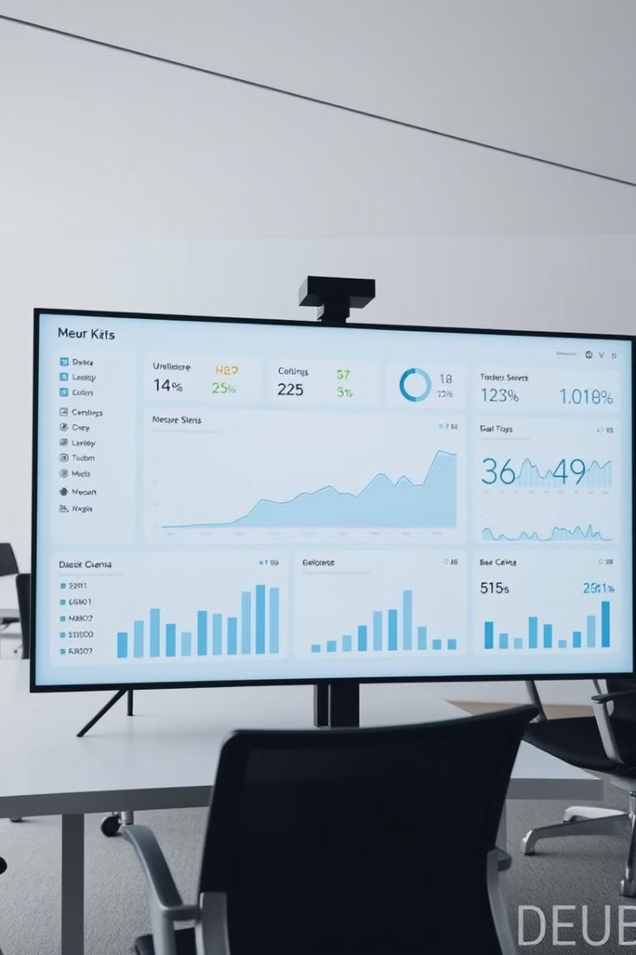
The Power of Data-Driven Insights
1
Predictive Capabilities
2
Personalized Insights
Advanced analytics can identify patterns and trends, enabling organizations to predict employee performance and potential with greater accuracy.
Data-driven personality assessments provide tailored insights, empowering individuals to unlock their full potential and align their skills with the right opportunities.
3
Organizational Agility
Leveraging personality data can help organizations adapt to changing market conditions, ensure workforce readiness, and drive strategic decision-making.

Slide 4

Personality Traits and Professional Readiness
Cognitive Abilities
Emotional Intelligence
Certain personality traits, such as openness and conscientiousness, are closely linked to an individual's cognitive abilities and problem-solving skills.
Personality factors like empathy, self-awareness, and adaptability can significantly impact an employee's interpersonal skills and emotional intelligence.
Motivational Drivers
Cultural Fit
Understanding an individual's personality-driven motivations can help organizations align them with the right roles and responsibilities.
Personality assessments can identify candidates whose values and working styles are a strong match for a company's culture and expectations.

Slide 5
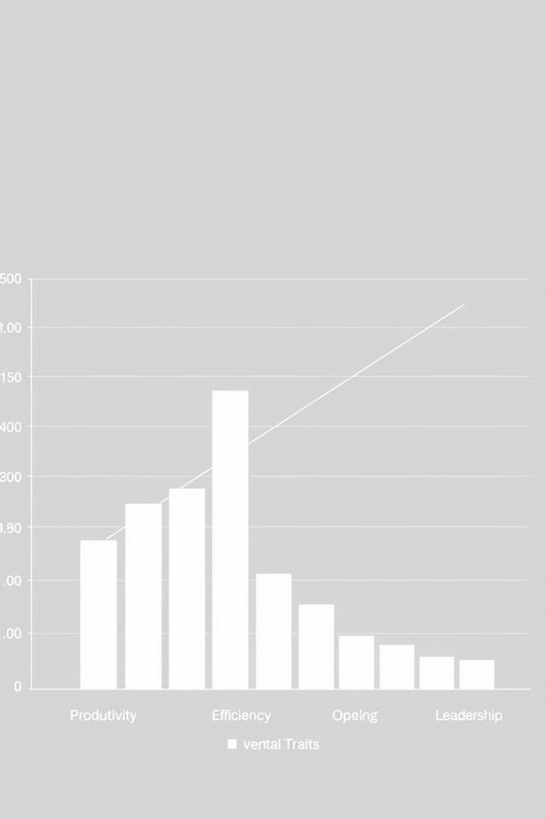
Exploring the Personality-Performance Link
1
Personality Profiling
Comprehensive personality assessments provide a detailed understanding of an individual's unique traits, preferences, and behavioral tendencies.
2
Job Requirements Analysis
Analyzing the specific personality requirements for different roles and job functions enables organizations to identify the best-fit candidates.
3
Performance Evaluation
By tracking the performance and career progression of employees, organizations can validate the predictive power of personality-based hiring and development strategies.

Slide 6





Assessing Personality: From Self-Report to Multifaceted Evaluation
Self-Report
Virtual Assessments
Peer Feedback
Neuroscience
Traditional self-reported personality assessments provide valuable insights based on an individual's own perceptions and experiences.
Innovative virtual assessments leverage AI, machine learning, and natural language processing to capture more nuanced and objective personality data.
Incorporating 360-degree feedback from colleagues and managers can provide a more well-rounded understanding of an individual's personality and interpersonal skills.
Emerging neuroscience-based techniques, such as brain imaging and physiological monitoring, offer insights into the biological underpinnings of personality.

Slide 7






Predictive Modeling: Identifying High-Potential Candidates
1
Personality Profiling
2
Job Requirements
3
Predictive Analytics
4
Talent Identification
5
Workforce Planning
By integrating personality data with job requirements and predictive analytics, organizations can identify high-potential candidates who are most likely to excel in specific roles, enabling them to make informed hiring and promotion decisions.
6

Slide 8
Personalized Development Plans for Employee Growth
1
Personality Insights
2
Skill Gap Analysis
3
Tailored Training
4
Career Progression
Combining personality data with a deep understanding of individual strengths and development needs enables organizations to create personalized growth plans that empower employees to reach their full potential.
5

Slide 9

Case Studies: Real-World Applications and Outcomes
25%
Increased Retention
A leading tech company saw a 25% improvement in employee retention by implementing personality-based hiring and development strategies.
40%
Improved Productivity
A global consulting firm achieved a 40% boost in team productivity by aligning employee personality traits with project assignments.
35
Accelerated Growth
A fast-growing startup was able to identify and develop 35 high-potential leaders in just 18 months, fueling its expansion into new markets.

Slide 10
The Transformative Impact of Personality Insights
Competitive Advantage
Employee Engagement
Organizational Agility
Unlocking Human Potential
Leveraging personality data empowers organizations to make more informed and strategic talent decisions, driving superior business performance.
Personalized development plans and alignment of personality traits with job roles lead to increased employee motivation, job satisfaction, and retention.
Comprehensive personality insights enable organizations to quickly adapt to changing market conditions and continuously evolve their workforce strategies.
By understanding and nurturing the unique personality traits of individuals, organizations can help their employees reach new heights of success and fulfillment.

