Slide 1
Week 10
Spatial Regression

Slide 2
Today’s Agenda
Spatial regression: motivations
What is spatial regression?
Proximity variables
Spatial heterogeneity: Spatial fixed effects and regimes
Spatial dependence: Spatial lag and error models
Geographically weighted regression

Slide 3
Spatial regression: motivations
Question: What determines the price of a single family house?

Slide 4
Spatial regression: motivations
Question: What determines the price of a single family house?
Land value + actual house value

Slide 5
Spatial regression: motivations
Question: What determines the price of a single family house?
Land value + actual house value
Land value:
Proximity to: Noise, pollution, other types of land uses
Proximity to: Schools/school district, transit, green spaces

Slide 6
Spatial regression: motivations
Question: What determines the price of a single family house?
Land value + actual house value
Land value:
Proximity to: Noise, pollution, other types of land uses
Proximity to: Schools/school district, transit, green spaces
Price is influenced by these factors through geographic processes.

Slide 7
Spatial regression: motivations
Spatial autocorrelation: The price of two homes close to each other both influence each other and are influenced by similar explanatory variables.
The prices are not independent observations and we need to account for this.

Slide 8
What is spatial regression?
Spatial econometrics: applications of statistical methods to understand economic relationship empirically (of which regression is one technique) with explicitly spatial considerations

Slide 9
Proximity Variables
One way to explicitly include space in our regression model is through proximity variables
These are typically distances to amenities and events that could influence our outcomes.

Slide 10
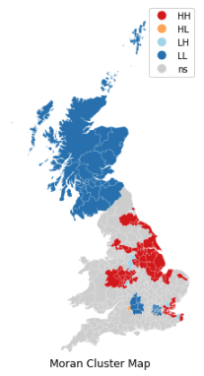
Spatial Heterogeneity
The intercepts and coefficients of my model can vary:
The intercept might change for different areas. (For ex: higher or lower baseline home prices because of school districts)
The slope or coefficients of my model can also change (for ex: proximity to public transit can be have a larger impact on home prices in areas where the default is not driving)

Slide 11
Spatial fixed effects
In regression more generally: fixed effects are X variables that are constant across y observations
Any change caused by a fixed effect is the same across observations

Slide 12
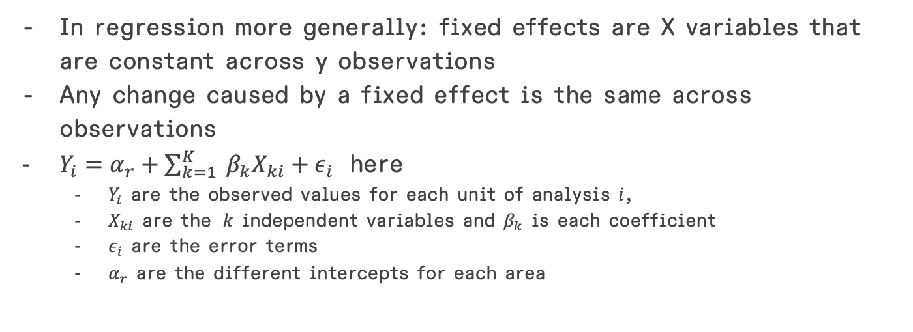
Spatial fixed effects
In regression more generally: fixed effects are X variables that are constant across y observations
Any change caused by a fixed effect is the same across observations
$Y_{i}=α_{r}+\sum_{k=1}^{K}{{ β}_{k}X_{ki}}+ε_{i}$ here
$Y_{i}$ are the observed values for each unit of analysis $i$,
$X_{ki}$ are the $k$ independent variables and $β_{k}$ is each coefficient
$ε_{i}$ are the error terms
$α_{r}$ are the different intercepts for each area

Slide 13
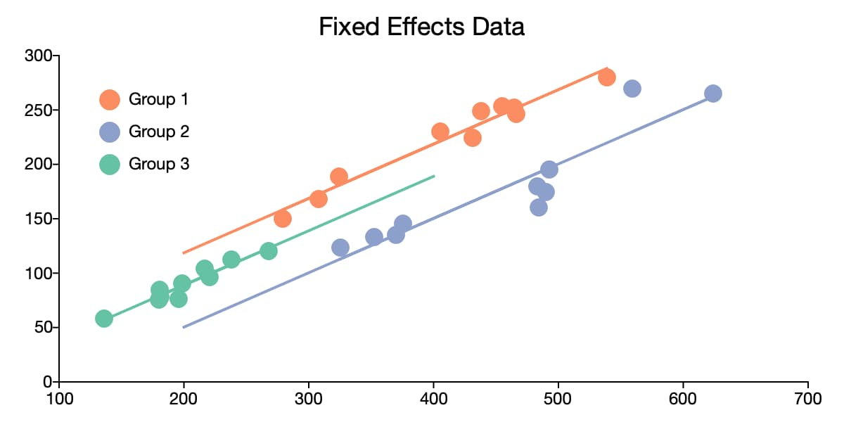
Spatial fixed effects
From https://www.aptech.com/blog/introduction-to-the-fundamentals-of-panel-data/

Slide 14
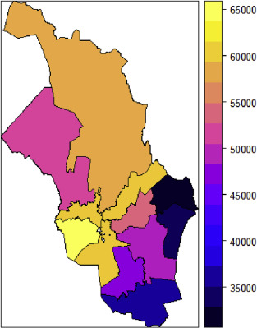
Spatial fixed effects
Heat map of median square meter prices for Oslo 1 to Oslo 12.
From Sommervoll, Å., & Sommervoll, D. E. (2019). Learning from man or machine: Spatial fixed effects in urban econometrics. Regional Science and Urban Economics, 77, 239-252.

Slide 15
Spatial regimes
The idea that both intercept and slope can vary by geography.

Slide 16
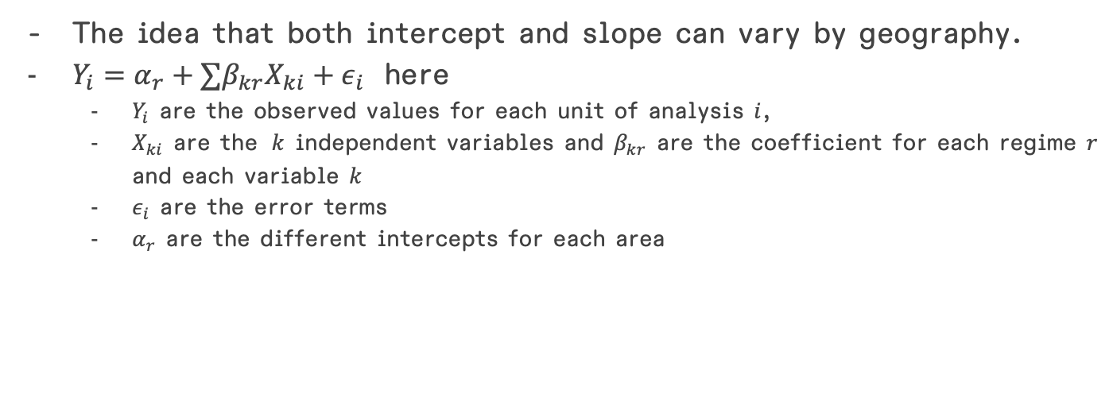
Spatial regimes
The idea that both intercept and slope can vary by geography.
$Y_{i}=α_{r}+∑β_{kr}X_{ki}+ε_{i}$ here
$Y_{i}$ are the observed values for each unit of analysis $i$,
$X_{ki}$ are the $k$ independent variables and $β_{kr}$ are the coefficient for each regime $r$ and each variable $k$
$ε_{i}$ are the error terms
$α_{r}$ are the different intercepts for each area

Slide 17
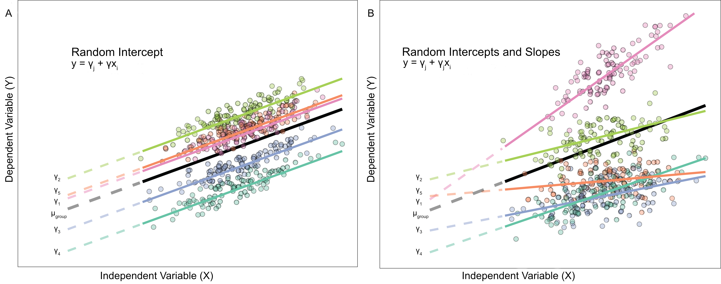
Spatial regimes

Slide 18
Spatial dependence
What about spatial autocorrelation?

Slide 19
Spatial dependence
What about spatial autocorrelation?
Again, what if the price of this house is related to the prices of houses nearby?
Or, what if the ”neighborhood character” – the housing composition of the rest neighborhood – matters?

Slide 20
Spatial dependence
What about spatial autocorrelation?
Again, what if the price of this house is related to the prices of houses nearby?
Or, what if the ”neighborhood character” – the housing composition of the rest neighborhood – matters?
Like our spatial autocorrelation calculations from the previous weeks, the weights matrix is the key element that describes our spatial dependence

Slide 21
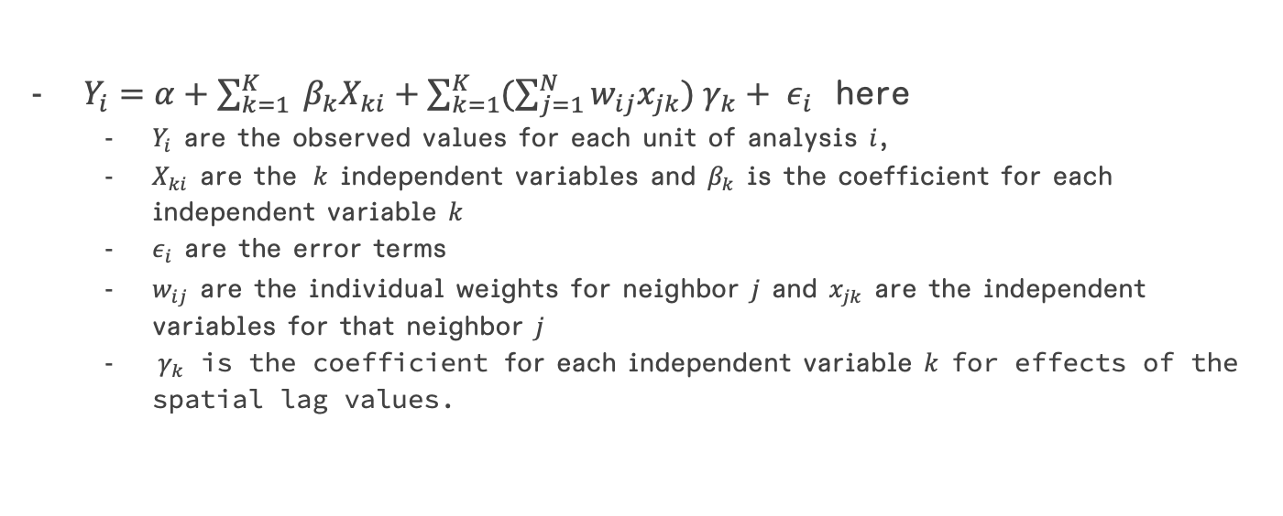
The SLX model
$Y_{i}=α+\sum_{k=1}^{K}{{ β}_{k}X_{ki}}+\sum_{k=1}^{K}{(\sum_{j=1}^{N}{w_{ij}x_{jk}}){ γ}_{k}}+ ε_{i}$ here
$Y_{i}$ are the observed values for each unit of analysis $i$,
$X_{ki}$ are the $k$ independent variables and $β_{k}$ is the coefficient for each independent variable $k$
$ε_{i}$ are the error terms
$w_{ij}$ are the individual weights for neighbor $j$ and $x_{jk}$ are the independent variables for that neighbor $j$
${ γ}_{k}$ is the coefficient for each independent variable $k$ for effects of the spatial lag values.

Slide 22

The SLX model
Matrix notation:
$Y=α+Xβ+WXγ+ε$

Slide 23
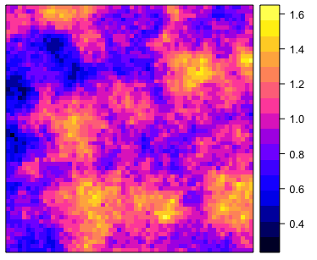
Spatial error model
What if our residuals were spatially autocorrelated?
Let’s pretend this is a map of residuals: From https://www.r-bloggers.com/2019/07/exploring-spatial-autocorrelation-in-r/

Slide 24
Spatial error model
What if our residuals were spatially autocorrelated?
We are excluding a process that is producing spatially non-randomness in our outcomes.
Let’s pretend this is a map of residuals: From https://www.r-bloggers.com/2019/07/exploring-spatial-autocorrelation-in-r/

Slide 25
Spatial error model
What if our residuals were spatially autocorrelated?
We are excluding a process that is producing spatially non-randomness in our outcomes.
Remember: We want random errors, i.e. ”noise” in our residuals
Let’s pretend this is a map of residuals: From https://www.r-bloggers.com/2019/07/exploring-spatial-autocorrelation-in-r/

Slide 26
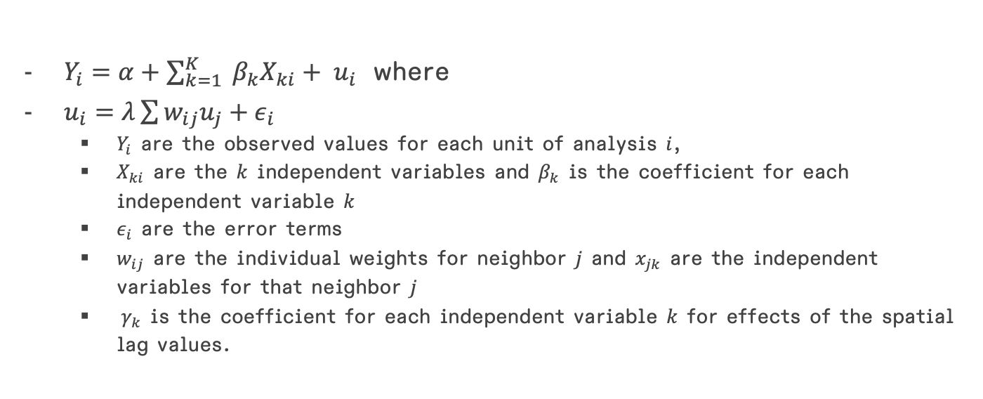
Spatial error model
$Y_{i}=α+\sum_{k=1}^{K}{{ β}_{k}X_{ki}}+ u_{i}$ where
$u_{i}=λ\sum{w_{ij}u_{j}}+ε_{i}$
$Y_{i}$ are the observed values for each unit of analysis $i$,
$X_{ki}$ are the $k$ independent variables and $β_{k}$ is the coefficient for each independent variable $k$
$ε_{i}$ are the error terms
$w_{ij}$ are the individual weights for neighbor $j$ and $x_{jk}$ are the independent variables for that neighbor $j$
${ γ}_{k}$ is the coefficient for each independent variable $k$ for effects of the spatial lag values.

Slide 27
Spatial error model
This actually violates the error term assumptions in a standard regression model, but pysal has some alternate estimations for the same statistics we would normally use.

Slide 28

Spatial lag model
Spatial lag models are typically used when we see spatial autocorrelation of the dependent variable Y.
This means that neighboring outcomes $Y_{j}$ will have an impact on $Y_{i}$ itself.

Slide 29
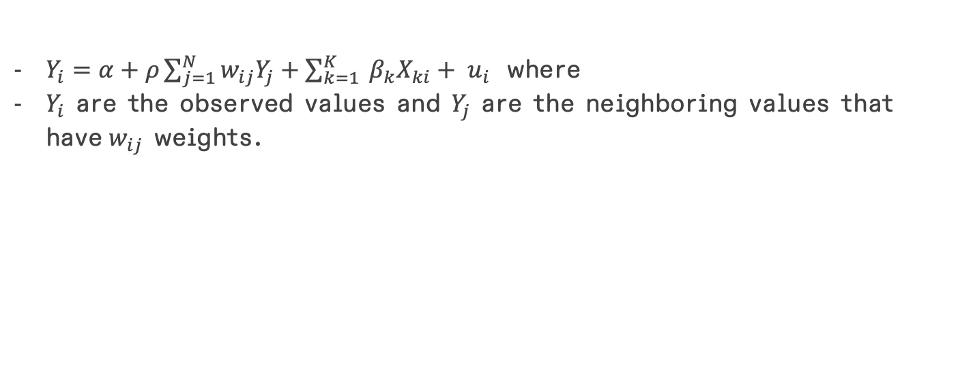
Spatial lag model
$Y_{i}=α+ρ\sum_{j=1}^{N}{w_{ij}Y_{j}}+\sum_{k=1}^{K}{{ β}_{k}X_{ki}}+ u_{i}$ where
$Y_{i}$ are the observed values and $Y_{j}$ are the neighboring values that have$w_{ij}$ weights.

Slide 30
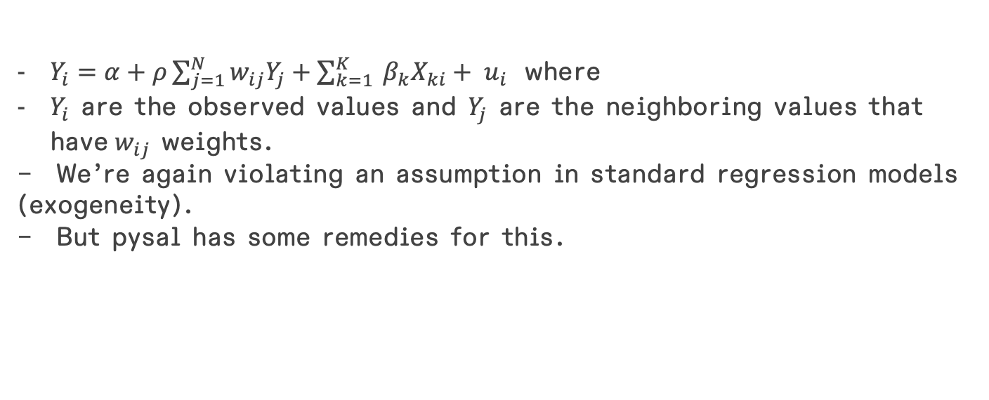
Spatial lag model
$Y_{i}=α+ρ\sum_{j=1}^{N}{w_{ij}Y_{j}}+\sum_{k=1}^{K}{{ β}_{k}X_{ki}}+ u_{i}$ where
$Y_{i}$ are the observed values and $Y_{j}$ are the neighboring values that have$w_{ij}$ weights.
We’re again violating an assumption in standard regression models (exogeneity).
But pysal has some remedies for this.

Slide 31
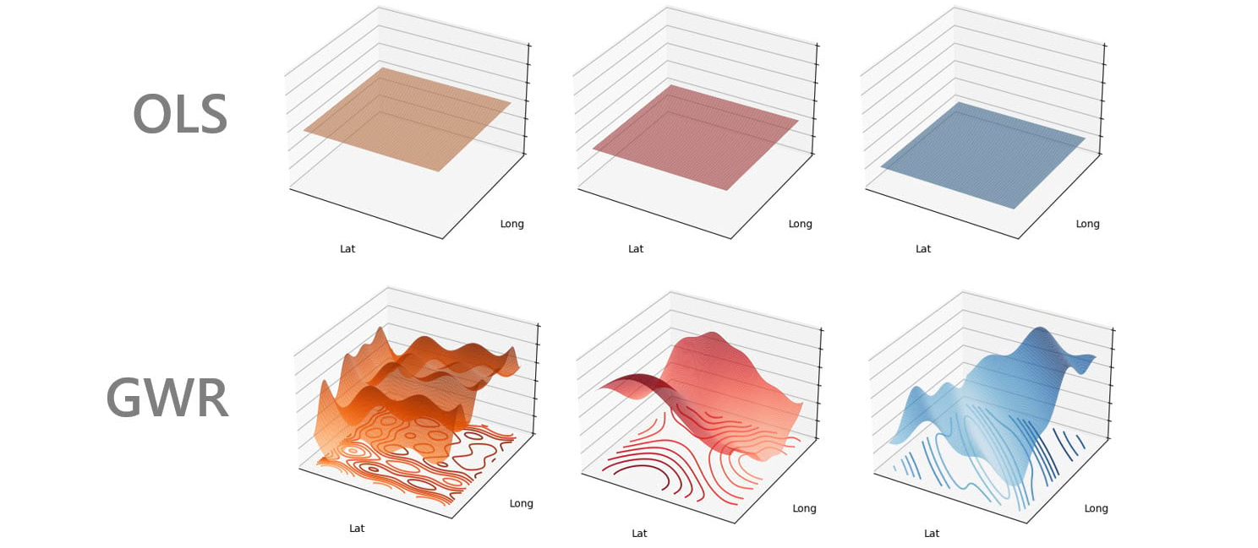
Geographically weighted regression
Coefficients can vary!
From https://www.esri.com/arcgis-blog/products/arcgis-pro/analytics/discovering-spatial-relationships-with-multiscale-geographically-weighted-regression/

Slide 32
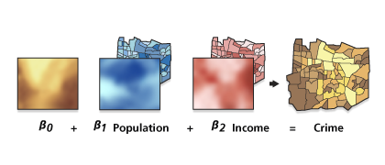
Geographically weighted regression
From https://pro.arcgis.com/en/pro-app/latest/tool-reference/spatial-statistics/geographically-weighted-regression.htm

Slide 33
Geographically weighted regression
From https://pro.arcgis.com/en/pro-app/latest/tool-reference/spatial-statistics/geographically-weighted-regression.htm
- We are not covering how to implement in this course!

Slide 34
Geographically weighted regression
Each observation gets its own regression
We include a weighted bandwidth of independent variables
Each neighboring variable’s influence on the observation is dependent on the spatial weight

Slide 35
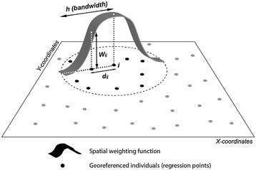
Geographically weighted regression
From Feuillet, T., Charreire, H., Menai, M., Salze, P., Simon, C., Dugas, J., ... & Oppert, J. M. (2015). Spatial heterogeneity of the relationships between environmental characteristics and active commuting: towards a locally varying social ecological model. International Journal of Health Geographics, 14(1), 1-14.

