Slide 1
CRP 5680 Urban Spatial Data Analytics
Data Management using Pandas

Slide 2
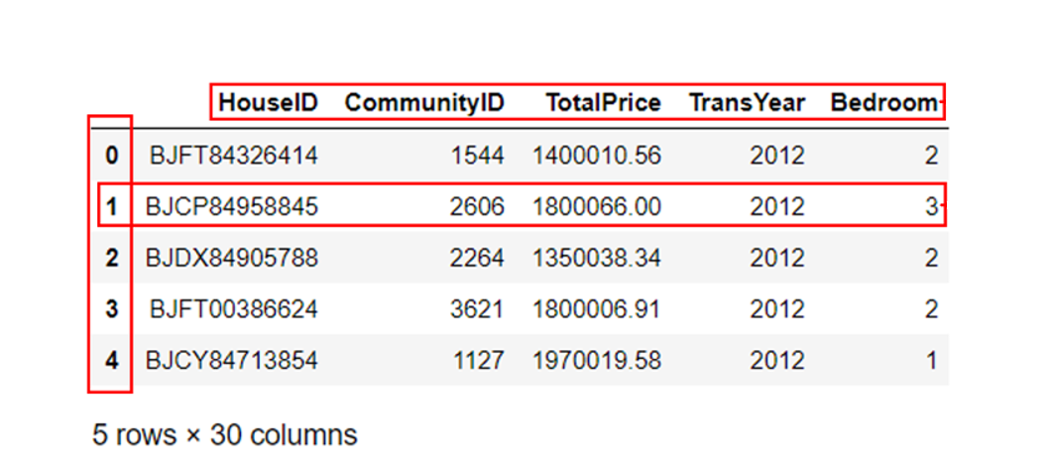
Pandas？
Pandas provides fast and easy functions for reading and writing different kinds of files (e.g., .xlsx, .csv, .pickle) and managing data in the form of Dataframe.
Pandas provides two new data types—Series and Dataframe.
Dataframe: Three components—column names, rows, and index
Series: represents a single column of data (one dimension). Think of it as a Pandas-type list.
columns
index
Column names
row

Slide 3
Importing and exporting dataset in Pandas
Pandas can import and export dataset in many data formats using the Pandas I/O API tool.
we can read (import) an Excel (.xlsx) file from a file folder and present it as a DataFrame in Python.
we can write (export) the DataFrame to Excel file using Pandas.
Pandas can also read and write .json, .html, .pickle, and other formats. Check here all the data format Pandas can read.
File path? How to read a file path in Pandas?
absolute file path: file path that starts from the root of the file system.
D:\TA_CRP5680_UrbanDataSci\Lab8_SP2023_PythonPandas
File path
Data/File name
relative file path: an incomplete file path that is joined to your current working directory to create an absolute file path.
the relative path = the absolute path - the current path

Slide 4
Explore a Dataframe using Pandas built-in functions
df.head(5) — check out the top five rows
df.tail(5) — check the last five rows
df.shape — explore the shape (dimensions) of the Dataframe. How many rows and how many columns?
df.columns
print out column names
returns a Pandas object rather than a list
convert a Dataframe to a list: list(df.columns)

Slide 5
Indexing and Slicing a Dataframe
how to select a subset of a Dataframe?
Indexing: simply selecting a particular row or column from a Dataframe.
Slicing:
selecting all the rows and some of the columns,
some of the rows and all of the columns,
or some of each of the rows and columns.
Three ways of selecting particular rows and columns of an Dataframe
df[ ]
df.loc[ rows_label , columns_label ]
df.iloc[ row_position , column_position ]

Slide 6
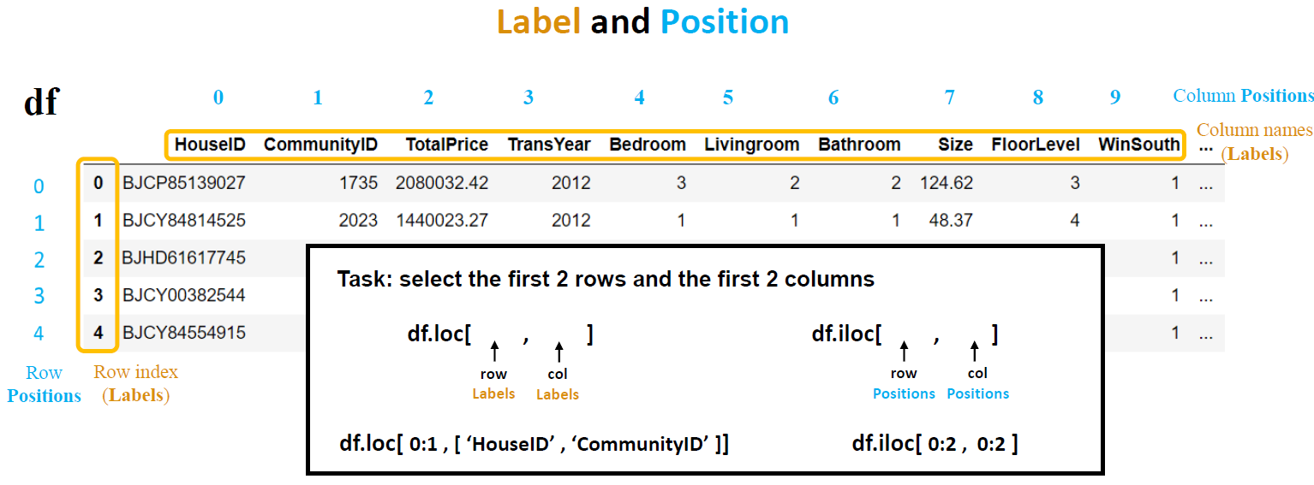
Label and Position
A label can be understood as one name in the column list or an index in the row index column (the column at far left).
A position denotes the corresponding position of column name or index in a sequence, starting from zero.

Slide 7
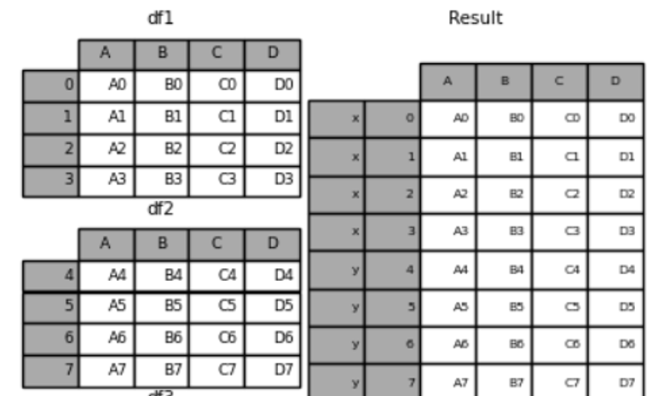
Concatenating multiple Dataframes along the row axis
concatenating along the rows:
joining df 2 to df 1 vertically using column names as concatenating/joining identifiers.

Slide 8
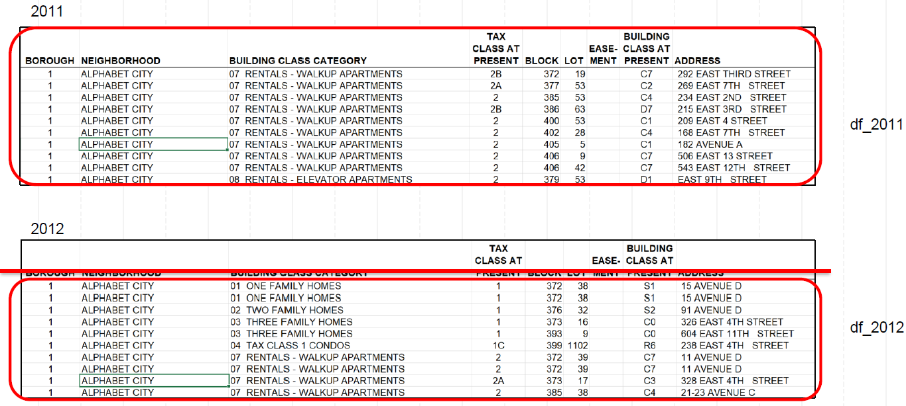

Slide 9
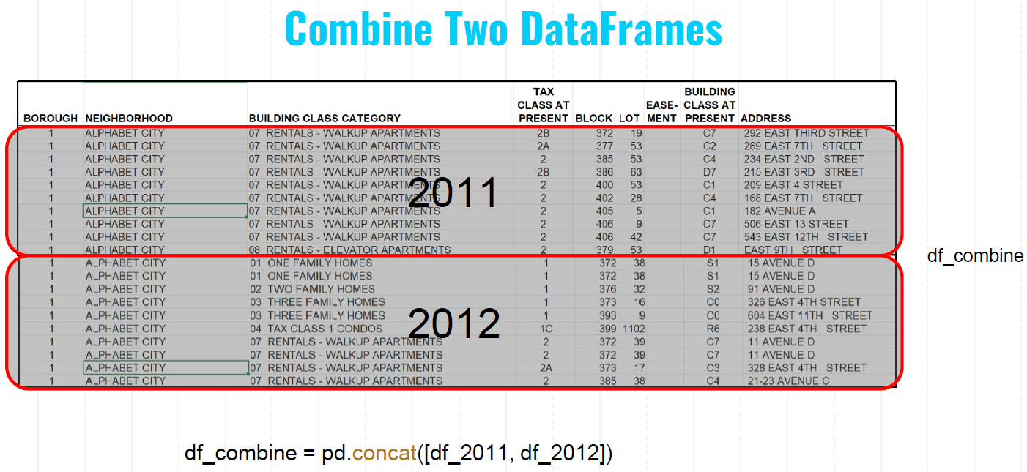
Let us try to concatenate the 2012 and 2013 Beijing housing dataset along the rows using pd.concat()

Slide 10
Let us combine the five housing datasets (2012 to 2016) together
initialization:
df_combine
Blank

Slide 11
Let us combine the five housing datasets (2012 to 2016) together
initialization:
df_combine
Blank
i = 2012:
df_temp = housing data 2012
df_combine = df_temp
df_combine
2012

Slide 12
Let us combine the five housing datasets (2012 to 2016) together
initialization:
df_combine
Blank
i = 2012:
df_temp = housing data 2012
df_combine = df_temp
df_combine
2012
2012
i = 2013:
df_temp = housing data 2013
df_combine = pd.concat([ df_combine, df_temp ])
df_combine
2012, 2013

Slide 13
Let us combine the five housing datasets (2012 to 2016) together
initialization:
df_combine
Blank
i = 2012:
df_temp = housing data 2012
df_combine = df_temp
df_combine
2012
2012
i = 2013:
df_temp = housing data 2013
df_combine = pd.concat([ df_combine, df_temp ])
df_combine
2012, 2013
i = 2014:
df_temp = housing data 2014
2012, 2013
df_combine = pd.concat([ df_combine, df_temp ])
df_combine
2012, 2013,2014

Slide 14
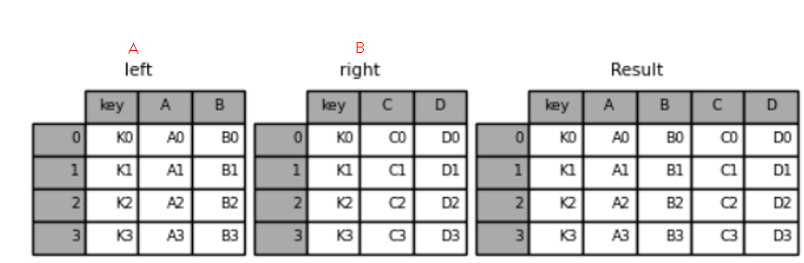
Merging Dataframes along the column axis
Merging along the columns means merging DataFrame B to DataFrame A horizontally.
Function: pd.merge( )
the pd.concat() can also be used to merge along columns by changing the argument axis = 1;
the function pd.merge() can ONLY be used to merge along the columns.

Slide 15
More about data manipulation using Pandas
Row manipulation—selecting the rows that satisfy certain conditions
1. calculate unit housing price
2. unique(): obtain the unique values
3. Filtering Dataframe
Example 1: select those housing samples located within 1500m of the subway stations.
df_subway = df_combine[df_combine["Dist2Subway"] <= 1500]
step1, df_combine["Dist2Subway"] <= 1500 return a series with values of False or True;
step2, it is wrapped by df_combine[ ] and return a subset of the candidate rows
step3, assign the returned DataFrame to a new DataFrame called df_subway

Slide 16
Creating Categorical variables and using df.groupby() function
Demand: comparing the average housing prices for the houses that are located at different distances from the nearest subway station.
Solution:
Step 1: create a category variable with 3 levels: 0-500m, 500-1500m, and beyond 1500m.
Step 2: apply the df.group() to split the Dataframe by the categorical variable "Subwaylevel", calculate the average price of each group, and regroup data to form a new Dataframe with average UnitPrice

