Slide 1
Week 10
Model validation

Slide 2
Today’s Agenda
Classification vs Regression
Hyperparameters
Cross-validation
Model scoring
Bias-variance trade-off (the worst term ever)

Slide 3
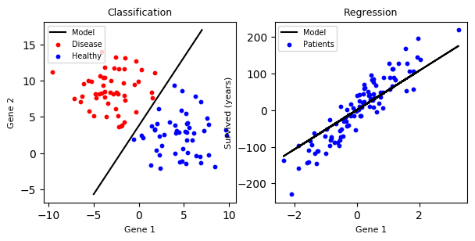
Classification vs Regression

Slide 4
Classification vs Regression
In sklearn: GradientBoostingClassifier vs GradientBoostingRegressor, etc

Slide 5
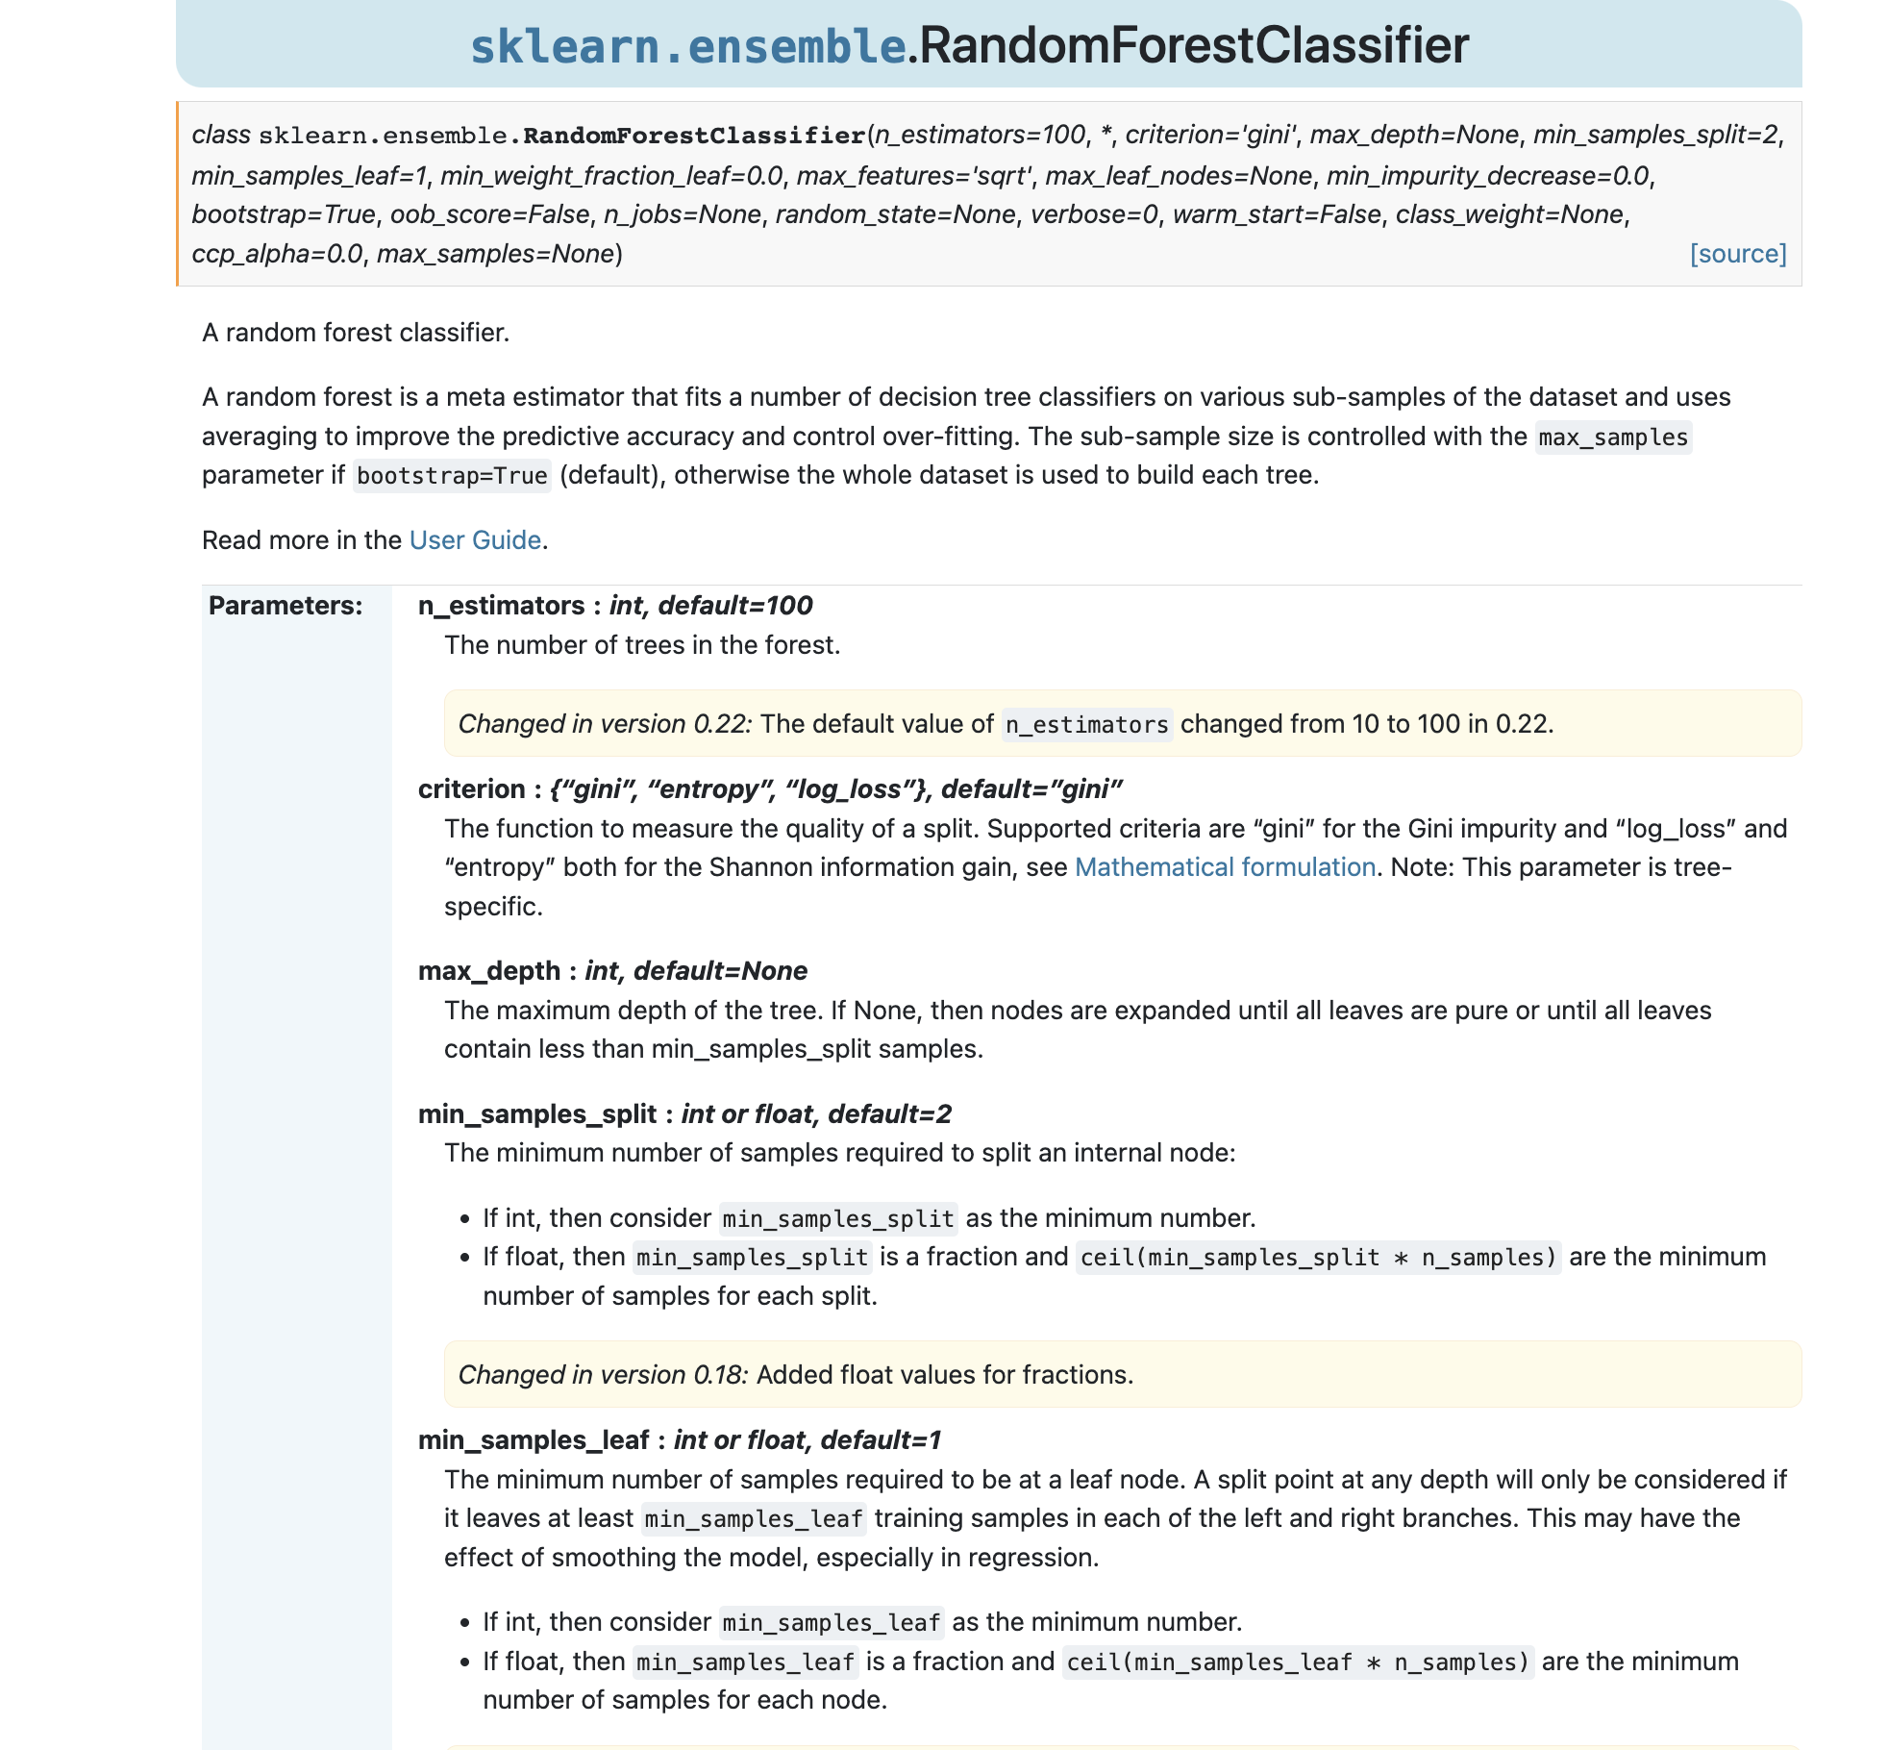
Model Validation: Tuning Hyperparameters
Hyperparameters tuning refers to tweaking the input parameters in a machine learning model.

Slide 6
Model Validation: Tuning Hyperparameters
Hyperparameters tuning refers to tweaking the input parameters in a machine learning model.
For instance, in a random forest model, we can decide:
The number of trees in the forest(“n_estimators”)
How the measure the quality of the split (“criterion”)
The maximum depth of the tree (“max_depth”)
etc

Slide 7
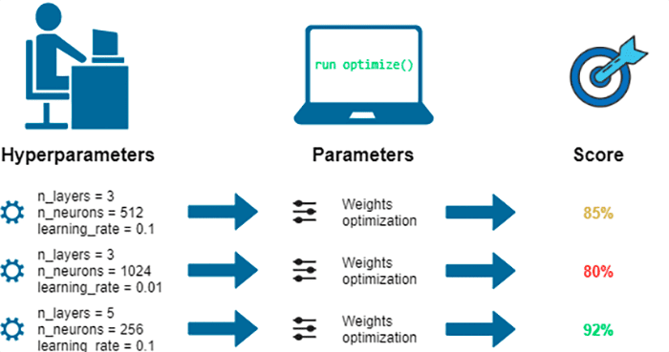
Model Validation: Tuning Hyperparameters
Tweaking these may result in different scores for your model.
Our job is to figure out which combination of hyperparameters will get the optimal results.

Slide 8
Model Validation: Tuning Hyperparameters
Tweaking these may result in different scores for your model.
Our job is to figure out which combination of hyperparameters will get the optimal results.
We typically do this by exploring a hyperparameter space

Slide 9
Model Validation: Tuning Hyperparameters
Tweaking these may result in different scores for your model.
Our job is to figure out which combination of hyperparameters will get the optimal results.
We typically do this by exploring a hyperparameter space, which is just a fancy way of saying we’re going to delineate a list of possible hyperparameters to choose from

Slide 10
Model Validation: Tuning Hyperparameters
Tweaking these may result in different scores for your model.
Our job is to figure out which combination of hyperparameters will get the optimal results.
We typically do this by exploring a hyperparameter space, which is just a fancy way of saying we’re going to delineate a list of possible hyperparameters to choose from
For ex: My possible number of trees could be [5,10,15,…,100]

Slide 11

Model Validation: Cross-validation
Cross-validation is a technique for evaluating models by splitting our training data into train-test subsets.

Slide 12
Model Validation: Holdout Set
The training-test set split is called the holdout set technique.

Slide 13
Model Validation: Cross-validation
Cross-validation is a technique for evaluating models by splitting our training data into train-test subsets.
K-fold cross-validation is one technique were we split the data into k subsets (aka “folds”).

Slide 14
Model Validation: Cross-validation
Cross-validation is a technique for evaluating models by splitting our training data into train-test subsets.
K-fold cross-validation is one technique were we split the data into k subsets (aka “folds”).
In the example on the right, we would have 5 different models, which are typically averaged.

Slide 15
Model Validation: Scoring
There are different ways of scoring a model for classification vs regression.

Slide 16
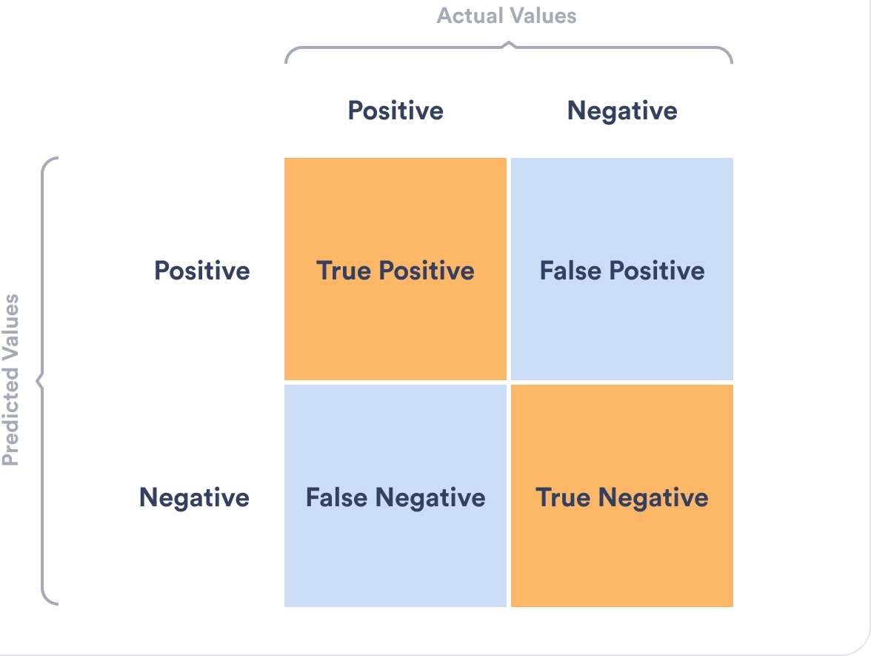
Model Validation: Classification Scoring
For classification, they are all based on the TP,TN,FP,FN concepts we learned in week 10.

Slide 17
Model Validation: Classification Scoring
For classification, they are all based on the TP,TN,FP,FN concepts we learned in week 10.
In classification, we often think about:
Accuracy
F1
Area Under the Receiver Operating Characteristic Curve (ROC AUC)
Log Loss

Slide 18
Model Validation: Classification Scoring
For classification, they are all based on the TP,TN,FP,FN concepts we learned in week 10.
In classification, we often think about:
Accuracy
F1
Area Under the Receiver Operating Characteristic Curve (ROC AUC)
Log Loss
NOTE: These are all binary (either 0/1 , yes/no, true/false) classifications currently, we’ll get to multi-class in a bit.

Slide 19
Model Validation: Classification Scoring
For classification, they are all based on the TP,TN,FP,FN concepts we learned in week 10.
In classification, we often think about:
Accuracy: TP + TN
F1
Area Under the Receiver Operating Characteristic Curve (ROC AUC)
Log Loss

Slide 20
Model Validation: Classification Scoring
For classification, they are all based on the TP,TN,FP,FN concepts we learned in week 10.
In classification, we often think about:
Accuracy
F1
Area Under the Receiver Operating Characteristic Curve (ROC AUC)
Log Loss
Precision: TP/(TP+FP)
I.e. Of all positive predictions, how many are really positive?
TP = Positive and labeled as such
FP = Not positive, but labeled positive
Best score = ?
Worst score = ?

Slide 21
Model Validation: Classification Scoring
For classification, they are all based on the TP,TN,FP,FN concepts we learned in week 10.
In classification, we often think about:
Accuracy
F1
Area Under the Receiver Operating Characteristic Curve (ROC AUC)
Log Loss
Precision: TP/(TP+FP)
I.e. Of all positive predictions, how many are really positive?
TP = Positive and labeled as such
FP = Not positive, but labeled positive
Best score = 1
Worst score = 0

Slide 22
Model Validation: Classification Scoring
For classification, they are all based on the TP,TN,FP,FN concepts we learned in week 10.
In classification, we often think about:
Accuracy
F1
Area Under the Receiver Operating Characteristic Curve (ROC AUC)
Log Loss
Precision: TP/(TP+FP)
I.e. Of all positive predictions, how many are really positive?
TP = Positive and labeled as such
FP = Not positive, but labeled positive
Best score = 1
Worst score = 0
Precision measures the extent of error caused by FP

Slide 23
Model Validation: Classification Scoring
For classification, they are all based on the TP,TN,FP,FN concepts we learned in week 10.
In classification, we often think about:
Accuracy
F1
Area Under the Receiver Operating Characteristic Curve (ROC AUC)
Log Loss
Recall: TP/(TP+FN)
I.e. Of all real positive cases, how many are predicted positive?
TP = Positive and labeled positive
FN = Positive and labeled negative
Best score = ?
Worst score = ?

Slide 24
Model Validation: Classification Scoring
For classification, they are all based on the TP,TN,FP,FN concepts we learned in week 10.
In classification, we often think about:
Accuracy
F1
Area Under the Receiver Operating Characteristic Curve (ROC AUC)
Log Loss
Recall: TP/(TP+FN)
I.e. Of all real positive cases, how many are predicted positive?
TP = Positive and labeled positive
FN = Positive and labeled negative
Best score = 1
Worst score = 0

Slide 25
Model Validation: Classification Scoring
For classification, they are all based on the TP,TN,FP,FN concepts we learned in week 10.
In classification, we often think about:
Accuracy
F1
Area Under the Receiver Operating Characteristic Curve (ROC AUC)
Log Loss
Recall: TP/(TP+FN)
I.e. Of all real positive cases, how many are predicted positive?
TP = Positive and labeled positive
FN = Positive and labeled negative
Best score = 1
Worst score = 0
Precision measures the extent of error caused by FN

Slide 26
Model Validation: Classification Scoring
For classification, they are all based on the TP,TN,FP,FN concepts we learned in week 10.
In classification, we often think about:
Accuracy
F1
Area Under the Receiver Operating Characteristic Curve (ROC AUC)
Log Loss
So, are FP or FN worse?
Perhaps we can find a balance between the two.

Slide 27
Model Validation: Classification Scoring
For classification, they are all based on the TP,TN,FP,FN concepts we learned in week 10.
In classification, we often think about:
Accuracy
F1
Area Under the Receiver Operating Characteristic Curve (ROC AUC)
Log Loss
F1: Maximizes both fewer FPs and FNs (i.e. precision and recall)

Slide 28
Model Validation: Classification Scoring
For classification, they are all based on the TP,TN,FP,FN concepts we learned in week 10.
In classification, we often think about:
Accuracy
F1
Area Under the Receiver Operating Characteristic Curve (ROC AUC)
Log Loss
F1: Maximizes both fewer FPs and FNs (i.e. precision and recall)
Formula:
2*(precision*recall)/(precision + recall)
Best score = ?
Worst score = ?

Slide 29
Model Validation: Classification Scoring
For classification, they are all based on the TP,TN,FP,FN concepts we learned in week 10.
In classification, we often think about:
Accuracy
F1
Area Under the Receiver Operating Characteristic Curve (ROC AUC)
Log Loss
F1: Maximizes both fewer FPs and FNs (i.e. precision and recall)
Formula:
2*(precision*recall)/(precision + recall)
Best score = 1
Worst score = 0

Slide 30
Model Validation: Classification Scoring
For classification, they are all based on the TP,TN,FP,FN concepts we learned in week 10.
In classification, we often think about:
Accuracy
F1
Area Under the Receiver Operating Characteristic Curve (ROC AUC)
Log Loss
F1: Maximizes both fewer FPs and FNs (i.e. precision and recall)
Formula:
2*(precision*recall)/(precision + recall)
If precision is very high, but recall is very low, the F1 score will also be very low. This is how the F1 score tries to balance both.

Slide 31
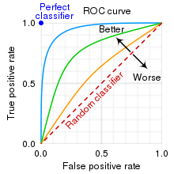
Model Validation: Classification Scoring
For classification, they are all based on the TP,TN,FP,FN concepts we learned in week 10.
In classification, we often think about:
Accuracy
F1
Area Under the Receiver Operating Characteristic Curve (ROC AUC)
Log Loss
ROC Curve (receiver operating characteristic curve)

Slide 32
Model Validation: Classification Scoring
For classification, they are all based on the TP,TN,FP,FN concepts we learned in week 10.
In classification, we often think about:
Accuracy
F1
Area Under the Receiver Operating Characteristic Curve (ROC AUC)
Log Loss
ROC Curve: Compares how TP changes with FP

Slide 33
Model Validation: Classification Scoring
For classification, they are all based on the TP,TN,FP,FN concepts we learned in week 10.
In classification, we often think about:
Accuracy
F1
Area Under the Receiver Operating Characteristic Curve (ROC AUC)
Log Loss
Notice how the better model has a steeper curve (blue line)

Slide 34
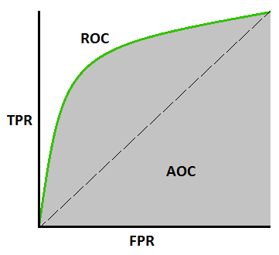
Model Validation: Classification Scoring
For classification, they are all based on the TP,TN,FP,FN concepts we learned in week 10.
In classification, we often think about:
Accuracy
F1
Area Under the Receiver Operating Characteristic Curve (ROC AUC)
Log Loss
Therefore, we want to maximize this “area under the curve” (AUC).

Slide 35
Model Validation: Classification Scoring
For classification, they are all based on the TP,TN,FP,FN concepts we learned in week 10.
In classification, we often think about:
Accuracy
F1
Area Under the Receiver Operating Characteristic Curve (ROC AUC)
Log Loss
Log loss, aka cross-entropy

Slide 36
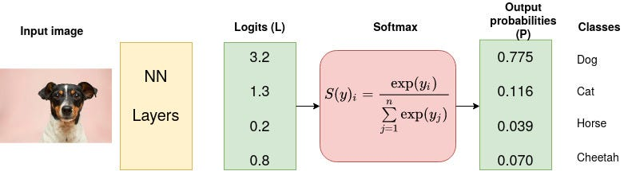
Model Validation: Classification Scoring
Let’s say we have a picture of a dog, and we want our model to predict that it’s a dog from four different categories
For classification, they are all based on the TP,TN,FP,FN concepts we learned in week 10.
In classification, we often think about:
Accuracy
F1
Area Under the Receiver Operating Characteristic Curve (ROC AUC)
Log Loss

Slide 37
Model Validation: Classification Scoring
For classification, they are all based on the TP,TN,FP,FN concepts we learned in week 10.
In classification, we often think about:
Accuracy
F1
Area Under the Receiver Operating Characteristic Curve (ROC AUC)
Log Loss
Our model gives us these output probabilities

Slide 38
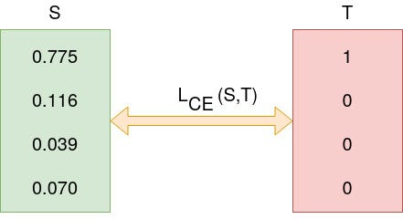
Model Validation: Classification Scoring
For classification, they are all based on the TP,TN,FP,FN concepts we learned in week 10.
In classification, we often think about:
Accuracy
F1
Area Under the Receiver Operating Characteristic Curve (ROC AUC)
Log Loss
The best probabilities we could have gotten is in the red rectangle

Slide 39
Model Validation: Classification Scoring
For classification, they are all based on the TP,TN,FP,FN concepts we learned in week 10.
In classification, we often think about:
Accuracy
F1
Area Under the Receiver Operating Characteristic Curve (ROC AUC)
Log Loss
The loss is calculated so that we are penalized based on how far we are from the actual value.

Slide 40
Model Validation: Classification Scoring
For classification, they are all based on the TP,TN,FP,FN concepts we learned in week 10.
In classification, we often think about:
Accuracy
F1
Area Under the Receiver Operating Characteristic Curve (ROC AUC)
Log Loss
This is called a “log” loss because differences closer to 1 matter more than differences closer to 0.

Slide 41
Model Validation: Classification Scoring
We can see that some metrics, like log loss, easily take into account classification problems with multiple categories.
What about our other scores?

Slide 42
Model Validation: Classification Scoring
We can see that some metrics, like log loss, easily take into account classification problems with multiple categories.
What about our other scores?
Any metric with TP/FP/TN/FN implies a binary classification.

Slide 43
Model Validation: Classification Scoring
Typically, scores for multi-class classifications are calculated by:
Treating each category as separate. For ex: how many TP/FP/FN/FP for cats? How many for dogs? Etc.
Averaging the scores across all categories. For ex: Average(F1_cat, F1_dog,…)

Slide 44
Model Validation: Regression Scoring
For regression, scoring methods should be more familiar:
R2
Mean Absolute Error
Root Mean Square Error (RMSE)

Slide 45
Model Validation: Regression Scoring
For regression, scoring methods should be more familiar:
R2
Mean Absolute Error
Root Mean Square Error (RMSE)
You should know this one!
Coefficient of Determination: the proportion of the variation in the dependent variable that is predictable from the independent variable(s).

Slide 46
Model Validation: Regression Scoring
For regression, scoring methods should be more familiar:
R2
Mean Absolute Error
Root Mean Square Error (RMSE)
You should know this one!
Coefficient of Determination: the proportion of the variation in the dependent variable that is predictable from the independent variable(s).
We use this to assess the accuracy of our model. Here, higher R^2 is always better. Remember: in machine learning, we’re typically less interested in interpretation and more in better prediction.

Slide 47
Model Validation: Regression Scoring
For regression, scoring methods should be more familiar:
R2
Mean Absolute Error
Root Mean Square Error (RMSE)
Sum of all the residuals / total number of points in the dataset.
It is the absolute average distance of our model prediction.

Slide 48
Model Validation: Regression Scoring
For regression, scoring methods should be more familiar:
R2
Mean Absolute Error
Root Mean Square Error (RMSE)
Sum of all the residuals / total number of points in the dataset.
It is the absolute average distance of our model prediction.
We typically use this to understand how close the predictions are to the actual model on average.

Slide 49
Model Validation: Regression Scoring
For regression, scoring methods should be more familiar:
R2
Mean Absolute Error
Root Mean Square Error (RMSE)
RMSE: The square root of the average squared distance between actual and predicted value.

Slide 50
Model Validation: Regression Scoring
For regression, scoring methods should be more familiar:
R2
Mean Absolute Error
Root Mean Square Error (RMSE)
RMSE: The square root of the average squared distance between actual and predicted value.
Because we are squaring distances (i.e. residuals/errors), large errors are more pronounced. This is popular metric because it makes these larger errors more pronounced.

Slide 51
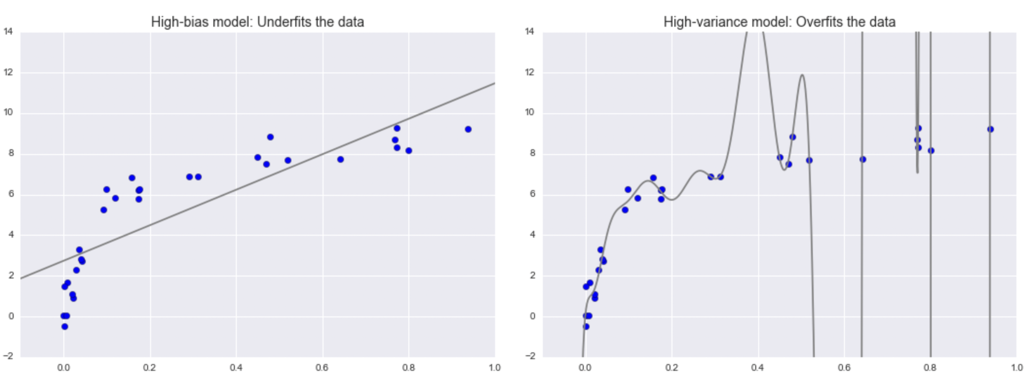
Model Validation: Bias-variance tradeoff
Since we want our model to generalize, we need to consider the following:
The “high-bias” model is another name for the idea that we are underfitting the data. It’s not descriptive enough of the patterns we see.

Slide 52
Model Validation: Bias-variance tradeoff
Since we want our model to generalize, we need to consider the following:
The “high-variance” model is another name for the idea that we are overfitting the data. It’s too specific to the data, which means it doesn’t generalize well.

Slide 53
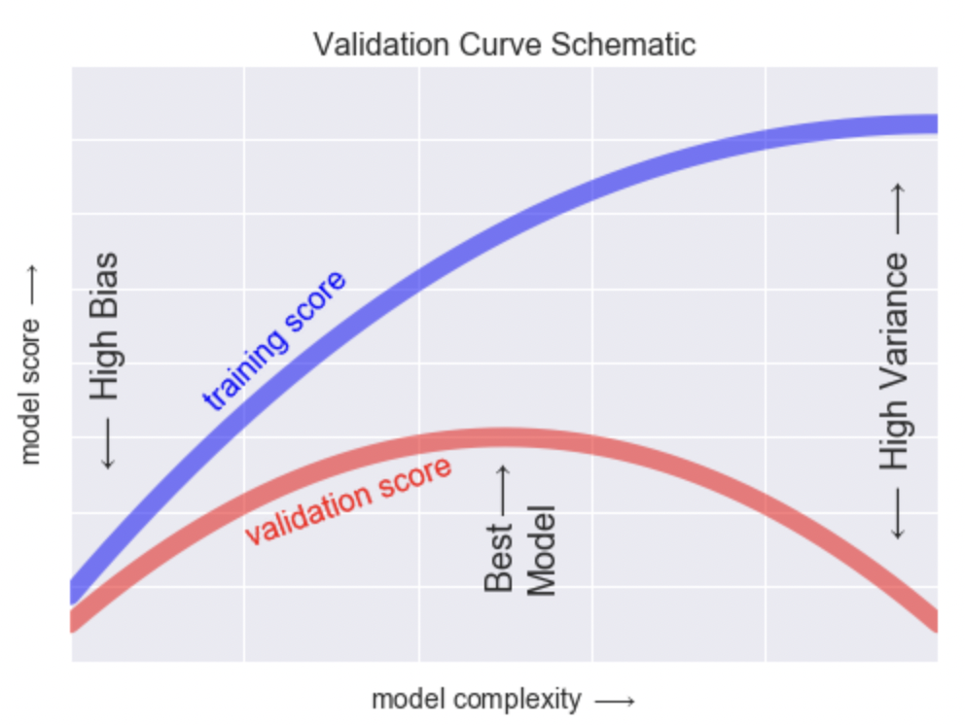
Model Validation: Bias-variance tradeoff
When looking at our models scores, we want to find the “sweet spot” where we don’t have too complex a training model such that the test (called “validation”) score is too low, but our model is not too simple such that both our training and test scores are also too low.

Slide 54
Model Validation: Steps for Tuning
Select the right type of model.
Review the list of parameters of the model and build the hyperparameter space
Select methods for searching the hyperparameter space
Applying the cross-validation scheme approach
Assess the model score to evaluate the model

