Slide 1
Week 12
Feature Importance + Spatial Regression

Slide 2
Today’s Agenda
Feature importance
Revisiting spatial regressions

Slide 3

Feature Importance
Recall: Decision Trees

Slide 4
Feature Importance
Recall: Decision Trees
Splits in the tree are made by certain decisions.

Slide 5
Feature Importance
Recall: Decision Trees
Splits in the tree are made by certain decisions.
The end result is a set of leaf nodes that, ideally, separate our data into “pure” leaf nodes where all the data in one node is of the same category.

Slide 6
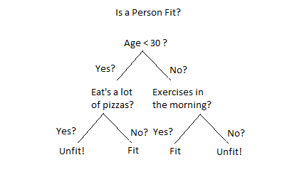
Feature Importance
Impurity based feature importance: We want to find splits that will decrease our “impurity” as much as possible

Slide 7
Feature Importance
Impurity based feature importance: We want to find splits that will decrease our “impurity” as much as possible
This type of feature importance is the mean decrease in impurity for each feature across all trees (remember we usually see trees in an ensemble learning context!)
Tree 1
Tree 2
Tree 3
Tree 4

Slide 8
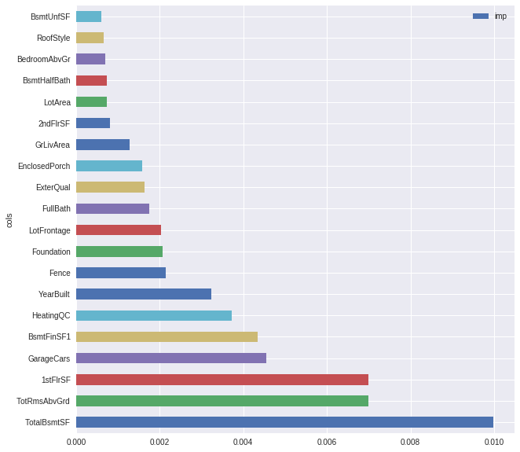
Feature Importance
Impurity based feature importance: We want to find splits that will decrease our “impurity” as much as possible
This type of feature importance is the mean decrease in impurity for each feature across all trees (remember we usually see trees in an ensemble learning context!)

Slide 9
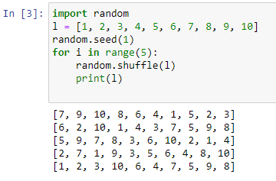
Feature Importance
Permutation based feature importance: We see how much our prediction score changes if we randomly shuffle one of our features

Slide 10
Spatial Regression Review
Proximity variables
Spatial fixed effects / spatial regimes
SLX Model
Spatial Lag Model
Spatial Error Model

Slide 11
Spatial Regression Review
Recall: Regression! (or Ordinary Least Squares regression, which is probably what most of you have learned)

Slide 12
Linear Regression Assumptions
Linearity - the relationships between the predictors and the outcome variable should be linear
Normality - the errors should be normally distributed
Constant error variance (homoscedasticity); the error variance should be constant. The opposite is called heteroscedasticity.
Independence - the errors associated with one observation are not correlated with the errors of any other observation
The model is specified properly – all known variables that are relevant predictors of the dependent variable are included. There are not individual observations that exert undue influence on the coefficients.
Low multicollinearity - we avoid predictors that are highly collinear, which can cause problems when estimating regression coefficients.

Slide 13
Spatial Regression Review
Proximity variables
Spatial fixed effects / spatial regimes
SLX Model
Spatial Lag Model
Spatial Error Model
Ordinary Least Squares
Violates Ordinary Least Squares

Slide 14
Spatial Regression Review
Proximity variables
Spatial fixed effects / spatial regimes
SLX Model
Spatial Lag Model – Accounts for “strictly exogenous” violation
Spatial Error Model – Accounts for “independent of errors” violation
Ordinary Least Squares

Slide 15
Proximity Variables
One way to explicitly include space in our regression model is through proximity variables
These are typically distances to amenities and events that could influence our outcomes.

Slide 16
Spatial fixed effects
In regression more generally: fixed effects are X variables that are constant across y observations
Any change caused by a fixed effect is the same across observations

Slide 17
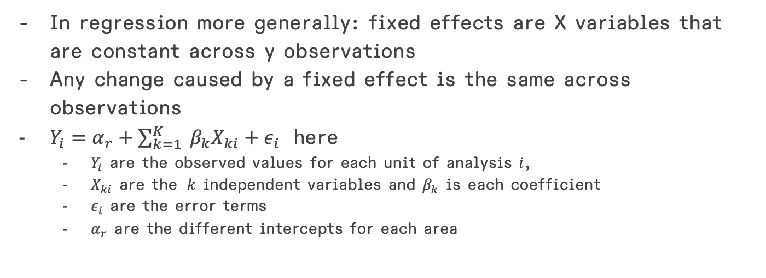
Spatial fixed effects
In regression more generally: fixed effects are X variables that are constant across y observations
Any change caused by a fixed effect is the same across observations
$Y_{i}=α_{r}+\sum_{k=1}^{K}{{ β}_{k}X_{ki}}+ε_{i}$ here
$Y_{i}$ are the observed values for each unit of analysis $i$,
$X_{ki}$ are the $k$ independent variables and $β_{k}$ is each coefficient
$ε_{i}$ are the error terms
$α_{r}$ are the different intercepts for each area

Slide 18
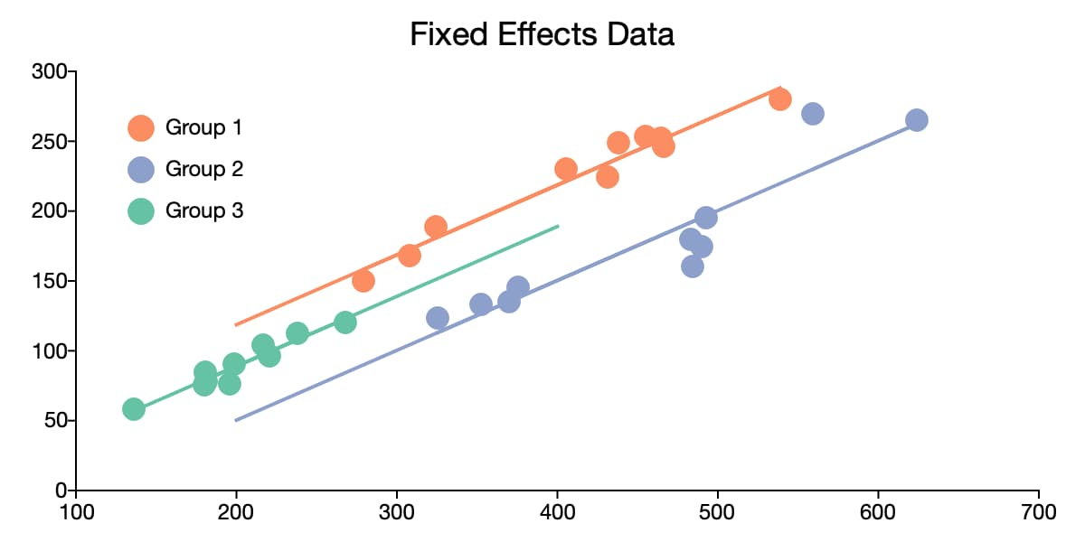
Spatial fixed effects
From https://www.aptech.com/blog/introduction-to-the-fundamentals-of-panel-data/

Slide 19
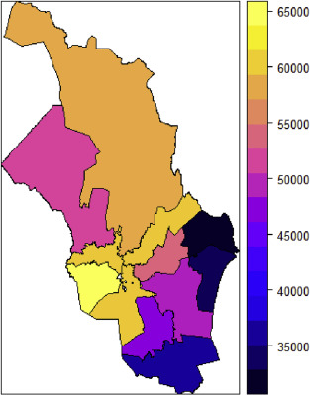
Spatial fixed effects
Heat map of median square meter prices for Oslo 1 to Oslo 12.
From Sommervoll, Å., & Sommervoll, D. E. (2019). Learning from man or machine: Spatial fixed effects in urban econometrics. Regional Science and Urban Economics, 77, 239-252.

Slide 20
Spatial regimes
The idea that both intercept and slope can vary by geography.

Slide 21
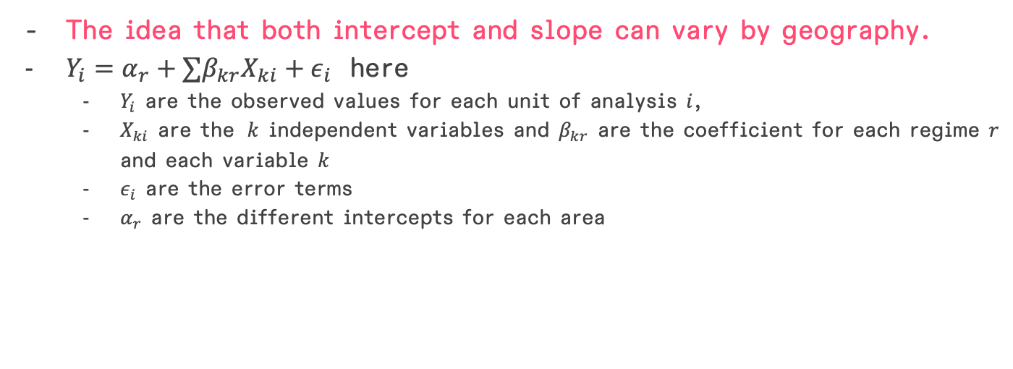
Spatial regimes
The idea that both intercept and slope can vary by geography.
$Y_{i}=α_{r}+∑β_{kr}X_{ki}+ε_{i}$ here
$Y_{i}$ are the observed values for each unit of analysis $i$,
$X_{ki}$ are the $k$ independent variables and $β_{kr}$ are the coefficient for each regime $r$ and each variable $k$
$ε_{i}$ are the error terms
$α_{r}$ are the different intercepts for each area

Slide 22
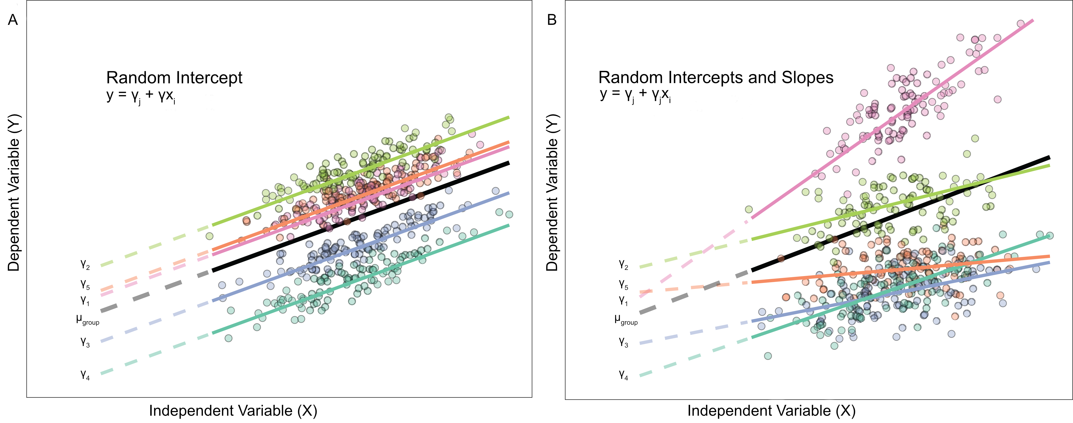
Spatial regimes

Slide 23
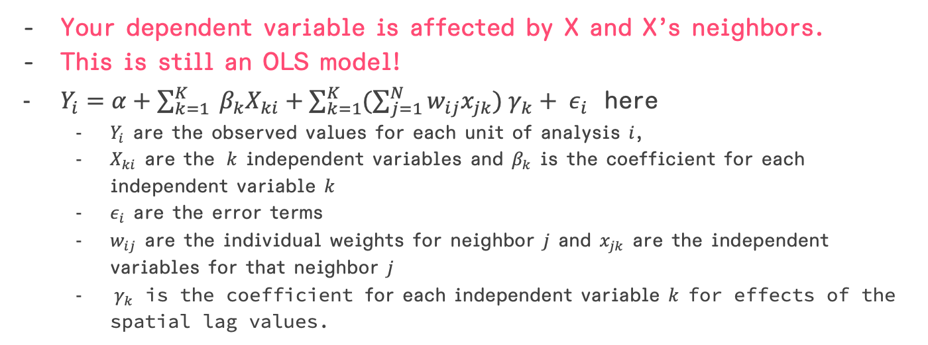
The SLX model
Your dependent variable is affected by X and X’s neighbors.
This is still an OLS model!
$Y_{i}=α+\sum_{k=1}^{K}{{ β}_{k}X_{ki}}+\sum_{k=1}^{K}{(\sum_{j=1}^{N}{w_{ij}x_{jk}}){ γ}_{k}}+ ε_{i}$ here
$Y_{i}$ are the observed values for each unit of analysis $i$,
$X_{ki}$ are the $k$ independent variables and $β_{k}$ is the coefficient for each independent variable $k$
$ε_{i}$ are the error terms
$w_{ij}$ are the individual weights for neighbor $j$ and $x_{jk}$ are the independent variables for that neighbor $j$
${ γ}_{k}$ is the coefficient for each independent variable $k$ for effects of the spatial lag values.

Slide 24
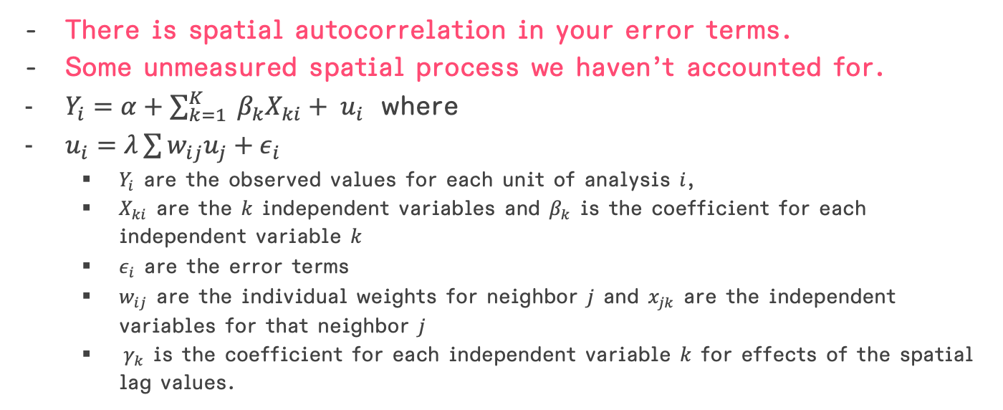
Spatial error model
There is spatial autocorrelation in your error terms.
Some unmeasured spatial process we haven’t accounted for.
$Y_{i}=α+\sum_{k=1}^{K}{{ β}_{k}X_{ki}}+ u_{i}$ where
$u_{i}=λ\sum{w_{ij}u_{j}}+ε_{i}$
$Y_{i}$ are the observed values for each unit of analysis $i$,
$X_{ki}$ are the $k$ independent variables and $β_{k}$ is the coefficient for each independent variable $k$
$ε_{i}$ are the error terms
$w_{ij}$ are the individual weights for neighbor $j$ and $x_{jk}$ are the independent variables for that neighbor $j$
${ γ}_{k}$ is the coefficient for each independent variable $k$ for effects of the spatial lag values.

Slide 25
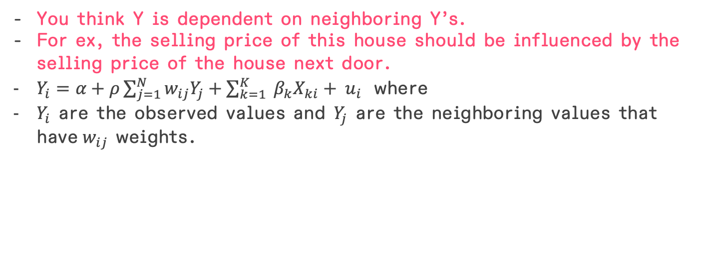
Spatial lag model
You think Y is dependent on neighboring Y’s.
For ex, the selling price of this house should be influenced by the selling price of the house next door.
$Y_{i}=α+ρ\sum_{j=1}^{N}{w_{ij}Y_{j}}+\sum_{k=1}^{K}{{ β}_{k}X_{ki}}+ u_{i}$ where
$Y_{i}$ are the observed values and $Y_{j}$ are the neighboring values that have$w_{ij}$ weights.

