Slide 1



Slide 2
1995,James Gosling and his team members ”Green Team” developed the language at Sun Microsystems.
high-level programming language
JAVA
platform independency
object-oriented programming language
First programming language to provide the concept of writing programs executed on the web.

Slide 3
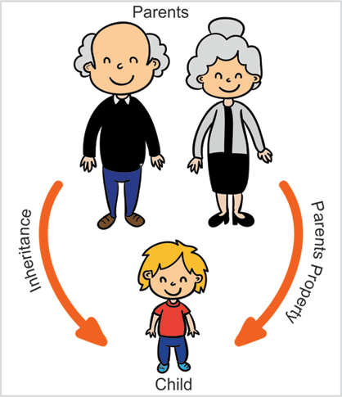
Inheritance in Java

Slide 4
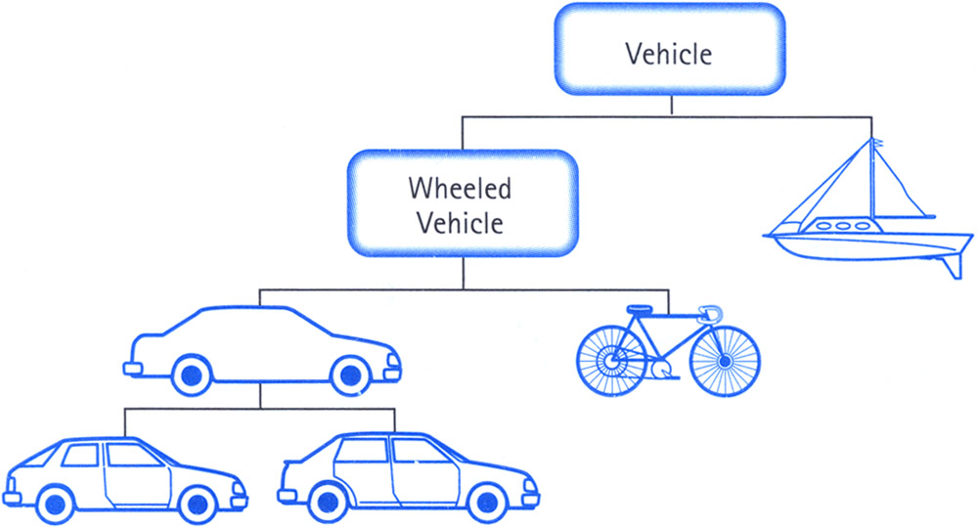
Example of Inheritance

Slide 5
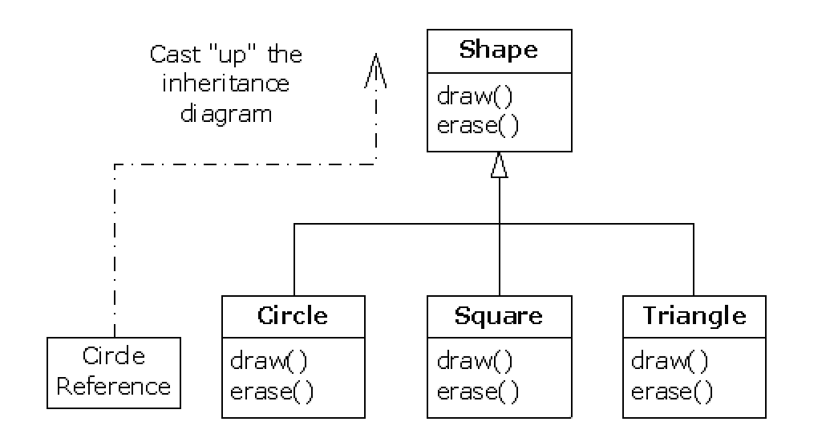
Need for Inheritance

Slide 6
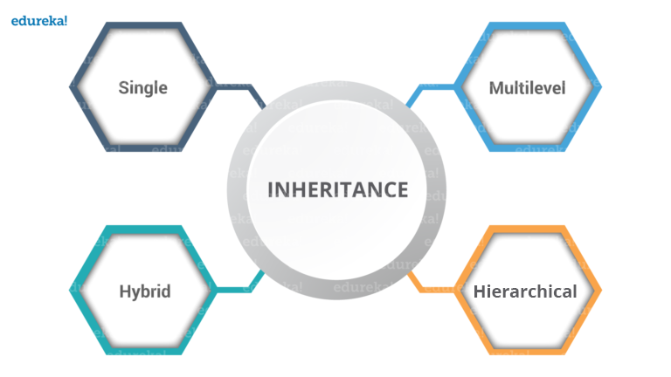

Slide 7
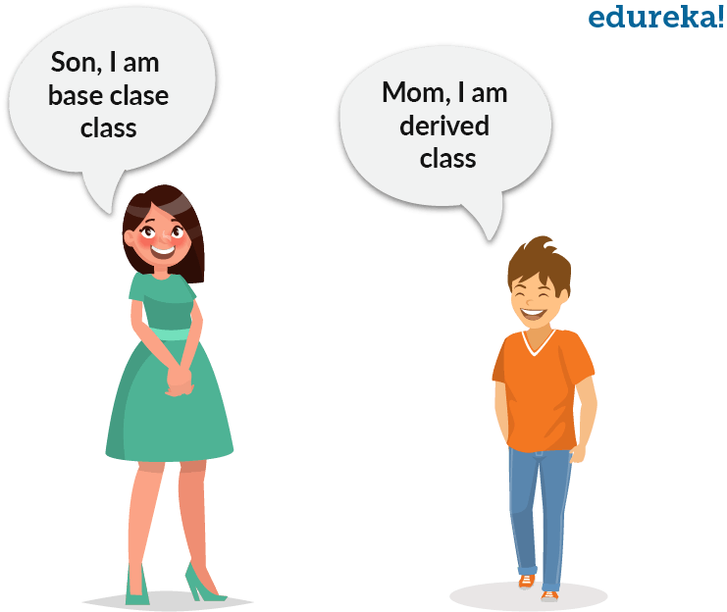
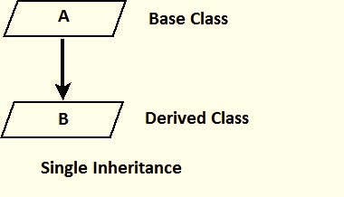
Single Inheritance(one parent)

Slide 8
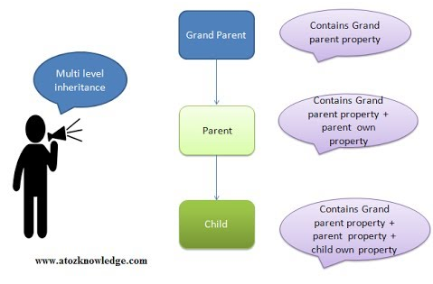
Multilevel Inheritance
One parent, one or more intermediate class, one child class.

Slide 9
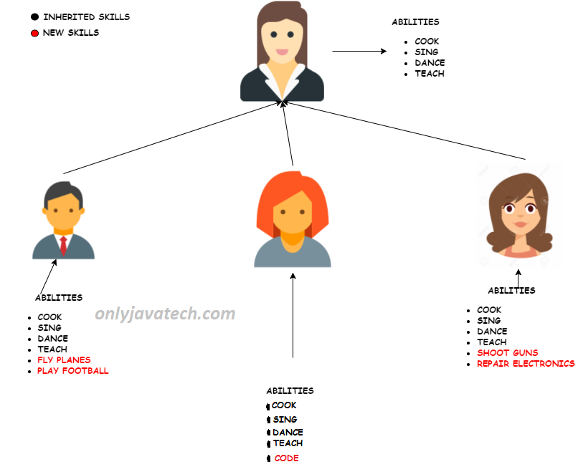
Hierarchial Inheritance
A structure having one parent and more child classes.
Child must have only one parent.

Slide 10
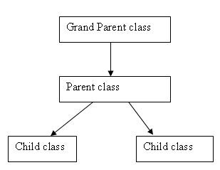
Hybrid Inheritance
A combination of single, multilevel inheritance.

Slide 11
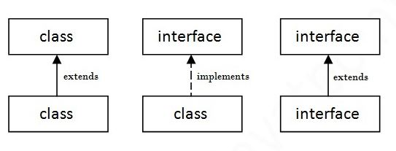
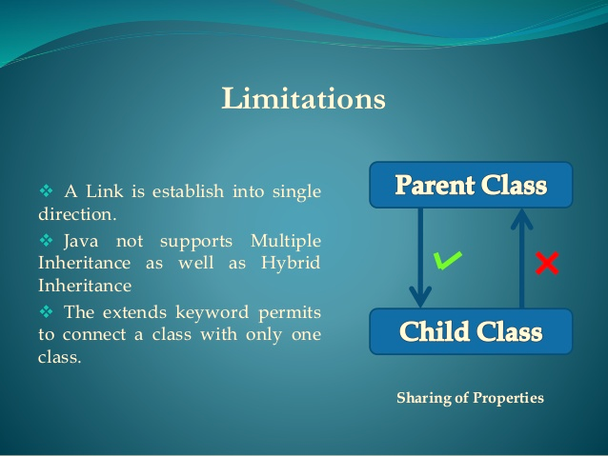
Limitations in Inheritance
The link between classes is established only in one direction.
The extends keyword permits connection to only one class at a time.
No support for multiple inheritance.

Slide 12


