Slide 1

Title : Campus Skill Exchange Network Hub
Student Name: T. Sai Sri Parinita
Student ID: 2520030562
Cluster: Cluster 1
Section: Section 3
Under the Guidance of
Supervisor Name: P. Surekha
Assistant Professor
Department of CSE
06-03-2026
2

Slide 2
OUTLINE
Abstract
Existing System
Proposed System
System Architecture
Project Modules
Objectives
CO's Attainments - FWD
CO's Attainments - DSA
Screenshots for FWD & DSA
Conclusion
Geo-Tagged Photos
06-03-2026
2520030562 Department of CSE
3

Slide 3
Abstract
SkillSwap is a web-based peer-to-peer skill exchange platform for students
Students can list skills they can teach and skills they want to learn
Enables barter-style learning — exchange skills without monetary transactions
Features include: user registration, skill browsing, sending/accepting requests, and a reputation-based leaderboard
Built using HTML, CSS, and JavaScript as part of the FWD course project
DSA concepts are integrated to manage data, process requests, and rank users efficiently
Promotes collaborative and self-driven learning within the student community
06-03-2026
2520030562 Department of CSE
4

Slide 4
Existing System
Current skill-learning relies on paid platforms such as Coursera, Udemy, and YouTube Premium
No peer-to-peer skill exchange system tailored for college students
Existing tools lack barter-based learning mechanisms
No built-in reputation system to encourage quality exchanges among peers
Students have no structured way to discover who around them can teach a needed skill
Limitations: cost barriers, lack of personalization, no community-driven approach
06-03-2026
2520030562 Department of CSE
5

Slide 5
Proposed System
SkillSwap proposes a free, student-driven skill exchange platform
Students register, create profiles listing skills they teach and skills they want
Smart matching system suggests compatible skill-exchange partners
Request management: send, accept, decline, and complete skill exchange requests
Reputation points awarded for completed exchanges to motivate participation
Leaderboard ranks students by reputation to encourage healthy competition
Dark/light theme support for enhanced user experience
DSA algorithms power the search, sorting, and request management under the hood
06-03-2026
2520030562 Department of CSE
6

Slide 6
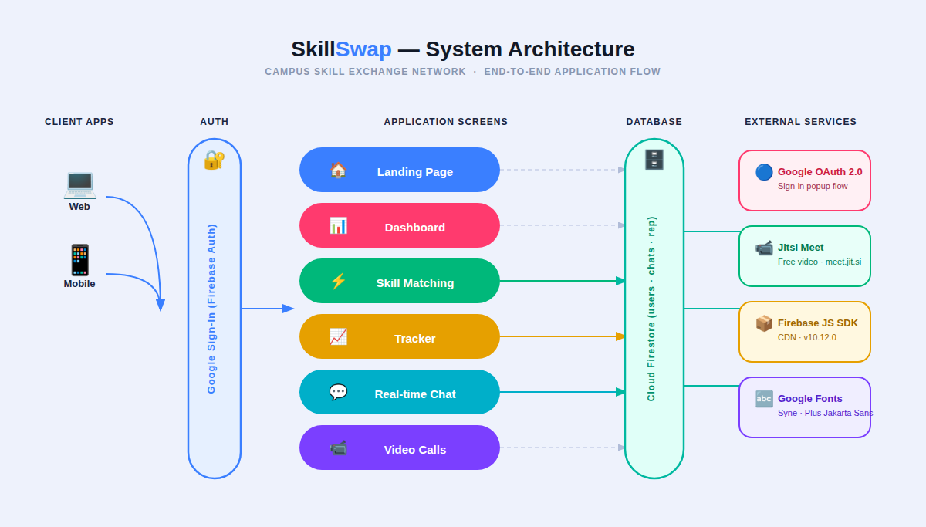
System Architecture
06-03-2026
2520030562 Department of CSE
7

Slide 7
Project Modules
1. Auth Module: Register & login with name, student ID, dept, skills taught & wanted
2. Browse Module: Explore all registered students, view profiles, filter by skill/department
3. Request Module: Send skill exchange requests; manage pending, accepted & completed requests
4. Tracker Module: Track exchange history, reputation points breakdown, and progress bars
5. Leaderboard: Ranks all students by reputation points earned through completed exchanges
6. DSA Module: Sub-folder with Array, Stack, Queue, Linear Search, Binary Search, Bubble Sort
06-03-2026
2520030562 Department of CSE
8

Slide 8
Objectives
To build a functional peer-to-peer skill exchange web application for students
To implement a user registration and profile system with skill listings
To design a request management workflow (send → accept → complete)
To develop a reputation system that incentivizes quality skill exchanges
To integrate DSA concepts (Arrays, Stack, Queue, Searching, Sorting) into the project
To demonstrate real-world application of FWD and DSA course outcomes
To produce clean, maintainable, and well-structured front-end code
06-03-2026
2520030562 Department of CSE
9

Slide 9
CO's Attainments - FWD
CO1: Designed and structured the SkillSwap web application using semantic HTML5 elements and well-organized CSS
CO2: Implemented responsive UI with CSS variables, dark/light theme toggle, flexbox layouts, and card components
CO3: Developed interactive JavaScript features: form validation, dynamic DOM rendering, event handling, and overlays
CO4: Implemented data-driven UI — student profiles, request management, leaderboard rendered dynamically via JS
CO5: Integrated all modules into a single-page application with seamless navigation and state management
06-03-2026
2520030562 Department of CSE
10

Slide 10
CO's Attainments - DSA
CO1: Implemented Linear Search (find students by skill) and Binary Search (find by rep score); Bubble Sort for leaderboard ranking
CO2: Used Arrays as primary ADT — store student profiles, traverse using forEach, filter by department, map to extract unique skills
CO3: Implemented Stack (LIFO) for request history with push/pop/peek; Queue (FIFO) for pending requests with enqueue/dequeue/front
CO4: Used JavaScript Arrays and custom Queue class as equivalents of Java List and Queue Collections for scalable data management
06-03-2026
2520030562 Department of CSE
11

Slide 11
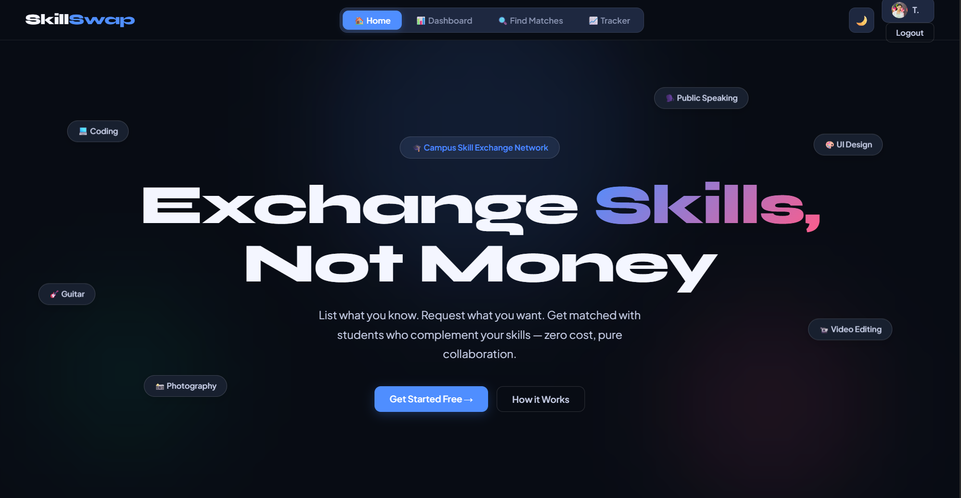
Screenshots - FWD (SkillSwap UI)
06-03-2026
2520030562 Department of CSE
12

Slide 12
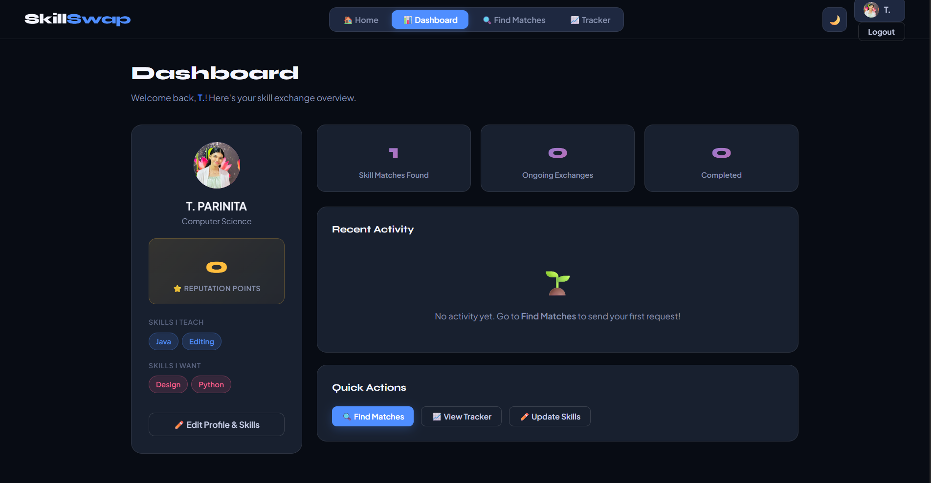
Screenshots - FWD (SkillSwap UI)
06-03-2026
2520030562 Department of CSE
12

Slide 13
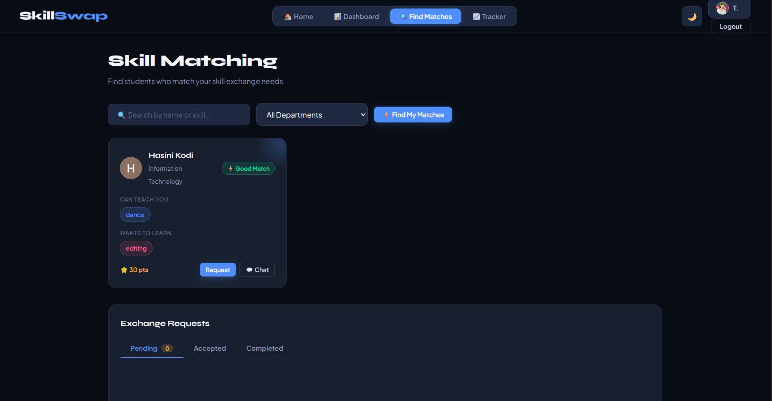
Screenshots - FWD (SkillSwap UI)
06-03-2026
2520030562 Department of CSE
12

Slide 14
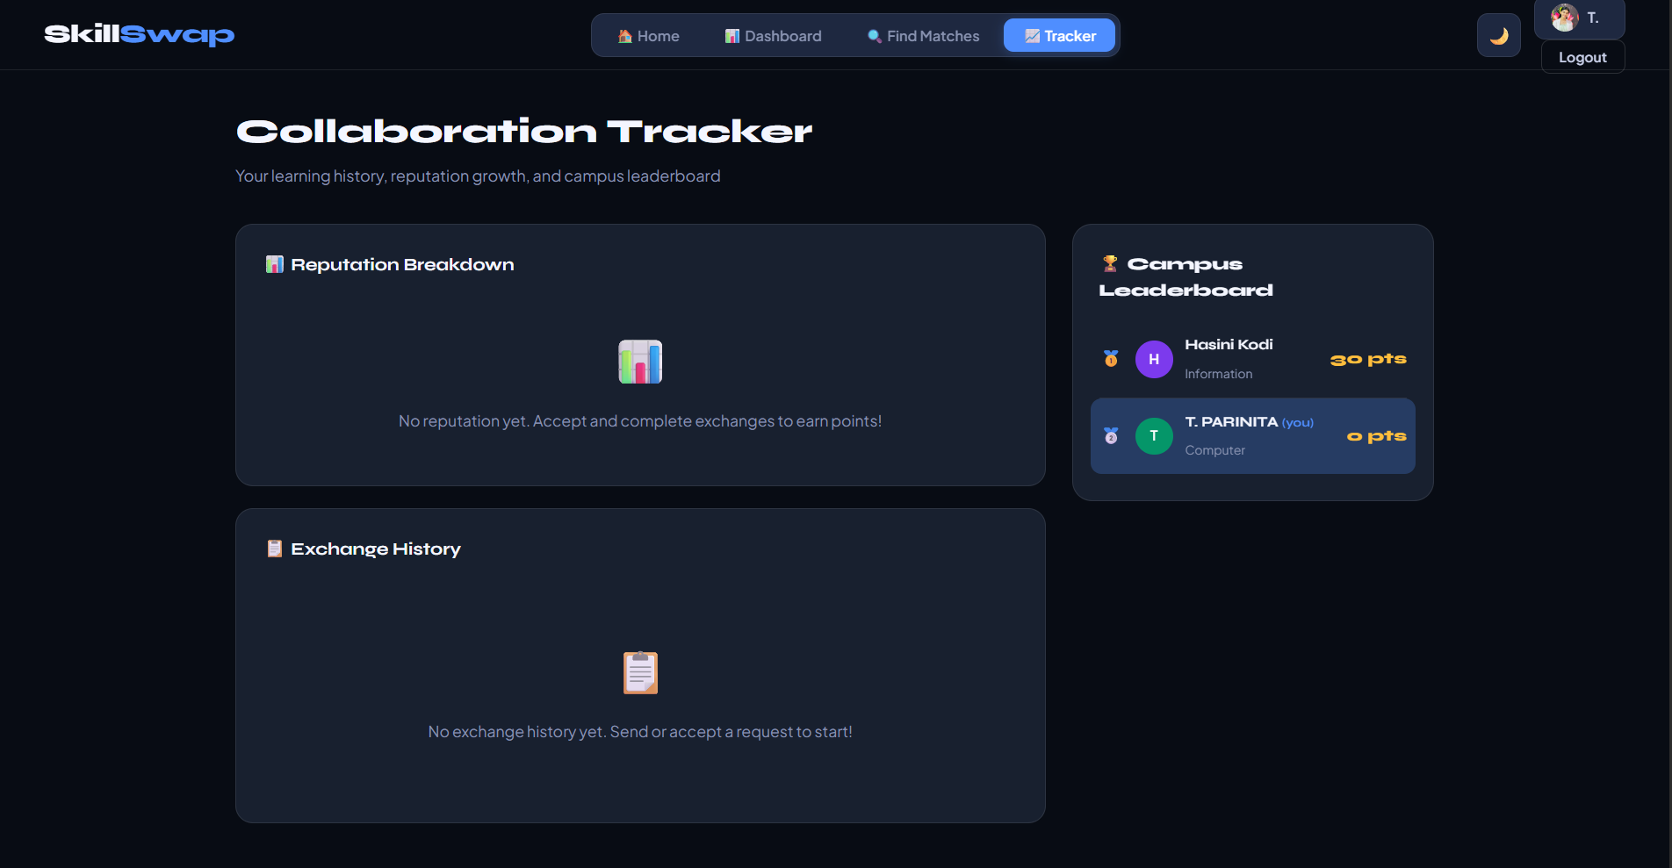
Screenshots - FWD (SkillSwap UI)
06-03-2026
2520030562 Department of CSE
12

Slide 15
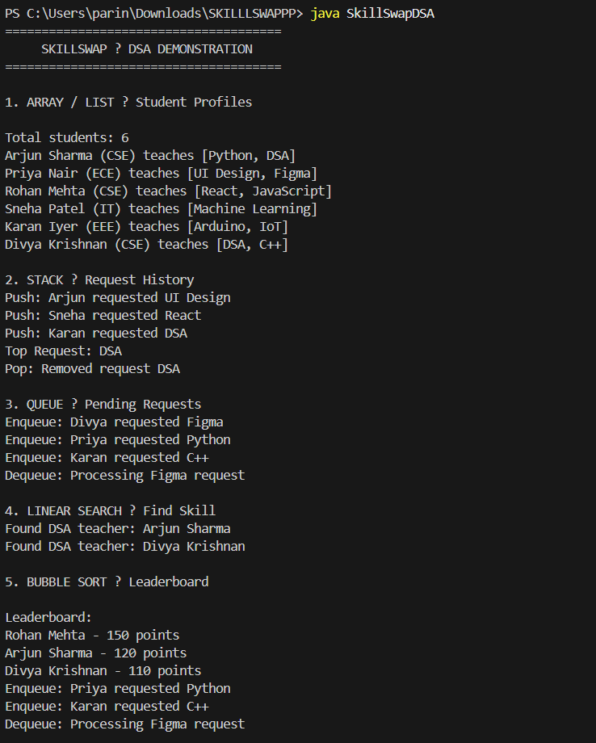
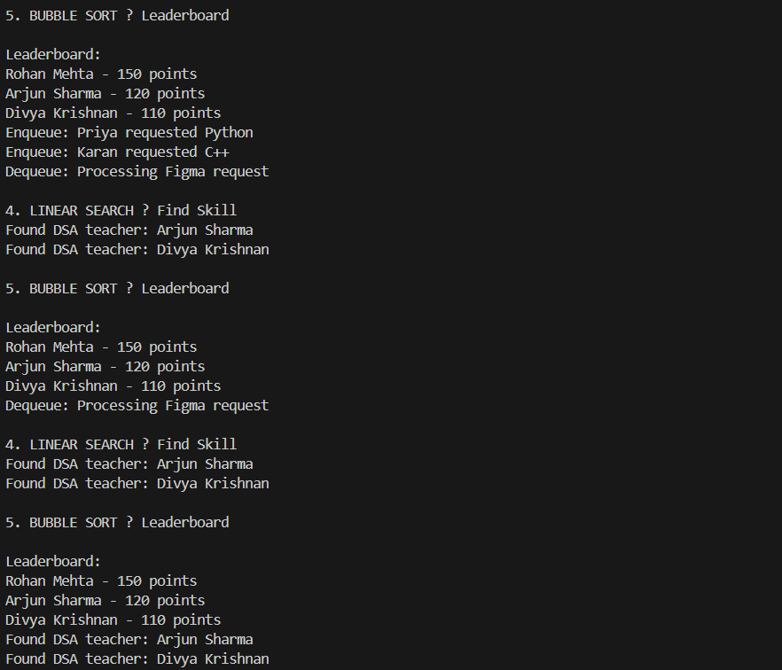
Screenshots - DSA (Console Output)
06-03-2026
2520030562 Department of CSE
13

Slide 16
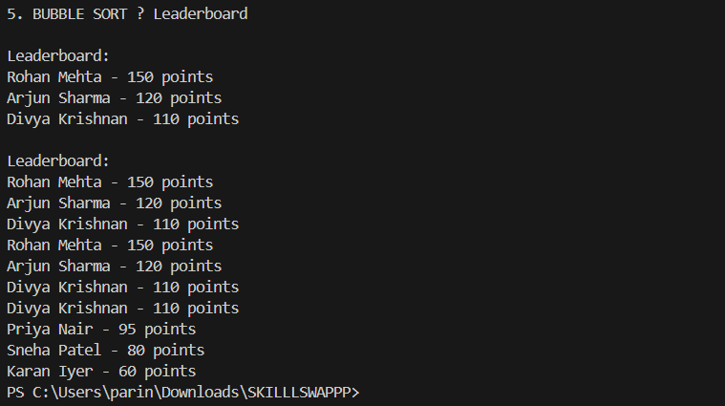
Screenshots - DSA (Console Output)
06-03-2026
2520030562 Department of CSE
13

Slide 17
Conclusion
SkillSwap successfully demonstrates a real-world web application built with HTML, CSS, and JavaScript
The platform bridges the gap in peer-to-peer skill exchange among students
All FWD course outcomes were achieved through responsive UI, dynamic rendering, and interactive features
DSA concepts (Arrays, Stack, Queue, Linear & Binary Search, Bubble Sort) were integrated meaningfully
Each DSA concept maps directly to a functional feature within the SkillSwap platform
The project reflects strong understanding of both front-end development and data structure fundamentals
Future scope: backend integration, real-time chat, and AI-based skill matching
06-03-2026
2520030562 Department of CSE
14

Slide 18
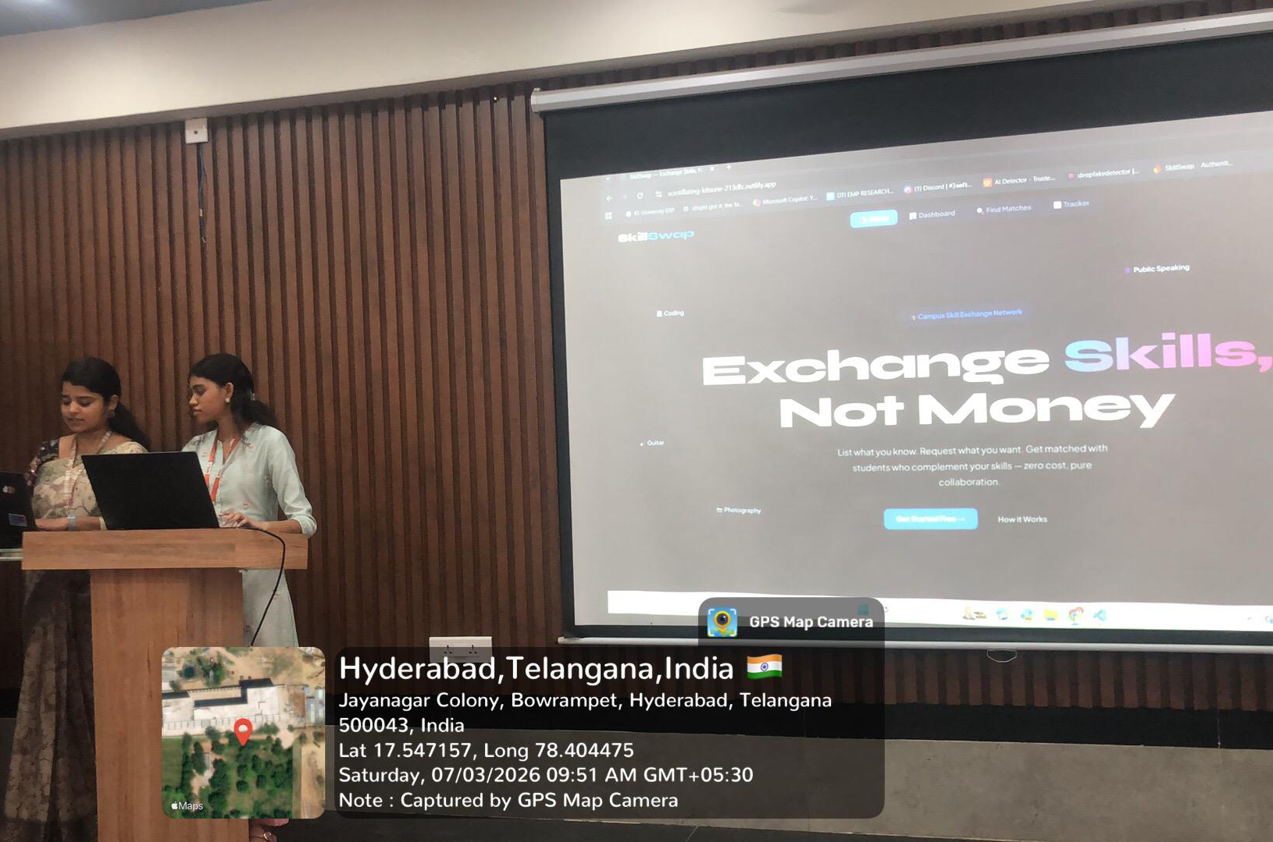
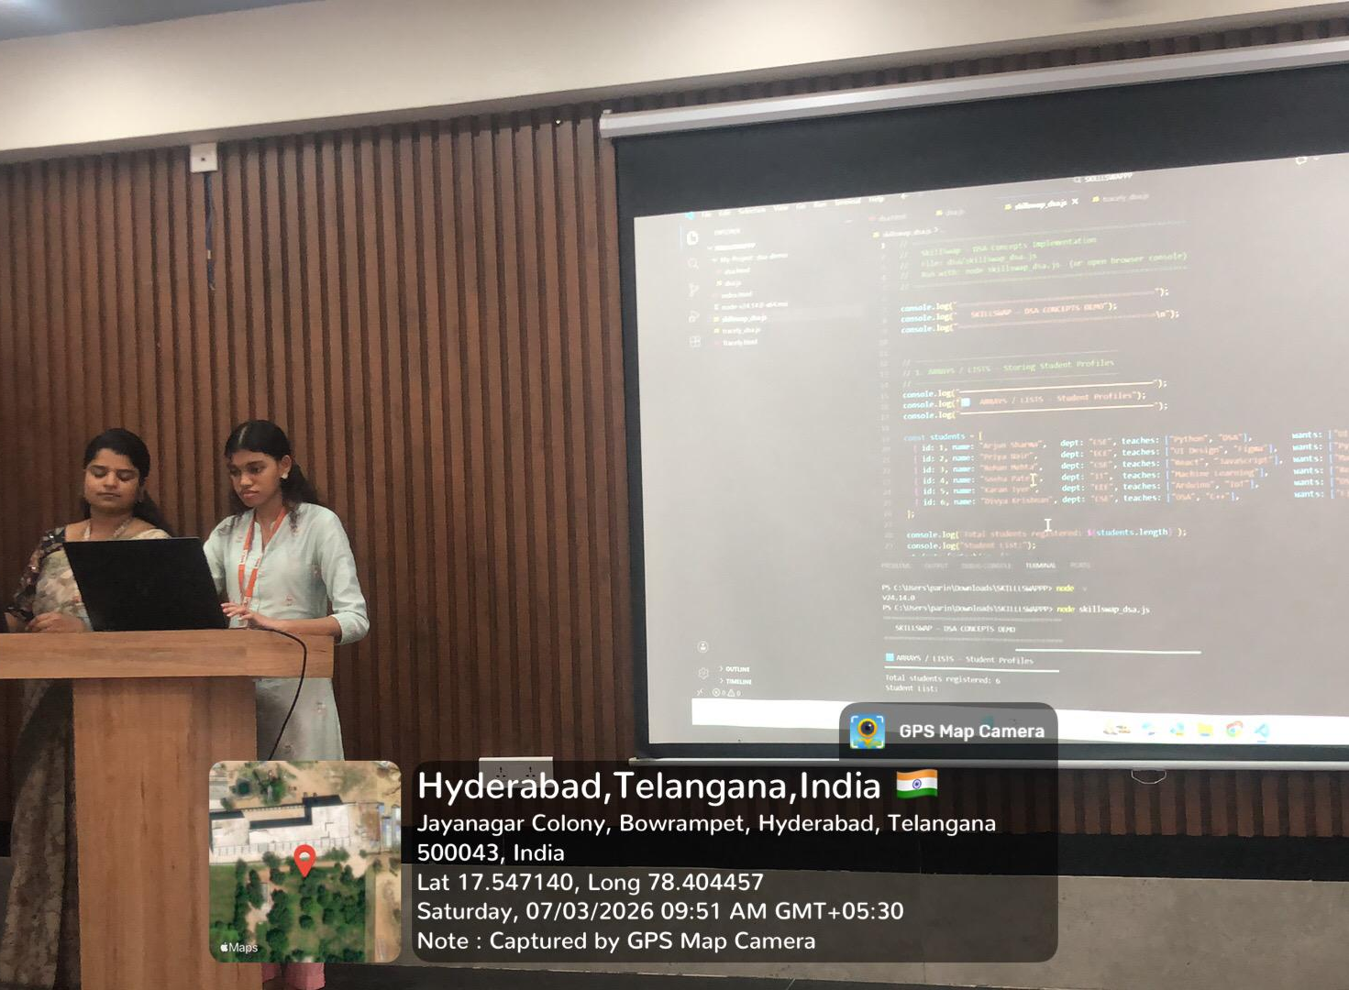
Geo-Tagged Photos
06-03-2026
2520030562 Department of CSE
15

Slide 19
THANK YOU
T. Sai Sri Parinita | 2520030562 | CSE | Cluster 1 | Section 2
06-03-2026
2520030562 Department of CSE
16

