Slide 1

Combinatorial Optimization “Thermal Planning with distance energy loss”
1624 Gavriillidis Paraskevas
1839 Kotanidis Dionysios

Slide 2
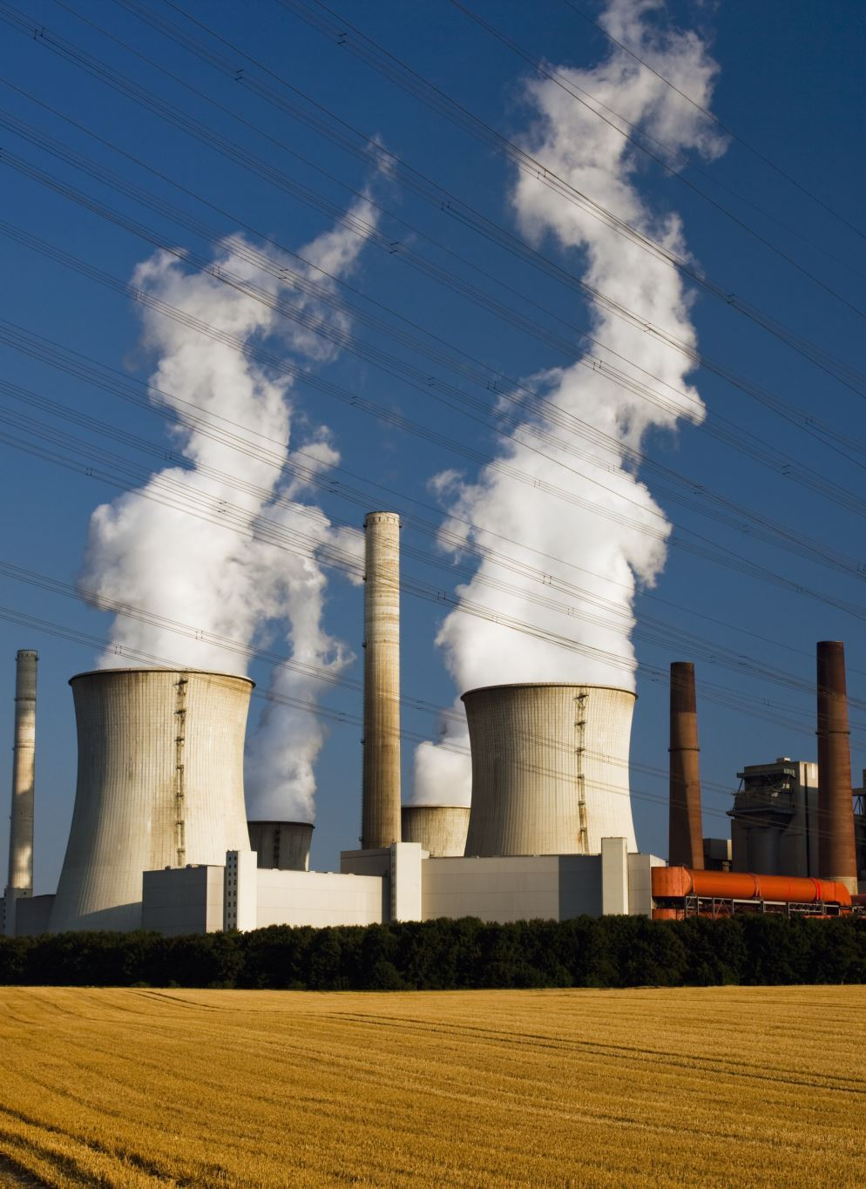
Initial Problem
How can we transmit energy , in this case thermal energy so that the network can be optimal given :
-Plants already exist
-Clients are in clusters

Slide 3
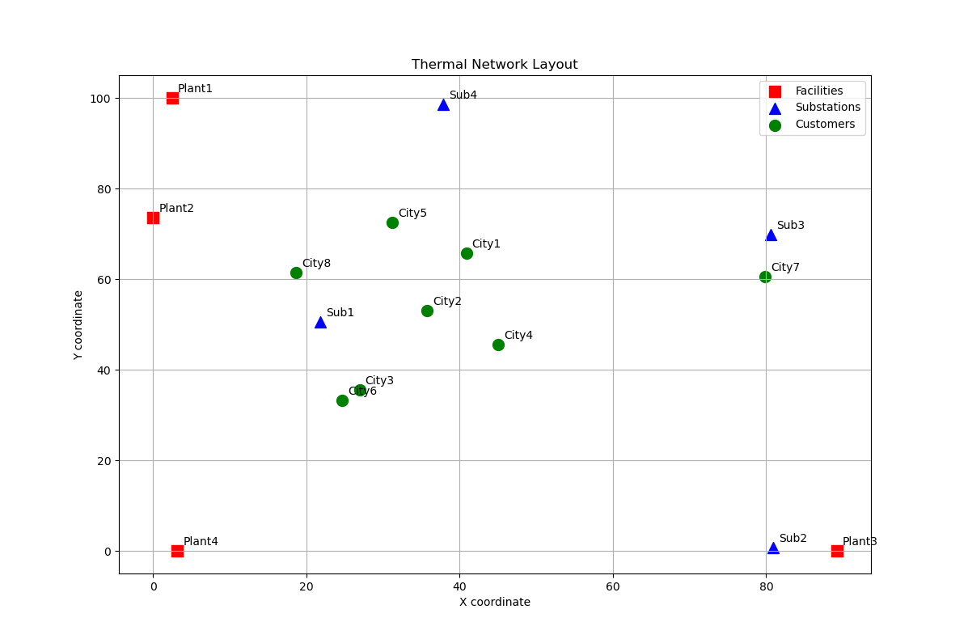
Initial Stage
This is what a network is at first.

Slide 4
Details
As you can see we created maps where :
Plants are fixed to the sides
Substations are randomly placed
Clients are in clusters

Slide 5
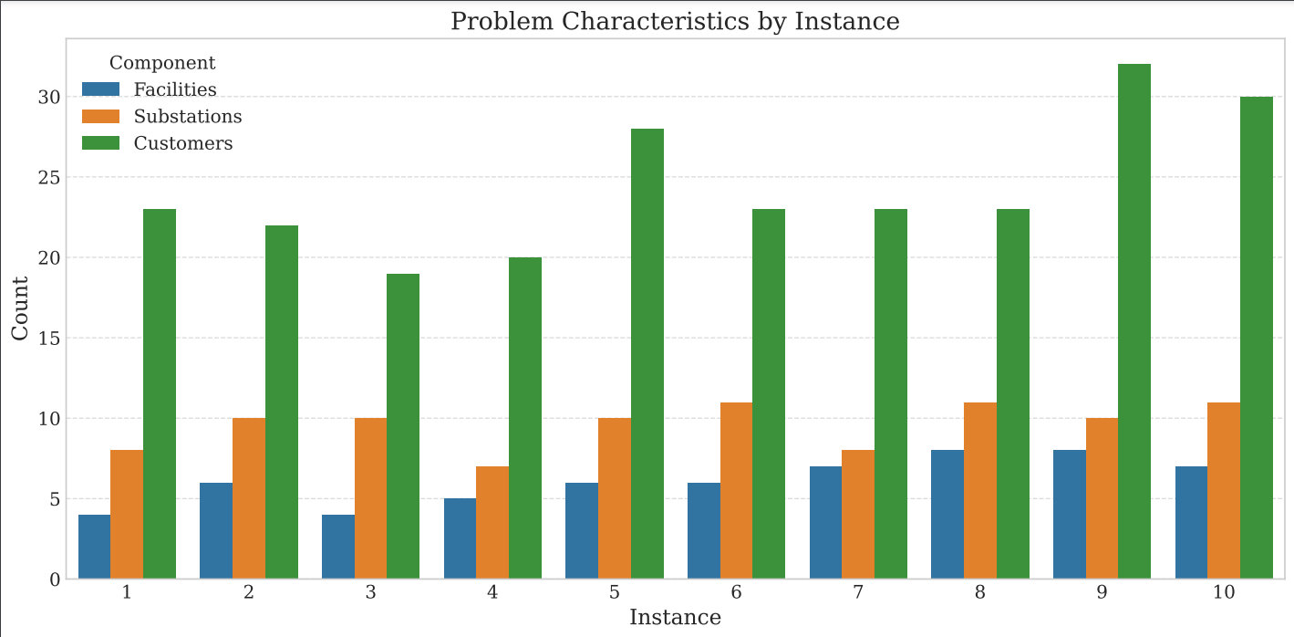
Problem Characteristics & Constraints
This chart illustrates the structure of our problem instances, highlighting the number of facilities, substations, and customers. As the network scales, feasibility becomes a challenge, especially when the number of clients increases. This observation motivated our need for an optimized Branch-and-Bound approach to balance constraints and maintain efficiency."

Slide 6

Questions Emerged
- How can we make sure constraints are kept in scaling?
- How can we make constraints harder and easier to our liking ?
Problematic Behavior
- after a certain number of inputs the problem suddenly became infeasible
- plants were fixed so we had to decide the number the problem needs
- at 3 separate clusters for clients we could not fit any more

Slide 7
Approach
Reformulated the problem and added binary constraints to the plants , so that the solver could place them optimally
That helped to have more variation and even solve bigger scale problems

Slide 8

Scaling Problems

Slide 9

In our particular problem scaling proved quite tricky
When scaling to a bigger map the problem became infeasible cause the capacity of the whole network was not enough for such long distances

Slide 10
Then we added more capacity
Our problem suddenly became too easy. So we explored in some sense the strictness of our base problem, change some constraints to make it as relaxed as possible, so at the same time it could be able to solve the problem in a reasonable period of time

Slide 11

Branch and bound
Simple and optimized version

Slide 12
First, we build a simple branch and bound implementation
You can see the results. Our Branch and Bound results show that while the Solver effectively finds solutions, it struggles with larger problem sizes due to weak pruning strategies.

Slide 13
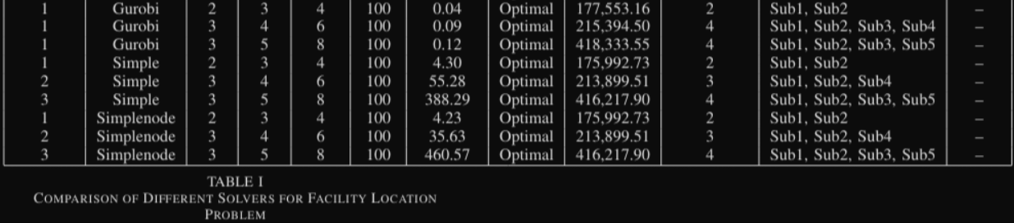
Then we made the optimized version of branch and bound
The optimized version had:
Node selection
Branching Selection
Preproccessing Heuristic

Slide 14
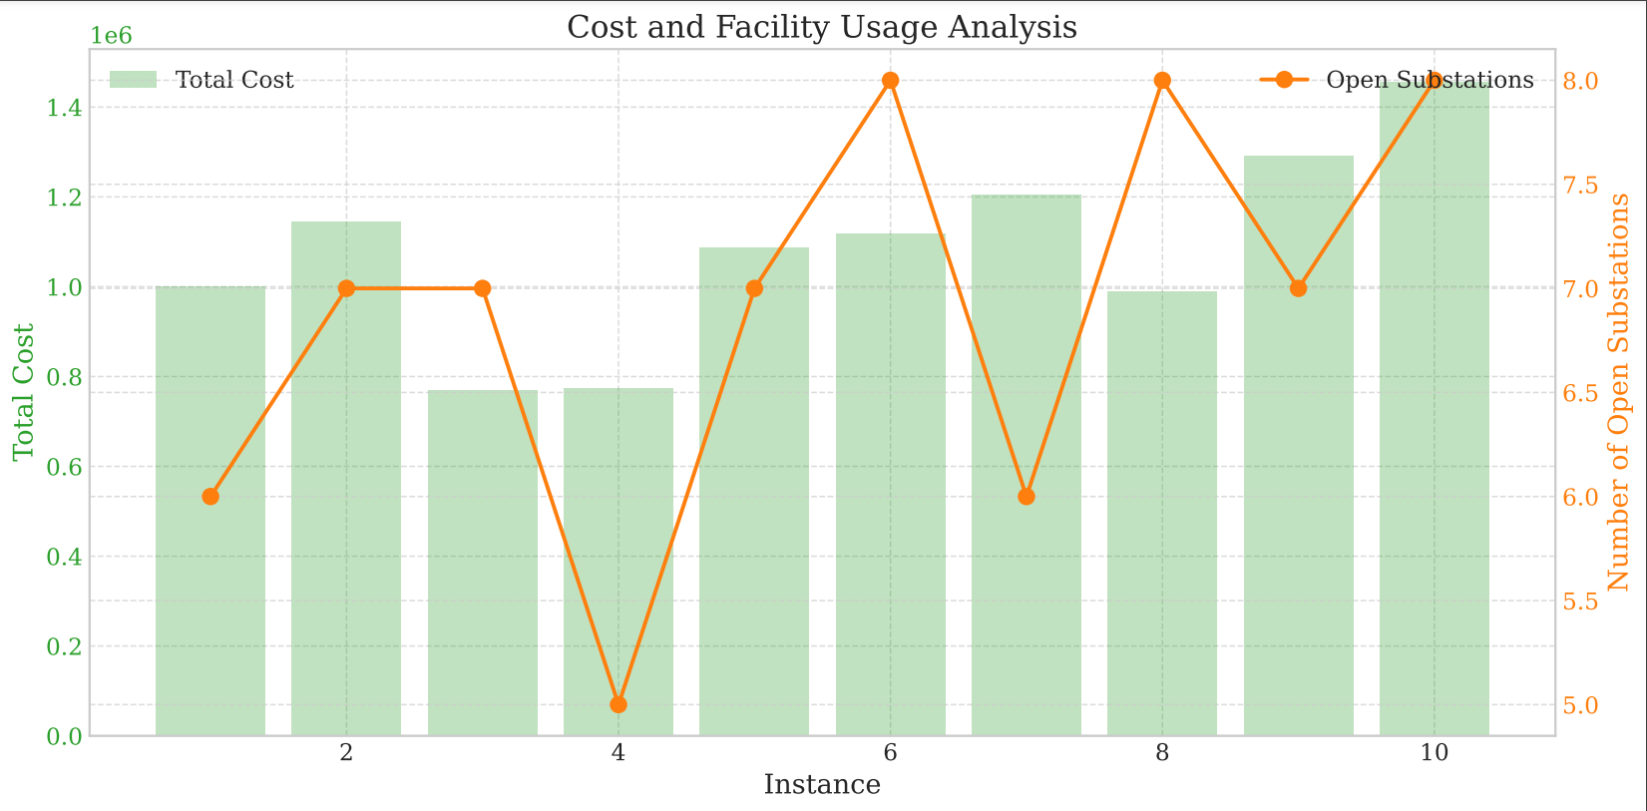
Cost and Facility Usage Analysis
Here, we analyze the relationship between cost and facility usage across different problem instances. Initially, limited capacity led to infeasibility, while excessive capacity made the problem trivial. By carefully adjusting constraints, we achieved an optimal balance where the network remained feasible without excessive costs, demonstrating the effectiveness of our optimization strategy.

Slide 15
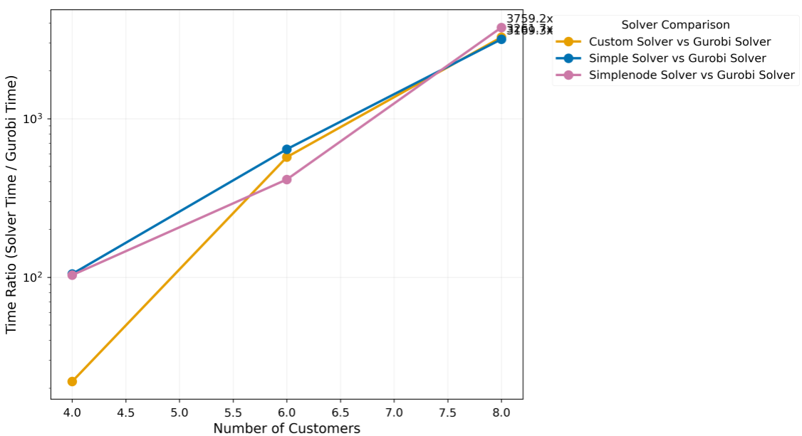
Solution Time vs Problem Size
This chart compares solution time across different problem sizes of optimized Branch-and-Bound implementations. our optimized versions—using preprocessing, better node selection, and heuristics-improved efficiency, making large-scale problems computationally feasible.

Slide 16
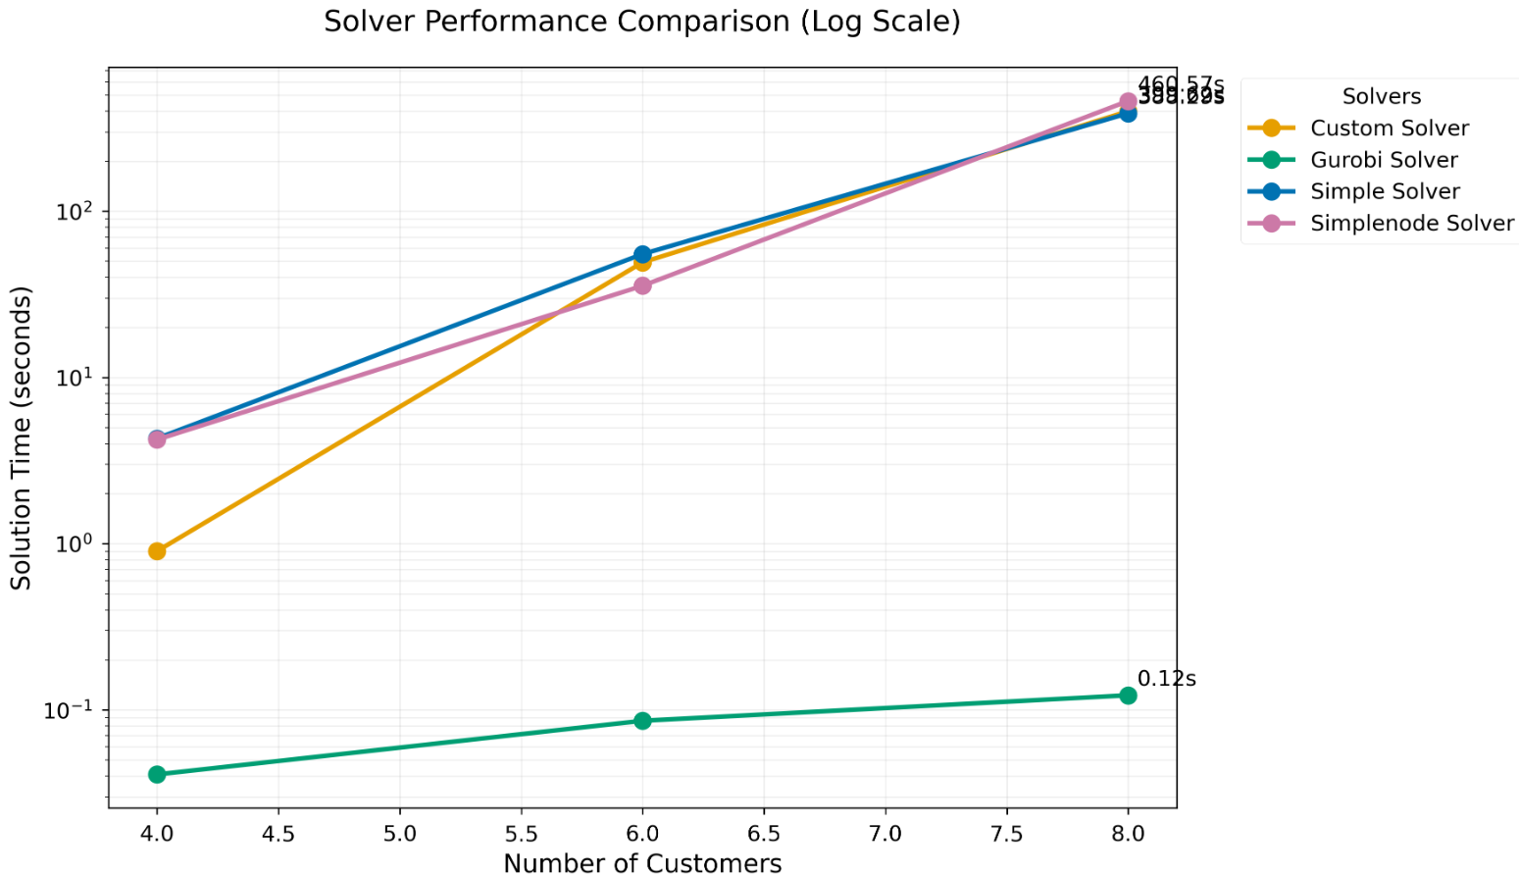
Solver Performance Comparison
We analyze the performance of four solvers: Gurobi, Custom Branch and Bound, Simple Solver (Branch and Bound with heuristic), and SimpleNode Solver (Branch and Bound with improved node selection). Gurobi, known for its advanced heuristics and optimizations, consistently achieves the fastest solution times. However, our custom solvers provide more flexibility tailored to specific problem constraints. By comparing these approaches, we assess trade-offs between computational efficiency and adaptability, highlighting the advantages of problem-specific solver designs

Slide 17
FINAL thoughts
Through this project on combinatorial optimization for thermal planning, we explored the challenges of designing an optimal energy transmission network under real-world constraints. Our study highlights the importance of optimizing solver performance for large-scale thermal planning problems. While Gurobi remains the most efficient solver, our optimized Branch-and-Bound approach demonstrates strong potential, offering flexibility and problem-specific adaptability. The results show that for smaller problem instances, the Simple Branch-and-Bound solver performs faster. However, as the problem size increases (with more customers and constraints), our Optimized Branch-and-Bound becomes more effective, with improved node selection and pruning strategies to manage larger problems more effectively. By starting with a good initial solution and making better branching decisions, we found a balance between speed and solution quality. Future work could explore additional refinements, such as dynamic branching strategies and parallel computing, to further enhance performance.

Slide 18
Through this project on combinatorial optimization for thermal planning, we explored the challenges of designing an optimal energy transmission network under real-world constraints. Our study highlights the importance of optimizing solver performance for large-scale thermal planning problems. While Gurobi remains the most efficient solver, our optimized Branch-and-Bound approach demonstrates strong potential. The results show that for smaller problem instances, the Simple Branch-and-Bound solver performs faster. However, as the problem size increases (with more customers and constraints), our Optimized Branch-and-Bound becomes more effective, with improved node selection and pruning strategies to manage larger problems more effectively. By starting with a good initial solution and making better branching decisions, we found a balance between speed and solution quality. Future work could explore additional refinements, such as dynamic branching strategies and parallel computing, to further enhance performance.
Final thoughts

Slide 19

THANK YOU for your time
1624 Gavriillidis Paraskevas
1839 Kotanidis Dionysios

