Slide 1

BOOKSHOP “λεξη”
Developer team: softtsing

Slide 2
Main requirements
Creation of a database that contains the client list, employees list, employee login and logout time, booklist and the order list.
Creation of a user-friendly interface for the software.

Slide 3
Database
The software we use for the creation of the database was Microsoft Access 2016.
For the creation of the database, we used SQL commands through the queries of the Access.

Slide 4
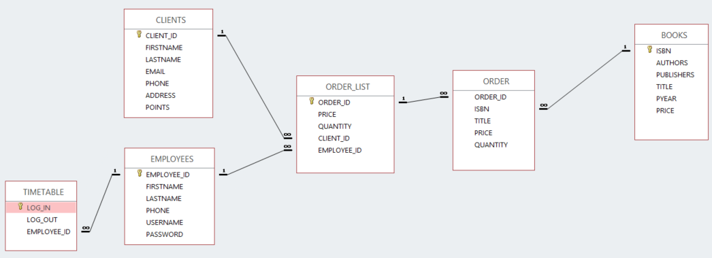
DATABASE & RELATIONSHIPS

Slide 5
User Interface
The language we use to develop the software was C#.

Slide 6

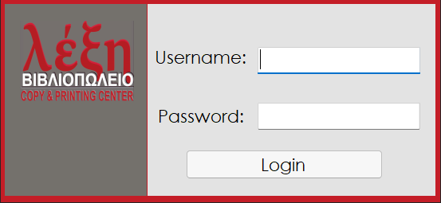
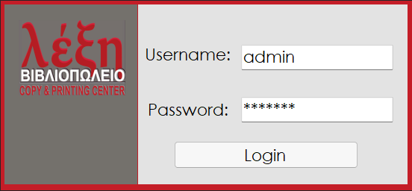
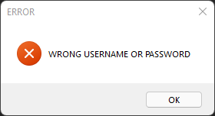
Starting forms
Login
Splash screen
Message form for Error

Slide 7
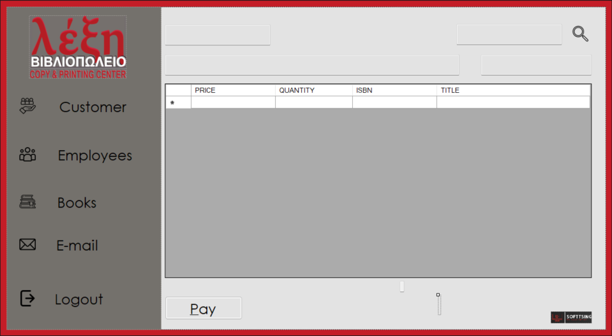
MAIN FORM
1
2
3

Slide 8
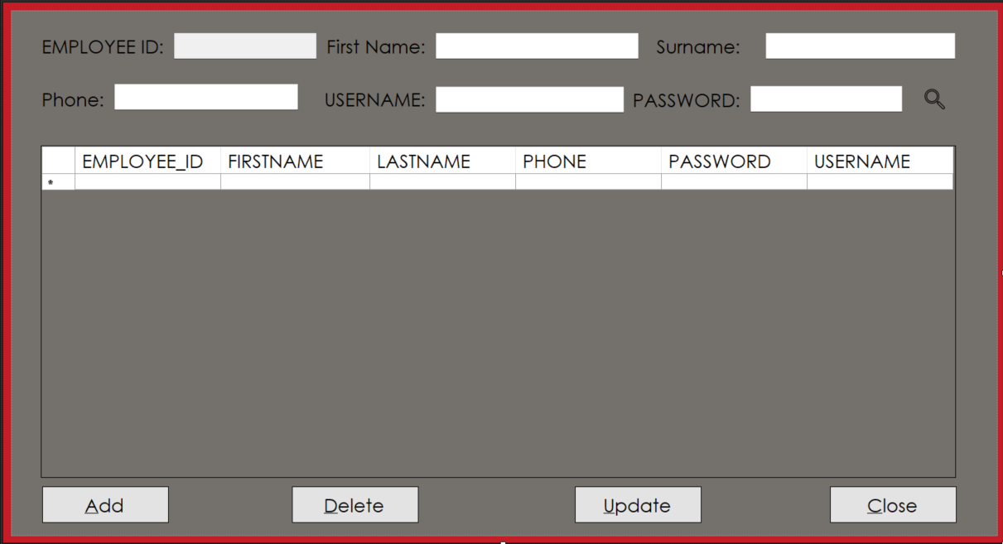
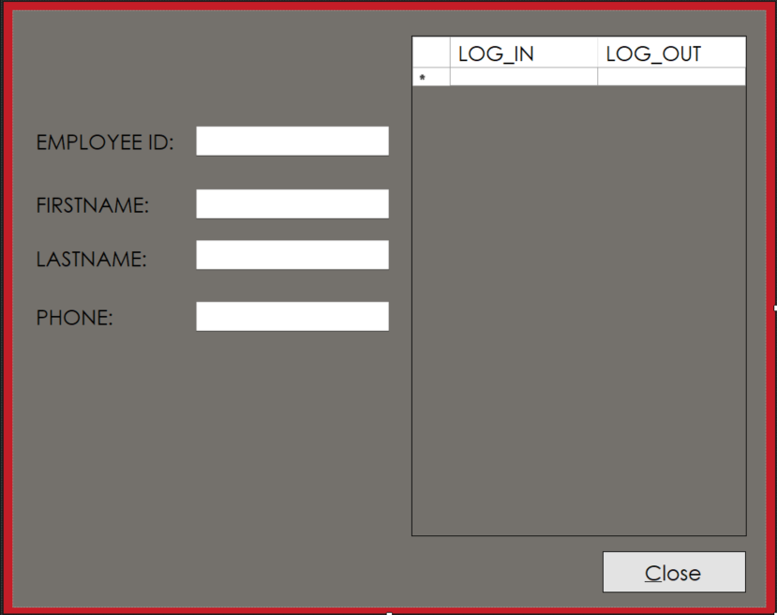
Employee form

Slide 9
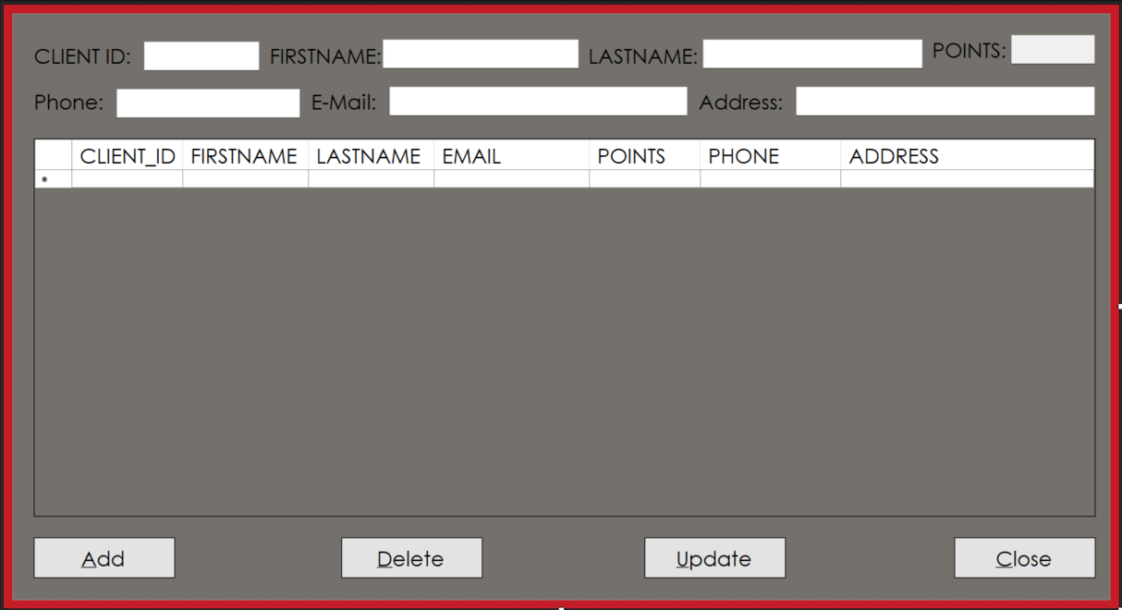
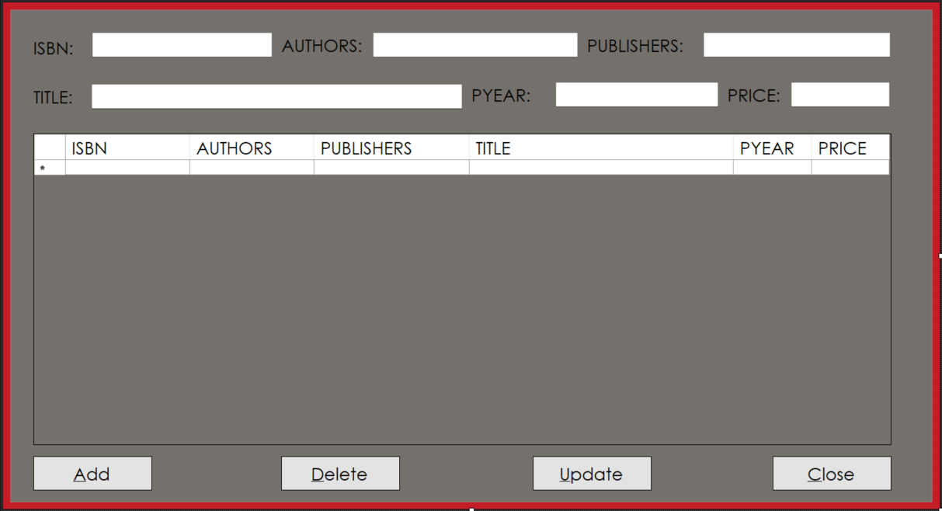
Customer form
book form

Slide 10
Thank you !!!

