Slide 1
PV (on-site and VIPV), Battery storage, and charger types
Infrastructure specifications and turnkey CapEx

Slide 2
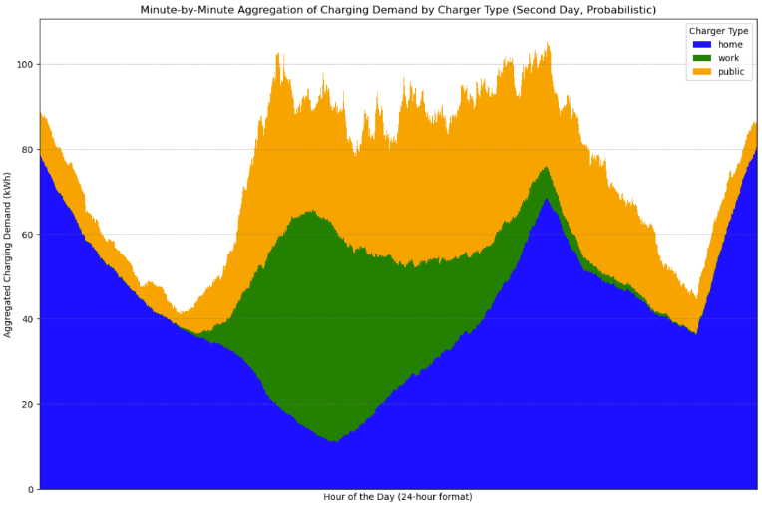

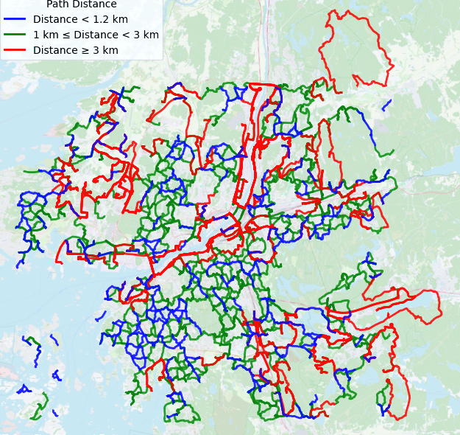
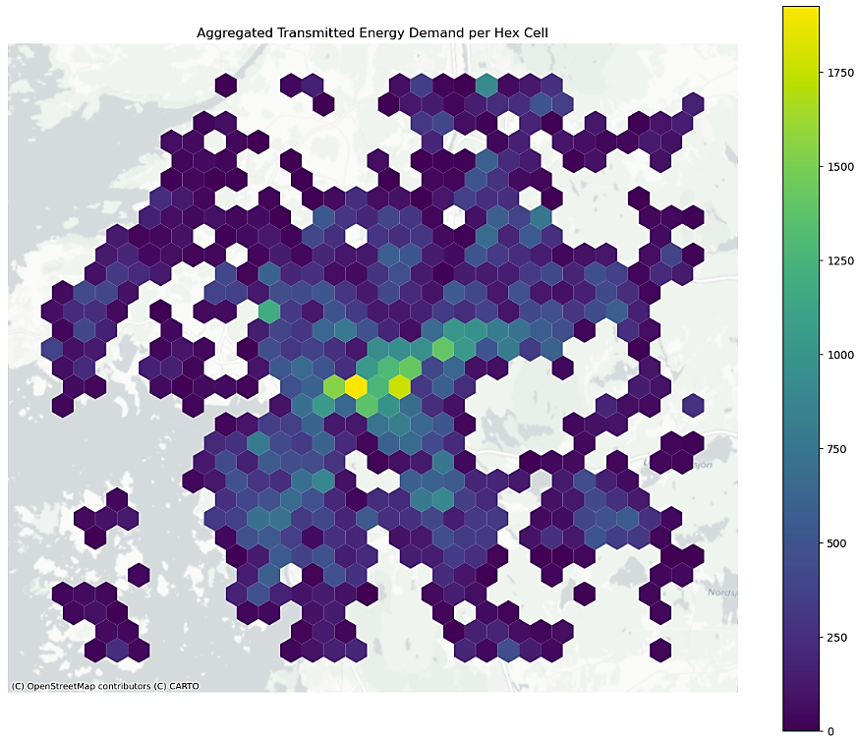

Research conceptualization
EV Charging
Infrastructure
Charger Point Operator
Where & How many to install?
Home Chargers
Slow Chargers
Medium Chargers
Fast Chargers
Joint Optimization
Charger capacity
EV Chargers
Parking space
Multi-class chargers, Redirections, Solar PV and battery storage
Spatiotemporal Charging Demands
PV panels
PV potential
Temporal variability
Renewable inclusion
Battery units
Implement Solar PV
Solar PV and battery storage
Land-use Land-cover
Cost Optimal Solution
Accessibility to infrastructure
Redirect Demand
User-Incentives
Temporal Demand Peak shave-off
Power Grid electricity
Satisfy EV charging demands
Time-of-use prices
Spatio-Temporal charging events
Spatio temporal charging demand aggregations
Notes:
To clarify the long title, we have the conceptualization here.
We have the charging demands from the first research- aggregated spatially and temporally.
And our goal is to have a join optimization model to deploy the charging and renewable energy infrastructure.
Constraints and parameters, and we aim to perform this joint optimization from the perspective of the CPO, assuming that the CPO deploys the infrastructure or invests for the expenditures, as he earns the revenue from EV users from charging.
So the baseline is that we satisfy the charging demands, but in a cost optimal way- while maximizing the net profit for the CPO.

Slide 3
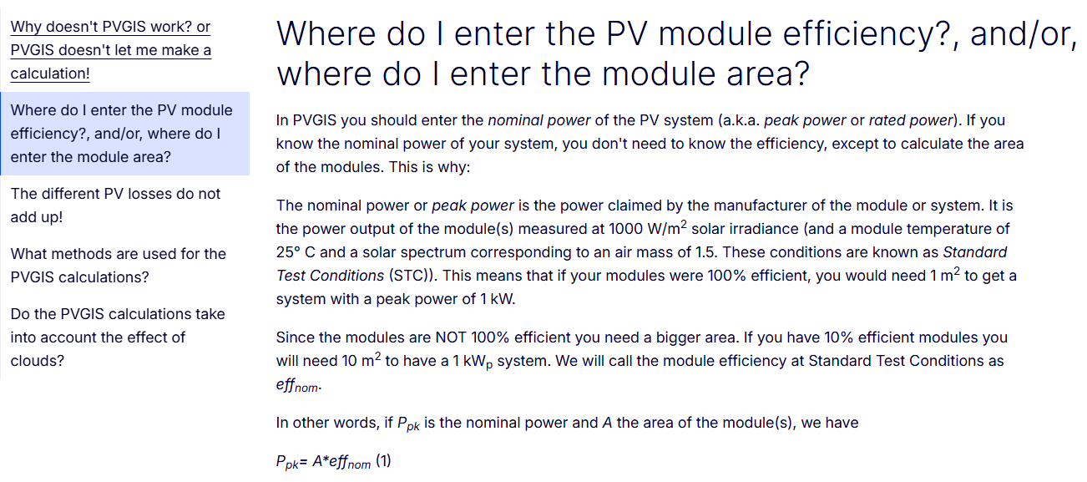
PV panels PVGIS: nominal power includes/considers efficiency

Slide 4
PV panels (on site)
Capacity | Area install
500 W | 2.16 sqm
450 W | 1.87 sqm
Source: https://jinkosolar.eu/wp-content/uploads/2024/10/JKM475-500N-60HL4-V-F8-EU.pdf
IEA-PVPS Sweden 2024 : National Survey Report of PV Power
Turnkey prices: 9.4 SEK/W for 100–250 kW large commercial systems, and 12.1 SEK/W for 10–100 kW small commercial systems.
Västerås: Potential analysis of roof-mounted solar PV in Sweden
Models Swedish rooftop PV potential while considering roof orientation, shadows, obstacles, tilt angles, and inter-row distances. It reports 5.74 sq.km usable roof area in Västerås and potential capacities of 727, 848, and 956 MWp across roof scenarios.
PV O&M https://www.solenerginyheter.se/20250407/3992/batterilagring-vaxer-snabbt-i-svenska-hushall?page=%2C1

Slide 5
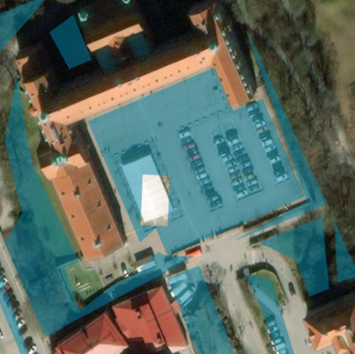
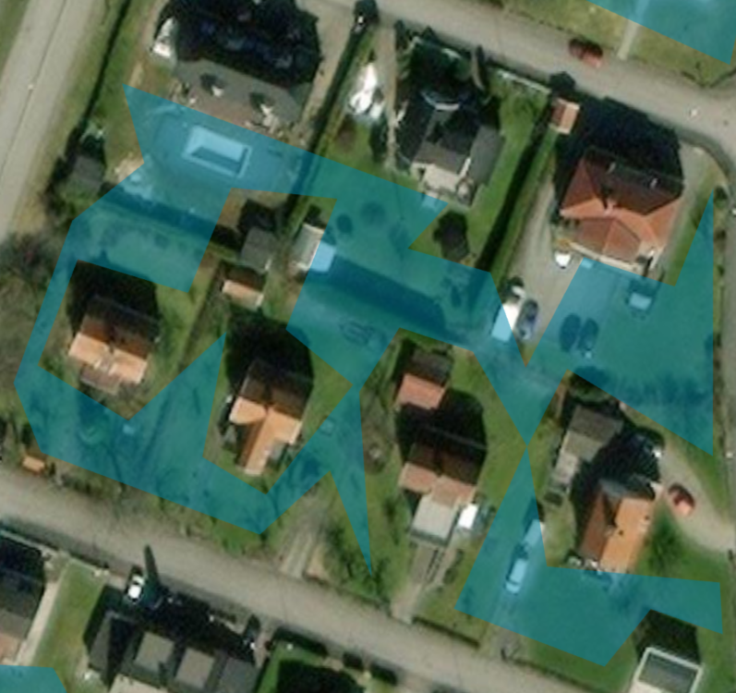
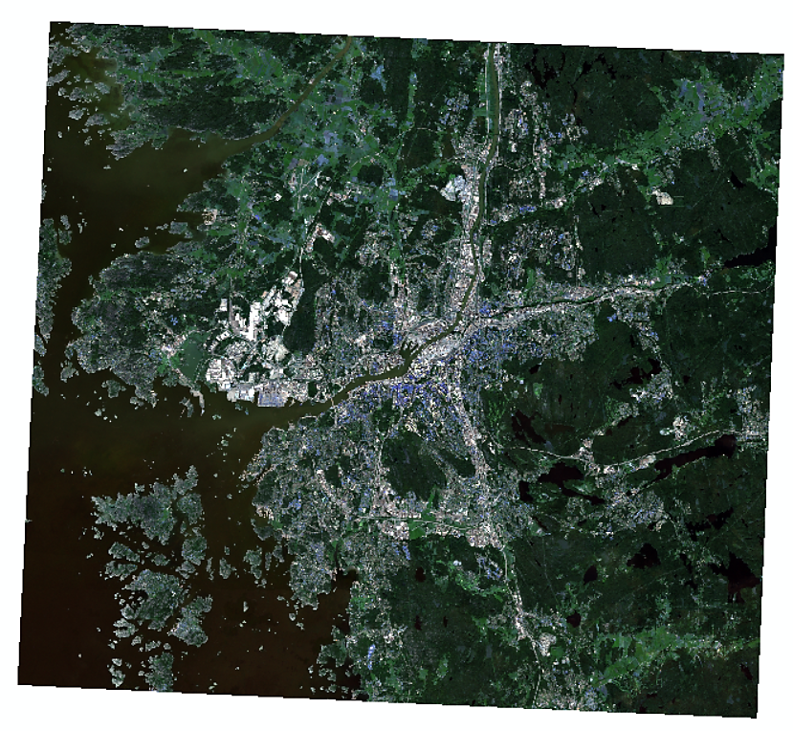
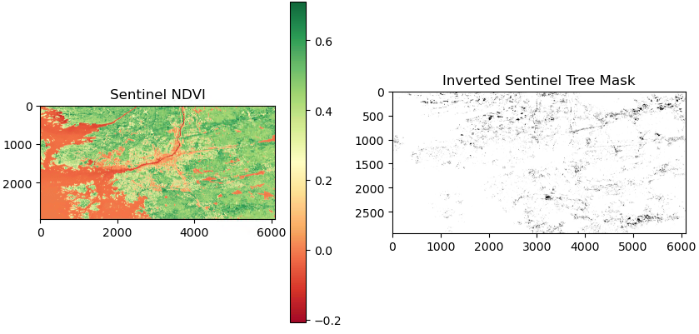
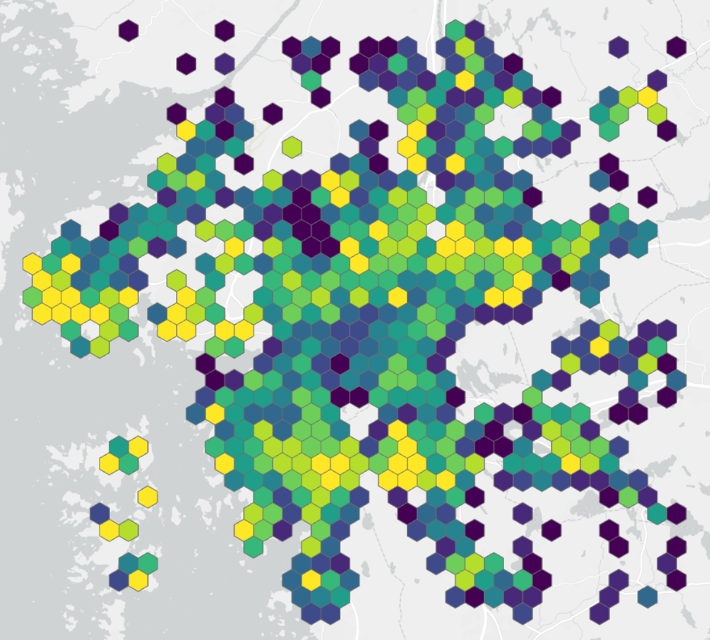
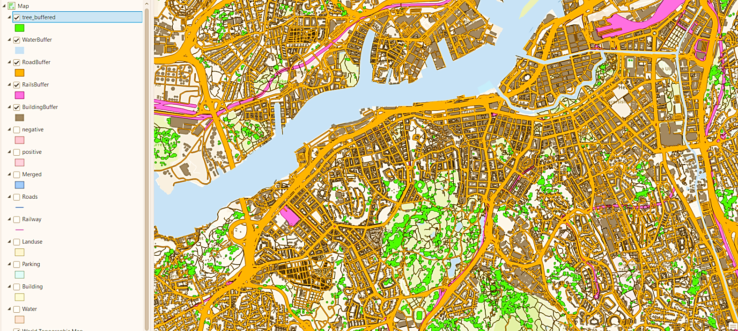

PV installation potential bounded
Classification using supervised ML algorithms (Copernicus Sentinel Imagery)
Parking lots
Public Parking
Multistoried parking
EV charging stations
Open area parking
Classified PV install areas:
PV potential is assessed for land cover (buldings, tree cover, roads, water) and using Deep Learning algorithm (CNN) to derive parking areas for PV install sites.

Slide 6
Battery storage systems in Sweden (BESS)
2018: MSc thesis at Svenska kraftnät reports BESS installation costs in the range of 2240–6250 SEK/kWh, with a central value of approximately 3400 SEK/kWh (thesis)
2023: Guidelines to implement BESS by world bank (report)
2024: Swedish Solar Energy Association estimates of 650–800 MW decentralized BESS installed and more than 1 GW cumulative decentralized BESS (IEA-PVPS)
2025: BW ESS and Ingrid Capacity - a 211 MW / 211 MWh portfolio of 14 operational BESS projects in Sweden (news blog), 20 MW BESS in Värnamo to support grid balancing and resilience in southern Sweden (project)
2025: BloombergNEF reported that global average turnkey energy storage system prices fell by about 40% in 2024 to USD 165/kWh (news blog). Swedish market estimate (Rebaba blog) gives a Europe oriented BESS cost range of 3500 - 7000 SEK/kWh usable capacity.

Slide 7
BESS turnkey cost structure
BESS cost structure should include 40% batteries/racks/cables, 25% power conversion system, 20% enclosure/HVAC/control/fire suppression, and 15% assembly, shipping, installation, testing and commissioning. – battery cost alone, not enough for modeling (US case studies- IRENA)
BESS unit capacity | 10 kWh/unit
Battery power capacity | 5 kWh/unit
Full charge duration (hour rate) | 2 h
Charge/Discharge efficiency | 0.95
SoC min–max | 10–90%
Lifetime | 15 years
Cost: site-level BESS with EPC, safety, and grid connection | 3400 SEK/kWh
3400 SEK/kWh swedish value considering charging-site integration, grid connection, fire safety, EMS or installation, and installation overhead (European C&I market price).

Slide 8
Swedish EV Chargers turnkey considerations
Swedish market prices 7,000–15,000 SEK for AC chargers of 11–22 kW, 80,000–300,000 SEK for DC fast chargers, 5,000–15,000 SEK per parking space for installation, 5,000–25,000 SEK for load balancing/control, and 500–1,500 SEK/year per space for cloud/operation services (Parkit consultant). A charging post/pedestal costs 20,000–50,000 SEK, including ground works and cabling (report)
Naturvårdsverket’s Klimatklivet framework treats the 10–50 kW category as a supported public charging class and subsidizes upto 50% of investment cost (subsidy, blog, Ladda bilen, Klimatklivet, Energimyndigheten)
For DC charging, the Swedish EVolution Road project reports: fast charging stations cost approximately 6,000 SEK per kW of charging capacity, implying about 400,000 SEK for a 50 kW charger (project)
ACEA reports average charger installation costs around €125/kW for AC 4–22 kW chargers, with higher costs for DC systems. Using a rough 11–12 SEK/EUR exchange rate, this corresponds to about 15,000 SEK for 11 kW AC and 30,000 SEK for 22 kW AC, before local site-specific variation (EU report)

Slide 9
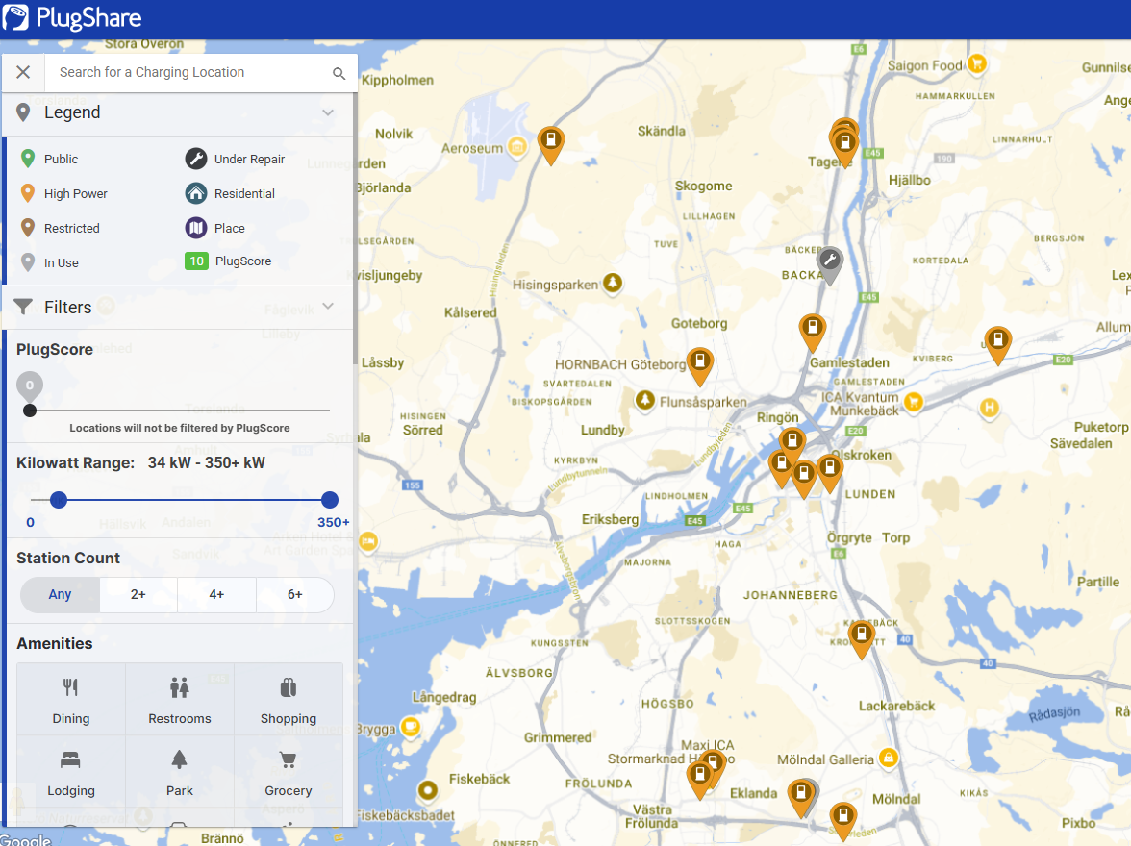
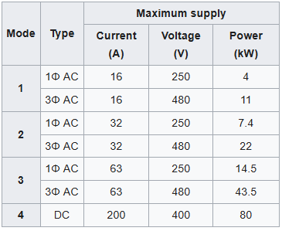
Charger cost and capacity references
Home chargers (7 kW): AC, Single-Phase/Level 1/2 (Allego, 7.4 kW portable, smart home wallbox)
Slow chargers (11 kW): AC, Three-Phase, Level 2 (go-eCharger Gemini, Pulsar Plus wallbox, ELFA..)
Fast chargers (22 kW): AC, Three-Phase, Level 2 (evify, Charge Amps Dawn, Zaptec Go..)
Ultra fast chargers- 23 charging points
(>43 kW up to 360 kW)
Chargemap
ChargeFinder
Hardware ~ 200,000 kr
Installation ~ 500,000 kr
(Heliox Rapid 50 kW, Tritium RT50, Noodoe DC50A)

Slide 10
Chargers turnkey costs
Charger class | Power | Energy per 30-min slot | turnkey CapEx | Lifetime
Slow AC charger | 11 kW | 5.5 kWh/slot | 25000 SEK/unit | 10 years
Medium AC charger | 22 kW | 11 kWh/slot | 40000 SEK/unit | 10 years
Fast DC charger | 50 kW | 25 kWh/slot | 450000 SEK/unit | 10 years
For AC chargers, installation can dominate the public pedestal deployment.
For DC chargers, the charger cabinet is expensive, but site works, grid connection, switchgear, and commissioning can also dominate.
Price of Grid Electricity
Price/kWh = 1.25 (VAT) * [(Spot_price (NordPool) + Elect_tax (0.36 kr/kWh) +
grid_fee (0.3 kr/kWh) + retail (0.02 kr/kWh)]

Slide 11

*Source: Aggregated electricity hourly values from Nordpool for SE3 region.
Spot Price | Jan | Feb | Mar | Apr | May | Jun | July | Aug | Sep | Oct | Nov | Dec
00 - 01 | 27.40 | 72.17 | 59.83 | 28.21 | 4.65 | 52.65 | 37.34 | 17.04 | 14.49 | -4.37 | 81.10 | 86.13
01 - 02 | 27.23 | 69.29 | 56.95 | 28.15 | 4.63 | 48.47 | 36.57 | 16.00 | 13.91 | -4.40 | 76.42 | 82.93
02 - 03 | 24.28 | 66.94 | 56.94 | 28.59 | 4.80 | 48.34 | 29.15 | 14.89 | 13.19 | -4.43 | 72.90 | 80.10
03 - 04 | 13.00 | 67.78 | 56.97 | 29.92 | 5.10 | 50.26 | 19.95 | 15.18 | 12.47 | -4.35 | 70.69 | 76.55
04 - 05 | 7.98 | 72.17 | 54.97 | 32.32 | 5.28 | 51.87 | 16.98 | 15.31 | 12.50 | -4.33 | 74.45 | 75.16
05 - 06 | 4.85 | 69.29 | 57.23 | 38.01 | 6.69 | 58.50 | 13.69 | 17.35 | 12.49 | -3.97 | 80.68 | 80.41
06 - 07 | 6.05 | 109.05 | 112.86 | 39.11 | 14.51 | 60.69 | 19.90 | 19.17 | 13.93 | -3.32 | 98.69 | 95.97
07 - 08 | 10.09 | 112.97 | 136.33 | 41.17 | 92.26 | 67.46 | 22.60 | 22.86 | 28.97 | -3.01 | 122.19 | 106.95
08 - 09 | 14.03 | 182.72 | 148.68 | 50.05 | 94.13 | 72.26 | 29.87 | 26.26 | 125.07 | -2.61 | 128.59 | 121.50
09 - 10 | 19.07 | 150.98 | 111.63 | 50.02 | 87.33 | 69.90 | 17.41 | 27.94 | 104.38 | -3.03 | 121.29 | 117.44
10 - 11 | 17.83 | 128.67 | 103.27 | 43.93 | 52.98 | 68.54 | 4.69 | 25.97 | 49.94 | -3.01 | 112.78 | 109.97
11 - 12 | 11.70 | 114.74 | 60.06 | 41.40 | 30.45 | 67.73 | 0.02 | 24.59 | 28.96 | -3.04 | 99.84 | 102.75
12 - 13 | 6.93 | 113.52 | 53.13 | 40.55 | 14.94 | 68.07 | 0.01 | 23.85 | 21.98 | -3.07 | 97.36 | 94.13
13 - 14 | 6.04 | 112.87 | 50.77 | 40.01 | 11.62 | 70.15 | -0.13 | 22.89 | 15.87 | -3.06 | 101.09 | 88.30
14 - 15 | 6.09 | 112.83 | 60.02 | 40.07 | 8.95 | 69.94 | -1.03 | 22.98 | 15.66 | -2.61 | 106.27 | 86.34
15 - 16 | 19.10 | 112.75 | 91.65 | 40.68 | 11.92 | 68.00 | -0.10 | 23.16 | 15.42 | -2.10 | 121.21 | 87.70
16 - 17 | 27.43 | 112.88 | 101.05 | 41.18 | 39.97 | 67.02 | 1.77 | 24.35 | 16.10 | -1.12 | 122.96 | 95.77
17 - 18 | 30.90 | 112.18 | 108.07 | 45.79 | 73.55 | 67.91 | 20.90 | 24.90 | 16.79 | -0.03 | 127.84 | 92.65
18 - 19 | 27.61 | 108.92 | 111.23 | 51.78 | 80.30 | 69.91 | 35.51 | 23.98 | 15.55 | 0.00 | 129.90 | 84.91
19 - 20 | 25.90 | 104.96 | 109.53 | 54.53 | 82.80 | 68.69 | 35.79 | 22.87 | 13.33 | -0.01 | 121.08 | 79.60
20 - 21 | 12.47 | 73.74 | 105.26 | 52.31 | 83.71 | 63.62 | 33.51 | 24.35 | 12.17 | -0.46 | 109.90 | 77.01
21 - 22 | 20.79 | 66.17 | 105.06 | 50.01 | 82.63 | 60.47 | 30.67 | 23.17 | 11.16 | -1.10 | 97.50 | 75.70
22 - 23 | 31.04 | 58.34 | 81.67 | 46.89 | 17.87 | 56.84 | 20.75 | 18.99 | 8.93 | -1.26 | 91.66 | 60.80
23 - 00 | 32.38 | 49.59 | 72.91 | 43.66 | 7.24 | 51.48 | 16.22 | 17.56 | 6.02 | -2.07 | 84.21 | 69.47

Slide 12
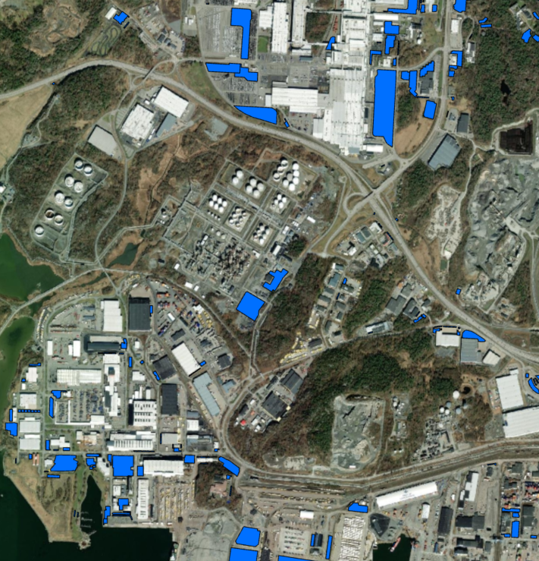
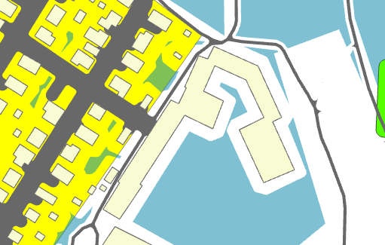
Home vs Public (slow, medium, fast) Charger areas
Home charger (7kW) areas
level 1/2- wall mounted
Inside garage or covered
8 m buffer – resi bldgs
Public Chargers?
Slow chargers (11 kW)
Area: 15 sqm (3 x 5m)
Medium (22 kW)
Area: 18 sqm (3 x 6m)
Fast (50 kW)
Area: 24 sqm (4 x 6m)
Resi landuse
Office Buildings
Parking / PV install area

Slide 13

User considerate redirections
Each redirected charging trip: User incentive offset the detour distance and travel time
The incentive considers user acceptance is realistic. Drivers receive compensation proportional to travel time, value of time, and tariff difference between origin and destination charger tariffs.
Travel/Redirection costs:
Value of time: 80 SEK/hr (Swedish Value of Time: 59 to 92 SEK).
Speed : 30 kmph
Redirection cost = 2.64 SEK/km (0.033 * 80)
Swedish Value of Time: 80 kr/hr- Elsevier (KTH, 2014), Uppsala (1998)- 89 kr/hr, JSTOR journal (2001) , SIKA (1995)- 110 kr/hr.

Slide 14


Omkar Parishwad
Doktorand (Urban Mobility Systems)
Chalmers University of Technology
omkarp@chalmers.se

