Slide 1
Assessing patterns of public disturbance acts using crowdsourced data
Vania Ceccato (on sabbatical at MIT/UCLA)
KTH Royal Institute of Technology, Sweden UCS - Urban and Community Safety Research Group
Omkar Parishwad Chalmers University, Sweden Ned Levine
Ned Levine & Associates, USA

Slide 2
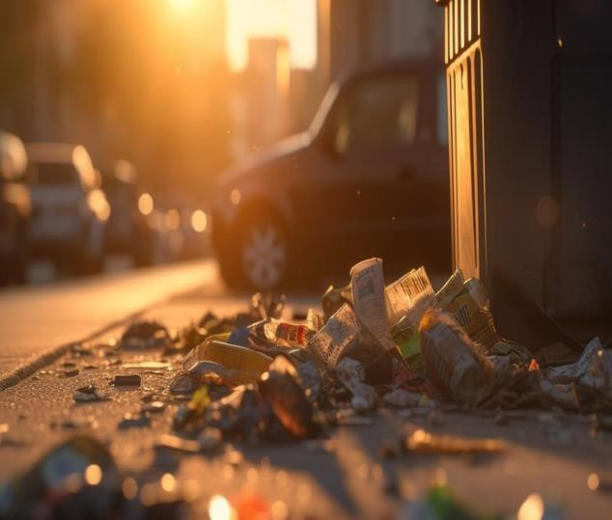
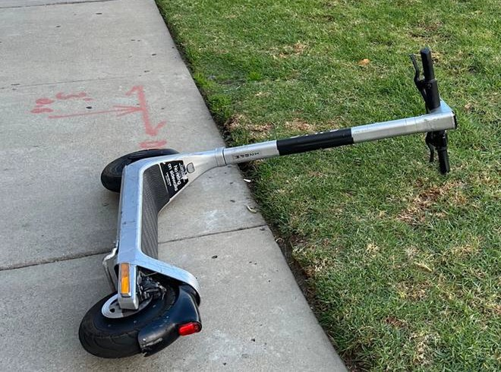

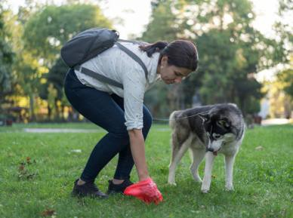
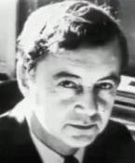
Acts of public disturbance
Littering
Abandoned vehicles
“Urban life is a series of performances … public spaces function
as a stage” (Goffman, 1959)
Defecation, urination
Situational conditions of misbehavior
What, Who, Where, When
Private pictures, Pixabay & iStock

Slide 3
The pandemic changed our movement patterns
Activities in parks and green areas increased, around basic services, small local squares, and close to outdoor serving locations (Legeby et al., 2022)
Did the intensification of activities in these spaces translate into an increase in acts of public disturbance?

Slide 4

Acts of public disturbance
Urination and defecation
Littering
Graffiti & physical damage (vandalism)
Abandoned cars
Poor bike parking

Slide 5
Aim of the study
Aim of the study is to investigate the level and the distribution of public disturbance acts in Stockholm before and after the recommended stay-at- home measures of the COVID-19 pandemic.
Did it change?
When/where change the most? Land use?
Crowdsourced data

Slide 6
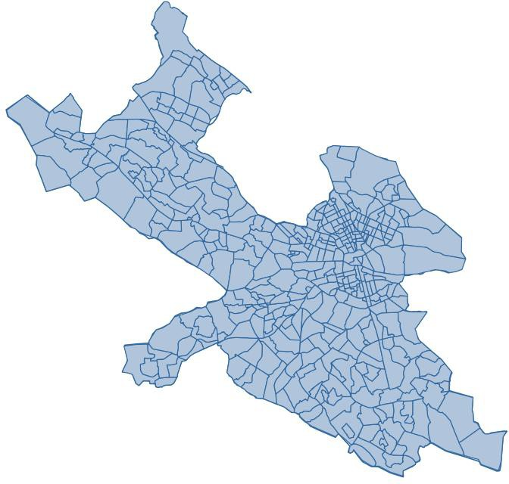
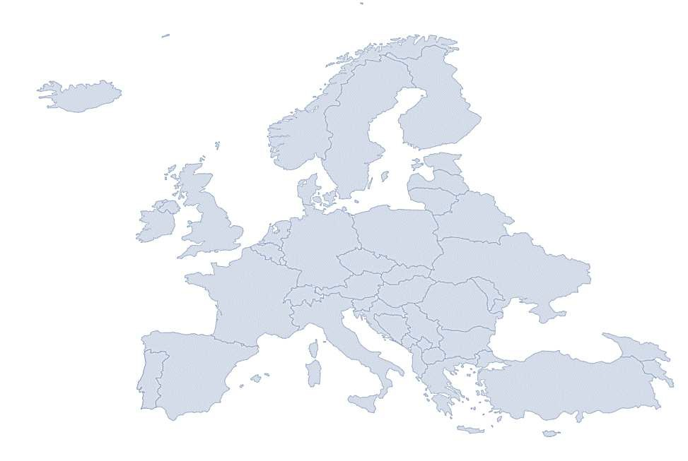
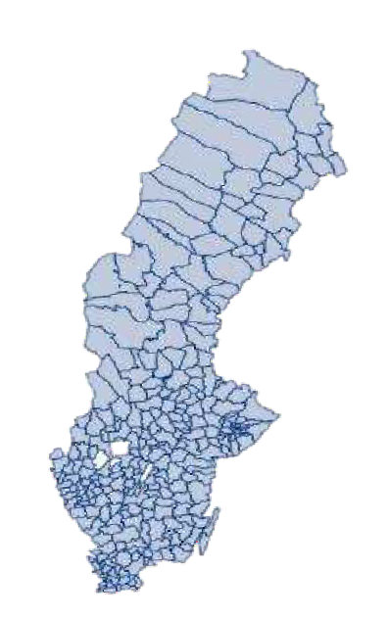
Study area
Sweden
Stockholm

Slide 7

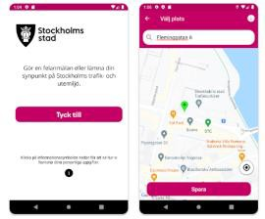



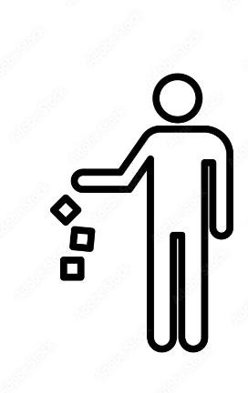










Crowdsourced records
App
littering
detection
reporting
mapping
analyzing

Slide 8
Data & methods
Data covered a total period of about 30 months (95,262)
5 types (Urine/defecation, littering, graffiti and physical damage, abandoned cars, poor bike/scooter parking)
Police recorded statistics of littering & vandalism
Before Pandemic (BP) & Post-Pandemic (PP) Temporal – SARIMAX models
Spatial – Heatmaps (Kernel density estimate) Poisson-Gamma-CAR regression models

Slide 9
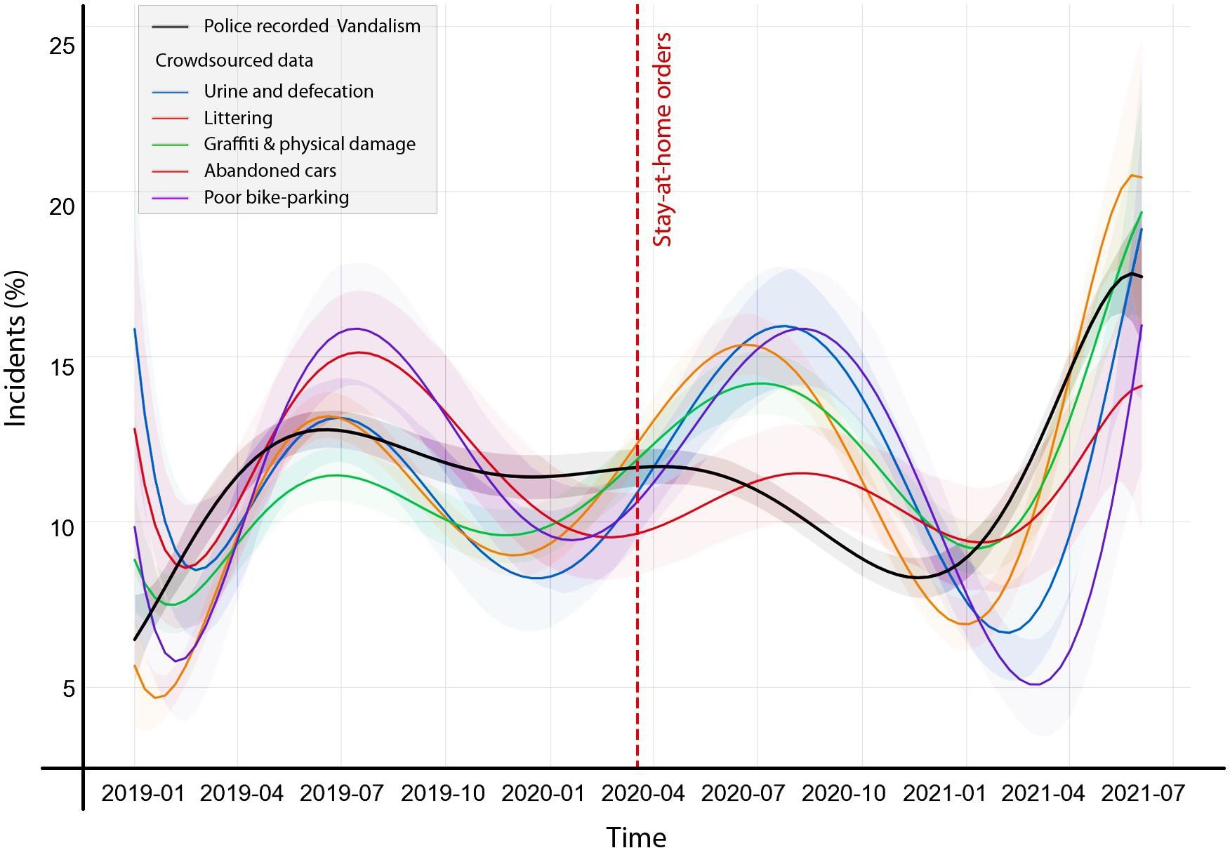
Temporal variation

Slide 10
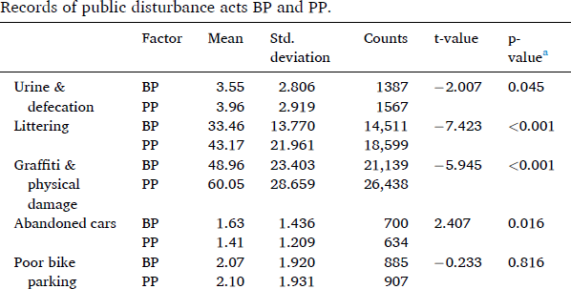
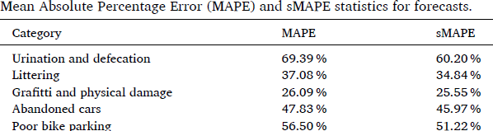
Change and temporal regularity between BP-PP

Slide 11
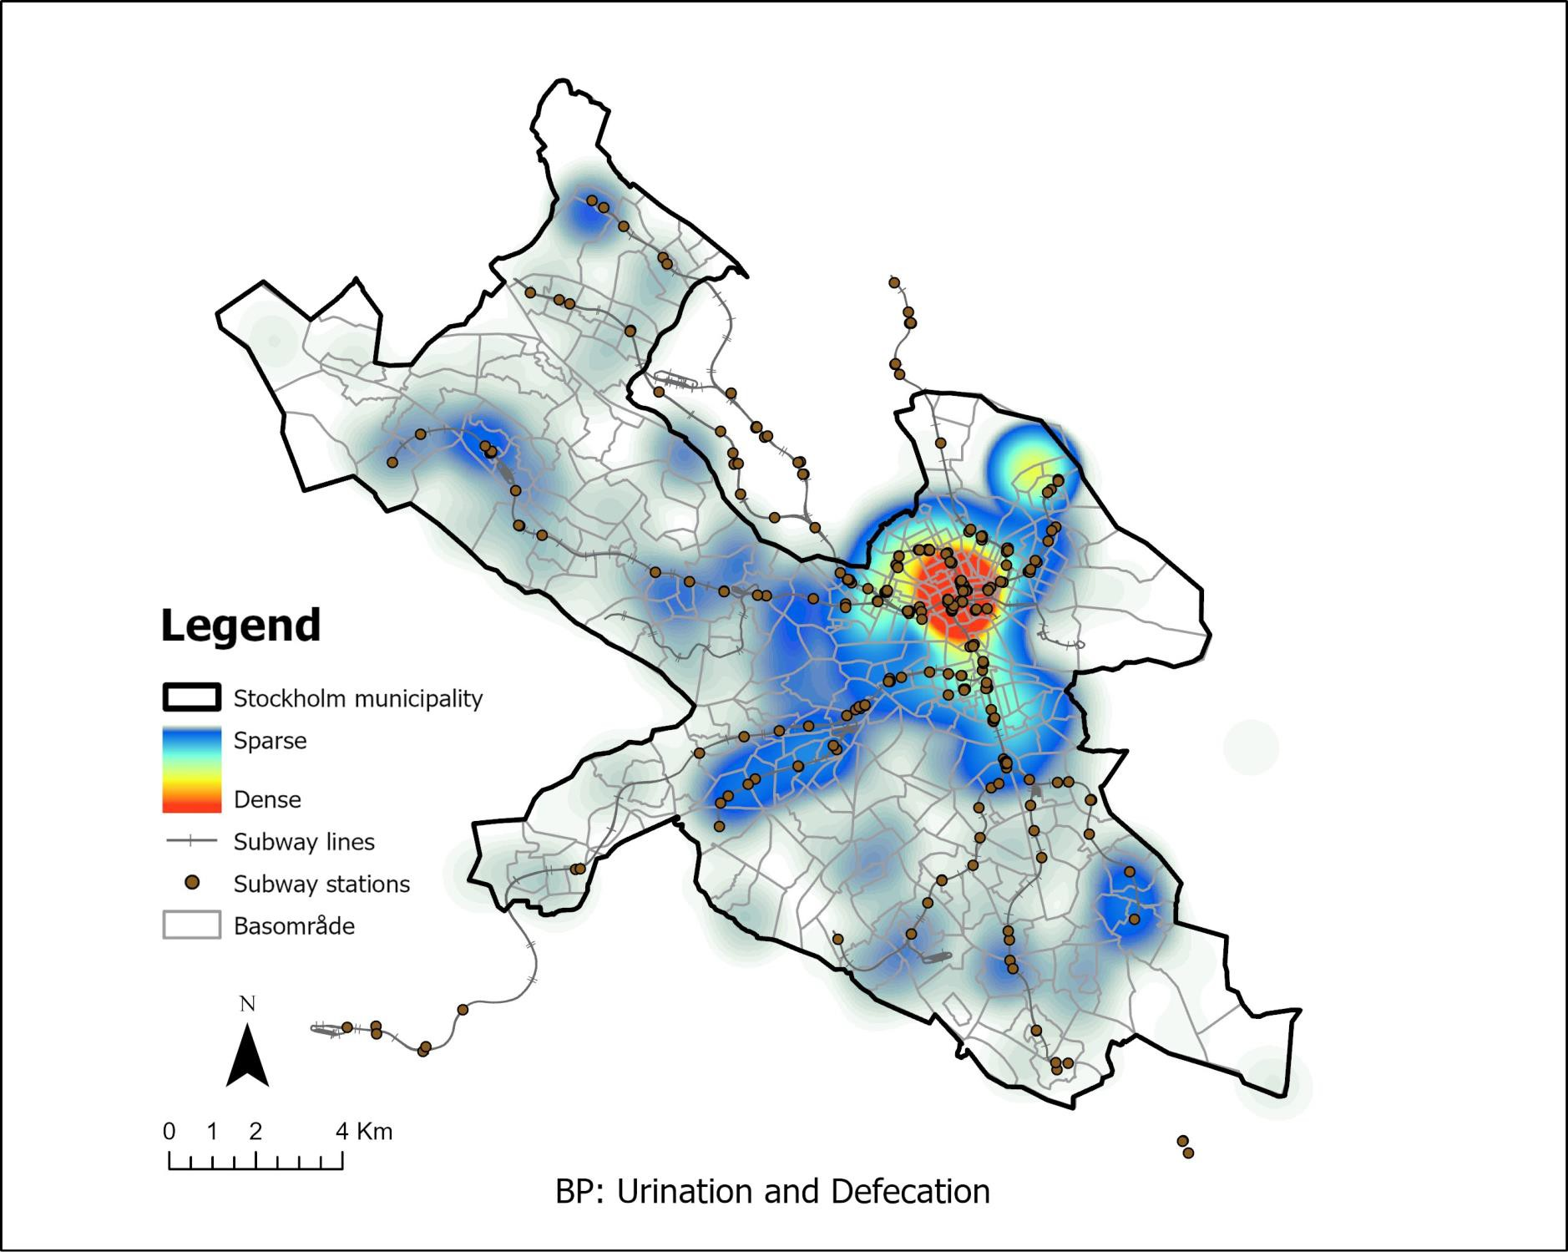
Spatial variation

Slide 12
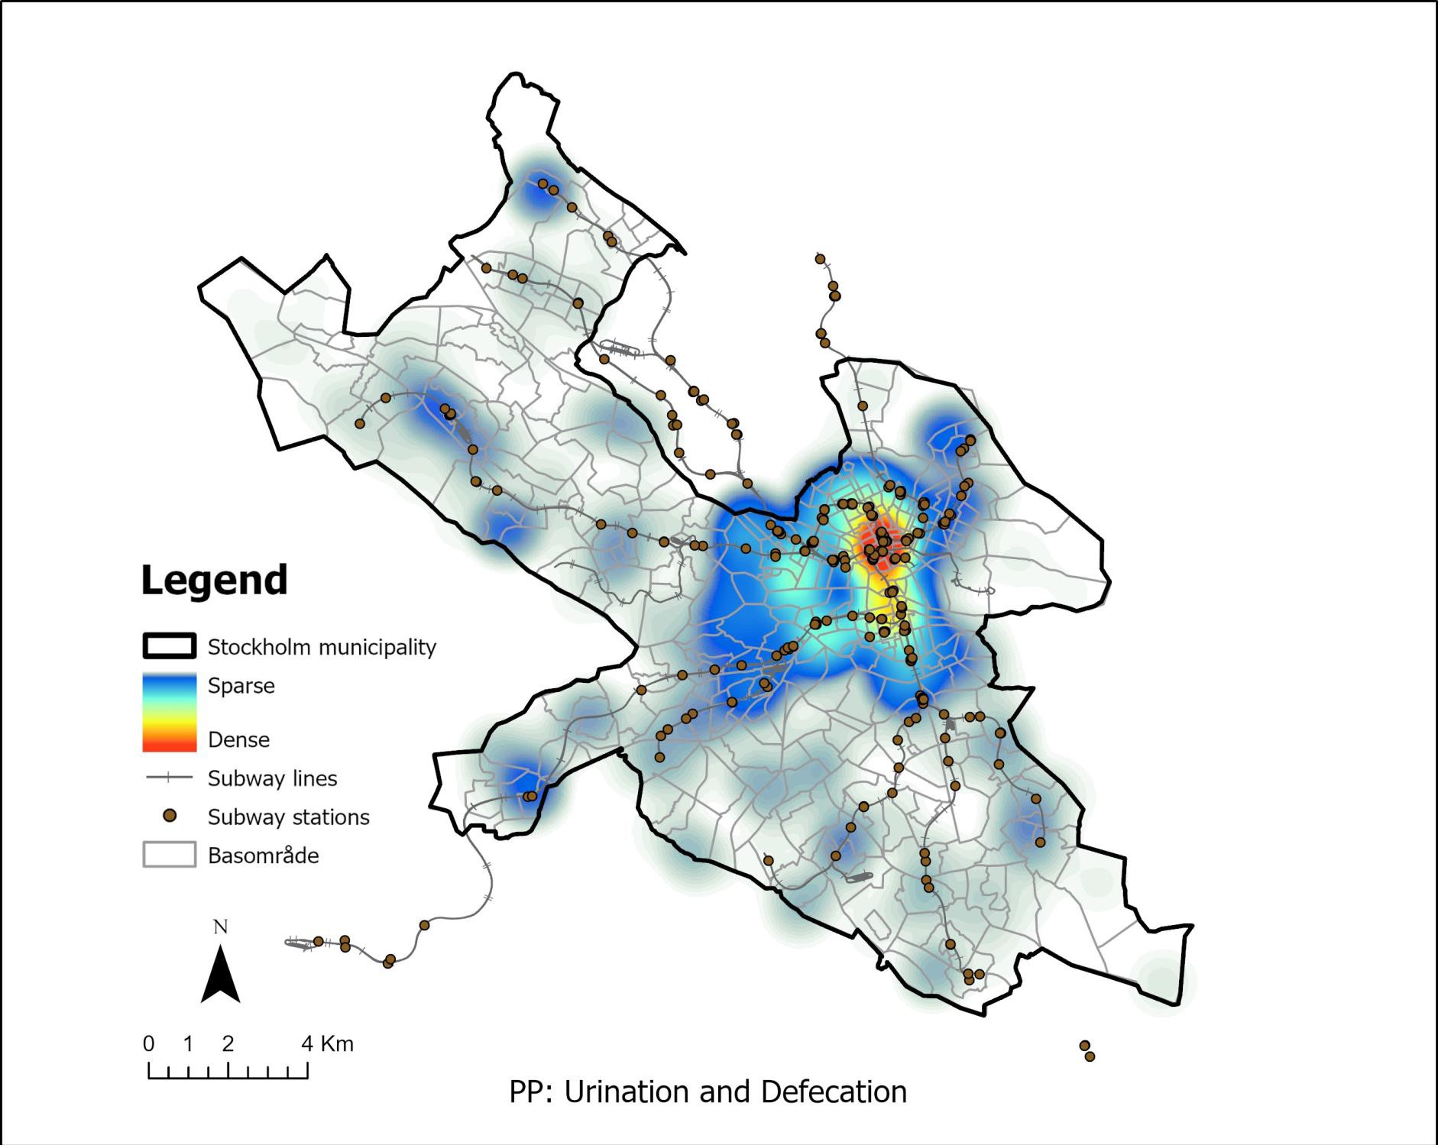
Spatial variation

Slide 13
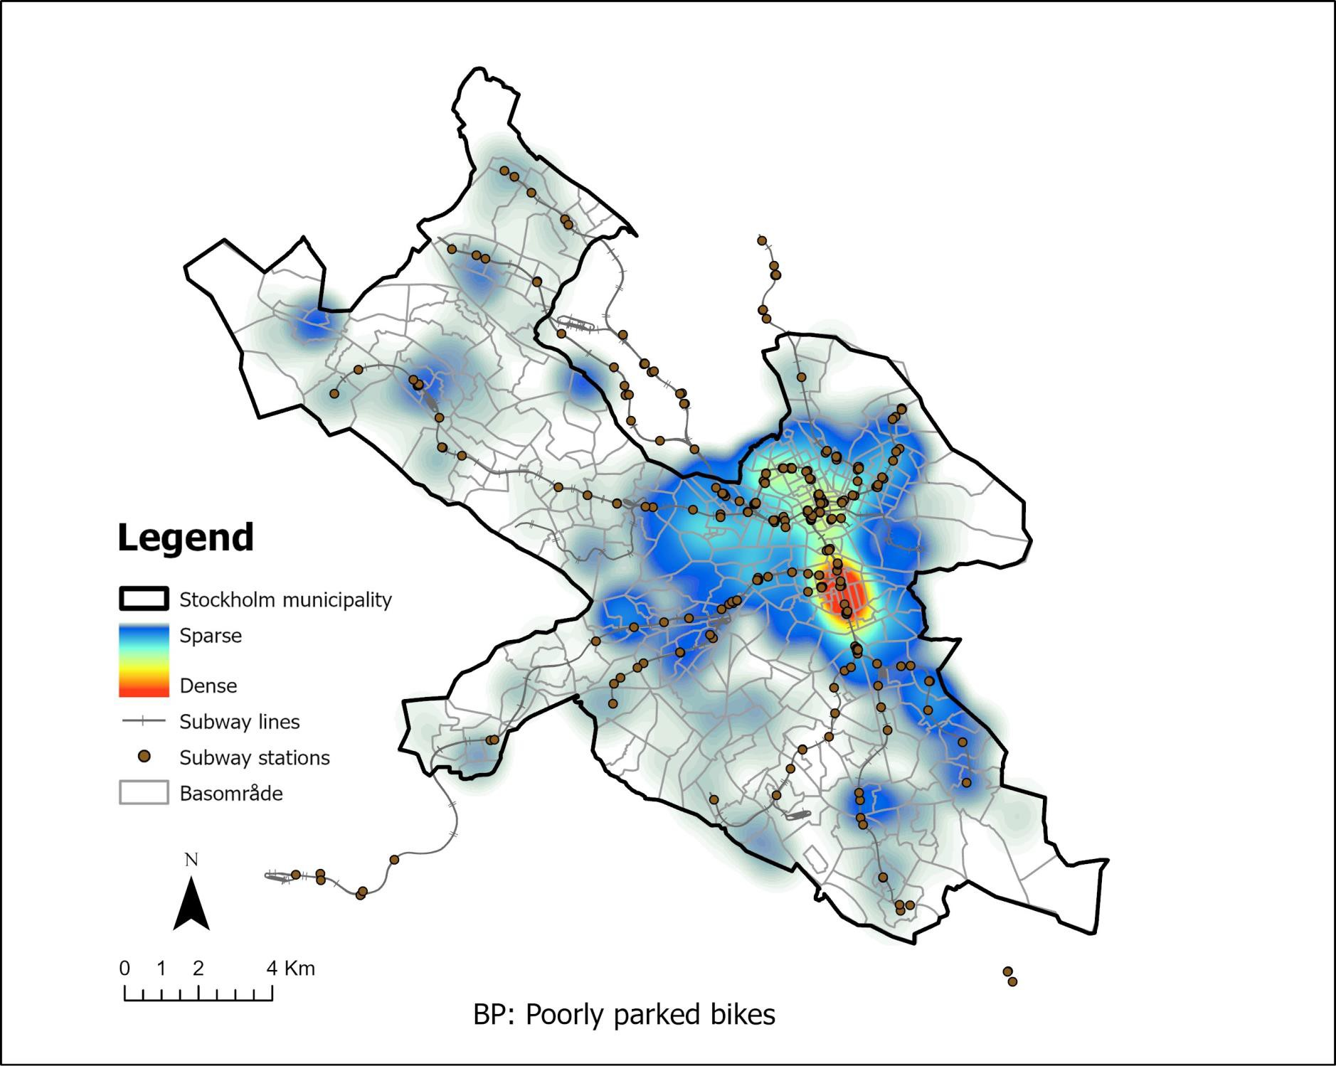
Spatial variation

Slide 14
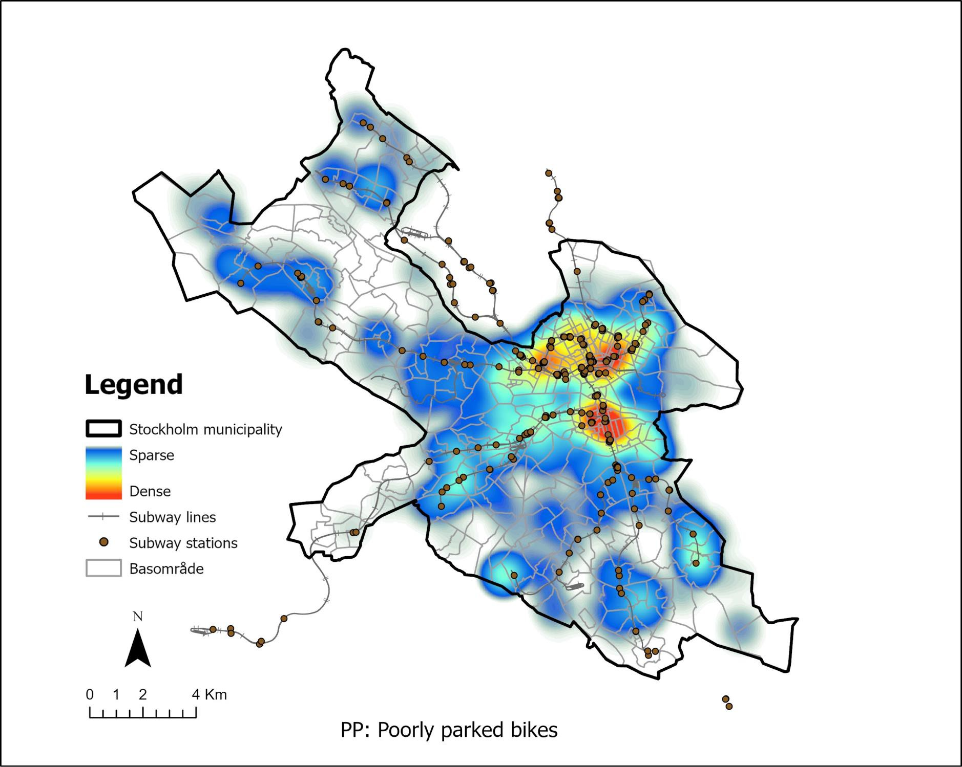
Spatial variation

Slide 15
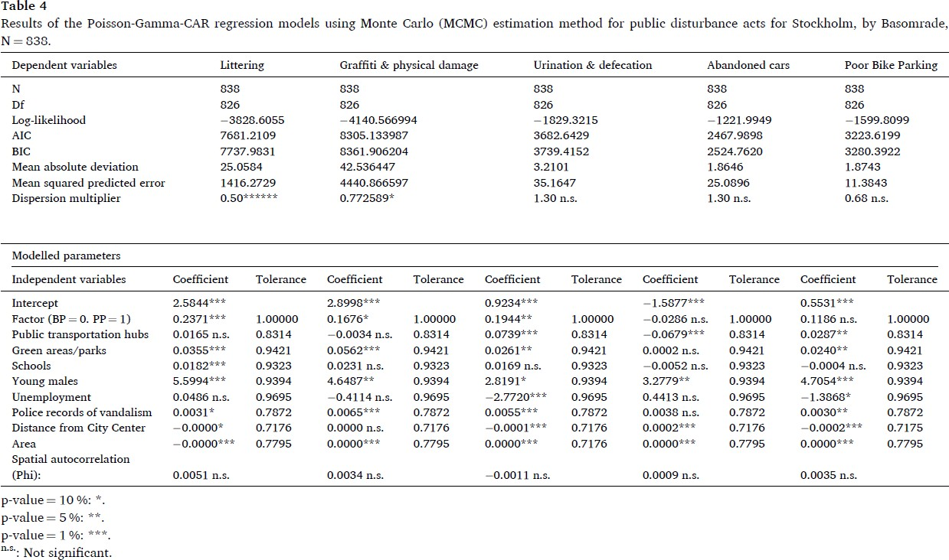
Parks, transport hubs and schools were significantly associated with public disturbances

Slide 16
Conclusion
Except for vehicle-related incidents, there was a significant increase in records of misbehavior or acts of public disturbance – changes in the geography too.
Changes in guardianship – reporting practices: unknown mechanisms
Anonymity & and willingness to report increased?

Slide 17
Use of crowdsourced data
Pros
Cons
Crowdsourced data can be when reporting practices are poor
Cost-effective and allows for community engagement
Limited control over data collection
Difference between perceptions of
incivility and the actual cases

Slide 18
Future research: situational mechanisms
“A man might urinate in a graffiti- covered alley, but would not dream of doing so in the manicured street outside an old folk's home.” (Montgomery, 2013, p. 160).

Slide 19
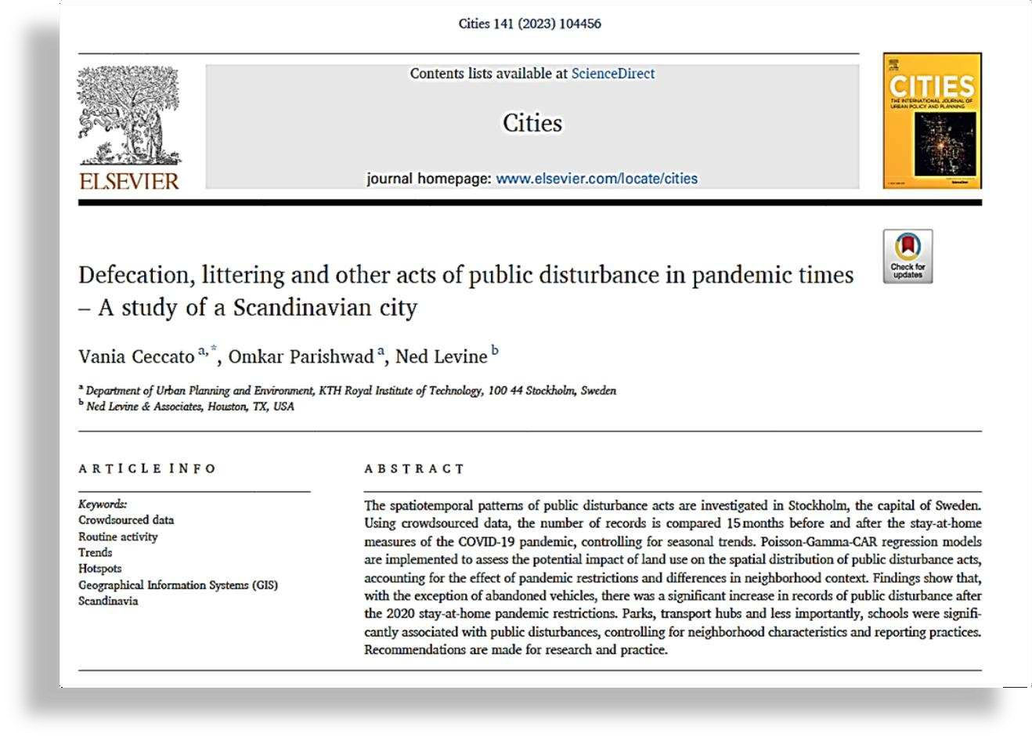
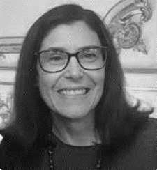

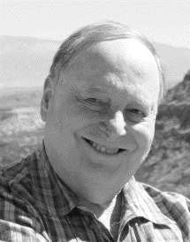
Thanks for listening!
Vania Ceccato
KTH Royal Institute of Technology, Sweden Email: vace@kth.se
Omkar Omkar Parishwad
Chalmers University, Sweden
Ned Levine
Ned Levine & Associates, USA

