Slide 1


CAR INSURANCE
PREMIUM
OPTIMIZATION MODEL

Slide 2
OVERVIEW
KEY BUSINESS ISSUESS
STRATEGIC OBJECTIVES
METHODS OF INSIGHTS DISCOVERY
VISUAL ANALYSIS AND FINDINGS
SUMMARY & STRATEGIC RECOMMENDATIONS
TABLE OF CONTENTS

Slide 3
OVERVIEW
Welcome to our project on optimizing the car insurance premium pricing model. Currently, our company uses a generic approach to determine insurance premiums, which fails to consider the unique characteristics and behaviors of individual customers. This lack of personalization has led to mismatched pricing—some customers are overcharged, while others are undercharged. As a result, we face growing customer dissatisfaction and a weakening competitive position.
To tackle these challenges, this project will create a more refined and personalized premium pricing model using data on individual characteristics like income, marital status, gender, education, job, travel time, car use, mileage, vehicle type, car age, city, and region. This approach aims to improve pricing accuracy, enhance customer satisfaction, and boost our competitive edge in the insurance market.

Slide 4
KEY BUSINESS ISSUES
The car insurance company’s current generic pricing model fails to account for individual customer risk factors, leading to inaccurate premiums, customer dissatisfaction, and loss of competitiveness. The company seeks to develop a personalized pricing model using data on demographics, driving habits, and vehicle details to better reflect customer risk and improve pricing accuracy.
Outdated Pricing Model
Issue: The current model doesn’t consider individual customer risks.
Result: Inaccurate premiums, causing customer dissatisfaction.
Poor Customer Satisfaction
Issue: Premiums don’t reflect actual driving behavior or risk.
Result: Customers feel overcharged, leading to high churn.
Falling Behind Competitors
Issue: Competitors use personalized pricing, while the company sticks to a generic model.
Result: Loss of market share and new customers.
Inaccurate Risk Assessment
Issue: Key factors like mileage and location aren’t considered in pricing.
Result: Misjudging risk, leading to financial losses.
Revenue and Profit Impact
Issue: Incorrect pricing reduces profitability.
Result: Lost customers and higher claims payouts.
Untapped Data Potential
Issue: The company has valuable data that isn’t being fully used.
Result: Missed chances for better pricing and higher profits.

Slide 5
STRATEGIC OBJECTIVES
The new Excel dashboard will improve customer satisfaction by providing clear insights for fair and competitive pricing, while ensuring profitability through accurate risk assessment. It will identify trends that better predict claims and losses, enabling appropriate premium adjustments. This dashboard will enhance decision-making, boost market competitiveness, and reduce customer dissatisfaction from mispriced policies.
Increase Customer Satisfaction
Provide clear information to offer fair and competitive prices for insurance policies
Adjust Premiums Based on Data
Help the company set the right premiums by showing patterns in the data, avoiding overpricing or underpricing.
Support Better Decision-Making
Make it easier for the company to make informed decisions with simple, easy-to-understand insights.
Stay Competitive
Use accurate pricing to stand out in the market and offer better value to customers.
Ensure Company Profitability
Help the company maintain profits by aligning pricing with accurate risk assessments.

Slide 6
Understanding of the data
Data Cleaning
Data Modelling
Data Analysis
Uncover Insights
METHODS OF INSIGHTTS
DISCOVERY

Slide 7
VISUAL ANALYSIS AND FINDINGS

Slide 8
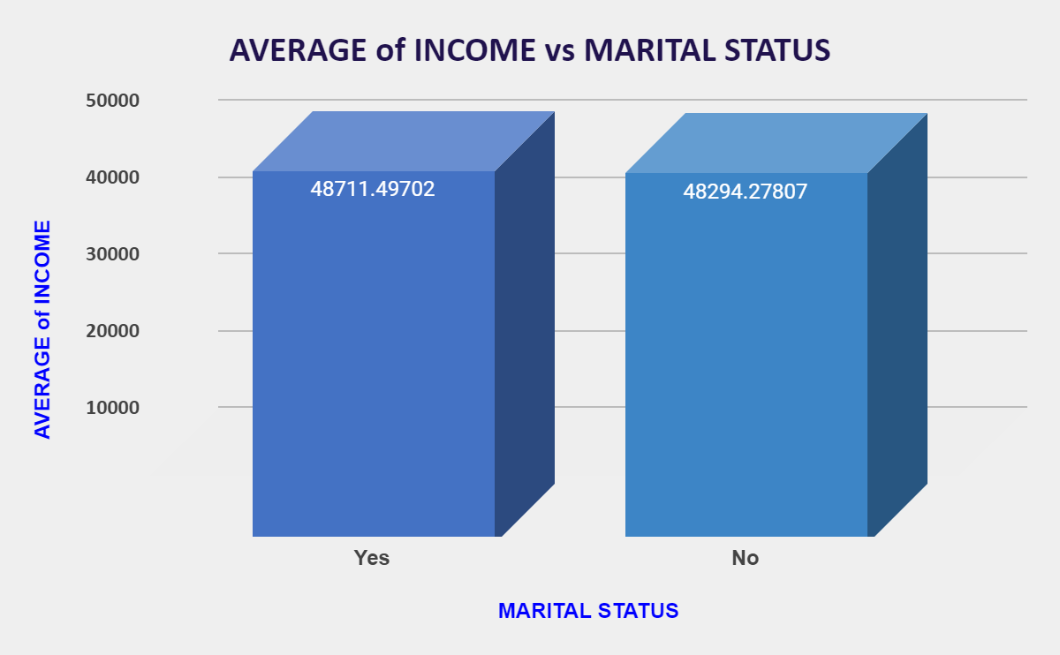
People who are not married earn an average of 48,294.27, slightly less than married individuals.
Married individuals have an average income of 48,711.49, which is only 780.34 higher than those who are not married.

Slide 9
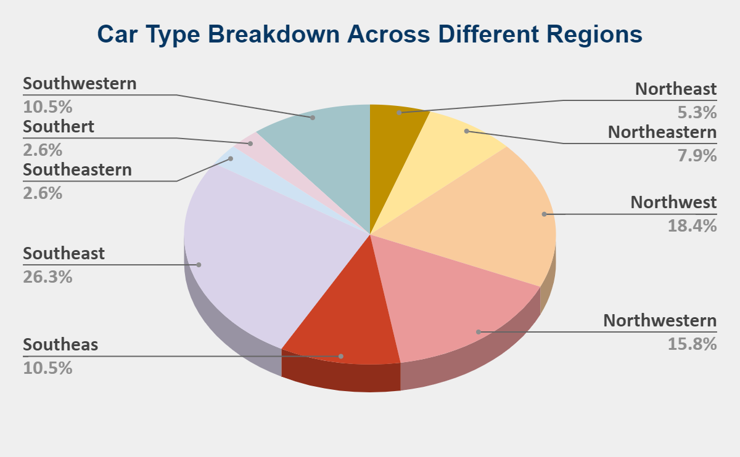
The Southeast region has the highest car type count (67), followed by the Northwestern region with 61.
These two regions make up a significant portion of the total car types, suggesting either larger populations or greater car variety.
Northwestern and Southwest show high variety in car types, making them ideal for diverse product offerings.
Southeast shows a balanced distribution across multiple car types, indicating a well-rounded market for most car categories.

Slide 10
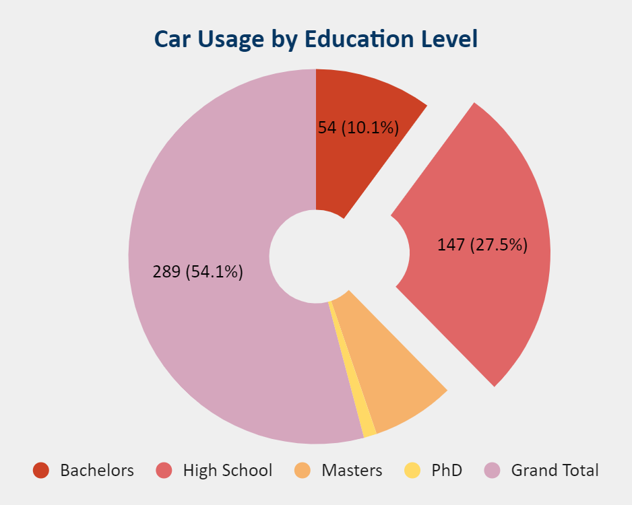
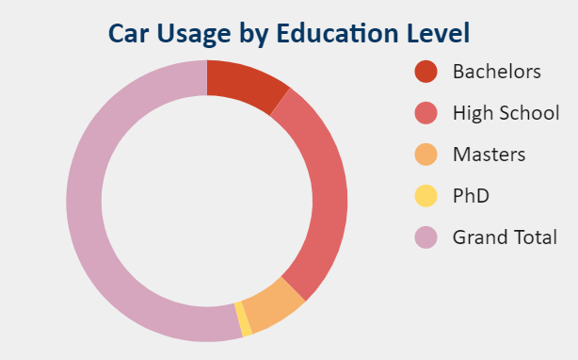
The largest portion of users 147 out of 289 , have a high school education. This suggests the majority of users may value accessible, practical solutions over highly specialized or academic offerings.
10.1% (54 users) hold a bachelor’s degree, a sizable group that may lean toward products or services requiring more technical knowledge or professional skills.

Slide 11
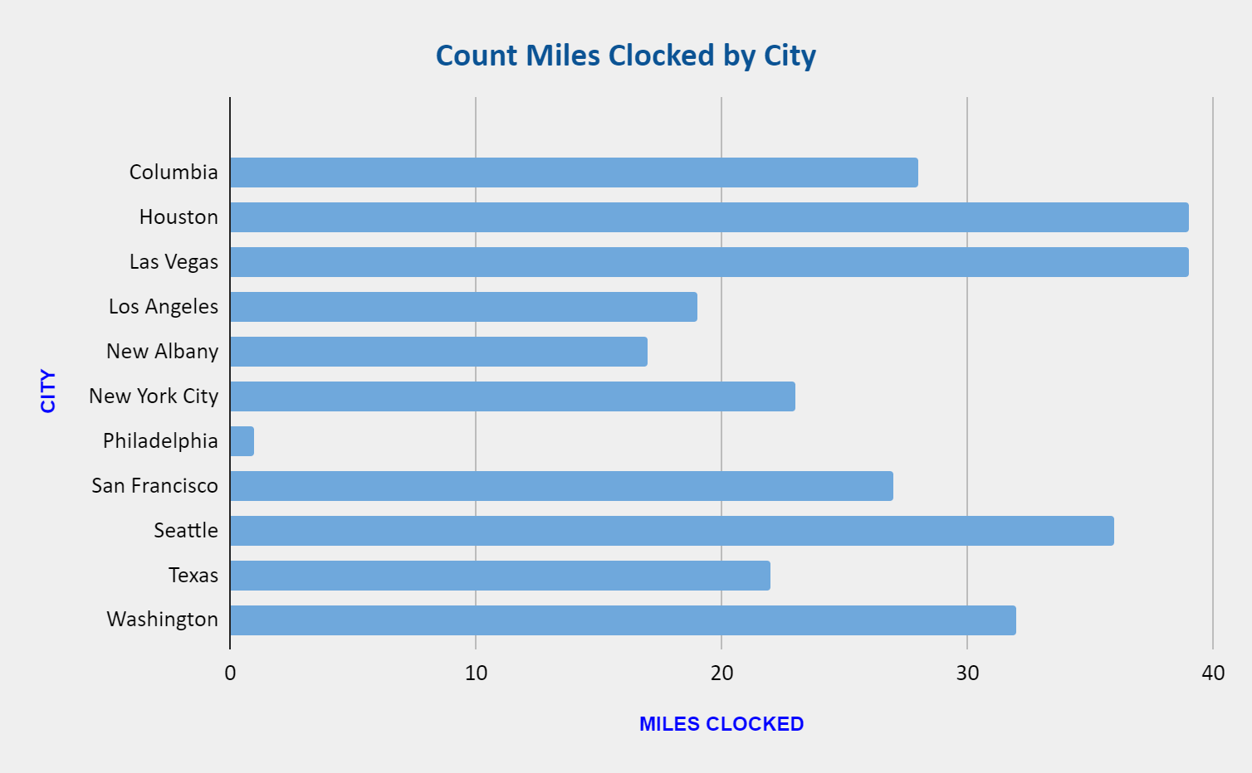
Houston and Las Vegas top the list with 39 miles each, indicating high levels of activity or transportation needs in these cities. This suggests these cities might benefit from services related to vehicle maintenance, fuel, or travel efficiency solutions.
San Francisco clocks 27 miles, while Columbia has 28 miles, representing mid-range cities in terms of usage.
New Albany (17 miles) and Philadelphia (1 mile) have much lower recorded miles, possibly indicating lower transportation demand or engagement.

Slide 12
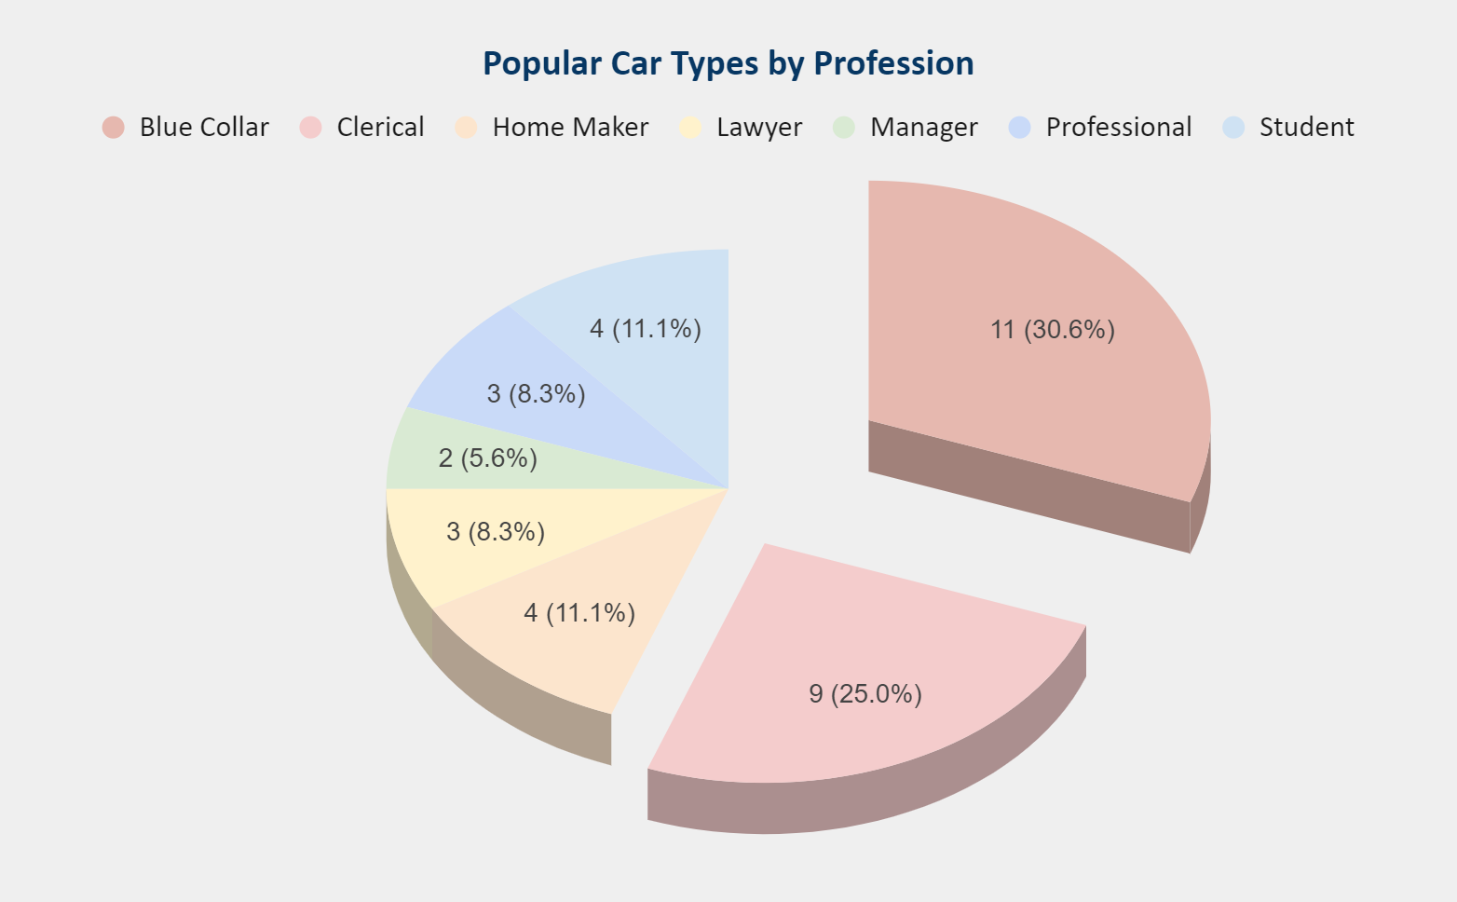
SUVs account for 32% of all vehicles, with 93 total. This suggests that SUVs are the preferred vehicle type across most job categories, particularly for Blue Collar (24 SUVs) and Home Makers (16 SUVs).
Panel trucks have limited popularity, with only 23 total users, concentrated in Blue Collar and Professional categories.

Slide 13
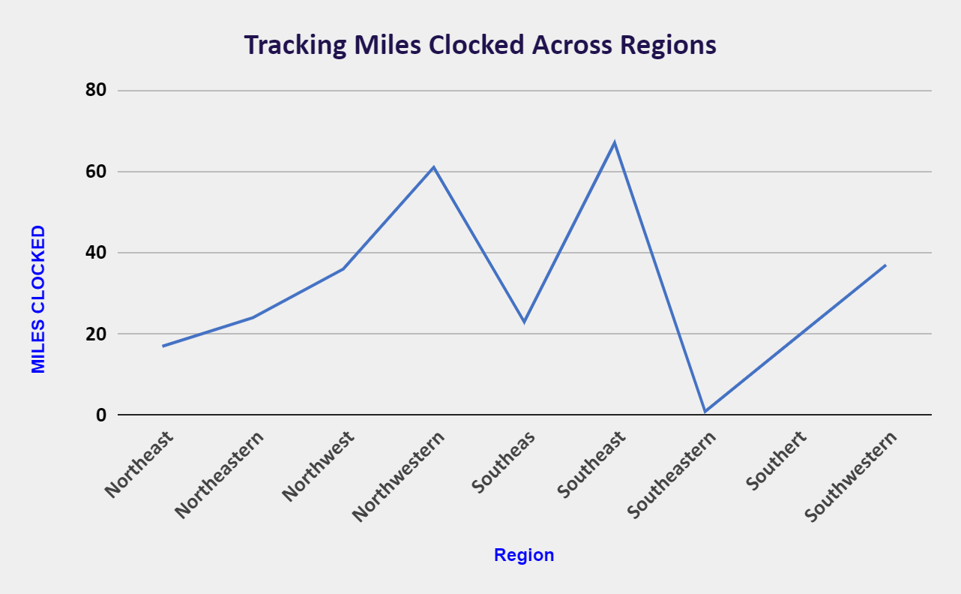
Southeast has the highest mileage with 67 miles, indicating the highest level of activity or transportation needs.
Northwest clocks 36 miles, and Southwestern records 37 miles. Both regions have moderate activity levels.
Northeastern (24 miles), Southeas (23 miles), Southert (19 miles), and Southeastern (1 mile) show lower mileage, with Southeastern being significantly lower.

Slide 14
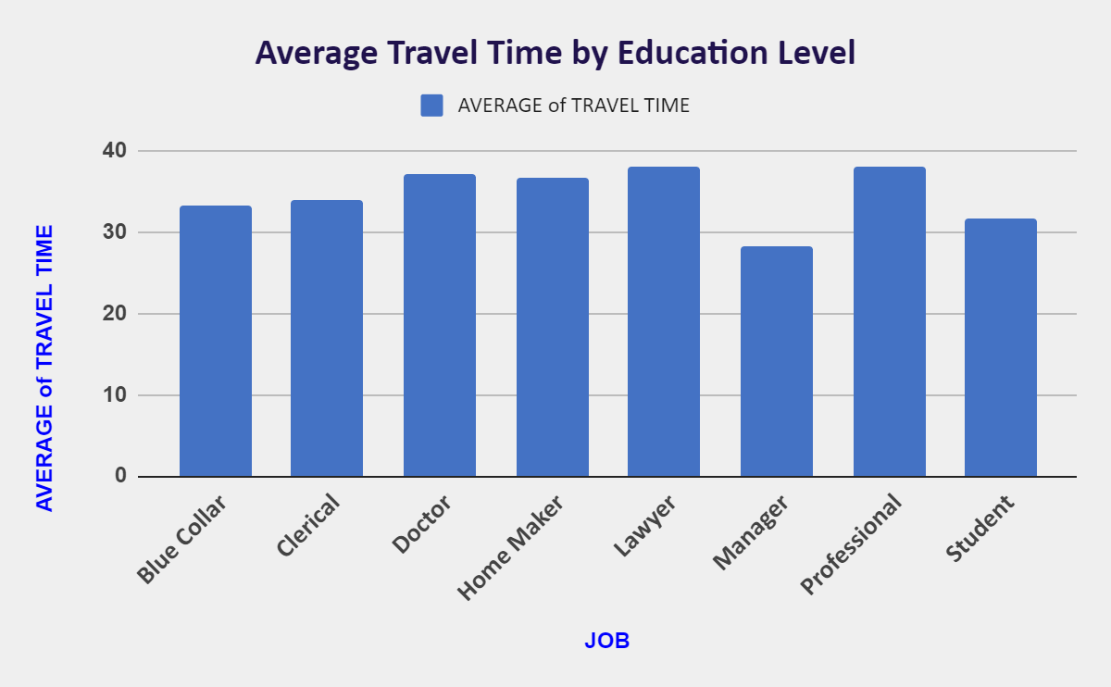
Display average travel times on the Y-axis and job categories on the X-axis. Use columns to represent each job type and their average travel times.
Highlight the highest travel times for Lawyers and Professionals and the lowest for Managers.
Blue Collar workers average 33.24 minutes, and Students average 31.74 minutes, indicating relatively shorter commutes.

Slide 15
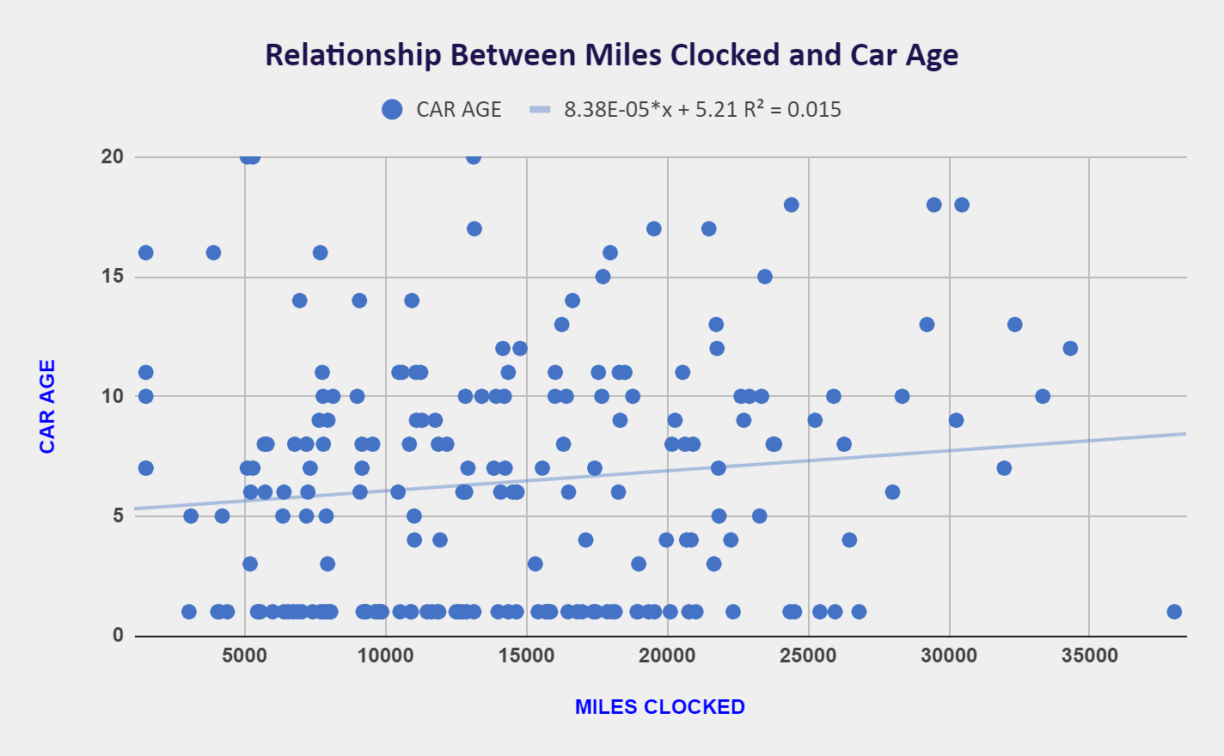
The x-axis represents Miles Clocked (total miles driven by the car).
The y-axis represents Car Age (age of the car in years).
Each point on the scatter plot represents a single car, with its position indicating its mileage and age.
Trendline slopes upward from left to right, it indicates that as Miles Clocked increases, Car Age also tends to increase.
This suggests that cars with higher mileage are generally older. This could be because older cars are likely to have accumulated more miles over time.

Slide 16
Focus on marketing SUVs and pickups primarily to blue-collar workers, homemakers, and students, as these groups show the most interest in these vehicle types.
Implement strategies to boost engagement in regions with lower mileage, such as Southeastern and Southert, through localized promotions and targeted campaigns.
Offer practical and cost-effective solutions for jobs with shorter commutes, including Managers and Students.
Provide products and services that cater to long commutes for jobs with high average travel times, such as Lawyers and Doctors.
scatter plot shows no clear pattern or a downward trend, it could suggest that older cars are driven less, or they are replaced with newer models more frequently, hence they have fewer miles.
RECOMMENDATIONS

Slide 17
PARITA HIRPARA
Parita.hirpara1496@gmail.com
THANK YOU

