Slide 1
Reflection of National Culture IN govt. hospital
HS490: Course Project
Yash Paritkar Roll Number: 210070096
Instructor: Prof. Pooja Purang

Slide 2
Introduction to National Culture
What is Culture?
National Culture
Hofstede’s Study on National Culture

Slide 3
What is Culture?
Culture is collective programming of the mind which distinguishes the member of one social group from another. -Greet Hofstede

Slide 4
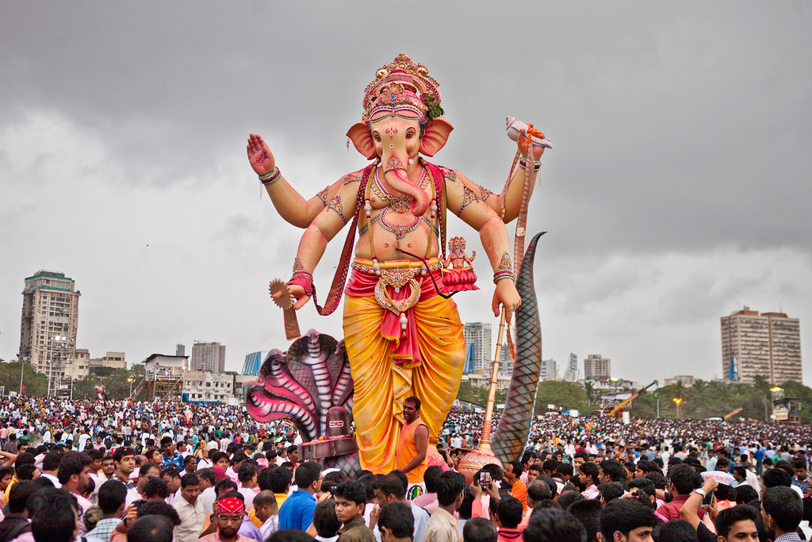
Ganesh Visarjan
Popular Festival in Maharashtra
This Photo by Unknown Author is licensed under CC BY-NC-ND

Slide 5
What is Culture?
Culture refers to the shared
Beliefs
Values
Customs
Behaviours
Artefacts
Culture is characterized by
Symbols
Language
Values
Beliefs
Norms

Slide 6
National Culture
National culture refers to the shared beliefs, values, customs, behaviours, and artefacts that characterize a particular country or nation.

Slide 7
National Culture
It affects daily lives via
Society
Business
Education
Government
Social Interaction
It is affected by
History
Geography
Religion
Language
Political System

Slide 8
Hofstede’s Study on National Culture
•Greet Hofstede was one of the first to attempt to analyse people according to their nationalities.
•He executed and analysed the survey of national values on a large sample of 1,17,000 IBM employees
•After this, he proposed his famous Cultural Dimensional Theory

Slide 9
Hofstede’s cultural dimensions theory
His cultural dimension theory includes six dimension
Individualism vs Collectivism
Uncertainty avoidance
Power Distance
Masculinity - Femineity
Long-Term Orientation
Indulgence vs Self-Restraint

Slide 10
National Culture of India
Introduction
Hofstede's Research on National Culture of India

Slide 11

Image representing popular art and festival of India
Image Source: https://www.bing.com/images/blob?bcid=S4OFbb.QtncF5MxAlMJCUd.1Ns4I.....4Q

Slide 12
Introduction
India’s national culture is distinctive. India has been thriving since primordial times. In many aspects, India is an unique nation,
Existence since ancient times
Varying weather, landforms and large area
Widespread and exhaustive practice of religion
Thousands of years of external invasion
250+ years of slavery
This features bestow India a unique culture.

Slide 13
Hofstede's Research on National Culture of India
Hofstede's research on national culture sheds light on the complex and diverse cultural landscape of this nation.

Slide 14
Cultural dimensions scores for India
Index | India | World Average
Power Distance | 77 | 56.5
Long-Term Orientation | 61 | 48
Masculinity | 56 | 51
Individualism | 48 | 40
Uncertainty avoidance | 40 | 65

Slide 15
Key Findings
People appreciate vertical hierarchy, and acceptance of un-equal rights is high.
Indians value thrift and perseverance, they have a high amount of respect for tradition, and they do tend to manipulate things for immediate success
India is not equally masculine in all characteristics.
Indians generally associate themselves with certain groups and assign a high status to those in the group
India is traditionally a patient country where tolerance for the unexpected is high, even welcomed as a break from monotony.

Slide 16
Assessment of Reflection of National Culture of India in Government Hospital
Why survey a Government Hospital?
Need for Survey
Choosing the Sample Set
Creating a Questionnaire
Analysing the Survey

Slide 17
Why survey a Government Hospital?
Surveying a government hospital can be a helpful way to reflect on the national culture of a country for several reasons.
Govt hospitals provide healthcare services to a large section of the population, including the vulnerable and marginalized sections.
the government hospitals are managed by the government, and hence they have to follow government regulations and policies
The hospital also offers a unique blend of employees, from well-trained and educated doctors to a sweeper who is 10th pass, offering a wide range of perspectives.

Slide 18
Need for Survey
In order to assess any information, a proper survey needs to be done. Surveys are a valuable tool for collecting data and measuring cultural values and practices. By analyzing patterns and trends in the data collected by the survey, one can reach good conclusions which form the basis of any study.

Slide 19
Choosing the Sample Set
Sample size of good number and quality
Govt hospital typically has a working staff of about 80 employees, we need to interview about 20
Also, in any given organisation, the role of the employee and his/her vertical position in the hierarchy can affect the answers
Hence we should have people from multiple categories.
After considering the accessibility to conduct a survey, the District Government Hospital, Jalna, Maharashtra- 431213, was selected.

Slide 20
Creating a Questionnaire
A good questionnaire is essential for collecting accurate and relevant data in any research project
A well-designed questionnaire helps to ensure that the information collected is reliable, valid, and free from bias.
Without a well-designed questionnaire, the data collected may be inaccurate or incomplete, leading to flawed conclusions and recommendations
The questionnaire used in this assessment was made by studying the book on Organisational Behavior by Robbins and reading various websites containing national cultures. And it was reviewed by persons from different positions to provide multiple perspectives.

Slide 21
Analysing the Survey
Analyzing the survey is an important step in any research project, as it helps to identify patterns and trends in the data collected
The first step in analyzing the survey is to clean and organize the data, removing any errors or inconsistencies that may have arisen during data collection
This was done with utmost care with the help of modern software such as Microsoft Excel and using various graphs and charts.

Slide 22
The Survey
Survey
Composition of Questionnaire

Slide 23
Survey
Designing of Survey
The Survey was designed as Google Form
The questions were made after studying various sources
The survey was kept brief while still including the most important questions.
Conduction of Survey
The link to the Google Form was floated in the group of Civil Hospital, Jalna
In total 19 responses were obtained
Link to the survey:
https://drive.google.com/file/d/1fBm0hNM2xrKJiMaiN55BHcJJa5gY-k8D/ view?usp=share_link

Slide 24
Composition of Questionnaire
The questionnaire consisted of 8 sections, The sections were made according to the dimension of the culture they were trying to enquire about.
Introduction
Display of emotions
Meetings
Pattern of context
Achievement or Ascription based
Long-Term Orientation
Individualistic or Collectivistic
Control vs Subjugation

Slide 25
Composition of Questionnaire
The questions were of different types
simple factual agree-disagree questions
multiple choice types
true-false types
The option of the custom answer was kept available in many questions as the given options may not be there. Finally, after each section, an optional question to add any comment was incorporated to make sure to collect any specific input any employee might want to give. The questionnaire of the survey can be found in this link

Slide 26
Analysis of the Survey
Step by Step analysis of each parameters

Slide 27
Analysis of the Survey
The next few slides goes through the
The full responses of the form can be seen here:
Survey Responses
https://docs.google.com/spreadsheets/d/13JBPbaedCzGmHHtawIFe-Poizsp84CtahEr07WUdKAw/ edit?usp=sharing

Slide 28
Analysis of the Survey
Introduction:
This section is there just to know the responder and his role in the organisation
This section verified the diversity of the responders with some being nurse, some assistants and some officer

Slide 29
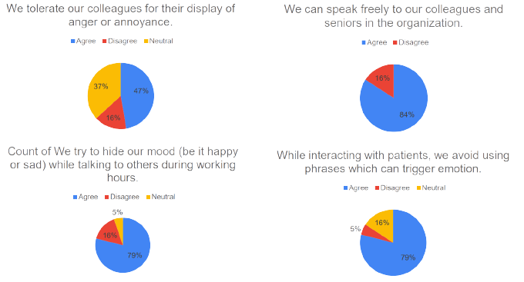
Display of Emotions
The objective of this section was to test how freely the people can express themselves.
Everyone agrees about being able to express emotion in the employee circle
Only half of them agree about being tolerant of the others when they express their feelings.
They try to hide their mood while speaking to patients and others.

Slide 30
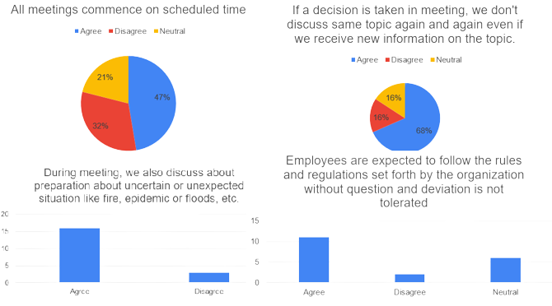
Meetings
This section try to cover official handling of the organisation regarding the procedure of the meeting Just like in typical poly synchronous culture, the meetings tend to get delayed
Same topic is not repeated again and again denies total poly synchronism
Unlike the typical view of India, the hospital is indeed seen as well prepared

Slide 31
Pattern of the context & Achievement or Ascription based
Pattern of the context
Among all the factors which affect the course of action, the position of senior affect most
The responses had a about half ( 52%) the votes. This strengthens the Hofstede's claim on high power distance
Achievement or Ascription based
This section tests how the employees are rewarded for their good work
Half of the responders agree that actual performance is the metric of their judgement
Half believe that position and people in association make a more significant impact

Slide 32
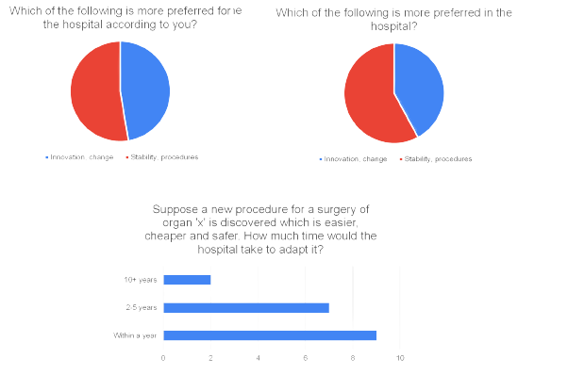
Long-Term Orientation
These questions try to ask how the goals of the organisation are with respect to time; they are short-term or long-term
For the first two questions, both have a narrow majority as stability and procedures. This symbolizes the fact that the hospital is looking for long-term goals
Even while this is true, 90% of the participants agreed that the hospital is pretty fast to incorporating new technology in the medical field

Slide 33
Individualistic or Collectivistic
When it comes to responsibility for both success and failure, the majority (60% and 50%) voted it is shared between the team.
A point to note is that, amongst other options, when the matter of success came in, the responsibility of management was rated higher.
This is a typical trait of a collectivistic organisation.
Responsible | Success | Failure
Head | 5 | 4
Management | 5 | 1
Whole Team | 11 | 8

Slide 34
Control vs Subjugation and communication
Control vs Subjugation
In the last section of the form, questions related to control and communication were asked
When it comes to controlling, unlike the typical perspective, the employees felt that the power is not centralized to the head, and others also have some say in decision-making, along with the fact that the conflicts are generally solved internally
Communication
We can also see the mode of communication sliding towards online communication, such as WhatsApp
Interestingly, the majority of the people who responded letters and emails as one of the mediums are officers at the hospital. Only 10% of respondents said that communication is not transparent which is also very fitting that it is a government hospital.

Slide 35
The Conclusion
Conclusions derived from the report

Slide 36
The Conclusion
In conclusion, the analysis of the survey conducted at Civil Hospital has provided valuable insights into the reflection of national culture in the healthcare system of the country.

Slide 37
The Conclusion
The survey reveals that the healthcare system is influenced by cultural factors in a few aspects of culture, including
Hierarchical relationships
Respect for authority
Collectivism
Meanwhile, it is not influenced strongly when it comes to certain attributes of national culture, such as
Uncertainty avoidance
Individualism

Slide 38
The Conclusion
The result of Hofstede’s study seems true here, although some characteristics are not as strongly expressed.
According to the survey, the subjugation is not very high amongst the member, and hence the power distance would be low which is not case.
The long-term orientation is still similar to what Hofstede finds.
The extent of individualism also seems lower than what Hofstede found. However, one of the reasons can be the long-term posting of employees, which might create a close family-like structure amongst the employees.
The dimension which is contrasting most is uncertainty avoidance. In general, the Indians tend to accept the uncertainty, but the hospital is also prepared for all basic uncertainties. This is probably the result of the healthcare system in which hospitals are obviously involved.

Slide 39
The Conclusion
We can see this in making a play in the recent Covid-19 pandemic.
Although it was an unpreceded event, India as a whole emerged strong from it while many advanced countries failed in such a strong response.
Every member of the team worked for a long duration, and the whole team was awarded.
Still, we should keep in mind that the sample size used is only one hospital. Hence it should not be generalized to all the hospitals in this vast country of 3.92 km² area.

Slide 40
Thank you
Link to the Report:
https://tinyurl.com/5n8asuzd

