Slide 1



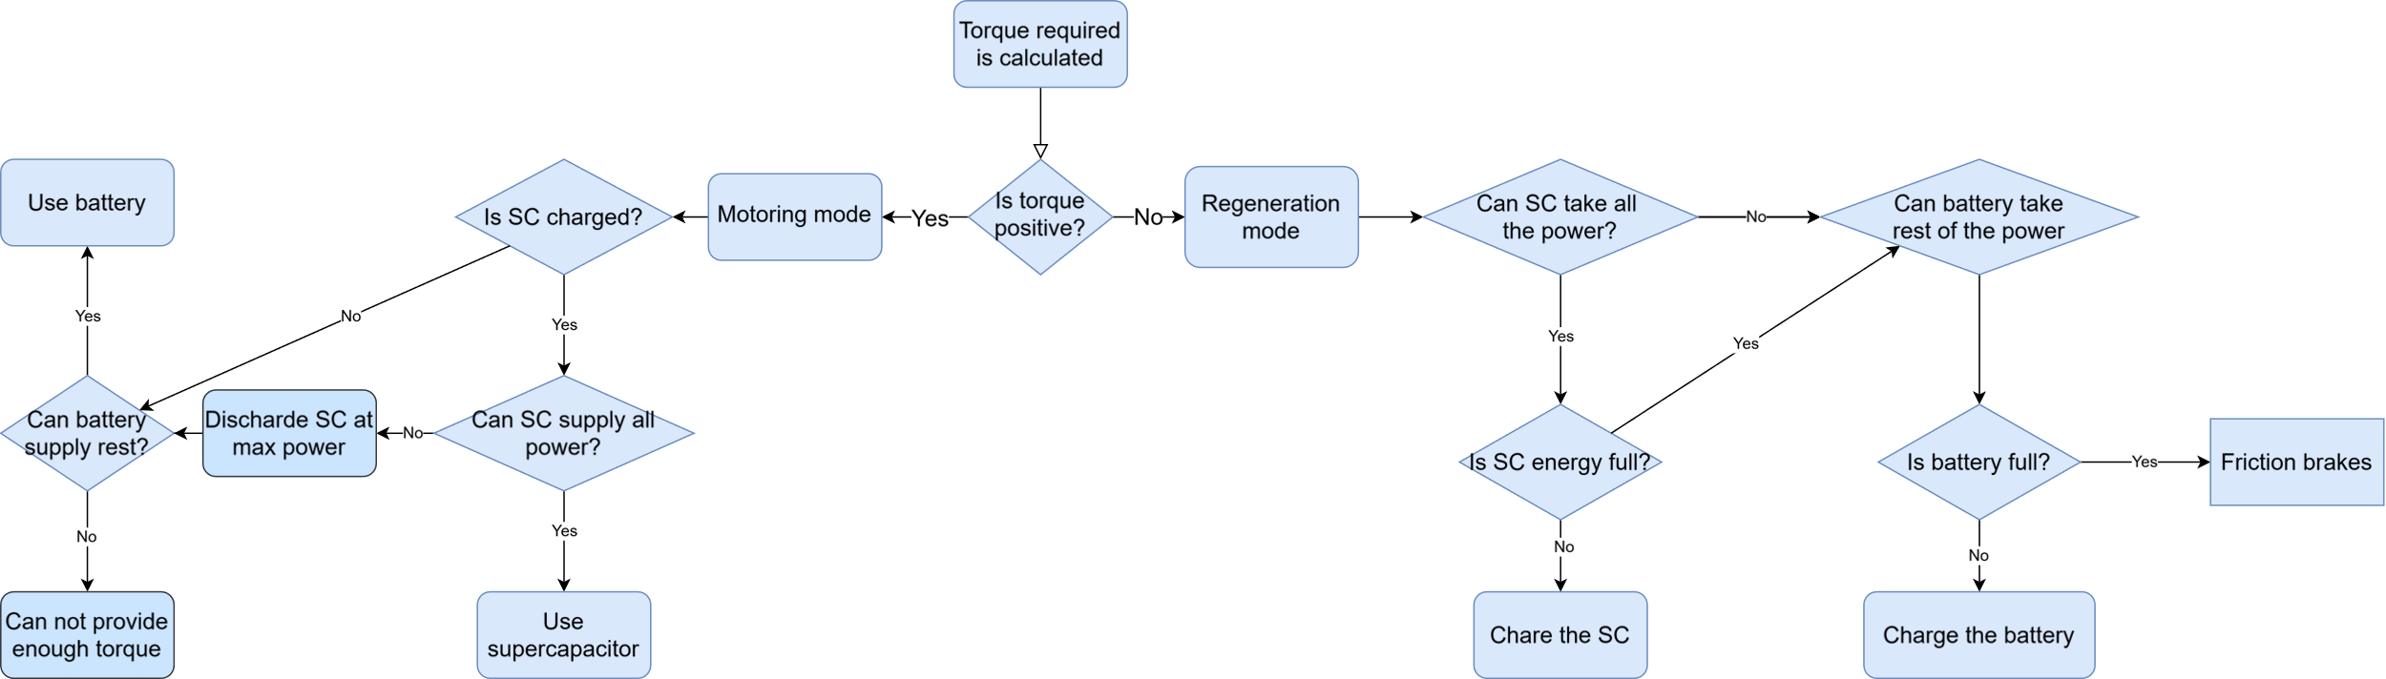
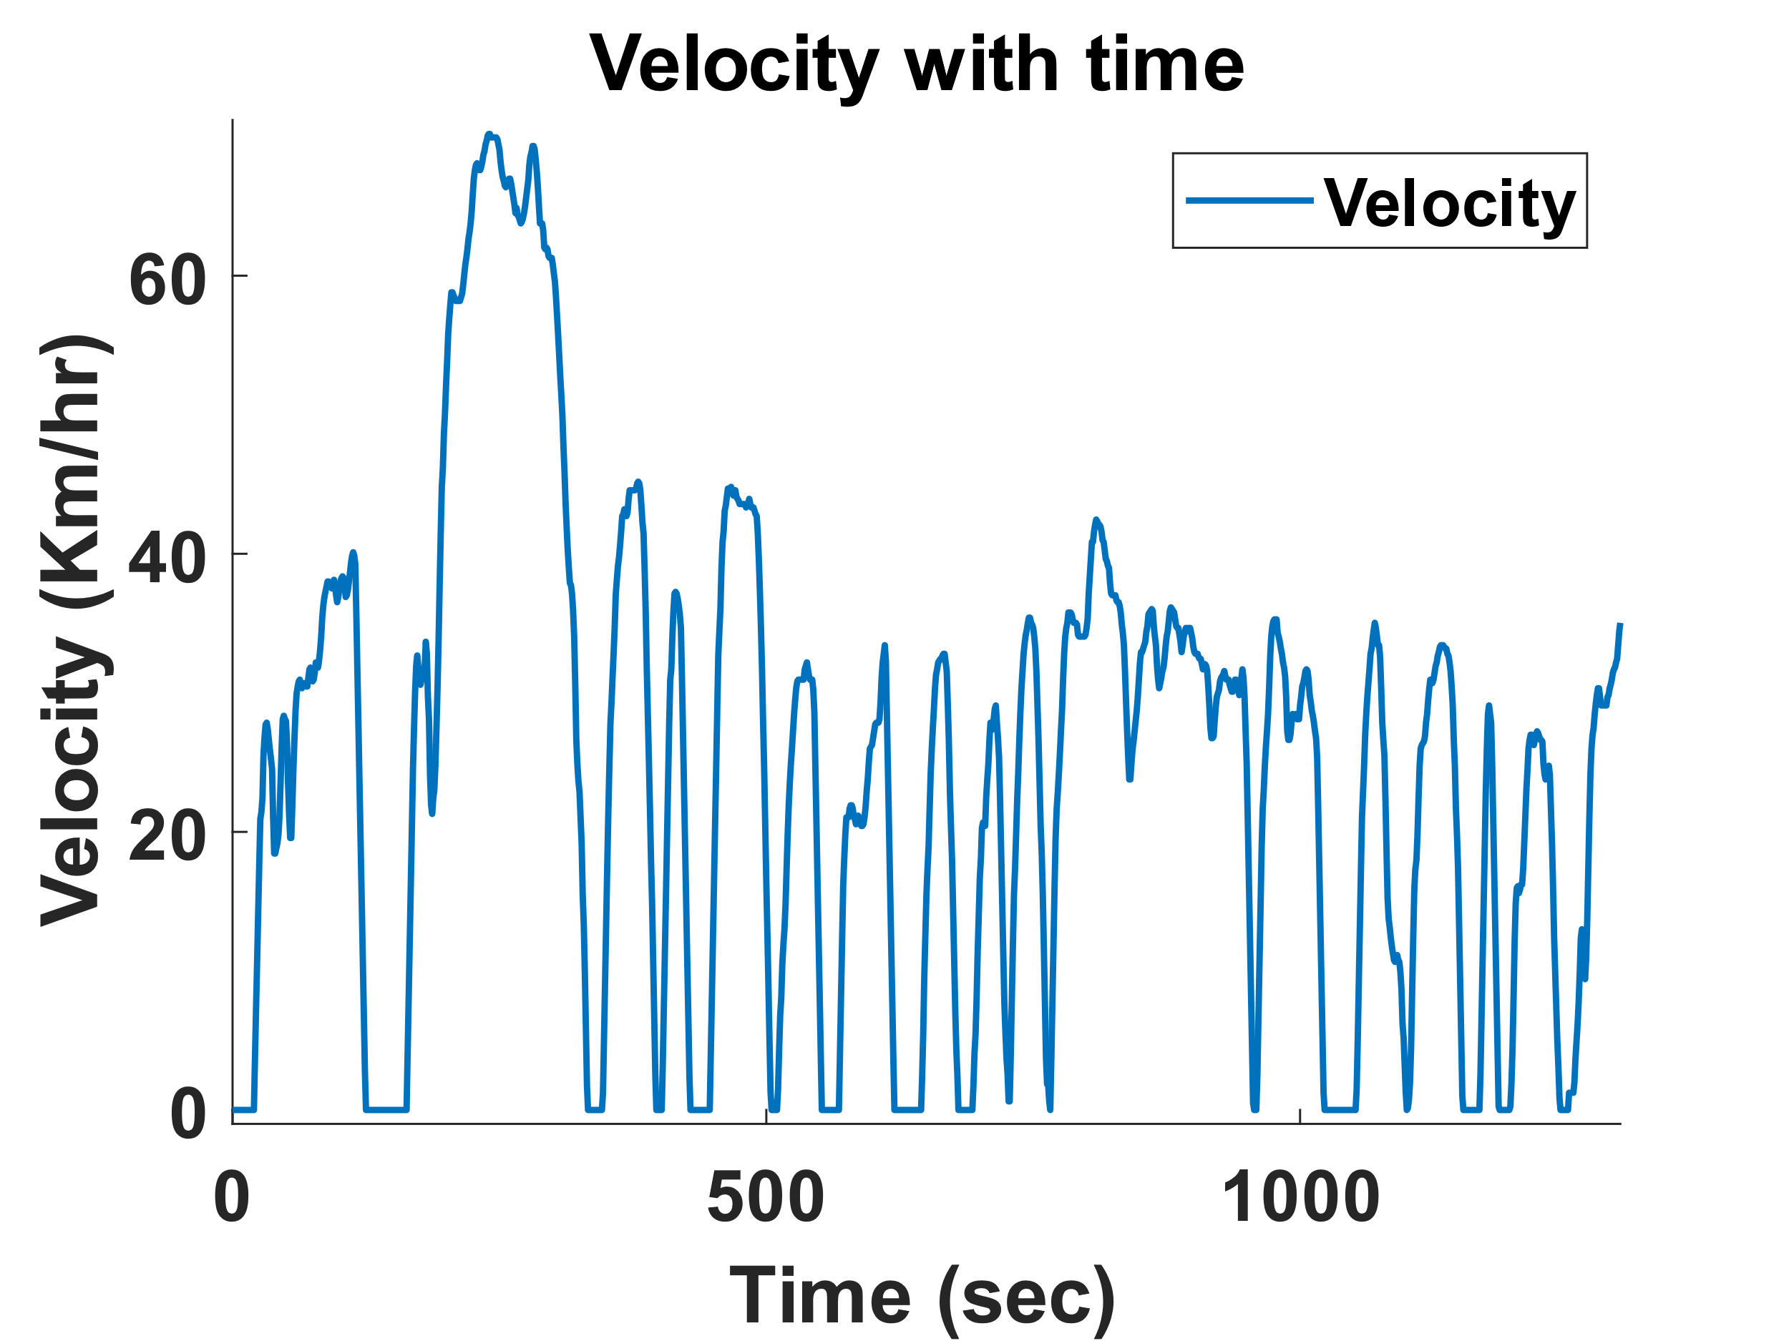
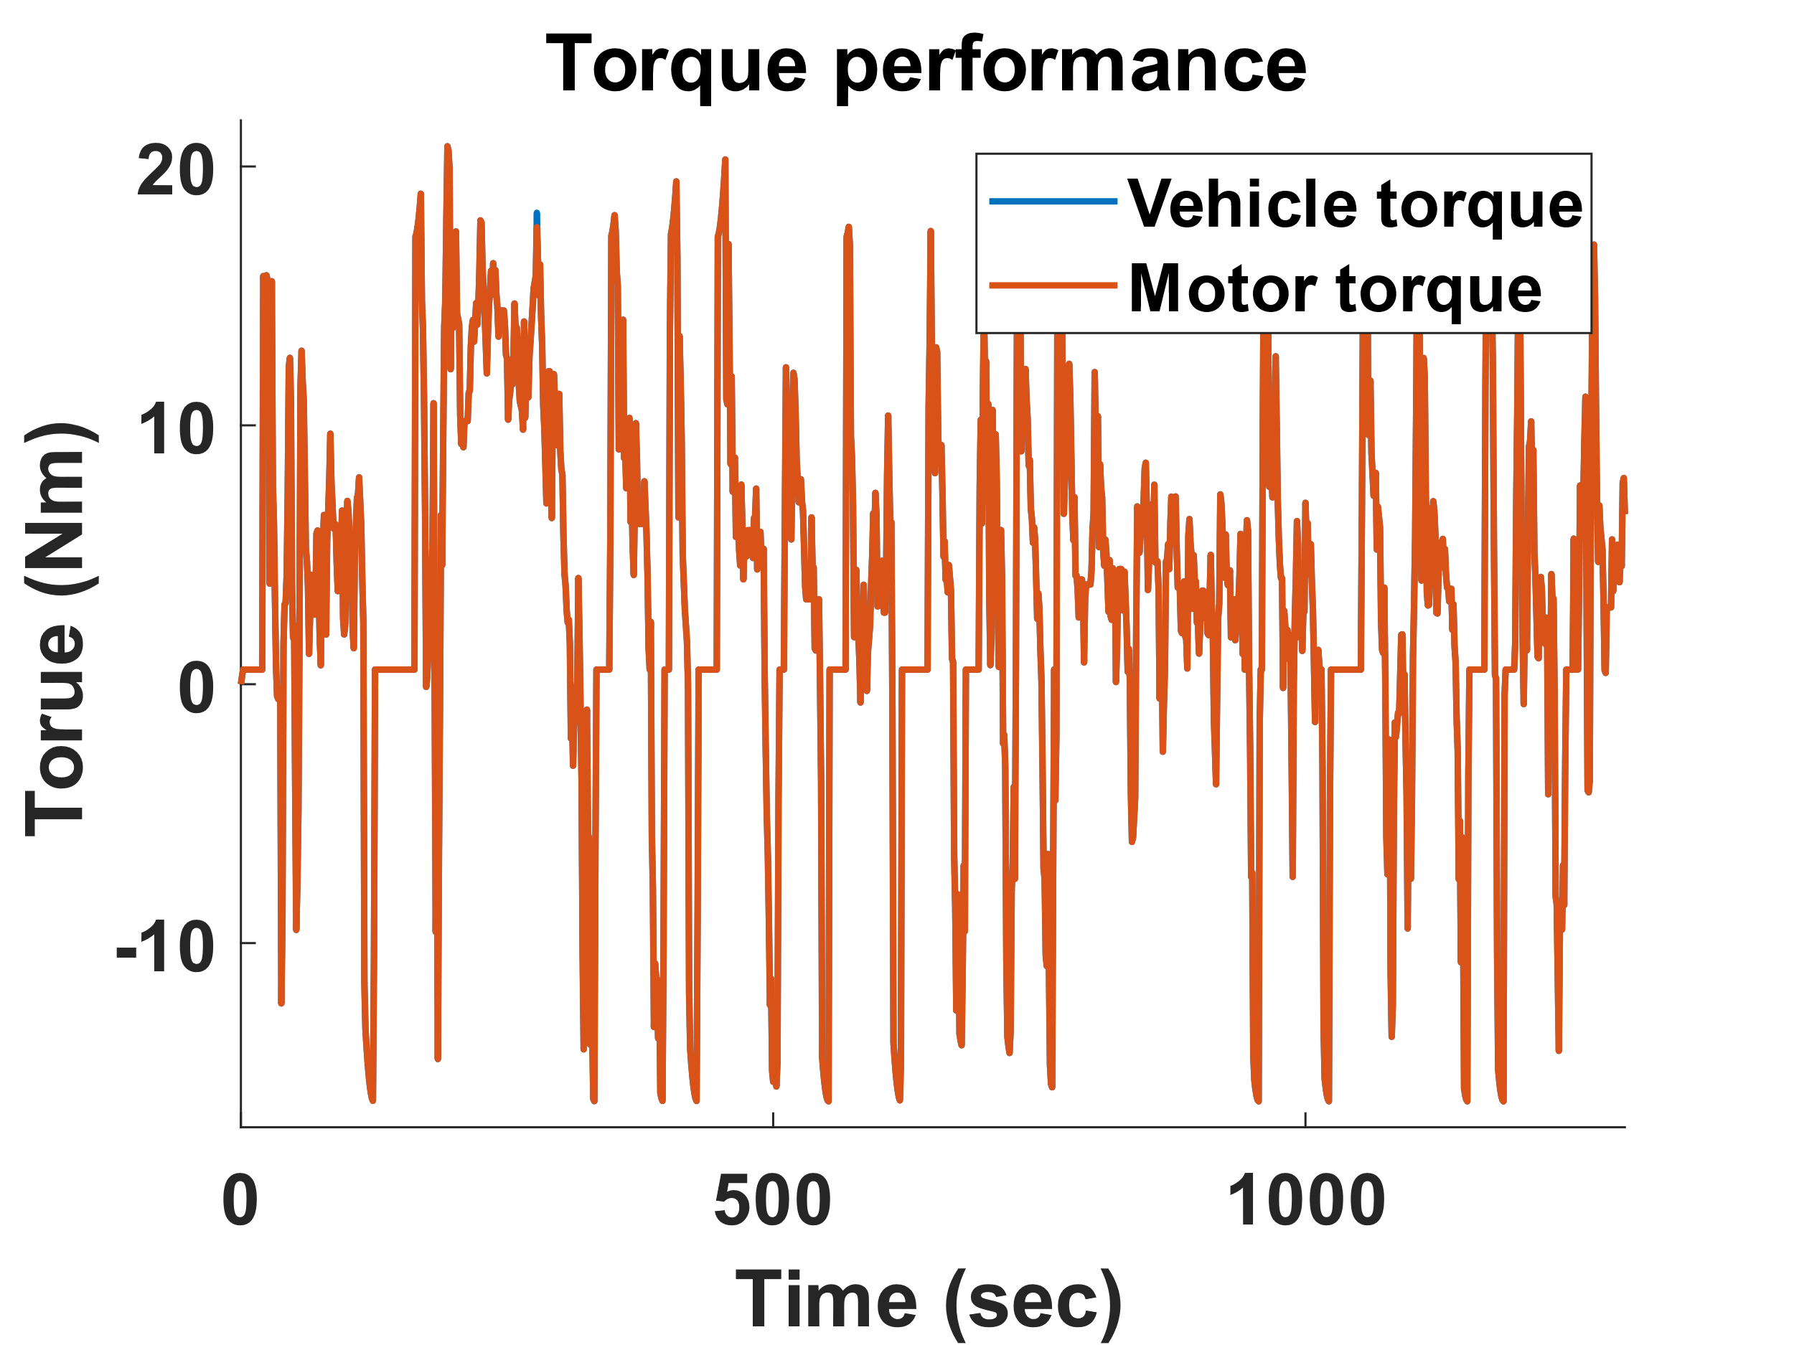
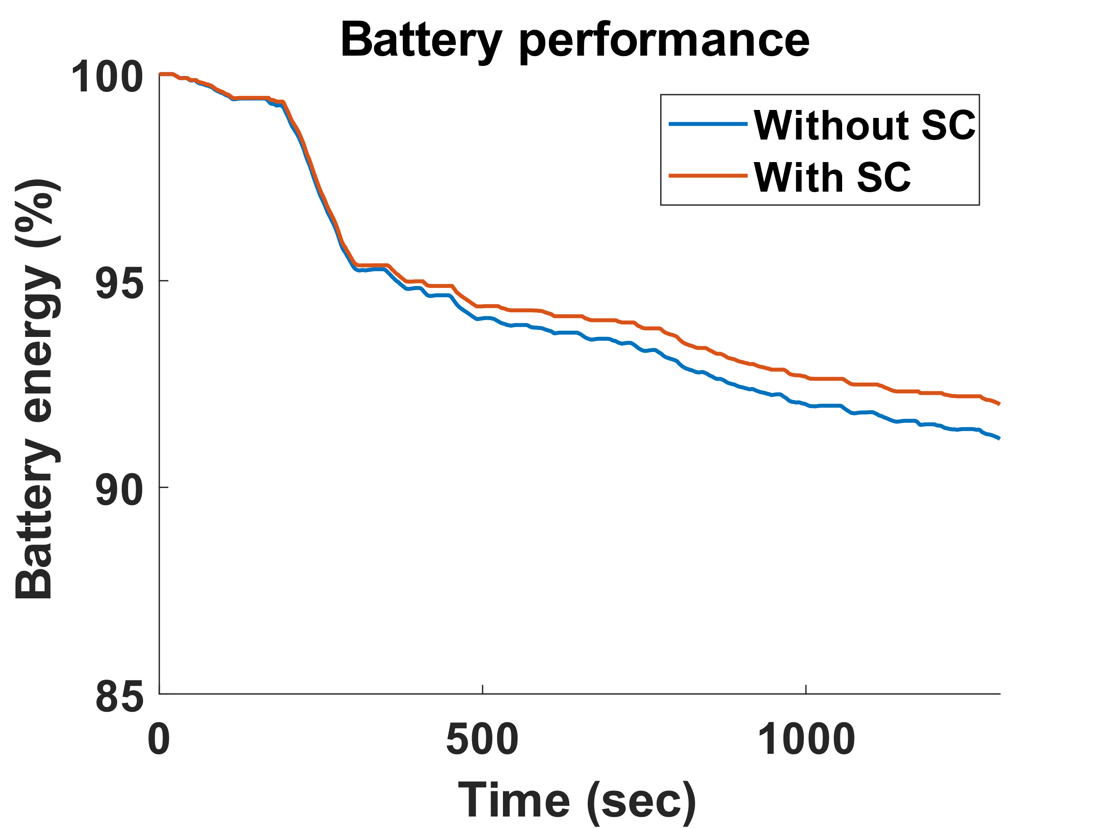
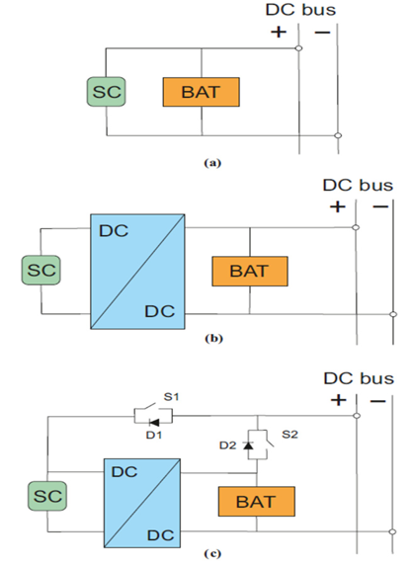
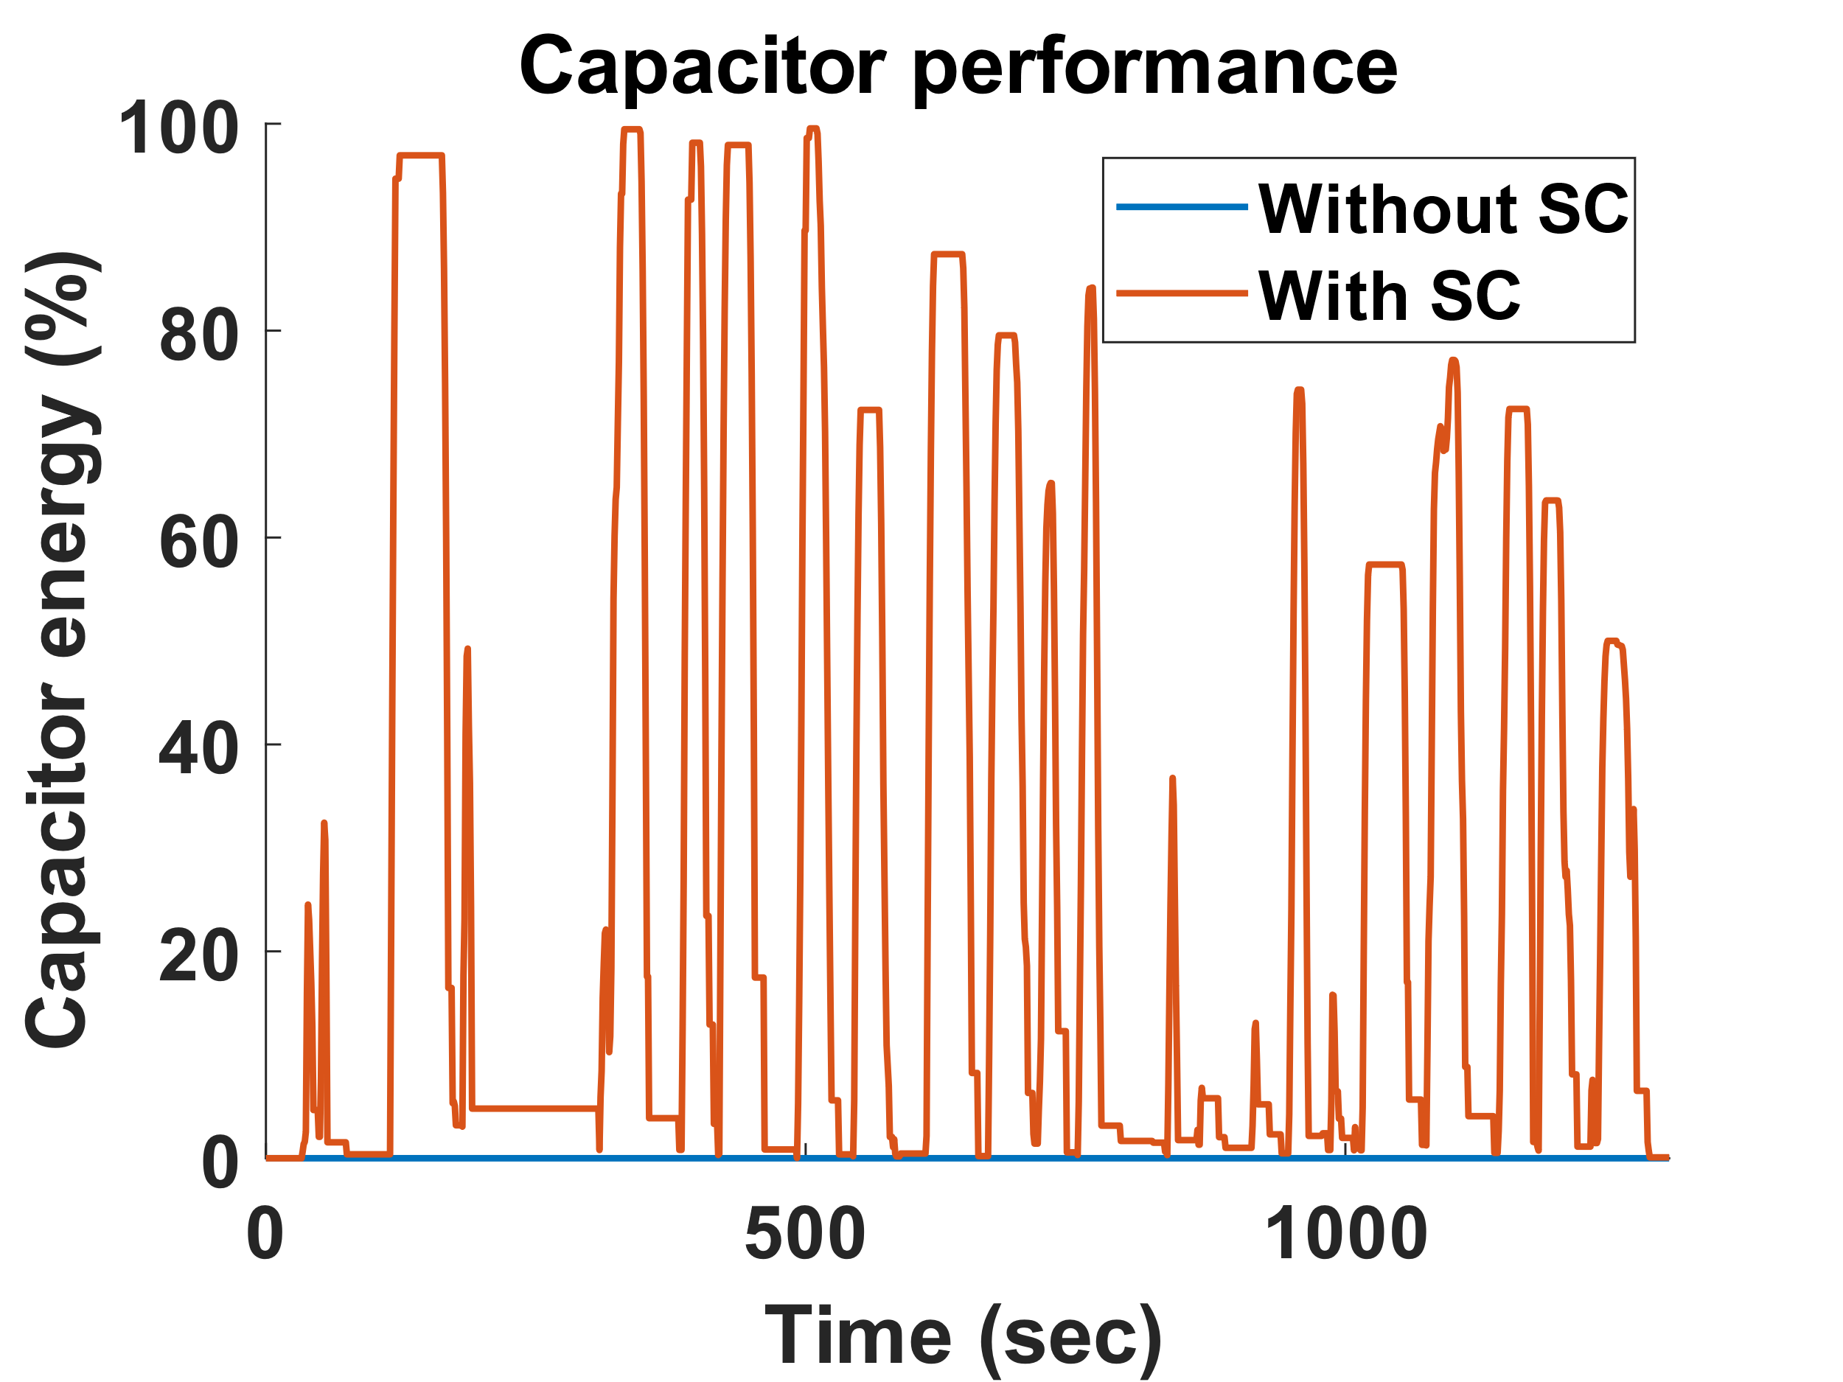
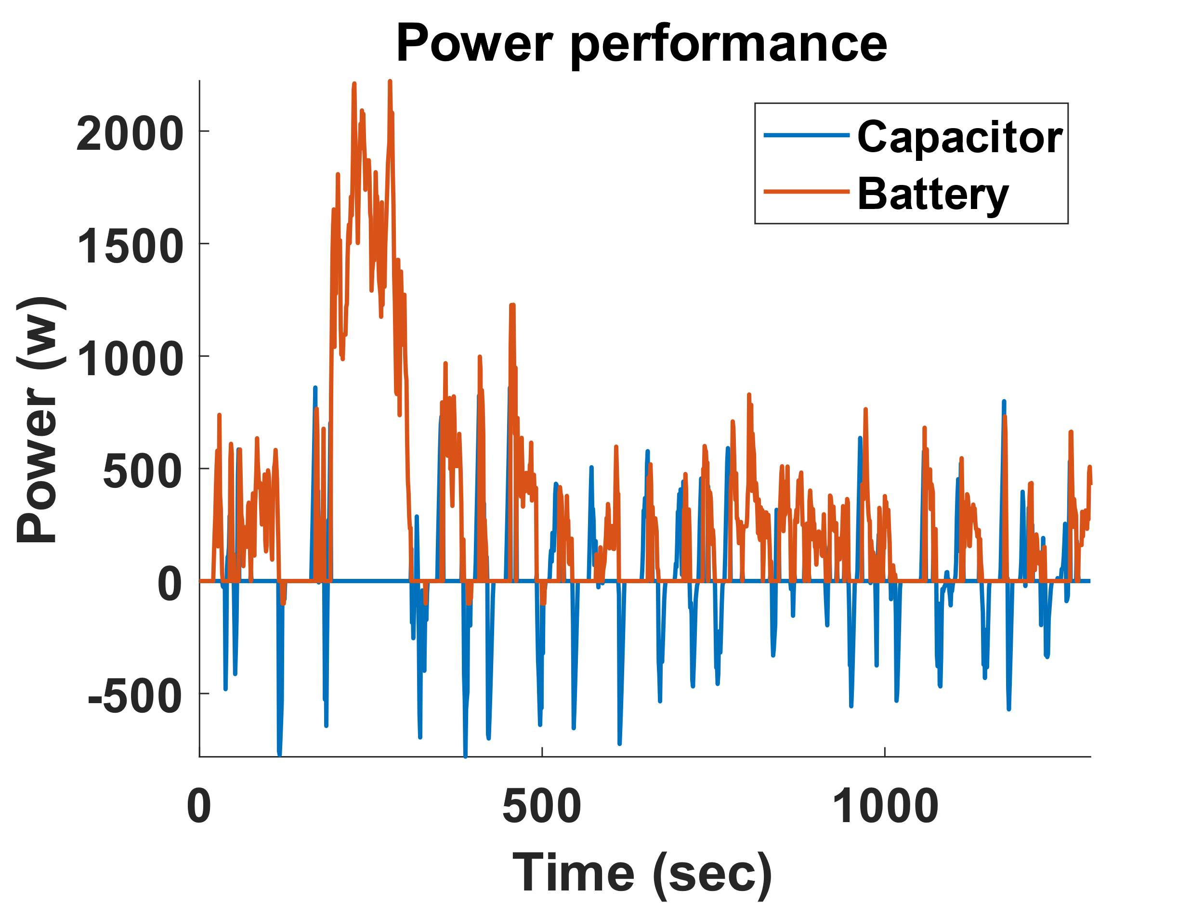

Supercapacitor Integrated Battery System for Electric Vehicle
EE6109: Electric Vehicle Powertrain | Course Project Presentation
Group 18: Yash Udayan Paritkar (210070096), Zala Mayursinh Meghrajsinh (210070099)
t
t
t
Introduction
Simulation setup
Simulation Algorithm
In this project, supercapacitor (SC) integrated batteries are analysed with respect to their feasibility
It goes through the limitations of Li-ion batteries, advantages of using supercapacitor hybrid batteries, simulations for both the batteries and conclusions
In this project, the comparison of an active SC hybrid battery with a li-ion only battery in terms of range
The simulations are performed using a speed-time vehicle profile obtained from the New York City drive profile. The data is saved in Excel format.
The feasibility of the input data is tested by comparing with the peak torque requirement with the motor capacity
No additional package of Matlab is used apart from the standard delivery executable.
At every time instant, the torque required is calculated with help of the speed-time profile and inertia
At every moment, an algorithm is used to decide form where the energy and power is used
The algorithm is run twice, with and without the supercapacitor for performance comparison
This allows us to gauge roughly the impact of the supercapacitor on the electric vehicle performance
t
Batteries in eV
t
Batteries, being primary energy storage, unit forms an integral part of electric vehicles
Efficiency, energy density, power density and durability are important parameters regarding batteries
Most of the modern electric vehicles use Li-ion batteries
These batteries are favoured for their high energy-to-weight ratio, low self-discharge rate, and ability to handle multiple charge cycles effectively
Li-ion batteries have low peak discharge rate and charge rate
This limits the ability to charge and accelerate quickly
Since this is a chemical-redox-based battery, it can only last a limited charge cycles (~500-1000)
This again limits our ability to regenerate energy
Simulation Algorithm Flowchart
t
Supercapacitors
Supercapacitors (SC) are essentially high-capacity capacitors with capacitance of the order of 1 F [1]
Although they have lower voltage limits than the capacitors of the order of few volts
They use electrostatic double-layer capacitance and electrochemical psuedocapacitance for energy storage
Since their main storage is not faradic, they tend to last for high number of charge cycles
The main disadvantage of the supercapacitor is their higher leakage over time
Hence typically used for burst-mode power delivery and storage
t
t
Simulation Results
Simulation Results and Conclusions
As expected, the battery performance increases due to increased regeneration ability due to supercapacitor
On a few instances, we can see that the battery also takes regenerative power which shows correctness of the model
Even small SC helps in improving regeneration, the marginal gain of capacitor value decreases after a point due to added mass
Using SC hybrid capacitor improved the energy saving on the current drive profile by 10.43 % in terms of Wh/km from 28.80 Wh/km to 38.81 Wh/km
The single charge range increases from 37.72 km to 41.66 km
The rough cost of the SC + added electronics amount to ₹ 2,600
The reduced number of charge cycles can improve the battery life by around 6 months
t
Comparision between SC and Li-ion battery [2]
Function | Supercapacitor | Lithium Ion
Charge time | 1 – 10 seconds | 10 – 60 minutes
Cycle life | 1 million | 500 and higher
Cell voltage (nominal) | 2.3 – 2.75 V | 3.6 – 3.75 V
Specific energy (Wh/kg) | 5 | 100 – 200
Specific power (W/kg) | ~ 10,000 | 1000 – 2000
Cost per Wh | ₹1600 | ₹40-80
Service life | 10 – 15 years | 5 – 10 years
Charge temperature | -40 – 60 ⁰C | 0 – 30 ⁰C
t
Possible future improvements
Variation in the power due to gradient can be included in the simulations which will affect the required torque
The ESR of the battery and the supercapacitor can be included. As batteries typically have higher ESR, the gain due to the supercapacitor will increase
The efficiency of the DC/DC converter and motor is not included; simple models, such as constant efficiency model, can be added easily
More advanced algorithms for battery-SC power-energy distribution can be used
Testing can be done for more drive profiles and models for better estimates of gains due to supercapacitor
t
SC Hybrid battery
In order to have advantages of both, SC hybrid batteries are also used in many models historically [3]
Depending on how both are connected to the bus, they are divided into three types [4]
1. Passive 2. Semi-active 3. Active
We have compared active configuration with no SC battery
t
t
References
Overview of simulations in Matlab
[1] Forouzandeh, P.; Kumaravel, V.; Pillai, S.C. Electrode Materials for Supercapacitors: A Review of Recent Advances. Catalysts 2020, 10, 969. https://doi.org/10.3390/catal10090969
[2] A. A. Nakad, M. Madi, O. Aaker, E. L. Ntantis and K. Y. Kabalan, "Comparing supercapacitors to lithium-ion batteries through measurements and simulations," International Conference on Electric Vehicle and Vehicle Engineering (CEVVE 2023), Shenzhen, China, 2023, pp. 28-33, doi: 10.1049/icp.2023.3348.
[3] Lingcong Guo, Pan Hu, Hong Wei, Development of supercapacitor hybrid electric vehicle, Journal of Energy Storage, Volume 65, 2023, 107269, ISSN 2352-152X, https://doi.org/10.1016/j.est.2023.107269.
[4] Lemian, D.; Bode, F. Battery-Supercapacitor Energy Storage Systems for Electrical Vehicles: A Review. Energies 2022, 15, 5683.
GitHub link for the project:
https://github.com/paritkary25/ee6109/
Primary Model Data
Pre-Processing
Computation of Energy Over Drive Profile
Analysis of the Result
Primary Model Data: Giving input of primary vehicle data such as vehicle mass, battery parameters, capacitor size, motor torque, etc.
Pre-Processing: Supplementary parameters such as maximum acceleration, maximum power delivered by battery, etc.
Computation of Energy Over Drive Profile: The vehicle run is simulated on a city drive profile obtained from the web while considering a supercapacitor for regeneration
Analysis of the Result: The results are analysed with the help of plots and numbers and the gain with respect to the supercapacitor
Notes:
Abstract -
This paper aims to discuss an innovative way to simulate orbital conditions in software such as Ansys Workbench,
which lacks direct orbital modelling. It aims to explore the modelling of the thermal subsystem of a small satellite in
the launch and in-orbit conditions through the performance of transient thermal simulations. These simulations
quantify the requirement of thermal control for maintaining the optimal functionality of electronic components
within the satellite. Passive thermal control methods such as multi-layer insulation and surface coatings have been
modelled and simulated in this paper. The paper attempts to study the effect of parameters such as the number of
layers and layer thickness on the effectiveness of multi-layer insulation. It studies the variation of temperature on
absorption and emission properties of surface coatings. It further looks at the optimisation of these techniques by
improving the meshing, which can significantly decrease computation time and reduce convergence issues. The
paper also proposes a method of performing thermo-structural simulations, which can provide an analysis of the
thermal stresses produced in satellites because of the temperature gradients. The role played by joint and contact
definitions in thermal simulations has also been highlighted.

