Slide 1
Analysis of Graph Partitioning Schemes on Distributed Clustering
Ruchi Bhoot
MTech (Research), CDS
Paritosh Tiwari
PhD Student, CPS
Project presentation for DS 256, Jan-Apr 2023

Slide 2
Objectives
Measuring effects of different partitioning algorithms on distributed clustering.
Using suitable metrics to quantify said effects for comparison.

Slide 3
Graph Partitioning
Partitioning to reduce communication between workers.
Communications are a result of a downstream task performed on the graph.
Here, the task is clustering.
DBH, HDRF and BTH partitioners have been used.

Slide 4
Apache Giraph
Vertex-centric graph processing framework.
Needed to change it to an edge-centric framework.
Edge-centric computations are better suited for clustering algorithms.
Runs compute function on each edge, instead of on each vertex.

Slide 5
Partitioner Logic
{0}
(1, 5)
(1, 7)
(5, 8)
(6, 7)
(6, 8)
{1}
(1, 2)
(2, 4)
[1.0,0, [[5.0,0], [7.0,0], [1.1,1]]]
[1.1,0, [[2.1,0], [1.0,1]]]
[2.1,0, [[4.1,0]]]
[3.2,0, [[4.2,0], [8.2,0]]]
[4.1,0, [[4.2,1]]]
{2}
(3, 4)
(3, 8)
Initial partition files (separate)
Reconfigured partition files (combined)

Slide 6
Triangle Count
A triangle in a graph is a set of three vertices mutually connected by edges.
Uses number of triangles in a graph to identify sets of densely connected vertices.
Effective in identifying communities in large graphs with a high degree of clustering or transitivity.
Sensitive to noise and outliers in the graph.

Slide 7
Experiment Workflow
Select a subgraph of ORKUT graph data.
Select DBH, HDRF and BTH partitions of the subgraph.
Run triangle count on each of the partitions.
Compare results.

Slide 8
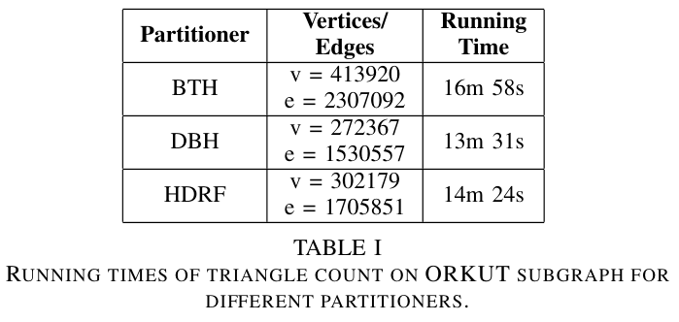
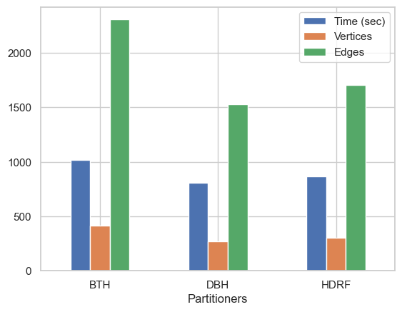
Results

Slide 9
Fin.

