Slide 1
Deep Learning & HMM in Genomic Sequence Classification
Comparative Modeling Across CNN, HMM, and Traditional ML

Slide 2
Dataset Overview
Sequences: 200bp fixed-length synthetic DNA samples
Training set: 38,000 sequences, Validation: 1,000, Test: 1,000
Balanced class labels (0 to 3) across all sets
Used consistently across all modeling approaches

Slide 3
Traditional ML Pipeline
Used k-mer (3-mer) tokenization + CountVectorizer
Converted sequences to numerical feature vectors
Applied Naive Bayes and SVM classifiers
Good for interpretable baselines, fast execution

Slide 4
HMM-Based Classification
One HMM trained per class using hmmlearn
Class prediction based on highest log-likelihood
Probabilistic sequence modeling with discrete state transitions
Moderate performance, interpretable transitions

Slide 5
Deep Learning - CNN Model
Used 1D CNN on one-hot encoded 200bp DNA sequences
Input shape: (200, 4), Output: 4-class softmax
Trained using Adam optimizer, categorical crossentropy
Regularized with dropout layers

Slide 6
Performance Impact of Training Epochs
Epochs = 2 → Accuracy: 84.7%, Loss: 0.382
Epochs = 10 → Accuracy: 93.8%, Loss: 0.144
Longer training improved generalization significantly
Training convergence reached around epoch 9–10

Slide 7
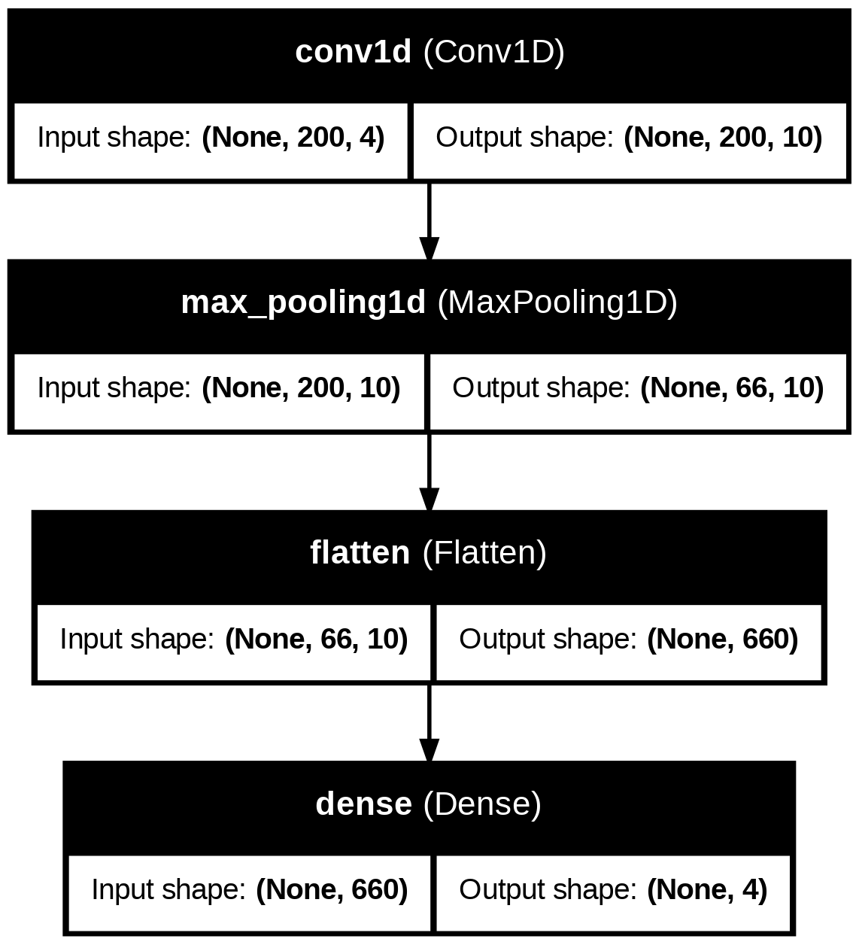
CNN Model Architecture Diagram

Slide 8
Comparative Summary
CNN (Deep Learning): High accuracy, needs more data & compute
HMM: Interpretable, decent accuracy, slow with scale
Naive Bayes/SVM: Quick, good baseline, weak on sequence structure
Best trade-off: CNN with 10+ epochs and dropout

Slide 9
Conclusion & Future Work
CNNs showed best generalization and scalability
HMMs useful for interpretable sequence models
Potential: use Transformers (e.g., DNABERT) for long-range genomics
Explore hybrid models: CNN + HMM or attention + LSTM

