Slide 1
Live Lecture
AI Teaching Copilot

Slide 2
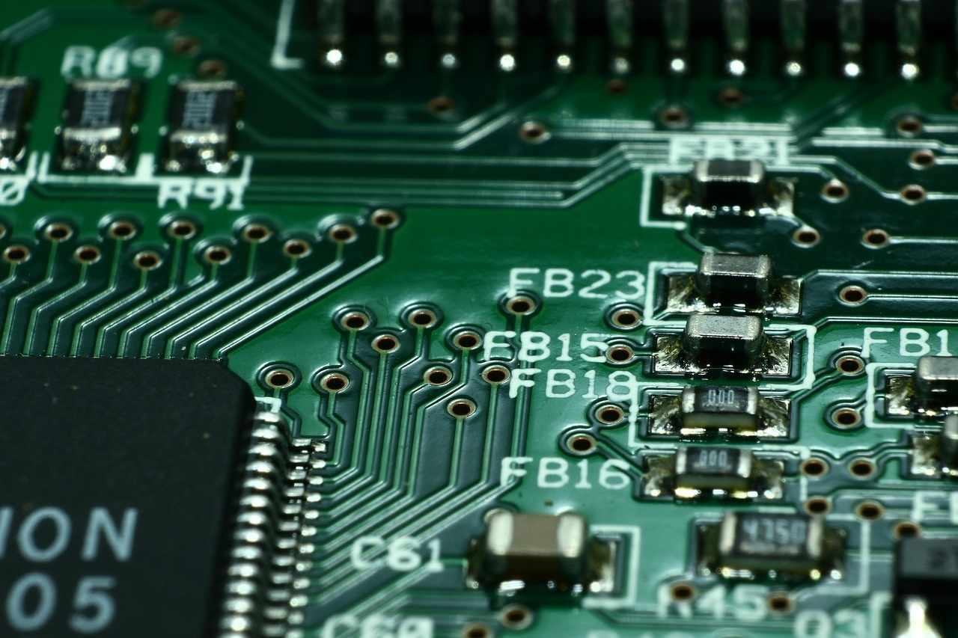
Introduction to Microcontrollers: The Core of Embedded Systems
Compact integrated circuits designed to govern specific operations in embedded systems.
Integrate a CPU, memory, and I/O peripherals onto a single chip.
Serve as the foundational building blocks for modern automated electronics.
Process real-time inputs from sensors to execute precise control signals.
Deliver cost-effective and energy-efficient computing for dedicated applications.

Slide 3
Introduction to Microcontrollers
Microcontrollers serve as foundational building blocks for modern electronic systems.
They integrate CPU cores, memory, and I/O peripherals onto single chips.
Essential for controlling dedicated functions within embedded hardware architectures.
Enable automated decision-making and real-time processing across diverse devices.

Slide 4
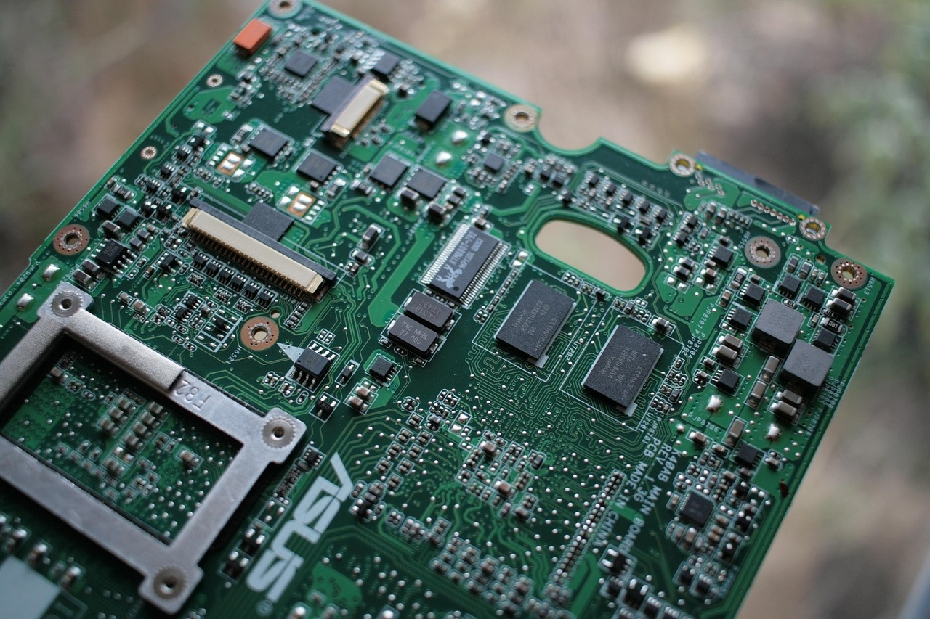
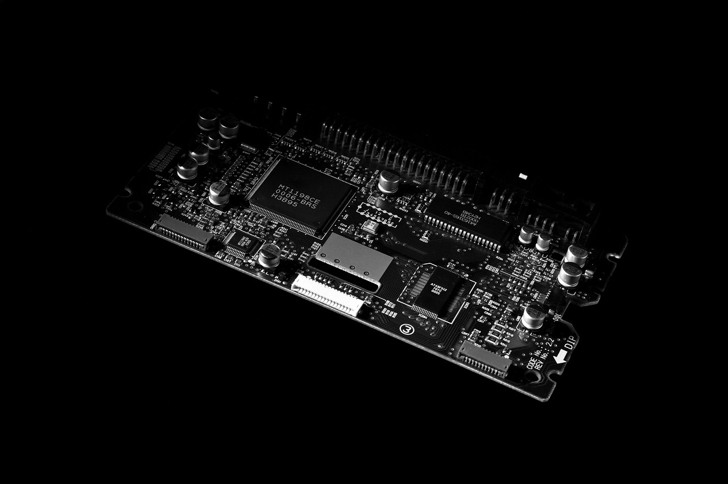
Introduction to Microcontrollers in Smart Systems
Fundamental building blocks for modern embedded hardware architectures.
Drive intelligence and control across Internet of Things (IoT) devices.
Integrate processing power, memory, and input/output capabilities on one chip.
Enable automated control in smart home and wearable technology.
Transform traditional electronics into interconnected, intelligent systems.

Slide 5
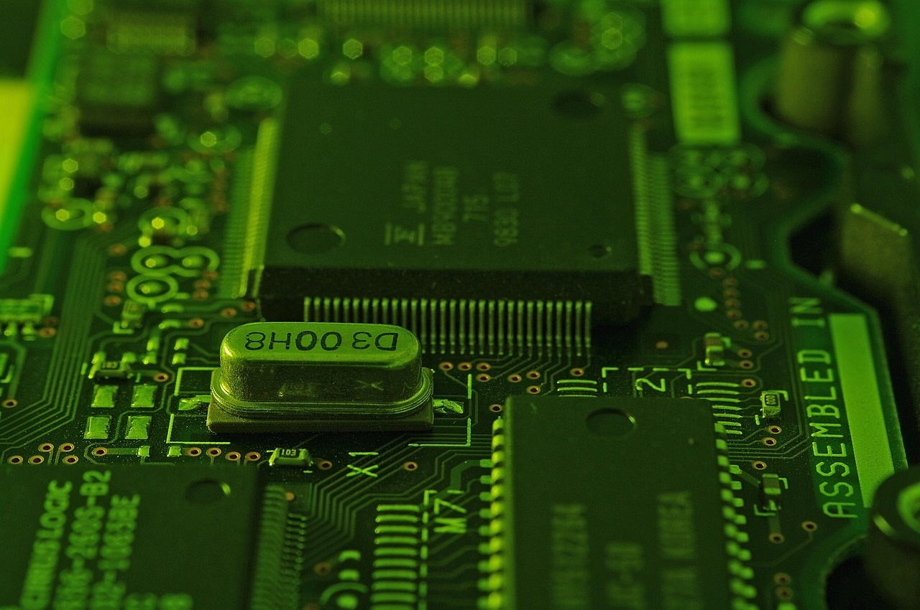
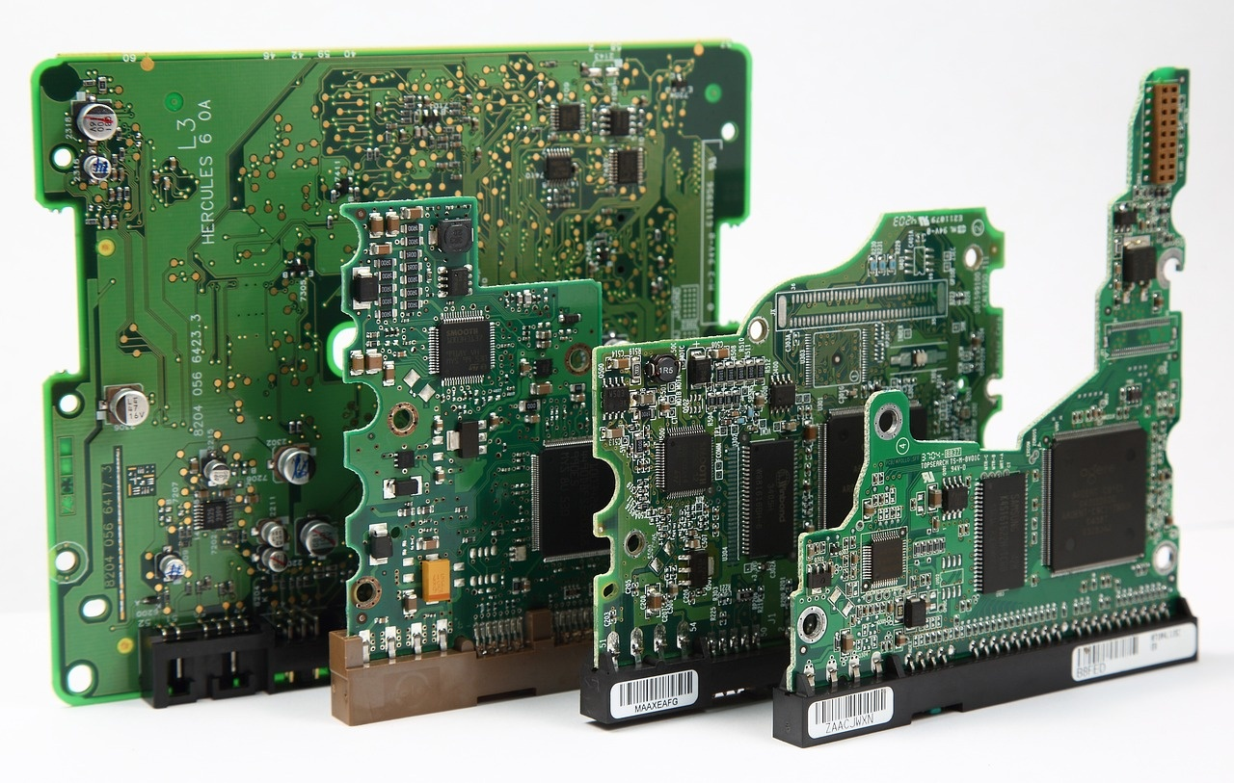
Introduction to Microcontrollers
Serve as core building blocks for smart and IoT devices.
Popular types include ESP32, Arduino (ATmega), and STM32 platforms.
Integrate CPU, RAM, ROM, and peripherals onto a single chip.
Differ from microprocessors, which rely on external memory and peripherals.

