Slide 1
Live Lecture
AI Teaching Copilot

Slide 2
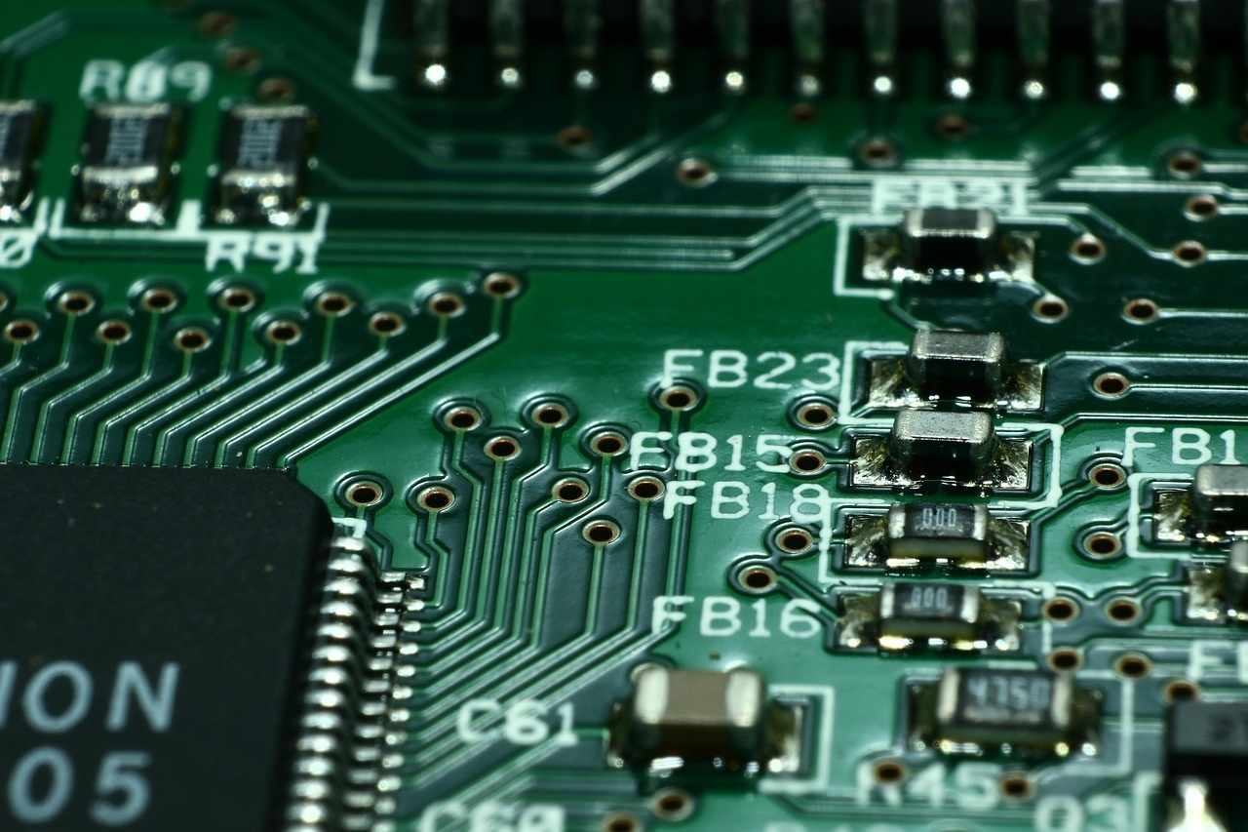
Introduction to Microcontrollers
Compact hardware device designed for dedicated electronic control tasks.
Integrates processor, memory, and input/output peripherals on one chip.
Embedded directly inside host systems to manage automated processes.
Powers everyday appliances, including air conditioners and robotics.
Executes pre-programmed instructions to control sensors and actuators.

Slide 3
Introduction to Microcontrollers
Compact hardware devices engineered for dedicated system control applications.
Integrates processing core, memory, and input/output peripherals single-chip.
Manages automated functions in everyday appliances like air conditioners.
Serves as the core processing unit in modern robotics.
Executes specific pre-programmed routines efficiently with minimal power.

