Slide 1
Live Lecture
AI Teaching Copilot

Slide 2
Understanding Photosynthesis: Process and Key Products
Converts light energy, water, and carbon dioxide into chemical energy.
Occurs in autotrophic organisms like plants, algae, and photosynthetic bacteria.
Chlorophyll pigments inside leaves absorb sunlight to power the process.
Roots absorb water from soil; stomata intake atmospheric carbon dioxide.
Light energy transforms water and gas into energy-rich glucose sugar.
Generates glucose for cellular nutrition and releases oxygen as a byproduct.

Slide 3
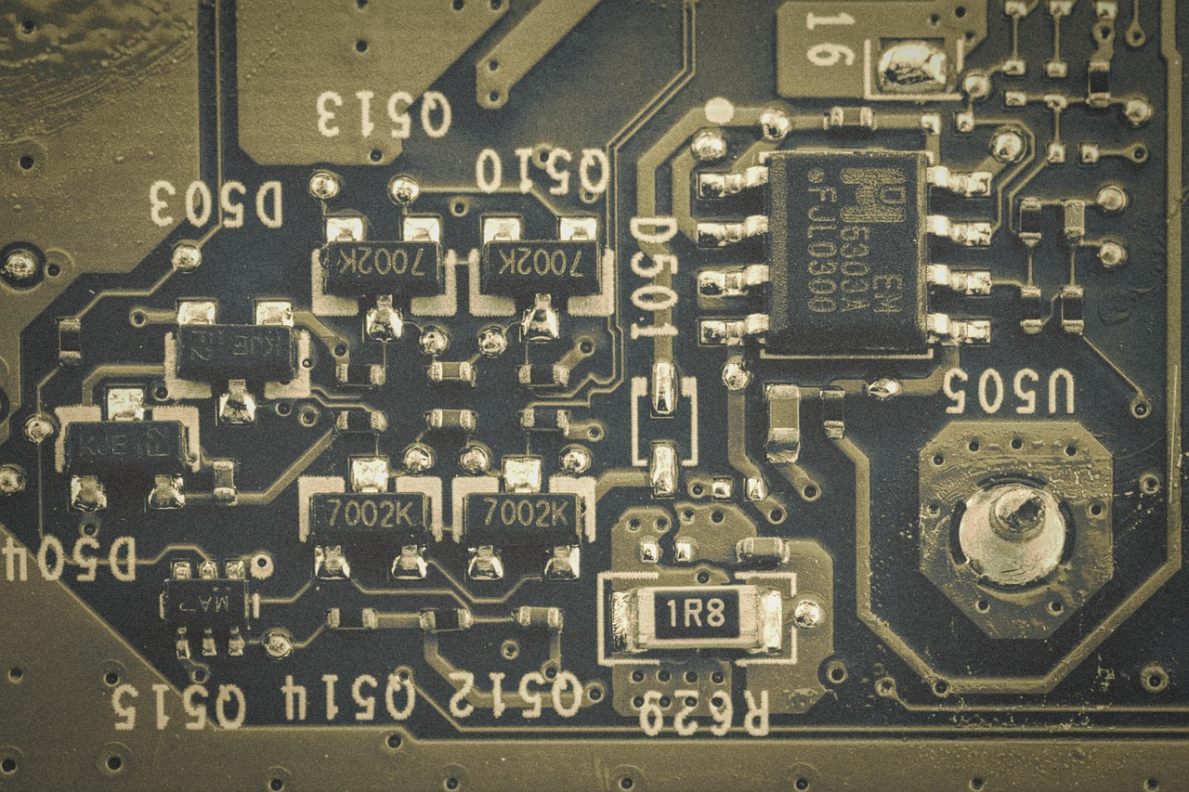
Introduction to Microcontrollers
Compact computer fabricated on a single integrated circuit chip.
Designed to control dedicated tasks within embedded systems.
Directly manages physical hardware using integrated peripherals.
Central Processing Unit (CPU) executes program instructions and logic.
On-chip memory stores code and operational data.
Input/Output (I/O) ports enable communication with external devices.

Slide 4
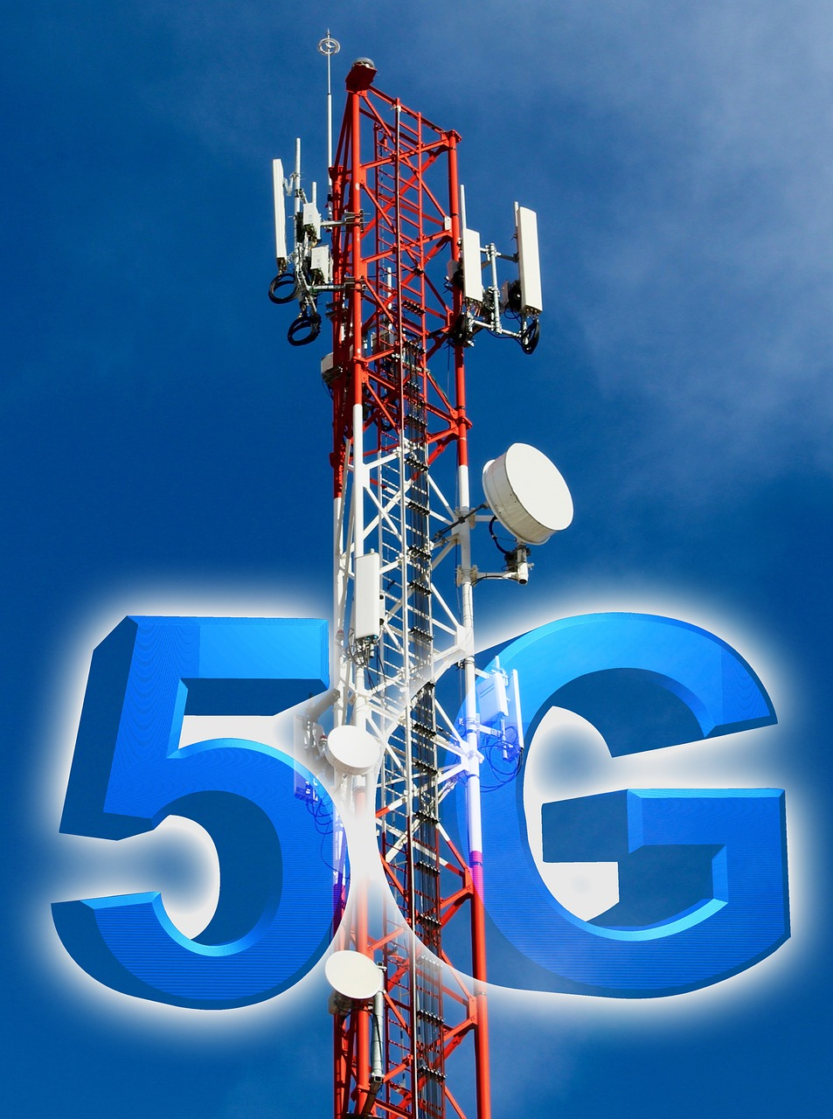
Introduction to 5G Mobile Technology
Next-generation telecommunications standard succeeding 4G mobile networks.
Delivers significantly faster data transmission and ultra-low latency.
Provides massive bandwidth capacity for interconnected device ecosystems.
Powers high-demand applications including high-definition streaming and online gaming.
Enables advanced IoT technology, smart cities, and autonomous vehicles.

Slide 5
Understanding Pi (π): The Fundamental Circle Constant
Mathematical constant representing the ratio of circumference to diameter.
Universally constant for all circles, approximately equal to 3.14159.
Classified as an irrational number with infinite, non-repeating decimals.
Defined by the relationship: Circumference divided by diameter equals Pi.
Essential for geometric calculations including surface area and volume.

Slide 6
Fundamentals of Bacteria: Structure, Shapes, and Roles
Single-celled microorganisms lacking a nucleus and cellulose cell walls.
Ubiquitous organisms inhabiting soil, water, and human bodies globally.
Common morphological shapes include spherical, rod-like, and spiral forms.
Beneficial bacteria aid gut digestion, synthesize vitamins, and ferment foods.
Pathogenic bacteria cause infections like strep throat and tooth decay.

