Slide 1
Live Lecture
AI Teaching Copilot

Slide 2
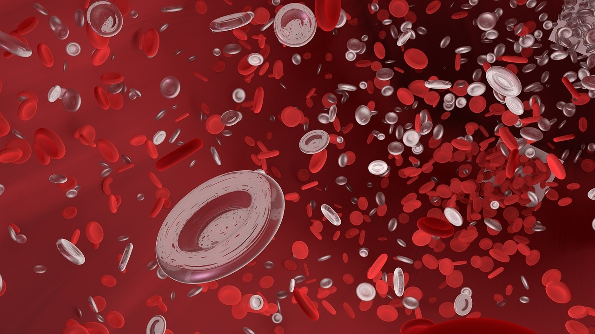
Fundamentals of Bacteria: Structure, Diversity, and Impact
Single-celled prokaryotic organisms lacking a defined nucleus, found globally.
Three primary morphological shapes: cocci (spherical), bacilli (rod), and spirilla (spiral).
Beneficial bacteria aid human gut digestion and synthesize essential vitamins.
Crucial in food production processes, such as fermenting yogurt.
Pathogenic strains cause infections like strep throat and food poisoning.
Bacterial infections are medically treated using specialized antibiotic medications.

Slide 3

Introduction to the Fourier Transform
Decomposes complex signals into fundamental sine and cosine frequencies.
Transforms signal data from the time domain to frequency domain.
Enables core spectral analysis through frequency component breakdown.
Serves as a foundational tool in modern signal processing.

Slide 4
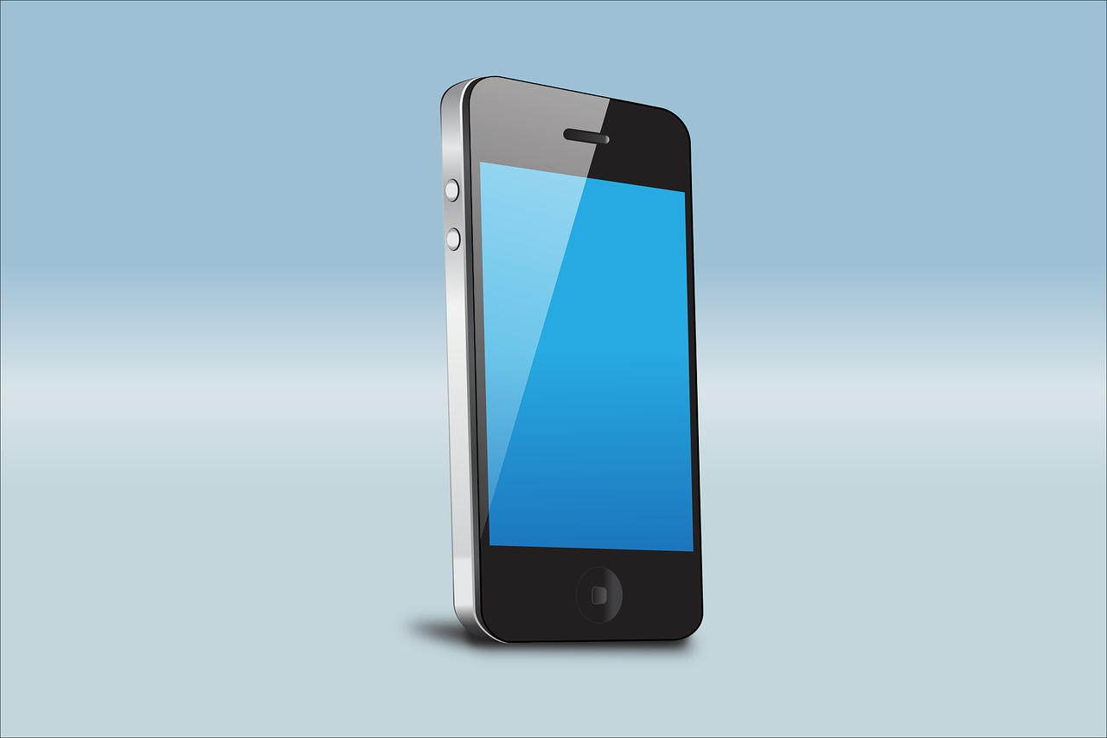
Introduction to Computer Systems
Electronic machines process raw data into useful, structured information.
Core workflow consists of Input, Processing, Storage, and Output stages.
Hardware includes physical components like processors, memory, and input devices.
Software encompasses programs and instructions that direct hardware operations.
Main categories include personal computers, mobile devices, and enterprise servers.

Slide 5
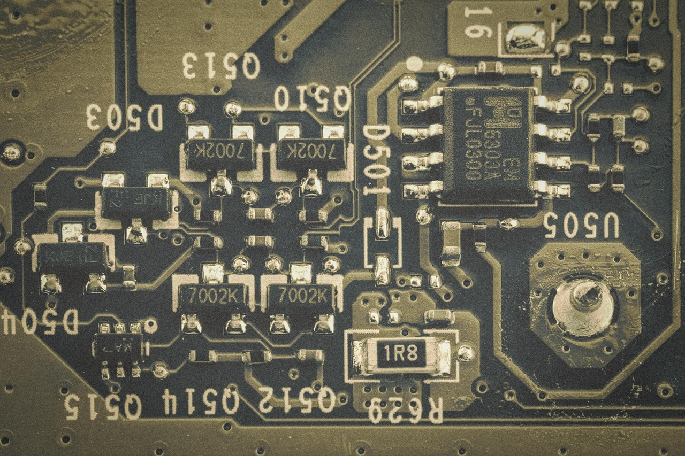
Introduction to Field-Programmable Gate Arrays (FPGAs)
Integrated circuits reconfigurable by users after leaving the factory.
Builds custom hardware circuits rather than executing sequential software.
Consists of configurable logic blocks and programmable interconnect wiring.
Programmed using specialized hardware description code to define circuitry.
Delivers exceptional processing speeds through parallel hardware execution.
Widely used for hardware prototyping, telecommunications, and custom acceleration.

Slide 6
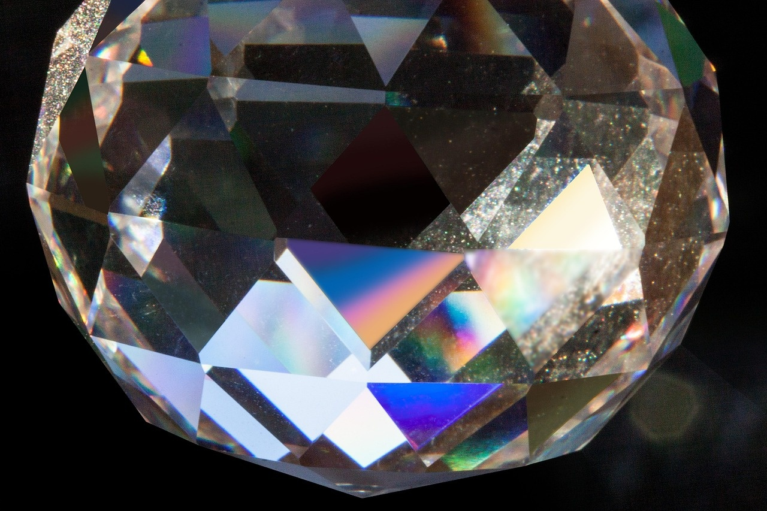
Fundamental Properties of Light
Electromagnetic radiation visible between 400 and 700 nanometers.
Consists of discrete energy packets known as photons.
Demonstrates dual nature, behaving as both waves and particles.
Travels at a fundamental speed near $3 \times 10^8$ meters per second.
Bounces off smooth surfaces through the process of reflection.
Bends via refraction when transitioning between different physical mediums.

Slide 7
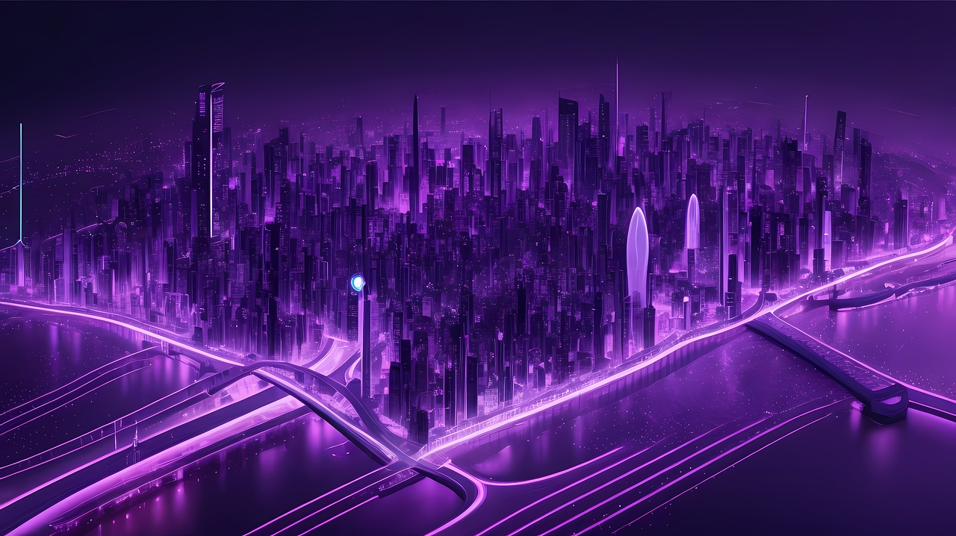
Understanding the Internet of Things (IoT)
Connected network of physical objects collecting and exchanging data autonomously.
Smart devices integrate embedded processors, sensors, and actuators for interaction.
Sensors measure environmental conditions, while actuators execute physical responses.
Cloud infrastructure and networks enable seamless real-time data processing.
Key applications include smart homes, wearables, industrial systems, and cities.

