Slide 1
Live Lecture
AI Teaching Copilot

Slide 2
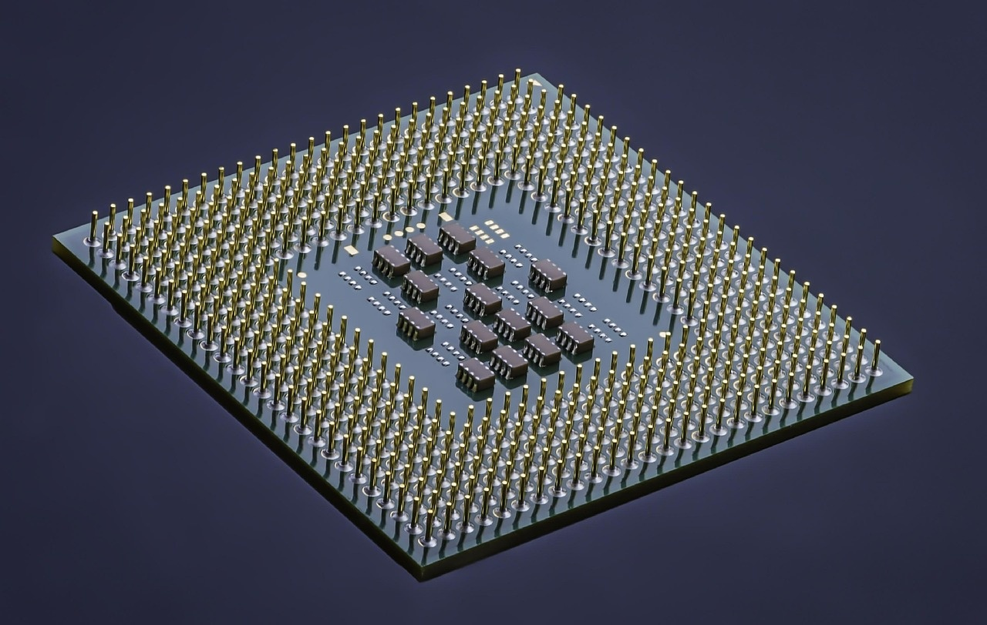
Introduction to Field-Programmable Gate Arrays (FPGAs)
Reconfigurable integrated circuits customizable after post-factory deployment.
Builds custom hardware circuits instead of running sequential software like CPUs.
Composed of configurable logic blocks connected by programmable interconnects.
Programmed using specialized Hardware Description Languages (HDLs).
Delivers high-speed processing with post-deployment reconfigurability.

Slide 3

FreeRTOS Task Architecture & Inspection
FreeRTOS tasks execute as independent programs within continuous infinite loops.
Use `vTaskGetInfo()` to retrieve specific task runtime parameters.
Inspects core attributes including task handle, name, and priority.
Monitors stack usage to evaluate memory efficiency and safety.
Tracks dynamic states: Running, Ready, Blocked, and Suspended.

Slide 4
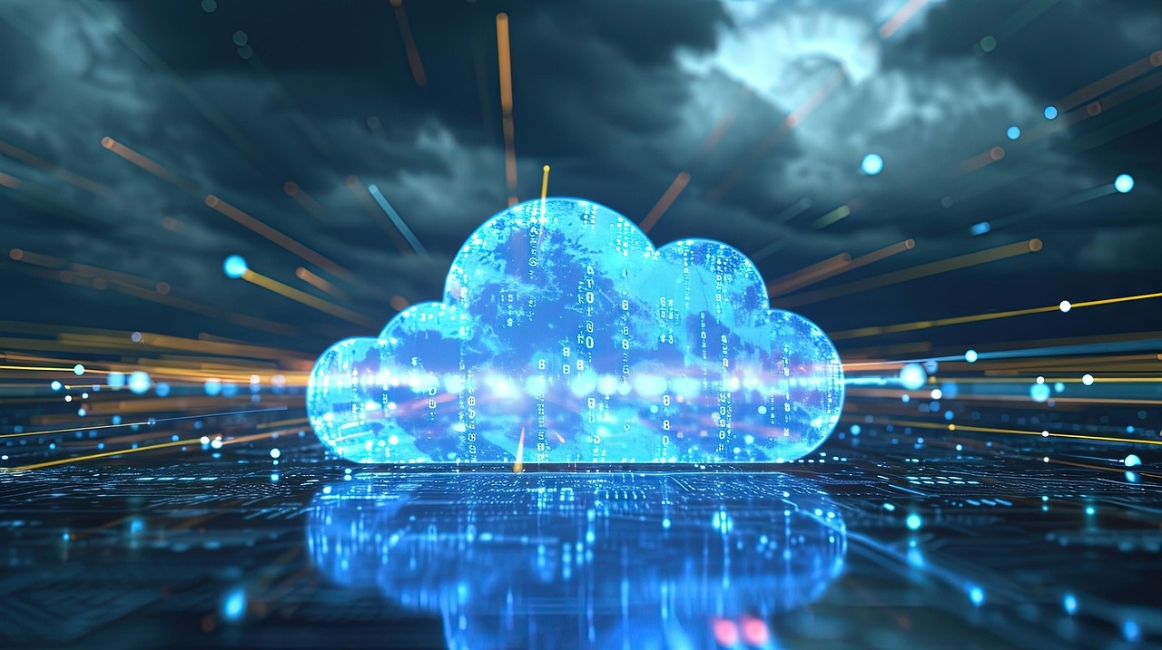
Fundamentals of Cloud Computing & Service Models
Delivers computing services like storage, servers, and software over internet.
Replaces physical hardware ownership with rented data center access.
Scalable infrastructure managed by providers like AWS and Microsoft Azure.
Infrastructure as a Service (IaaS) offers fundamental computing resources.
Platform as a Service (PaaS) provides development environments and tools.
Software as a Service (SaaS) delivers fully managed end-user applications.

Slide 5
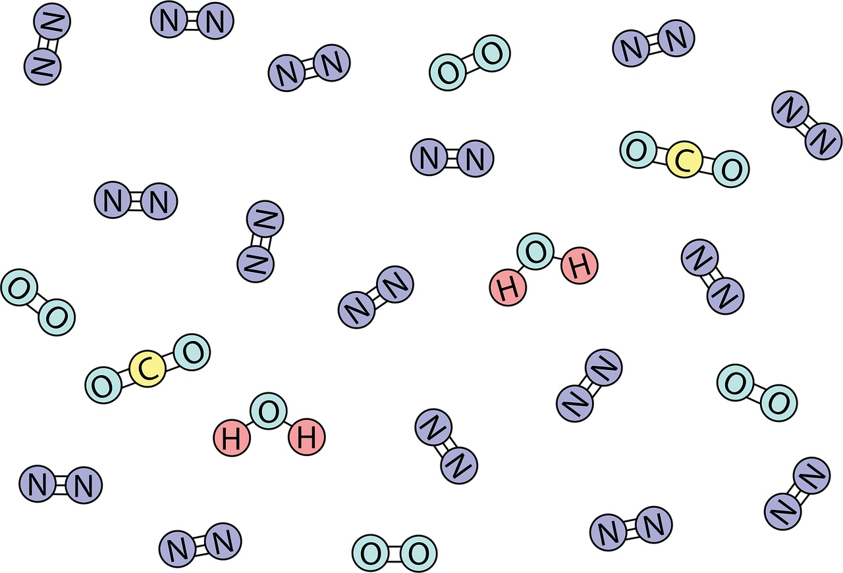
Fundamentals of Photosynthesis
Biological process in plants, algae, and select photosynthetic bacteria.
Converts sunlight, water, and carbon dioxide into chemical energy.
Synthesizes glucose (sugar) to fuel growth and metabolic functions.
Generates essential oxygen gas released directly into Earth's atmosphere.
Sustains global food chains and maintains atmospheric oxygen balance.

Slide 6

Survey of Key Computing and Biological Systems
FPGA: Reconfigurable integrated circuits enabling custom digital hardware post-manufacture.
FreeRTOS: Embedded operating system managing independent tasks and system states.
Cloud Computing: On-demand internet delivery of scalable computing and storage services.
Cloud Models: Categorized into Infrastructure (IaaS), Platform (PaaS), and Software (SaaS).
Photosynthesis: Biological process converting sunlight, water, and CO2 into oxygen.
Ecological Impact: Photosynthesis provides essential food and oxygen for living organisms.

Slide 7
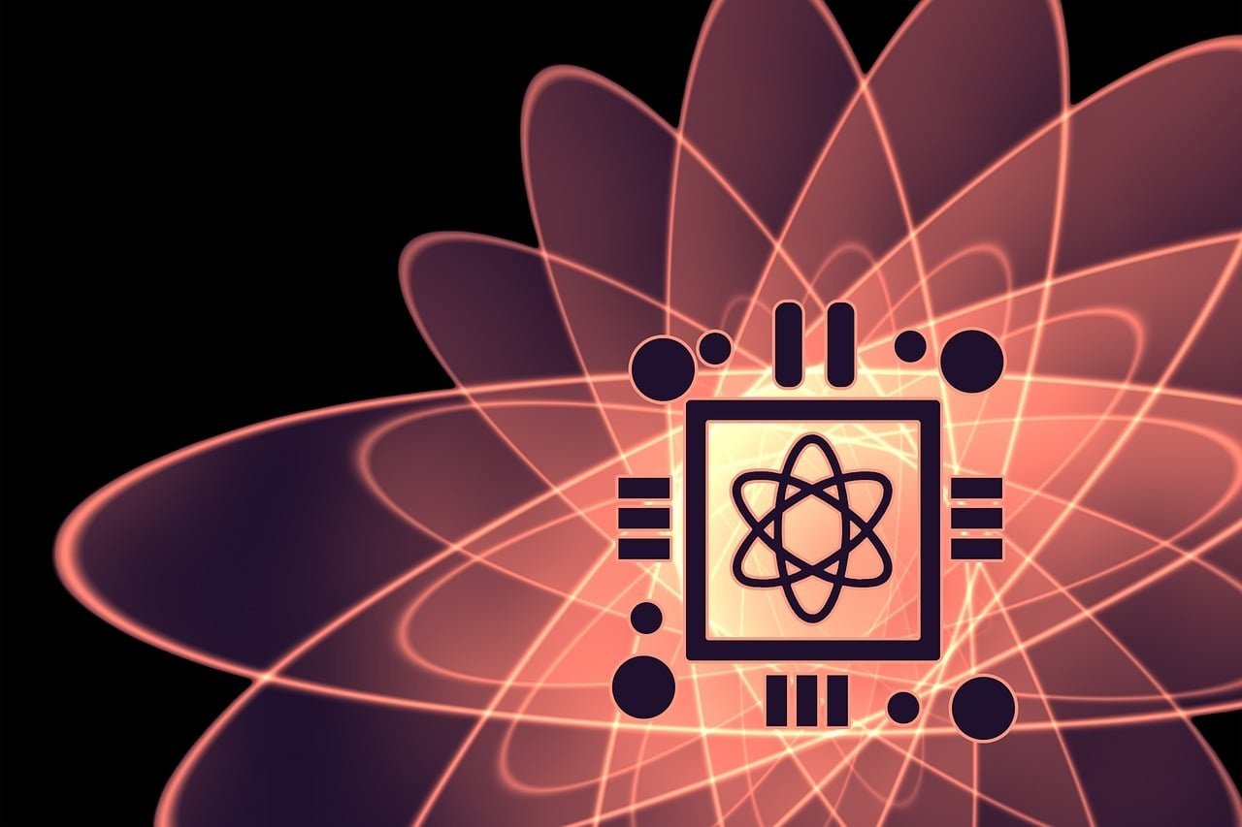
Survey of Fundamental Engineering and Biological Concepts
FPGAs: Reconfigurable integrated circuits enabling custom digital hardware post-manufacturing.
FreeRTOS: Real-time OS managing independent tasks across multiple execution states.
Cloud Computing: Internet-based delivery of hardware, storage, and software services.
Service Models: Cloud computing operates via IaaS, PaaS, and SaaS architectures.
Photosynthesis: Biological process converting sunlight, water, and carbon dioxide into energy.

