Slide 1
Live Lecture
AI Teaching Copilot

Slide 2
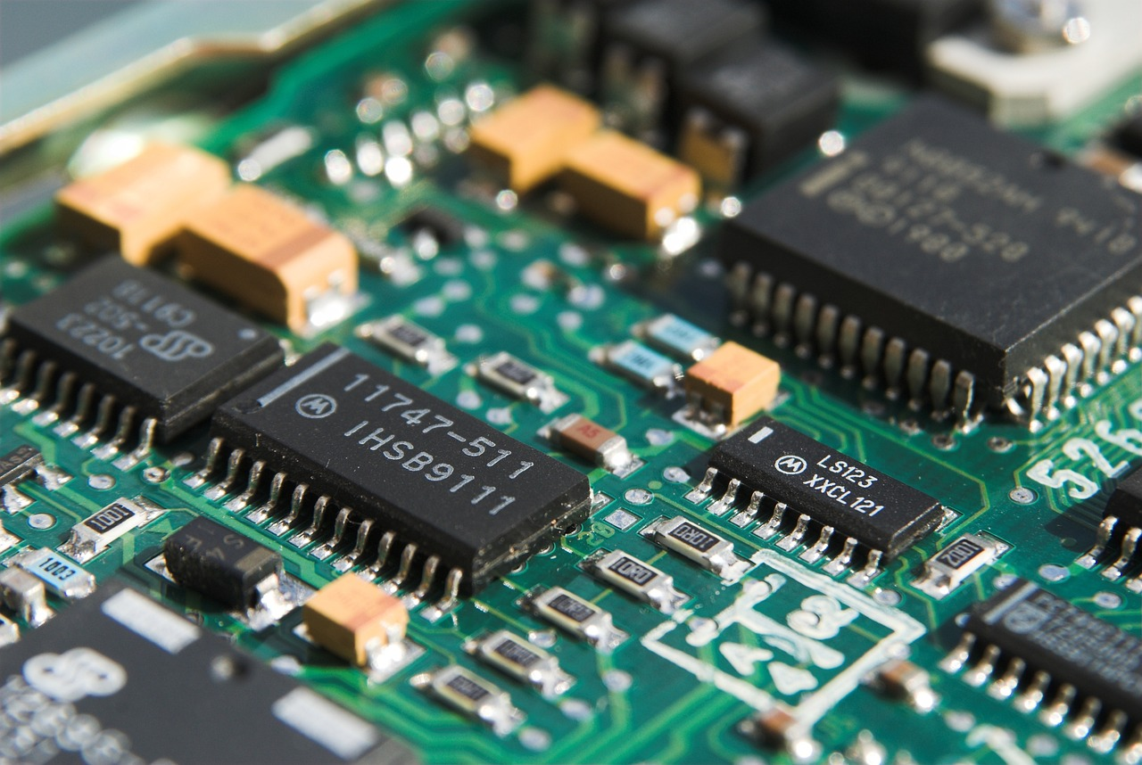
System-on-Chip (SoC) Integration & Advantages
Combines processor, memory, and I/O components onto one silicon chip
Powers modern portable electronics like smartphones, tablets, and wearables
Dramatically enhances processing speed and overall system performance
Reduces physical hardware footprint for compact consumer device design
Minimizes energy consumption to significantly extend mobile battery life

Slide 3
System-on-Chip (SoC) Architecture
Integrates processor, memory, and I/O onto a single microchip.
Powers modern compact devices like smartphones, tablets, and smartwatches.
Significantly reduces physical hardware size and circuit board footprint.
Delivers high-performance computing within a highly integrated system.
Optimizes energy efficiency by drastically lowering overall power consumption.

Slide 4
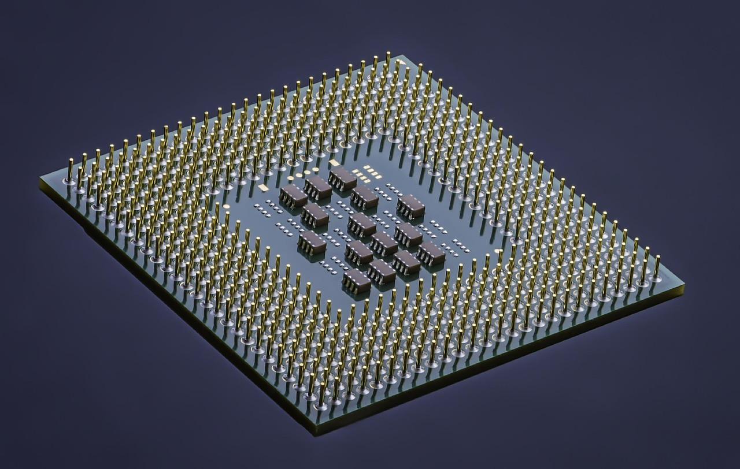
Introduction to System-on-Chip (SoC) Design
Integrates processor, memory, and I/O peripherals onto one microchip.
Replaces multi-chip architectures to streamline electronic system design.
Powers modern mobile devices including smartphones, tablets, and smartwatches.
Significantly reduces physical device footprint and overall hardware size.
Enhances processing performance by minimizing latency between components.
Optimizes energy efficiency by dramatically lowering overall power consumption.

Slide 5
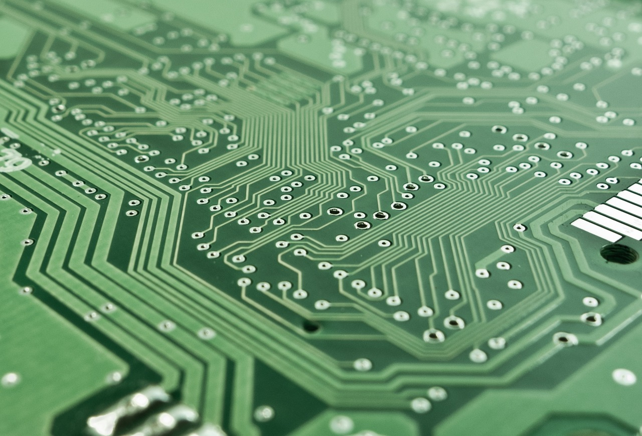
Introduction to System-on-Chip (SoC) Design
Integrates processors, memory, and I/O peripherals onto one microchip.
Powers modern electronics like smartphones, tablets, and smart devices.
Significantly enhances overall device performance and processing efficiency.
Drastically reduces physical hardware footprint and device size.
Optimizes energy management by significantly lowering power consumption.

Slide 6
System-on-Chip (SoC) Architecture & VLSI
Integrates processor, memory, and I/O peripherals on one microchip.
Powers modern devices including smartphones, tablets, and smart electronics.
Delivers exceptional computational performance in minimal space.
Drastically reduces physical size and hardware packaging requirements.
Optimizes energy efficiency by significantly lowering power consumption.

Slide 7
Introduction to System on Chip (SoC) Technology
Combines processor, memory, and I/O peripherals onto one microchip.
Powers modern mobile devices like smartphones, tablets, and smart wearables.
Dramatically reduces physical device size and hardware footprint.
Lowers operational power consumption to maximize battery efficiency.
Delivers high-performance computing through integrated component architecture.

Slide 8
Introduction to System-on-Chip (SoC) Design
Integrates processor, memory, and I/O peripherals onto a single silicon chip.
Powers modern mobile devices, smartphones, tablets, and smart wearables.
Delivers high computing performance within a drastically reduced physical size.
Significantly lowers power consumption compared to multi-chip electronic architectures.
Relies on Intellectual Property (IP) core integration for efficient system design.

Slide 9
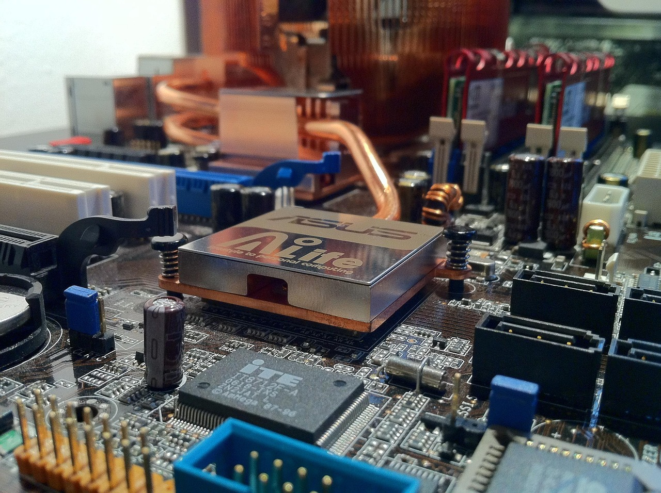
System-on-Chip (SoC) Architecture & VLSI Design
Integrates complete electronic systems onto a single semiconductor microchip.
Combines processing units, internal memory, and I/O peripherals together.
Powers modern mobile devices, including smartphones, tablets, and wearables.
Significantly reduces physical hardware size and overall form factor.
Dramatically lowers power consumption compared to multi-chip systems.
Delivers high processing performance in compact electronic architectures.

Slide 10
Lecture Conclusion: System-on-Chip (SoC) Design
SoC integrates processors, memory, and peripherals onto a single microchip.
Powers modern mobile technologies, smartphones, tablets, and smart devices.
Delivers exceptional computational performance within compact physical dimensions.
Significantly lowers power consumption for energy-efficient hardware operation.
Enables seamless connectivity across digital networks and integrated IP modules.
Thank you very much for your time and participation today.

Slide 11
Introduction to VLSI System-on-Chip (SoC) Design
Integrates processor, memory, and I/O peripherals onto one microchip.
Enables complete System-on-Chip (SoC) architecture for modern electronics.
Powers everyday devices including smartphones, tablets, and smart hardware.
Delivers significantly enhanced computational performance and overall speed.
Reduces physical component footprint to allow compact form factors.
Minimizes operational power consumption to maximize energy efficiency.

Slide 12
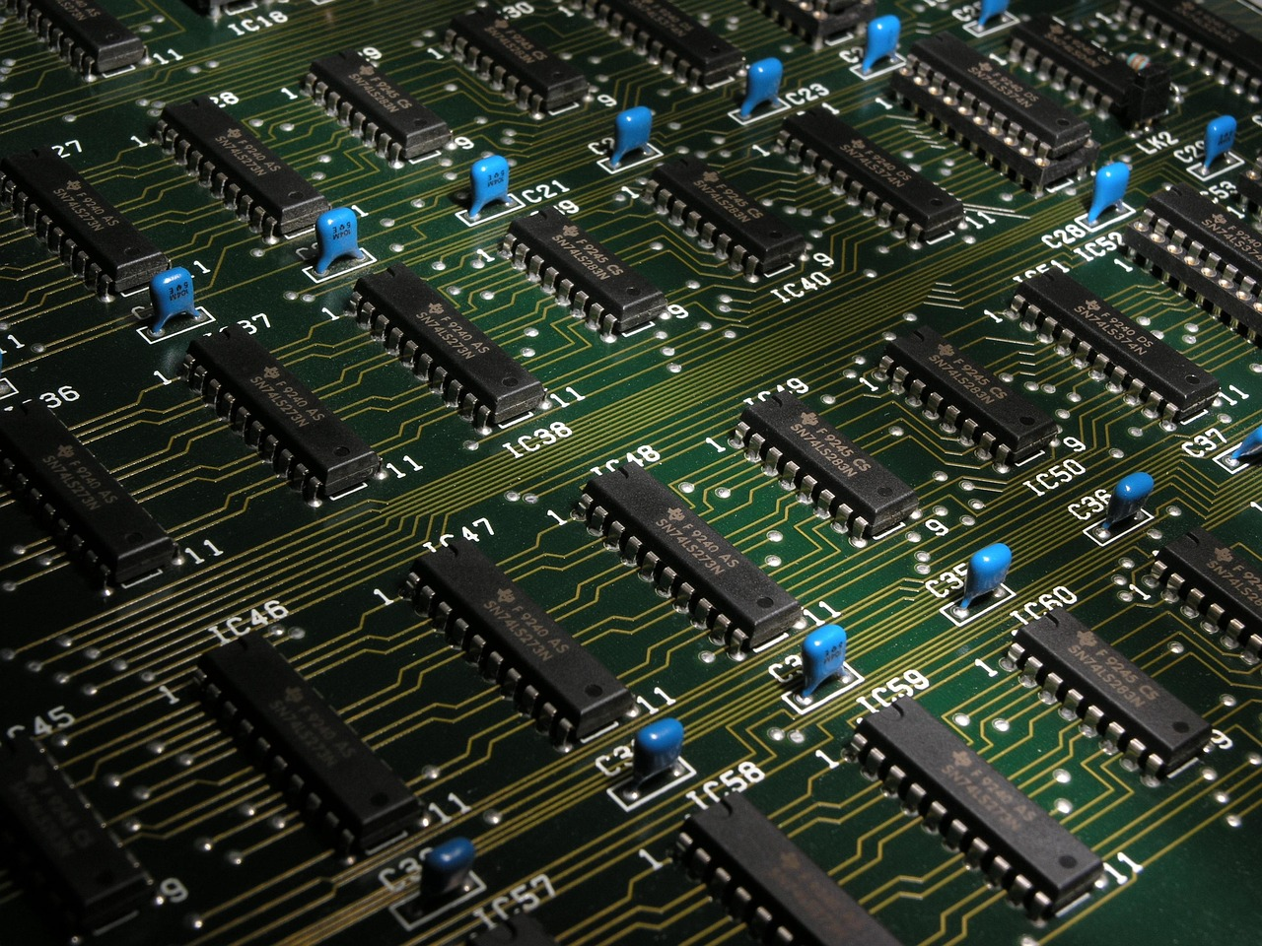
Introduction to System-on-Chip (SoC) & VLSI Integration
Integrates processor, memory, and I/O onto a single microchip.
Powers modern mobile devices, smartwatches, and embedded systems.
Delivers high computational performance in a compact physical footprint.
Significantly reduces overall power consumption for portable electronics.
Utilizes reusable Intellectual Property (IP) cores for streamlined integration.
Facilitates efficient internal data routing across all system peripherals.

Slide 13

Digital Network Integration and Systems Workflows
Digital infrastructure links remote projects, files, and office environments seamlessly.
Network configuration requires accurate IP addressing and content routing protocols.
Wireless connection stability is critical for continuous digital site integration.
Structured data handling ensures secure physical and digital document processing.
Replicating network connections streamlines workflow efficiency across multiple endpoints.
Interpersonal team collaboration supports effective technical system execution.

Slide 14

Closing Session & Gratitude
Connected seamlessly across digital systems, projects, and office networks.
Successfully completed key tasks and reviewed core operational processes.
Maintained strong communication and collaborative effort throughout the session.
Verified technical connections and file management procedures.
Deep appreciation expressed for team dedication and hard work.
Farewell and best wishes for upcoming collaborative projects.

