Slide 1
Live Lecture
AI Teaching Copilot

Slide 2
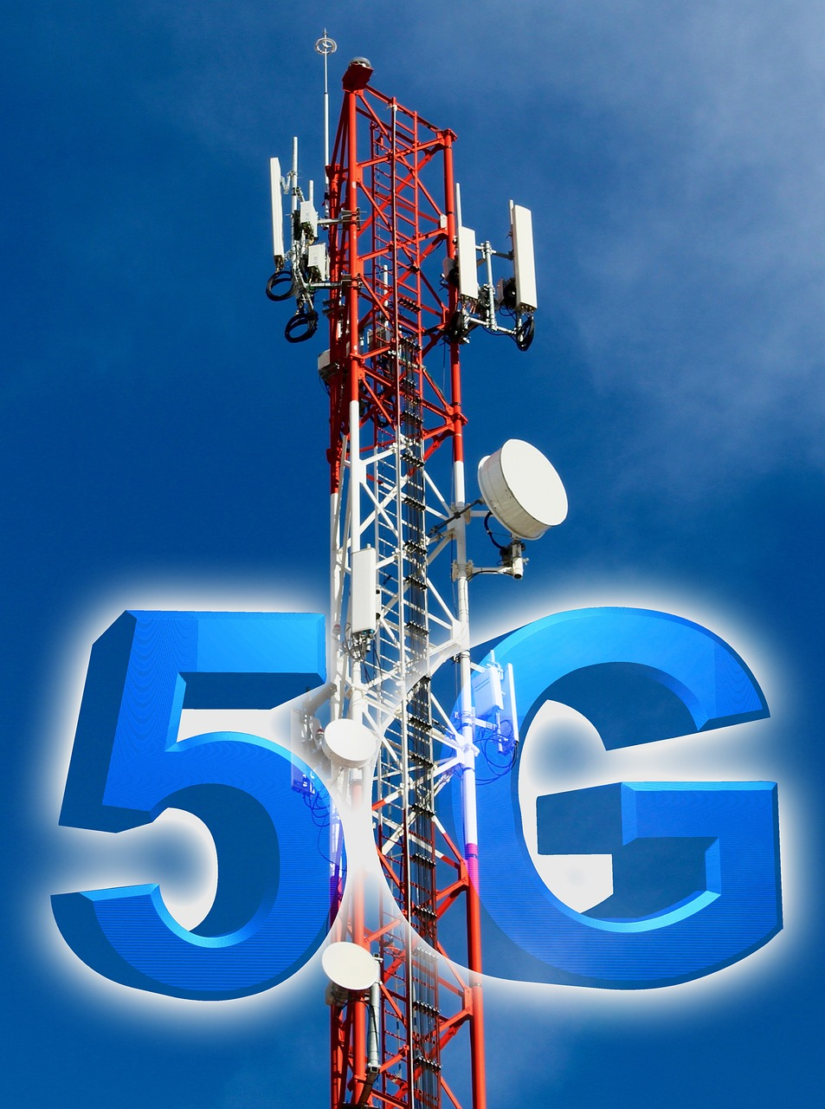
Fundamentals & Applications of 5G Technology
Next-generation wireless standard connecting people, machines, and IoT devices.
Delivers ultra-fast multi-gigabit peak speeds with near-zero network latency.
Key features include network slicing, expanded capacity, and high reliability.
Transforms transport and healthcare via autonomous driving and telemedicine.
Powers smart city infrastructure and interactive immersive media experiences.

