Slide 1
Live Lecture
AI Teaching Copilot

Slide 2
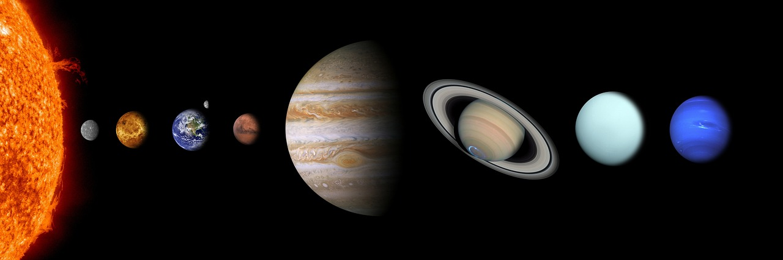
Structure and Classification of the Solar System
Eight distinct planets orbit the central Sun in structured regions.
Inner planets: Four terrestrial, rocky worlds closest to the Sun.
Outer planets: Four massive gas giants positioned in outer orbits.
The Asteroid Belt separates the inner Mars and outer Jupiter.
Notable extremes: Mercury is the smallest; Venus is the hottest.
Major features: Jupiter is the largest; Saturn possesses prominent rings.

Slide 3
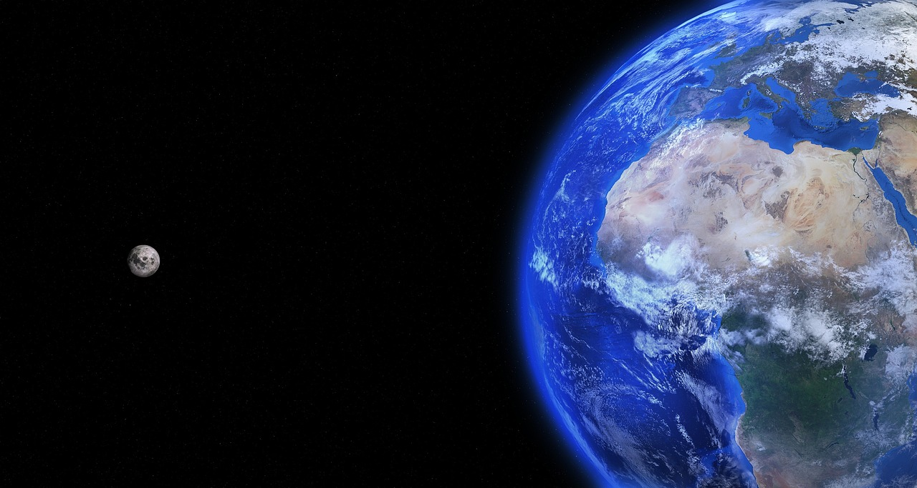
Overview of Solar System Structure
Eight planets revolve around the central Sun.
Inner terrestrial planets are rocky; outer jovian planets are gaseous.
Mercury is the smallest, while Jupiter is the largest planet.
Venus is the hottest planet in the solar system.
Saturn is distinguished by its extensive planetary ring system.
An asteroid belt divides Mars and Jupiter's orbital paths.

