Slide 1
Live Lecture
AI Teaching Copilot

Slide 2
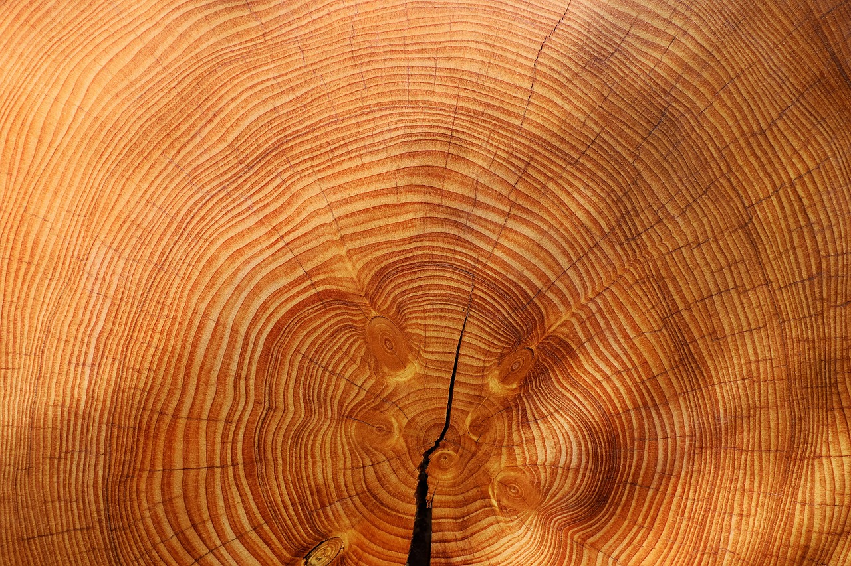
Fundamentals of Photosynthesis
Photosynthesis converts solar energy, water, and carbon dioxide into food.
Occurs in plants, algae, and specific photosynthesizing bacteria.
Chlorophyll pigments in leaves absorb light energy from the sun.
Roots absorb soil moisture while leaf stomata pull carbon dioxide.
Light energy transforms raw inputs into energy-rich glucose sugar.
Generates oxygen and water vapor as metabolic byproducts.

