Slide 1
Live Lecture
AI Teaching Copilot

Slide 2
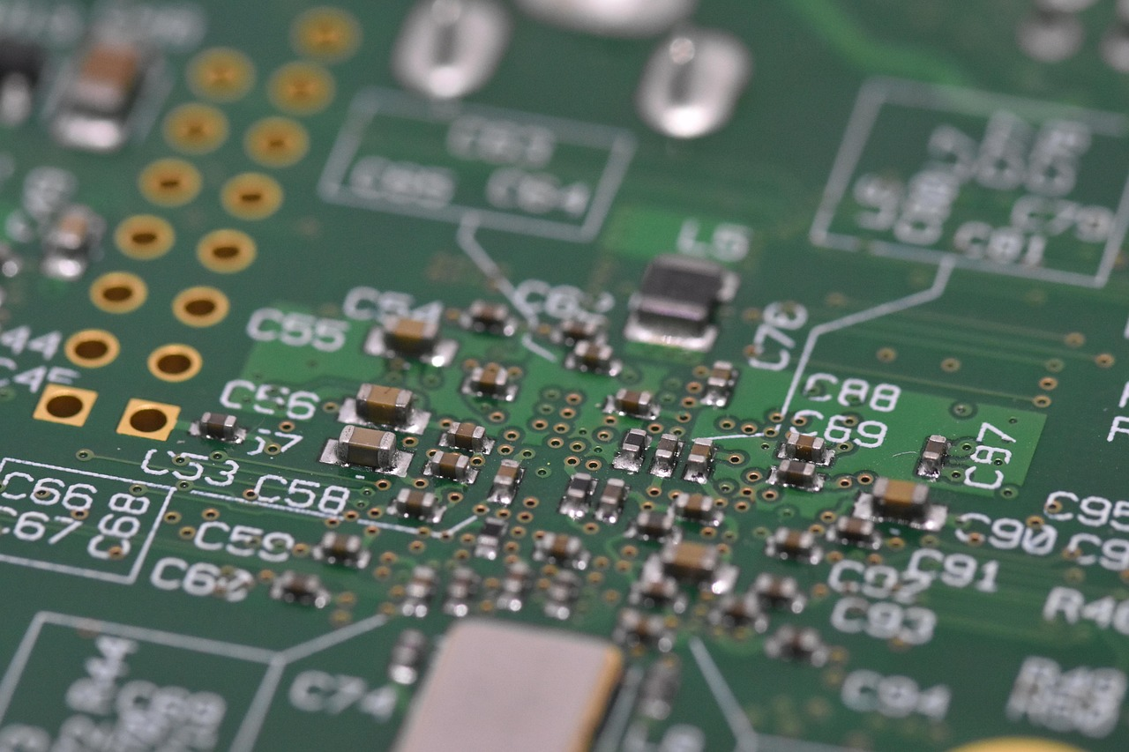
Introduction to Raspberry Pi: Single-Board Computing
Compact Single-Board Computer (SBC) featuring onboard RAM and customizable storage.
Supports standard desktop peripherals and full Linux operating system environments.
Executes advanced computational workloads including OpenCV and ROS framework models.
Ideal hardware platform for embedded systems, physical AI, and robotics.
Cost-effective and power-efficient solution for rapid engineering prototyping.
Mainstream variants include high-performance Raspberry Pi 4 and Pi 5.

