Slide 1
CYBER LAW IN INDIA
Real Challenges, Legal Framework & Solutions
Subject: PESE
Team Legal (5 Members)
Notes:
Member 1 introduces the topic and importance of cyber law in modern India.

Slide 2
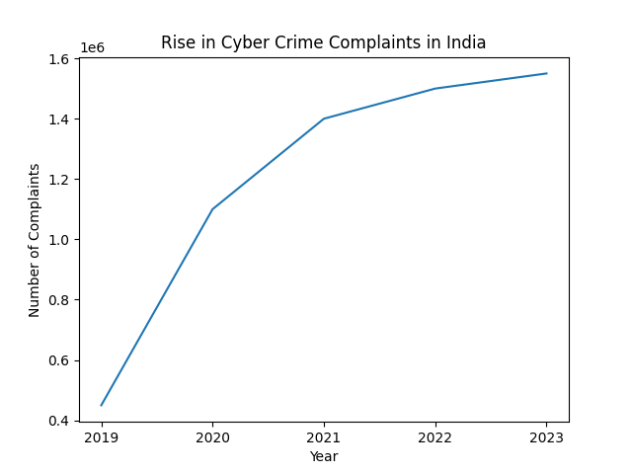
Digital India & Cyber Crime Reality
850+ Million Internet Users in India
Massive Growth in UPI & Online Banking
Over 1.5 Million Cyber Crime Complaints (Recent Years)
Most Common: Phishing & OTP Fraud
Problem: Digital growth faster than awareness
Solution: Strong Cyber Law + Public Awareness
Notes:
Explain digital expansion and rising cyber complaints. Give example of OTP fraud case.

Slide 3
Legal Framework – IT Act, 2000
Main Law: Information Technology Act, 2000
Amended in 2008 for modern cyber crimes
Legal recognition to digital signatures & e-records
Section 75: Applies even outside India
Problem: Technology evolving rapidly
Solution: Continuous amendments & enforcement
Notes:
Explain importance of IT Act 2000 and why amendments are needed.

Slide 4
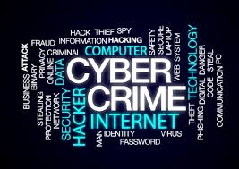
Major Cyber Crimes in India
Phishing & Bank OTP Fraud
UPI & Online Payment Scams
Identity Theft (Section 66C)
Cyber Bullying & Harassment
Ransomware Attacks
Solution: Awareness + Two-Factor Authentication
Notes:
Give real-life example like fake bank call asking OTP.

Slide 5
Important Sections of IT Act
Section 43 – Damage to Computer Systems
Section 66 – Computer Related Offences
Section 66C – Identity Theft
Section 66D – Online Cheating
Section 67 – Obscene Content Online
Punishment: Fine + 3 to 7 Years Imprisonment
Notes:
Explain that strict punishment exists but awareness is low.

Slide 6
Problems & Practical Solutions
Problem: Low Public Awareness
Solution: Digital Education & Awareness Programs
Problem: Data Theft & Privacy Issues
Solution: Encryption & Cyber Security Tools
Problem: Underreporting of Crimes
Solution: National Cyber Crime Portal Reporting
Notes:
Explain that law alone is not enough; awareness and reporting are essential.

Slide 7
Cyber Law & PESE (Employability Skills)
Promotes Ethical Digital Behavior
Important for Corporate Professionals
Useful Knowledge in Job Interviews
Builds Responsible Digital Citizenship
Strong Closing: Cyber Law is a Digital Responsibility
Notes:
Conclude confidently. Link topic with PESE and interview importance.

Slide 8
Thank You
Thank You for Listening
Any Questions?
Notes:
Team thanks audience.

