Slide 1
Network Design Proposal For Bank

Slide 2
Abstract
Network Design Proposal for Bank
A network proposal has to be developed for a bank. The bank has a main office , which is located in Chennai, and has 5 branch offices located at Coimbatore, Madurai, Trichy, Salem and Tirunelveli. The bank has an application server, which is used by it’s customers across the world for online transactions. All the branches have high speed internet connection. There are approximately 50 users in each of the branch offices and 100 users in the main office.

Slide 3
Introduction
An ideal Bank Networking system will be fully network base and easy with friendly user interface staff task management system where any banking system manage their networking system somehow Head office , Branch Office, and other office are maintain LAN, MAN, WAN, VLAN, VLSM,VPN and some branch are maintain by manageable switch.
LAN is used by Local Area Networking system for example one office and a one building. And MAN are using by the Metro Politian area Network for Example small town, and WAN are use by the WIDE AREA NETWORK.
In this networking system are used by all banking users can use by shared their data very easily. So that every user use to take about Network Structure & Security of Banking System instantly this way anywhere.

Slide 4
Objectives
To design and simulate a banking network system which is secure.
To simulate a banking network system that will easily manage any banking task.
To manage the banking network by a central system

Slide 5
Literature Survey
Title of the Paper- | Author- | Objective of the paper- | Methodology- | Result- | Reference
Design and Simulation of a Banking Network System | Abdul Hannan , M.A.Jobayer Bin Bakkre , Rajib Chandra Ray , Md.Selim Hossain . | The general aim of this project is to simulate a banking system which is secure and easy to use. Previously the system was manual, not secure, also working slowly. This proposed system overcomes the lacking of the existing manual system. | In this project “Design and Simulation of a Banking System” discuss the total banking network structure & some security feathers. | In today’s world, people are using mobile banking and internet banking services that help people manage banking online. This project will help people to deal with all this in a well planned and easy manner. | http://www.ajer.org/papers/v4(11)/K0411079091.pdf

Slide 6
Journals referred
Title- Design and Simulation of a Banking Network System
Author- Abdul Hannan , M.A.Jobayer Bin Bakkre , Rajib Chandra Ray , Md. Selim Hossain .
Title- Creating Network Design Proposal Based On Specific Requirements
Author- Jenny Larrson

Slide 7
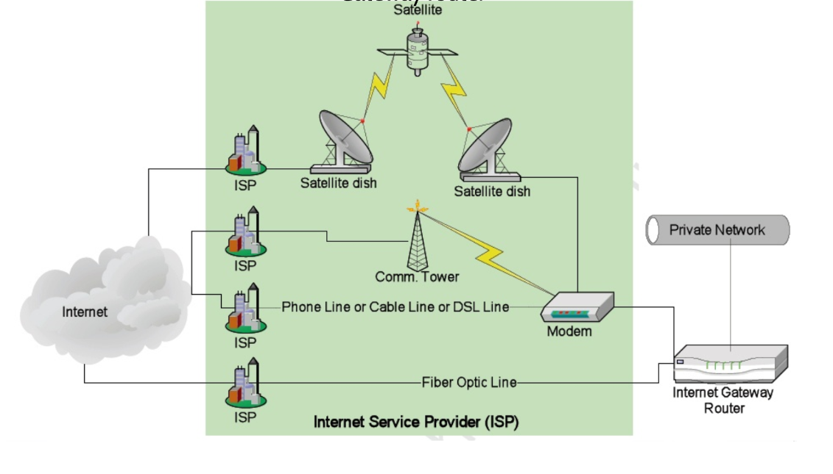
Hardware Components
Cable and dsl modems
Switch/ Routers
Wireless modems
Cable connection
32 GB RAM
Intel i5 Processor
Servers
Keyboard and mouse
Hard disk 100 GB

Slide 8
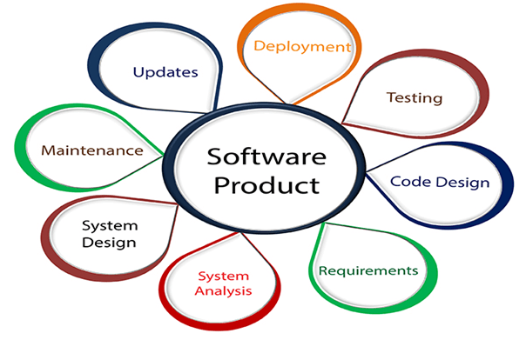
Software Requirements
This following software we have used to implement our project-
Packet Tracer 7.3.1
Windows 10 platform.
Antivirus Software
Switch.
Router.
Firewall.
Virtual Machines

Slide 9
Network Design & Configuration
Connect the VPN appliances to the appropriate internet connections.
Configure VLANS, VLAN 2 and VLAN 3 on the switches at the main office.
Connect one of the ports on the switch to the trunk port on the NSA appliance.
Configure the VLAN 2 and VLAN 3 gateway on the NSA appliance as 192.168.1.1 and 192.168.2.1 respectively.
Configure site to site IPSEC tunnels between the TZ170 and NSA.
Configure static NAT on the NSA appliance to map the public IP address of the application server with the LAN IP address.
Configure ACL on the NSA appliance to allow only TCP port 443 (https) communication the application server. Configure ACL’s to allow all traffic between the branch and main office networks.
Configure failover cluster on the application server, for high availability.

Slide 10
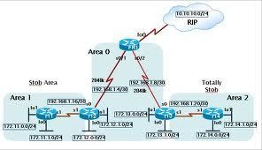
Design and Methodology
In this project “Network Design Proposal for Bank” discuss the total banking network structure & some security feathers. We are survey in the different bank and collect some data or information.
The OSI layer was introduced by the International Organization for Standardization (ISO) in 1984 in order to provide a reference model to make sure products of different vendors would interoperate in networks.
OSI is short for Open Systems Interconnection. Data transmitted between software programs passes all 7 layers.
The Application, Presentation and Session layers are also known as the Upper Layers. The Data Link and Physical layers are often implement4ed together to define LAN and WAN specifications

Slide 11
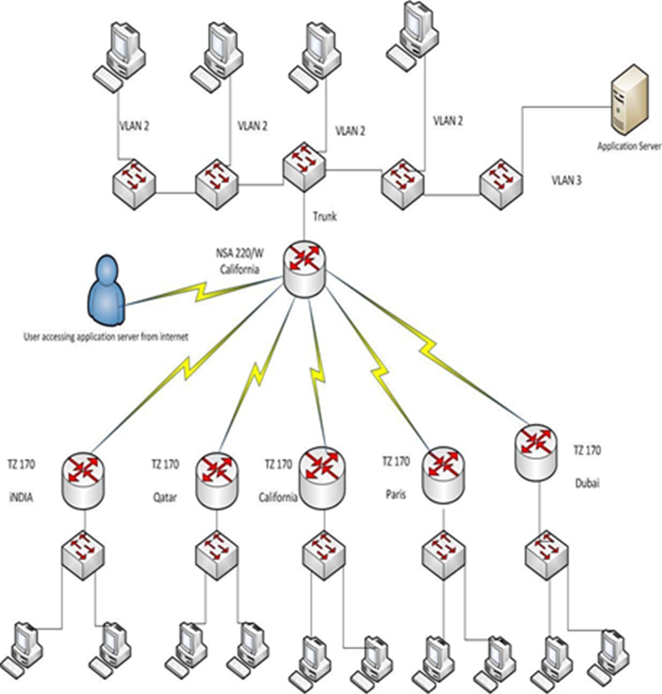
Network Topology Design
Architecture

Slide 12
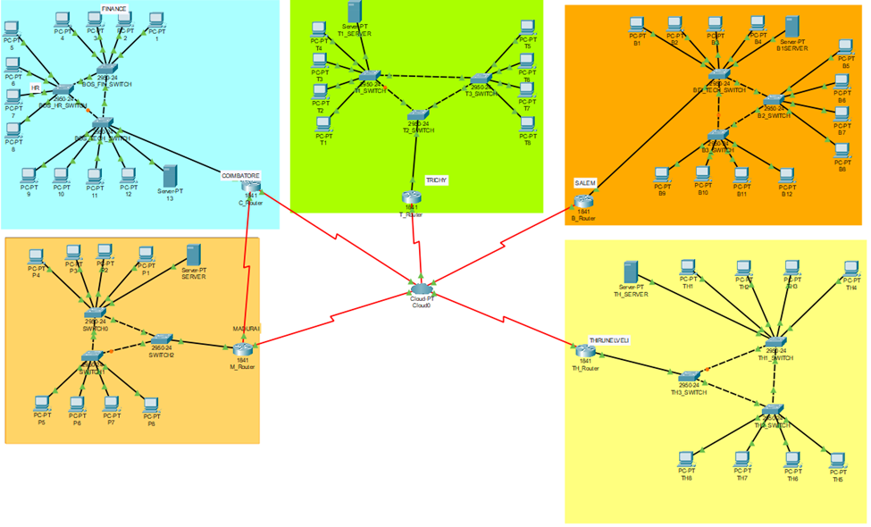
Network Topology Diagram Implementation

Slide 13
Result
Now a days, technological development, and automated system development is more essential and crying need for the expansion of banking services because they will need less employers by using automated system.
On top of that Security is a major issue regarding banking issues. With this system network will be more easy to handle and it will route the data in a shortest path in a vast distributed system.
In future we will try to implement it in real life so that banks can use it and get benefited from this project.

Slide 14
Limitations
We will not be able to resolve issues from any of the following by using this Network:
  Any unreported/ undetected Bugs in standard software’s, or tools
  Any changes in Application Software features
  Older versions are incompatible with current features
Lease line uptime depends on a particular Service Provider.
This Network is limited by the state of technology and functionality of software tools or products deployed.
Third-party IOS integration will be carried out on the best-effort basis.
All hardware devices upgrades, hardware re-deployments, and policy changes shall be done after the mutual consent of the customer, based on the impact it would have on the overall security situation and performance of the network.
Security can be implemented in a better way.

Slide 15
Conclusion
There is a vast future scope of this Network. This Design can be improved and can be used by various banks.
If the limitations present in this Design are removed then, this Network will become very reliable and provide 100% uptime.
We can easily implement any changes to the Network Design as we are using the latest protocol like Border Gateway Protocol (BGP) in our network which is having attributes to easily divert or control the flow of data and QOS which can be used to allocate bandwidth to servers accordingly.

Slide 16
References
J.Claessens, V. Dem, D. Cock, B. Preneel, J. Vandewalle (2002) “On the Security of Today's On-line Electronic Banking Systems”.
Andrew S. Tanenbaum, (2002)“Computers network”.
CCNA study Guide, Available At: https://www.google.com.bd/?source=search_app&gws_rd=cr, ssl&ei=y9b VYniG4KsuQ TuvY84#q=Todd+Lammle,+%E2%80%9CCCNA+study+Guide%E2%80%9D,BPB+Publications,+Edition:+5th .
Computer Network Device, Available At: http://basic-networking.blogspot.com/2007/08/computer-network-devices-and component.hml.
IPv4 -Address Classes Available At: http://www.tutorialspoint.com/ipv4/ipv4_address_classes.htm
Stuttgart Available At: http://www.ba-stuttgart.de/~schulte/html/55771.html#HDR3
http://cisco.com/univercd/cc/td/doc/cisintwk/ito_doc/ethernet.htm#1020850
Definition Available At : www.defination.com
OSPF Available At: http://www.answers.com/topic/open-shortest-path-first
Understanding of ATM in Bangladesh Available At: http://www1.searchresults.com/web?l=dis&q=understanding+ ATM+in+bangladesh&o=APN10645&apn_dtid=^BND406^YY^BD&shad=s_0042&apn_uid =9734054855124.
Access Control List (ACL) Available At: http://en.wikipedia.org/wiki/access_control_list.
standard-access-control-list Available At: http://www.answers.com/topic/standard-access-control-list.
Computer networking Available At: http://compnetworking.about.com/od/vpn/g/bldef_vpn.htm.
OWASP Available At: https://www.owasp.org/index.php/Category: OWASP_Top_Ten_2013_Project

Slide 17
Presented by –
Name Reg. No.
Parivesh Sood RA1811029010018
Satyam Gupta RA1811029010019
Aditya Anand RA1811029010020
Selvaa M RA1811029010021

