Slide 1
Pharmacy Management System

Slide 2
Abstract Pharmacy Management System
The Pharmacy Management System, in all its uniqueness, is a comprehensive solution for efficient, quick and elegant management of a medical enterprise which includes a wide array of functional activities ranging from medicine and store management to supply and transaction processing.
To build a Management System that can efficiently handle all the functional activities of a pharmaceutical enterprise- Store Management, drug management, transactions, distribution and supply.

Slide 3
Objectives
To handle the data of all stores affiliated to a particular enterprise and means to setup records of an allocated store.
To handle the distribution of medicines to each store whereby a virtual representation of a dealer/distributor/supplier is considered.
To manage and monitor all the transactions associated with every store, and to be able to retrieve the details of the desired transactions.
To keep a constant track on the medicines available in each store, their expiry status, and the quantity. Necessary measures are to be taken as and when the above said status hits an undesirable mark.

Slide 4
To obtain useful statistical information about the entire system, (e.g.: The list of medicines that are the best sellers), which may provide a great impetus for the organizations to expand and improve their business, ultimately benefitting the society.
To provide security in terms of authentication so that only the authorized personnel is allowed to carry out his activities in his sphere of control.
To ensure interoperability between the various functional units which may be accomplished by coordinated messages and requests, while at the same time maintaining the integrity of each unit.

Slide 5
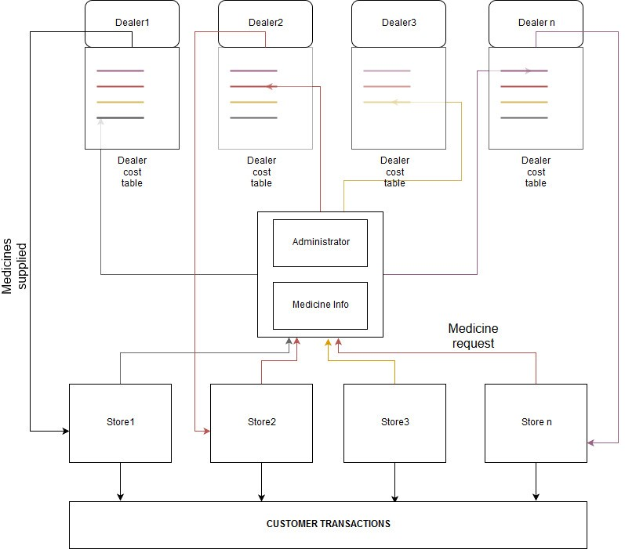
Representation

Slide 6
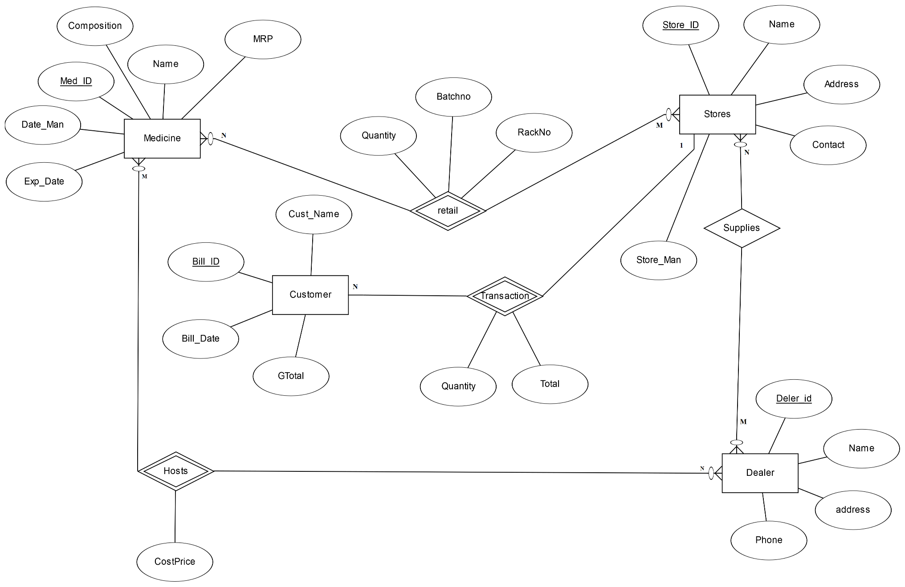
ER DIAGRAM

Slide 7
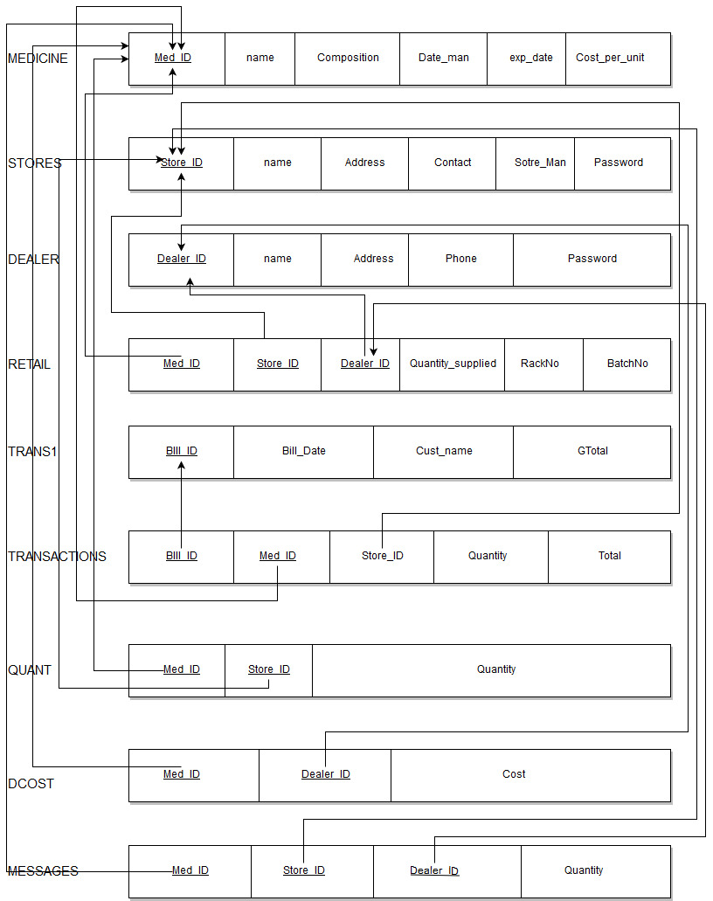
SCHEMA

Slide 8
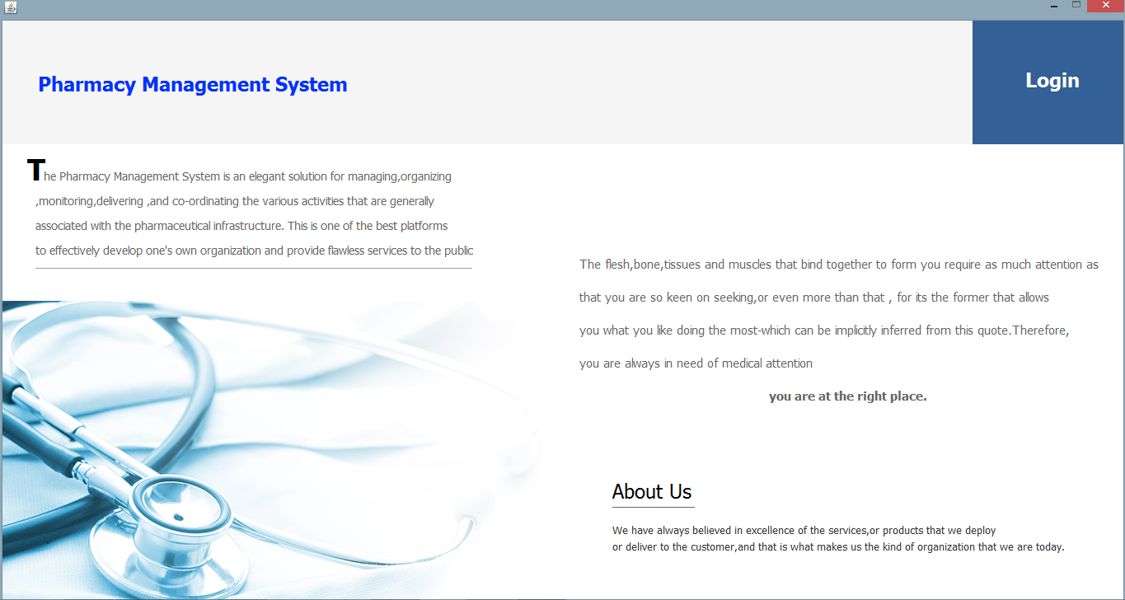
Results and Screenshots
Start Page

Slide 9
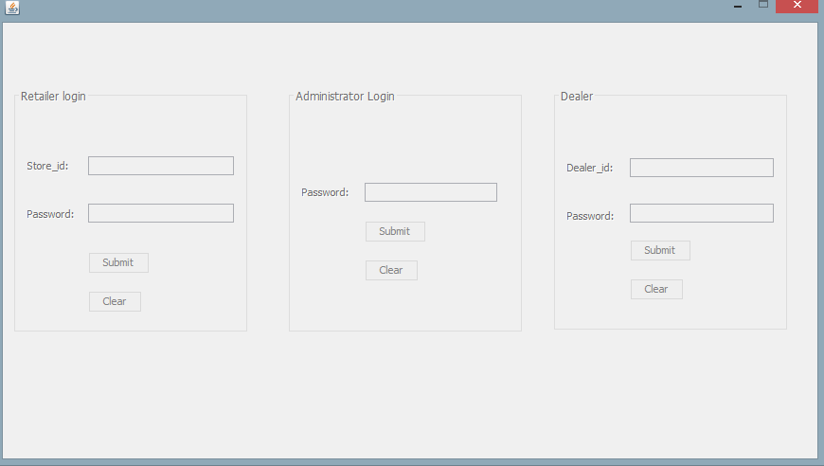
Login Page

Slide 10
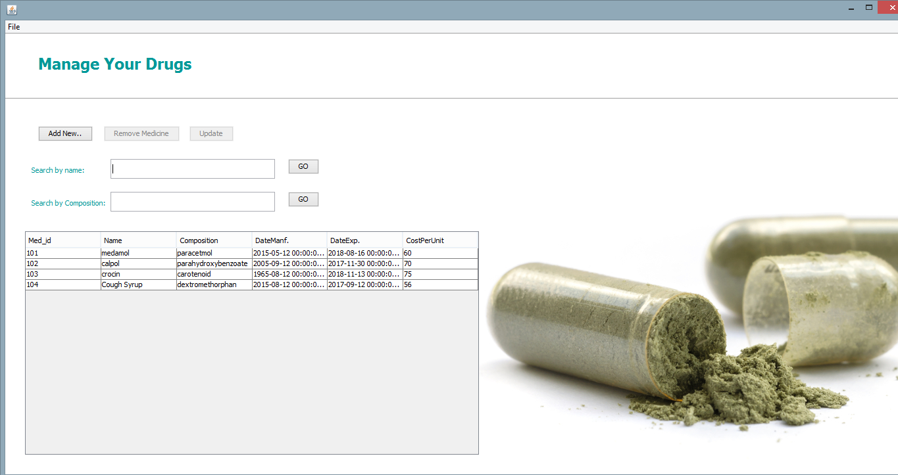
Medicine Management

Slide 11
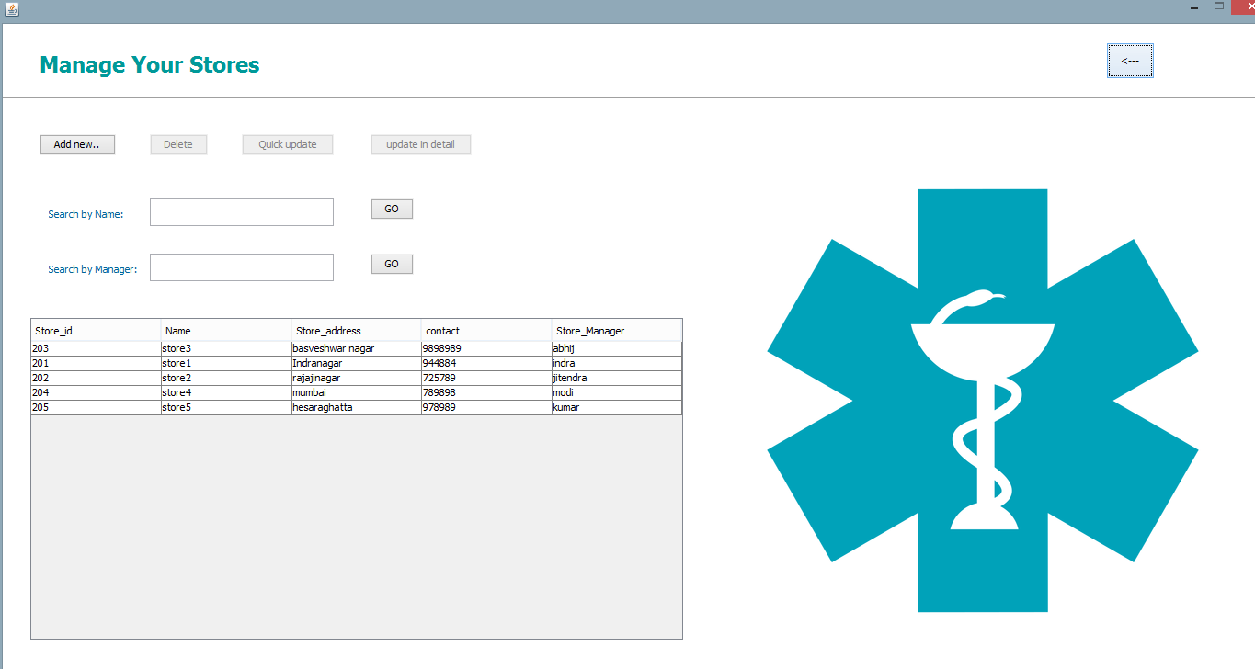
Store Management

Slide 12
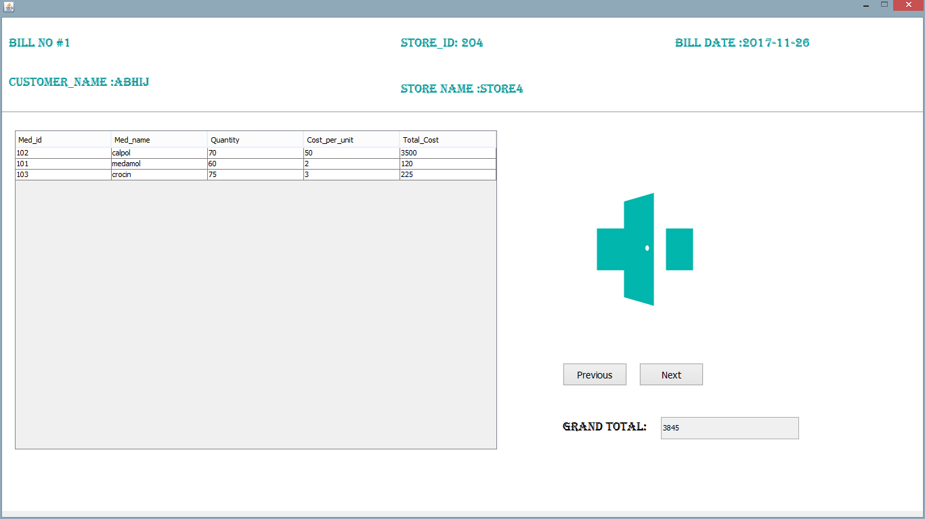
Viewing a Transaction

Slide 13
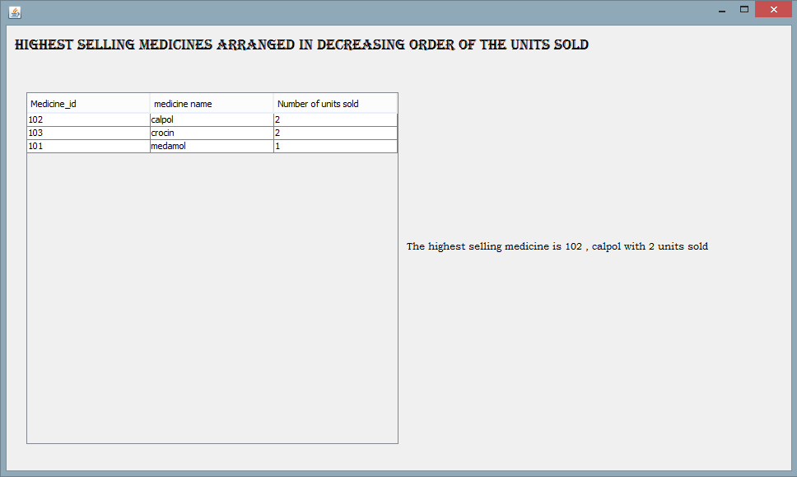
Highest Selling Medicine

Slide 14
Future Works
This system can be enhanced by having provisions to calculate the cost price incurred to buy medicines from the dealer, and to formulate the profit data (using the transaction data produced by each store). Appropriate statistical quantities may therefore by calculated, organized and shown.
The details of prescription can also be included- the doctor’s name, the illness treated etc.
Each bill can have a code (qr or bar) and a scanner can be used to scan this to retrieve information about the transaction
An android based mobile application can be developed which is easy to use and portable.

Slide 15
Conclusion
The Pharmacy Management System, (its conception, organization, development and integration), has been a tremendous task and the objectives have been well accomplished. The system provides the user with a user-friendly interface. Textual data entry (for obtaining information) is minimized as much as possible by replacing it with GUI constructs. The focus lies on displaying the right information to the user from a huge pool of data. Relating the data, and retrieving the related data makes it easy to use.

Slide 16
References
R. R. Berardi, L. V. Allen, E. M. DeSimone (eds.), Handbook of Nonprescription Drugs, 14th ed., American Pharmaceutical Association, Washington, DC, 2004.
G. Briggs, R. K. Freeman, S. J. Yaffe (eds.), Drugs in Pregnancy and Lactation, 7th ed., Williams & Wilkins, Baltimore, MD, 2005.
J. T. DiPiro, T. L. Schwinghammer, B. Wells (eds.), Pharmacotherapy: A Pathophysiologic Approach, 5th ed., Appleton & Lange, Stamford, CT, 2002.
A. R. Gennaro, et al. (eds.), Remingtonâ™s The Science and Practice of Pharmacy, 20th ed., Mack Publishers, Easton, PA, 2000.
J. D. Grabenstein, Immunofacts: Vaccines and Immunologic Drugs, Drug Facts and Comparisons, St. Louis, MO, 1995.
P. D. Hansten, J. R. Horn (eds.), Drug Interactions: Analysis and Management, Drug Facts and Comparisons, St. Louis, MO, 2004.
J. G. Hardman, L. E. Limbird (eds.), Goodman & Gilmanâ™s Pharmacological Basis of Therapeutics, 10th ed., McGraw Hill, New York, NY, 2001.

Slide 17
Presented by –
Name Reg. No.
Parivesh Sood RA1811029010018
Mohit Verma RA1811029010016
Shubham Aggarwal RA1811029010023
Sahil K. Patel RA1811029010005

