Slide 1
SMART INDIA HACKATHON 2026
SIH
2026
IDEA SUBMISSION — TITLE PAGE
Problem Statement ID:
26186
OUR CORE IDEA
Not “is this person stressed today?”
Problem Statement Title:
AI-Based Predictive Personnel Stress and
Welfare Monitoring System for Uniformed Forces
But “is their welfare trajectory deteriorating — and when should a human step in?”
Theme:
MedTech / BioTech / HealthTech
PS Category:
Software
32
→
41
→
57
→
73
Team ID:
CSE-SIH-038
Stable
Rising
Concerning
Critical
Team Name (Portal):
PsychoLogics
Risk trajectory over successive check-ins (illustrative)
SIH 2026 Idea Submission | PS ID 26186 | Team CSE-SIH-038 — PsychoLogics
1

Slide 2
PsychoLogics
WMS — WELFARE MONITORING SYSTEM
SIH
2026
Proposed Solution
A privacy-first, welfare-support early-warning system for uniformed personnel that fuses HR, deployment, workload and voluntary wellness data into a longitudinal welfare-risk trajectory — flagging deteriorating trends to trained welfare officers for human review, not automated diagnosis or disciplinary action.
UNIQUE VALUE PROPOSITION
Longitudinal, not one-time
Tracks the shape of a trend (32→41→57→73: Stable→Rising→Concerning→Critical), not a single questionnaire snapshot.
Fuses voluntary wellness check-ins with HR, deployment, leave and workload records — contextualized risk, not isolated indicators.
Psychology-informed
Need-to-know RBAC: personnel see only their own data; welfare officers see assigned cases; commanders see aggregated unit-level trends only.
Uses validated screening instruments (GAD-7, PHQ-9 style constructs) and DSM/ICD-informed logic — never an automated diagnosis.
Longitudinal trajectory engine tracks how welfare risk changes over successive check-ins — not a single-point-in-time score.
Calibrated & explainable
Every risk score ships with a confidence level and the top contributing factors, so reviewers can trust or challenge it.
Explainable reason codes accompany every flag (e.g. ‘+18% risk from workload, +9% from deployment tempo’) so a human reviewer sees why, never a black-box number.
Human-in-the-loop by design
The system recommends and prioritizes; only a trained welfare officer decides on intervention.
How it addresses the problem: Shifts welfare management from reactive, manual self-reporting to proactive, trend-based early intervention — while keeping a human decision-maker in every loop.
SIH 2026 Idea Submission | PS ID 26186 | Team CSE-SIH-038 — PsychoLogics
2

Slide 3
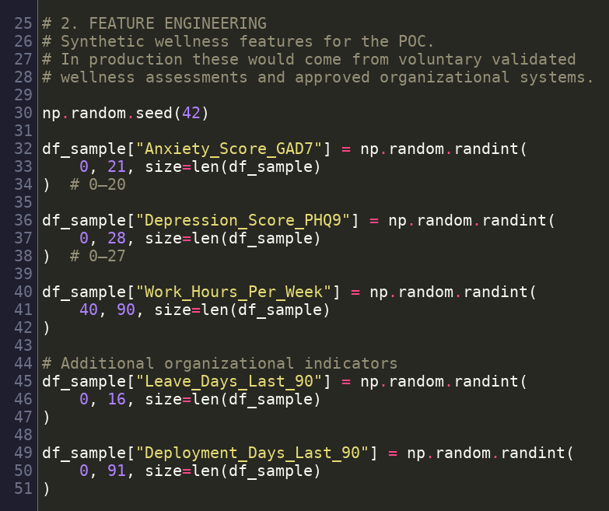
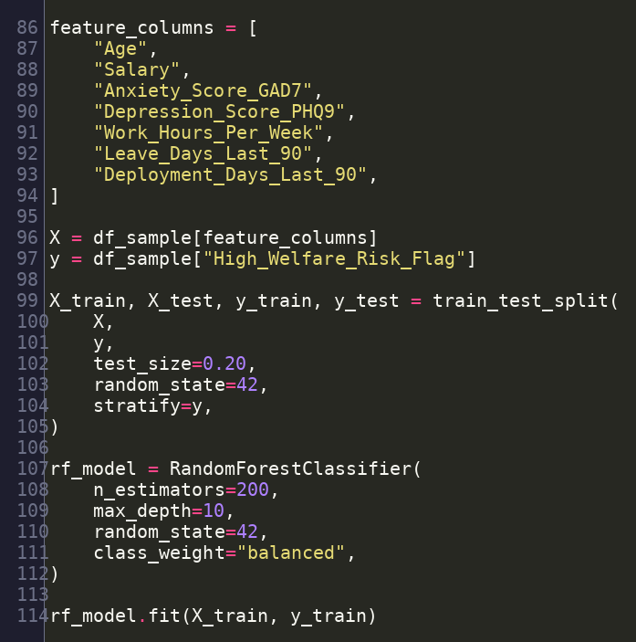
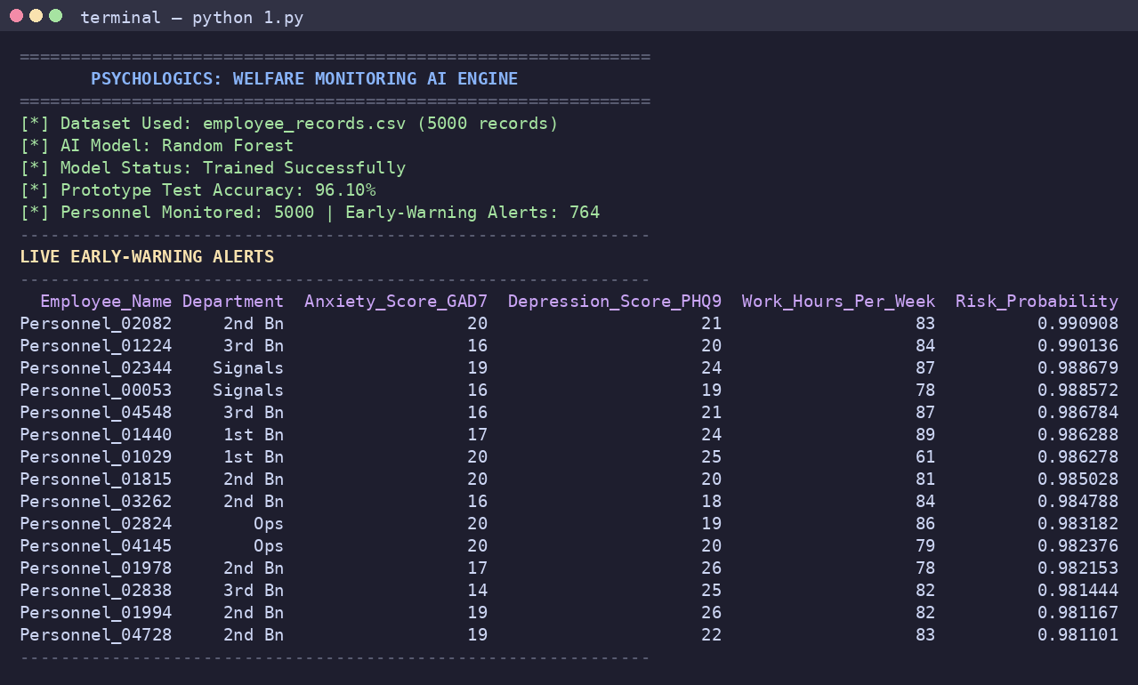
PsychoLogics
TECHNICAL APPROACH
SIH
2026
Data
Ingestion
→
Validate, Clean,
Pseudonymize
→
Feature
Engineering
→
AI / Risk
Engine
→
Risk Calib. &
Welfare Score
→
Trajectory
Engine
→
Explainable
Reason Codes
→
Decision Engine
→ Human Review
Working prototype
Partially built
Proposed / planned
Prototype accuracy shown is inflated by label leakage (label derived from features) — flagged honestly, not a real-world result.
WORKING PROTOTYPE — CODE EVIDENCE (actual run of 1.py)
Feature engineering — lines 25–51 (synthetic wellness signals)
Random Forest training — lines 86–114 (200 trees, class-balanced)
Live console run — real output from the prototype
TECH STACK
PRIVACY & SECURITY LAYER
Frontend: React (Web) · Flutter (Mobile) Backend: FastAPI (Python)
AI/ML: Python · scikit-learn · Pandas/NumPy DB: PostgreSQL
RBAC (need-to-know) · Pseudonymization · Encryption + 2FA · Consent management · Audit logging · Data minimization — commanders see aggregated trends only, never individual data.
SIH 2026 Idea Submission | PS ID 26186 | Team CSE-SIH-038 — PsychoLogics
3

Slide 4
PsychoLogics
FEASIBILITY AND VIABILITY
SIH
2026
Feasibility
Challenges & Risks
Mitigation Strategy
Technical: cloud-native, built on widely available OSS (FastAPI, scikit-learn, PostgreSQL, React/Flutter)
No real uniformed-forces longitudinal dataset available for training/validation
Synthetic data for the prototype only; phased validation with anonymized pilot-unit data + clinician-labeled outcomes before deployment
Operational: designed as welfare-support/early-warning — explicitly not a disciplinary tool
Prototype label is derived from the same formula used as model input — risk of inflated/circular accuracy
Replace formula-derived labels with independent, expert-adjudicated outcome labels in the validation phase
Psychological: GAD-7/PHQ-9-style validated screening constructs, DSM/ICD-informed logic
False positives could erode trust; false negatives could miss a genuine case
Calibrated probabilities + confidence bands; human welfare officer makes the final call, never the model
Scalable RBAC model already separates individual, officer and command-level views
Cybersecurity: breach of sensitive personnel welfare data
Encryption, RBAC, pseudonymization, audit logs, data minimization
Adoption: personnel may under-report if they don't trust confidentiality
Transparent consent flow + visible ‘no automated disciplinary action’ policy to build trust
SIH 2026 Idea Submission | PS ID 26186 | Team CSE-SIH-038 — PsychoLogics
4

Slide 5
PsychoLogics
IMPACT AND BENEFITS
SIH
2026
Impact on Serving Personnel
Benefits of the Solution
Earlier recognition of deteriorating welfare trajectories, not just a bad day
Explainable AI turns raw signals into actionable, reason-coded welfare insights
1
1
Assessment contextualized to each individual's own history and workload
Trajectory-based prioritization helps welfare officers focus on genuinely worsening cases first
2
2
Encourages help-seeking by making welfare support proactive, not stigma-first
Commander dashboards show aggregated unit-level trends without exposing individual data
3
3
Direct routing to trained welfare officers rather than generic self-reporting
RBAC + pseudonymization protect sensitive personnel information by design
4
4
Supports long-term psychological wellbeing across deployment cycles
Human-in-the-loop review avoids automated diagnosis or disciplinary misuse
5
5
Preventive posture: acts on rising risk before it becomes a crisis
Structured longitudinal follow-up enables measurable, auditable outcomes over time
6
6
SIH 2026 Idea Submission | PS ID 26186 | Team CSE-SIH-038 — PsychoLogics
5

Slide 6
PsychoLogics
RESEARCH AND REFERENCES
SIH
2026
Datasets referenced for method design only — not CRPF/uniformed-forces operational data
Datasets
PROTOTYPE STATUS SNAPSHOT
• WESAD (Wearable Stress and Affect Detection)
Schmidt et al., ACM ICMI 2018 — physiological stress dataset, informs the future wearable/physiological signal module
Data pipeline (Pandas/NumPy)
Built
Random Forest risk classifier
Built — synthetic data
• DAIC-WOZ (Distress Analysis Interview Corpus)
USC Institute for Creative Technologies — behavioural distress-screening corpus, informs the planned NLP/sentiment module
Early-warning alert output
Built
NLP / sentiment analysis
Planned
Key Methods & Precedent
• SHAP (explainability)
Trajectory engine
Planned
Lundberg & Lee, “A Unified Approach to Interpreting Model Predictions,” NeurIPS 2017 — planned reason-code layer
SHAP explainability
Planned
• GAD-7 / PHQ-9 style constructs
Widely used validated screening instruments — inform (not replace) the psychological indicators used in prototype features
RBAC / pseudonymization
Planned (design complete)
• Comprehensive Soldier & Family Fitness
Full evidence, judge Q&A prep, and speaker scripts are provided alongside this deck.
US DoD resilience/wellness program — precedent for structured military welfare programs
SIH 2026 Idea Submission | PS ID 26186 | Team CSE-SIH-038 — PsychoLogics
6

