Slide 1
Spring vs. Spring Boot

Slide 2
Agenda
Spring Applications
Spring Boot Applications

Slide 3
Spring Applications
Spring Applications require a lot of setup

Slide 4
Spring Applications
Database Application:
Datasource
TransactionManager
EntityManagerFactory

Slide 5
Spring Applications
Web Application:
web.xml
ContextLoaderListener
DispatcherServlet
Notes:
For deployment, an Application Server: Tomcat, Jboss, WebSphere

Slide 6
Spring Applications
Dependency Management
Maven
Gradle
Ant
Ivy
Notes:
For deployment, an Application Server: Tomcat, Jboss, WebSphere

Slide 7
Spring Applications
Logging Configuration
Notes:
For deployment, an Application Server: Tomcat, Jboss, WebSphere

Slide 8
Spring Applications
Properties files
Notes:
For deployment, an Application Server: Tomcat, Jboss, WebSphere

Slide 9
Spring Applications
Monitoring
Notes:
For deployment, an Application Server: Tomcat, Jboss, WebSphere

Slide 10
Spring Applications
Security
Notes:
For deployment, an Application Server: Tomcat, Jboss, WebSphere

Slide 11
Spring Applications
Metrics
Notes:
For deployment, an Application Server: Tomcat, Jboss, WebSphere

Slide 12
Spring Applications
Lab: Creating a simple Spring Web application
Notes:
For deployment, an Application Server: Tomcat, Jboss, WebSphere

Slide 13
Agenda
Spring Applications
Spring Boot Applications

Slide 14
Spring Boot Applications
Spring Boot is an OPINIONATED runtime for Spring projects.

Slide 15
Spring Boot Applications
It provides:
sensible defaults
automatic configuration
ability to create runnable JAR files
embedded HTTP server support

Slide 16
Spring Boot Applications
It is not:
IDE plugin
code generator

Slide 17
Spring Boot Applications
Supports different project types
Web
Batch
Messaging
Integration
Cloud
Others…

Slide 18
Spring Boot Applications
What are the main components to create/start a Spring Boot application?

Slide 19
Spring Boot Components
Dependencies:
Maven
Gradle
Ant
Ivy

Slide 20
Spring Boot Applications
Spring Boot Starters can help curate dependencies without much fuss.

Slide 21
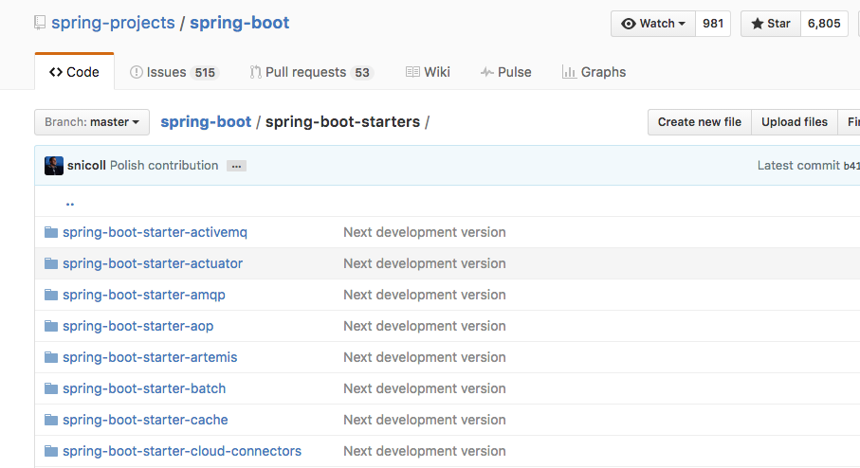
Spring Boot Components

Slide 22
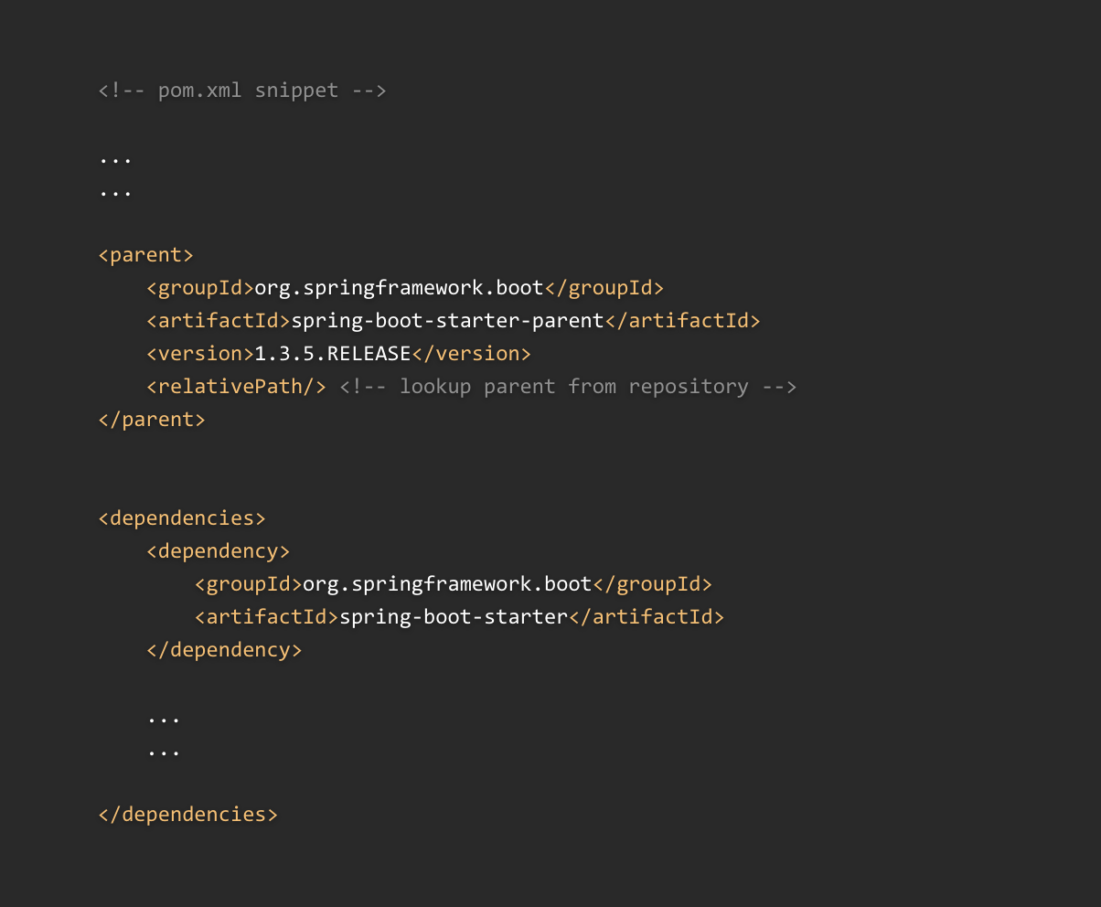
Spring Boot Components

Slide 23
Spring Boot Components
All Spring Boot applications start with:
@SpringBootApplication
SpringApplication.run()

Slide 24
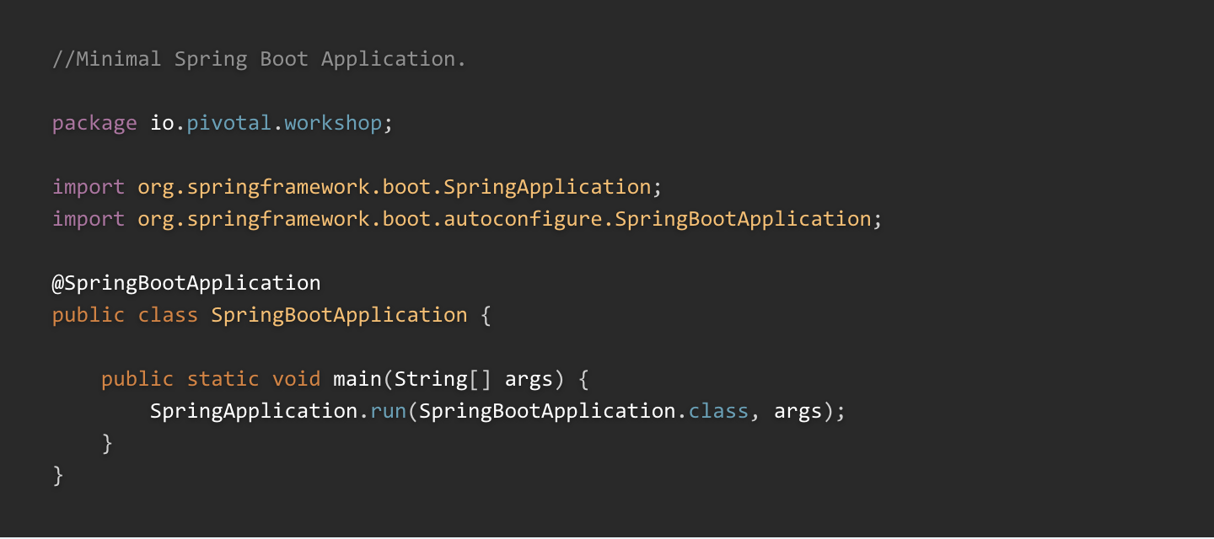
Spring Boot Components

Slide 25
Spring Boot Components

Slide 26
Spring Boot Components
@SpringBootApplication is a shortcut for:
@Configuration
@ComponentScan
@EnableAutoConfiguration

Slide 27
Spring Boot Components
Configuration:
application.properties
application.yml

Slide 28
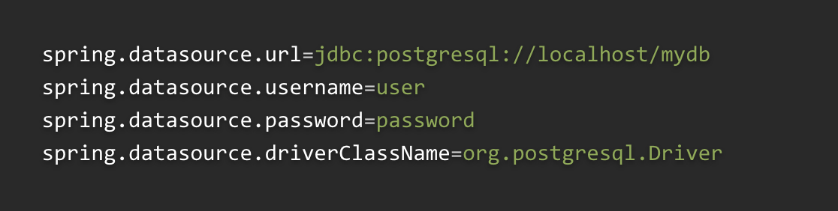
application.properties

Slide 29
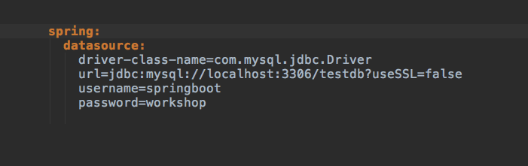
application.yml

Slide 30
Creating A Spring Boot Application
Ways to create a Spring Boot application:
Spring Boot Initializr
Spring Tool Suite IDE, based on Eclipse

Slide 31
Spring Initializr
Use just the technologies your application needs
Support for Java, Groovy, Kotlin
Java Versions (1.6, 1.7, 1.8)

Slide 32
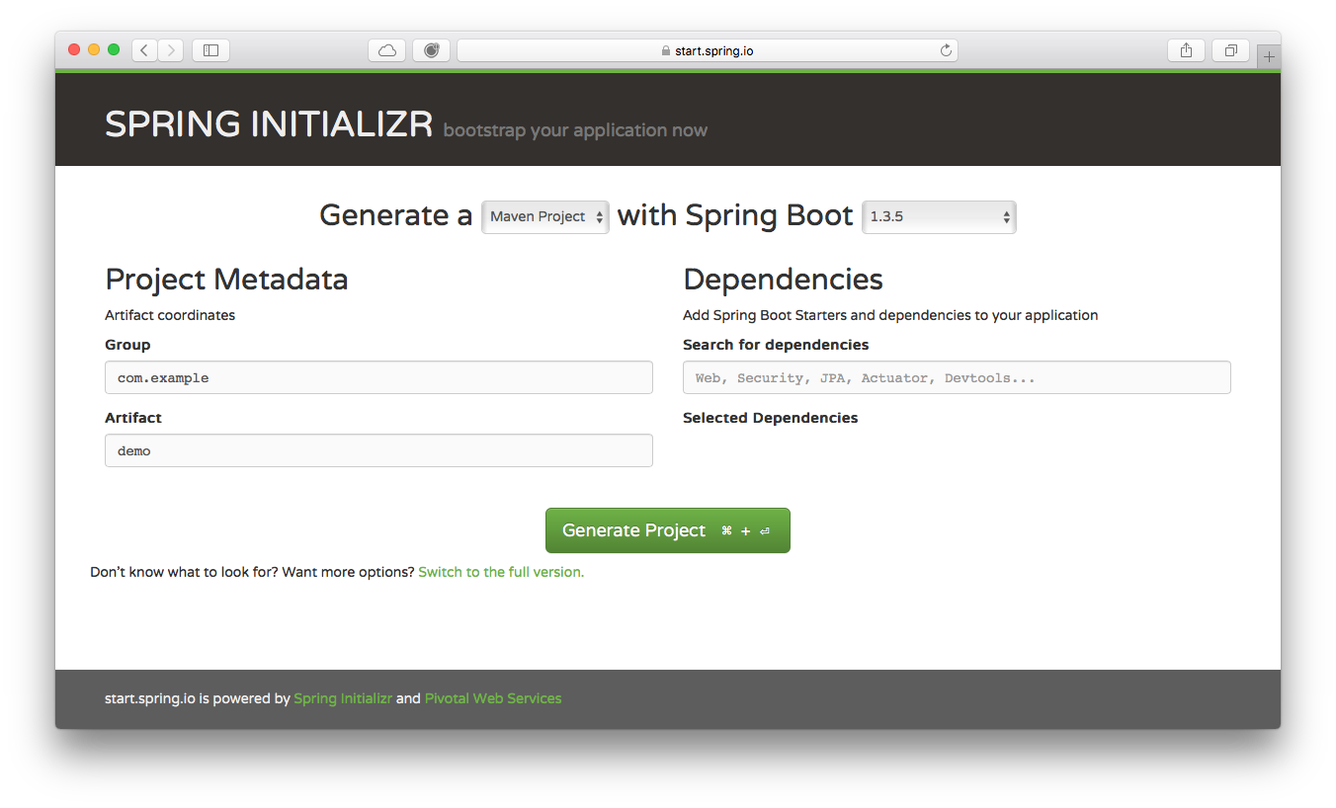
Spring Initializr http://start.spring.io

Slide 33
Spring Boot Components
Lab: Create a Spring Boot Web App using the Spring Initializr
Lab: Create a Spring Boot Web App using the STS IDE

Slide 34
Spring Tool Suite IDE
The Spring Tool Suite IDE or STS (for short) is one of the most used development environments in the Spring Community.

Slide 35
Spring Tool Suite IDE
Based on Eclipse
IDE extensions for Spring Boot
Dashboard
Properties Editor
Debugging

Slide 36
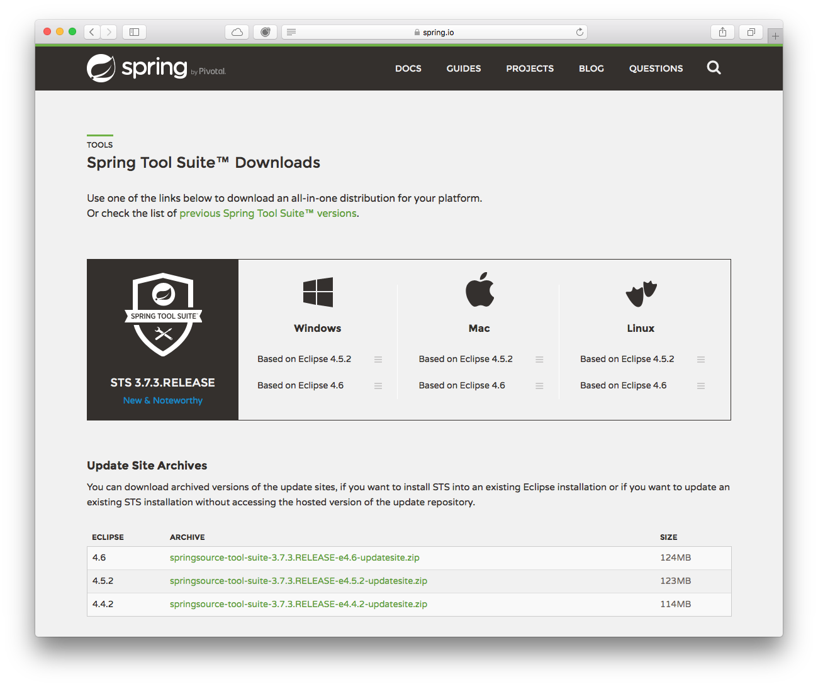
Spring Tool Suite IDE https://spring.io/tools/sts/all

Slide 37


