Slide 1
An Introduction to Node.JS
Pariwesh Gupta
connect with me on LinkedIn

Slide 2
Typical Usage
Web programing
Client side
Web pages
Browser plugins
Server side
SSJS (not in use)
NodeJS
MongoDB

Slide 3
NodeJS
JavaScript Runtime at command line
Allows us to write JS programs outside browser
Built on V8 JS engine
V8 is open source JS engine developed by Google
It also powers Google Chrome
Written in C++
Compiles JS code to native before execution

Slide 4
Good for
For IO heavy apps
Web socket (chat) server
Real time collaborative editor
Fast file uploads
Ad server
Any other real time data app (e.g. streaming server)
Crawler
Asynchronous chaining of tasks
NOT good for CPU heavy apps
Weather prediction

Slide 5
NodeJS is NOT
A web framework
Provides tools to create a web server
Multi threaded
Is Single threaded, event driven, asynchronous, non-blocking
For beginners
Needs programing at very low level
You start with writing a web server

Slide 6
Possible Issues
Can not utilize multicore processer because of single thread
Any CPU intensive task delays all the requests
Requires constant attention (non-traditional thinking) for not having blocking code

Slide 7
What Jargons Mean
Single threaded
Event driven
Asynchronous
Non-blocking

Slide 8
Single Threaded
New Node process does not start for every request
Only one function executes at a time
Everything else remains in the queue
No worry about different portions of code accessing the same data structures at the same time
Delay at one place delays everything after that
Can not take advantage of multi-core CPU

Slide 9
Non-blocking
There is only one process that is executing
If the process waits for something to complete, everything else gets delayed
So the code has to be structured in a way that wait for IO happens outside the main execution

Slide 10
Blocking Vs. Non-blocking
Blocking I/O
var a = db.query('SELECT * from huge_table’);
console.log('result a:’, a);
console.log(‘Doing something else’);
Non-Blocking I/O
db.query('SELECT * from huge_table’, function(res) {
console.log('result a:’, res);
});
console.log(‘Doing something else’);

Slide 11
Asynchronous
Not all code is executed in the same order it is written
Node (and you) divide the code into small pieces and fire them in parallel
Typically the code announces its state of execution (or completion) via events

Slide 12
Event Driven
A code block gets into the queue of execution when an event happens
It gets executed on its turn
Anyone can raise (or listen to) an event
System
Some library (module)
Your code
You have the choice (and ways) to attach a code block to an event
Also known as event callbacks

Slide 13
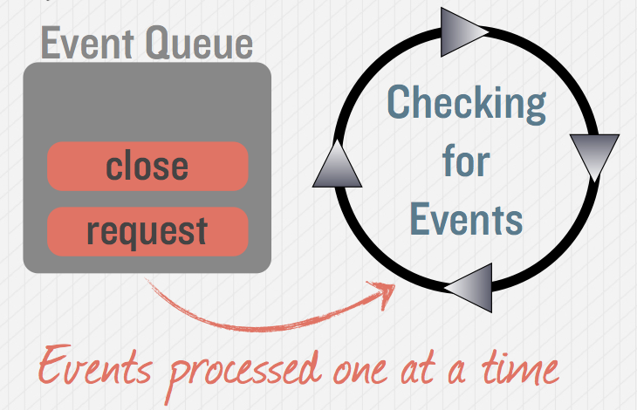
The Event Queue

Slide 14
Agenda
What Node.JS is
Why Node.JS?
Using Node.JS
As a Server
As a Client
Common Modules

Slide 15
What is Node.JS
Provides Event-based, non-blocking I/O
Built on Google’s V8
JavaScript Programming Environment
Designed for high concurrency
Without threads or new processes
Ideal for Data intensive Real-time Application

Slide 16
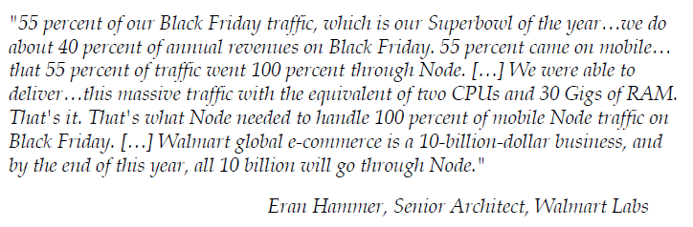
What is Node.JS

Slide 17
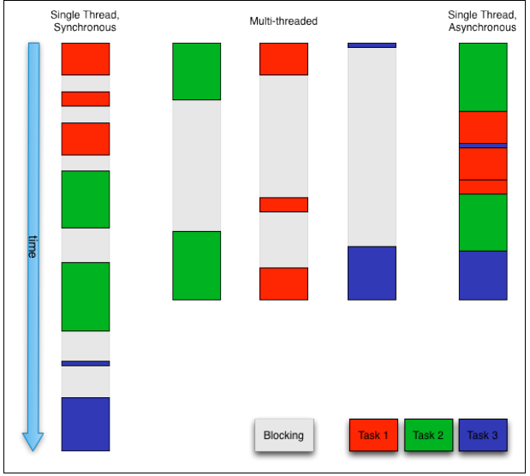
V8

Slide 18
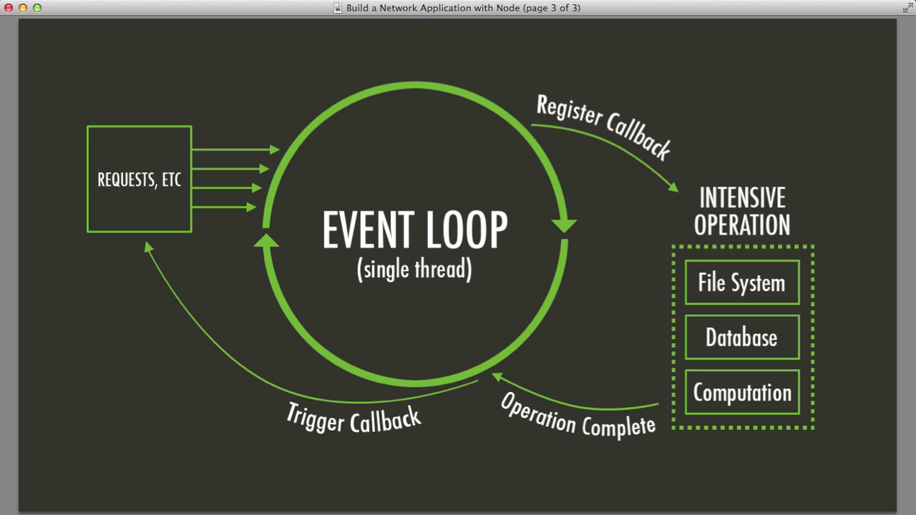
Event Loop

Slide 19
Using Node.JS
Install Node.JS and NPM
Install other modules you want with CLI
npm install <module_name>

Slide 20
Modularizing code
• Techniques for modularizing JavaScript code
• Understanding built-in modules
• Using require() to import modules
• Using npm for third-party modules
• Handling Exceptions

Slide 21
What are node modules?
We cannot write all code in a single file.
Need to organize code for reusability.
Modules can either be single files or directories containing one or more files

Slide 22
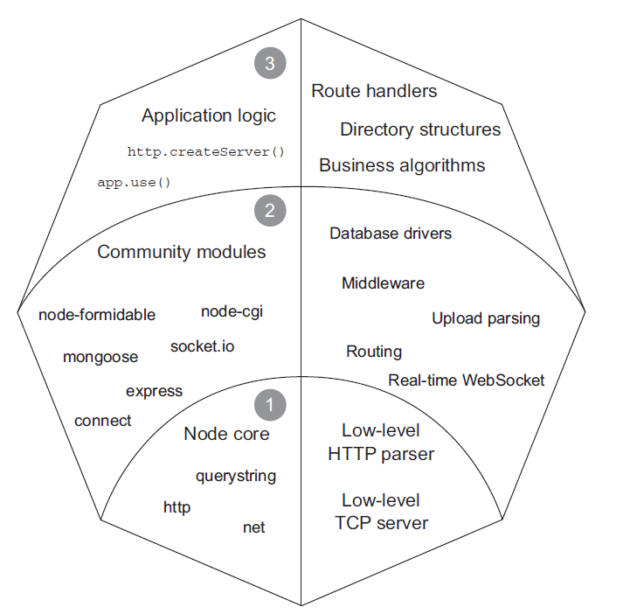
What are node modules?

Slide 23
Techniques for modularizing JavaScript code
To create a typical module, you create a file that defines properties on the exports or module.exports object with any kind of data, such as strings, objects, and functions.

Slide 24
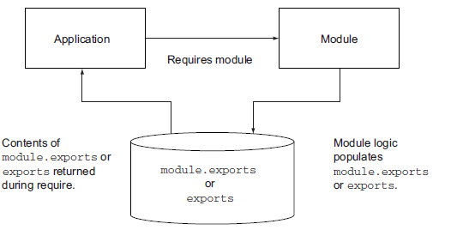
Using require() to import modules
require is one of the few synchronous I/O operations available in Node. Because modules are used often and are typically included at the top of a file, having require calls be synchronous helps keep code clean, ordered, and readable.

Slide 25
npm
npm install [-g] package.json
npm install <folder path>
npm install <name> [--save|--save-dev|--save-optional]
More info

Slide 26
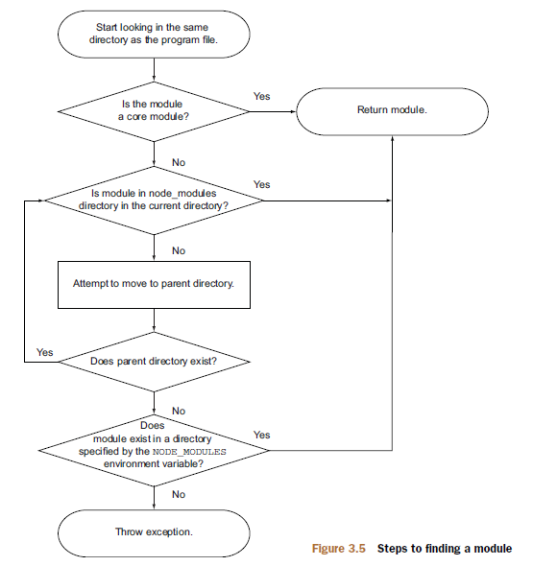
Module resolution

Slide 27
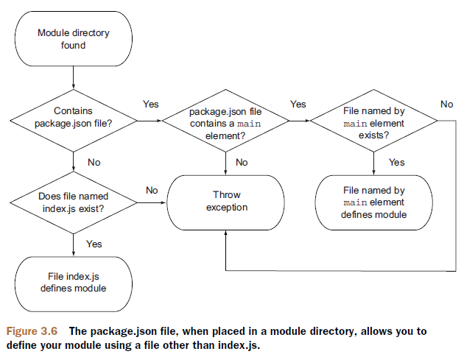
Module resolution

Slide 28
Built-in modules
Processes
Filesystem
Networking
Utilities

Slide 29
API Conventions
The first argument returned to a callback function is any error message, preferably in the form of an error object. If no error is to be reported, this reference should contain an undefined value.
When passing a callback to a function it should be assigned the last slot of the function signature. APIs should be consistently designed this way.
Any number of arguments may exist between the error and the callback.

Slide 30
Core Modules - Filesystem
Low level API to manipulate files
Available Modules
fs
os

Slide 31
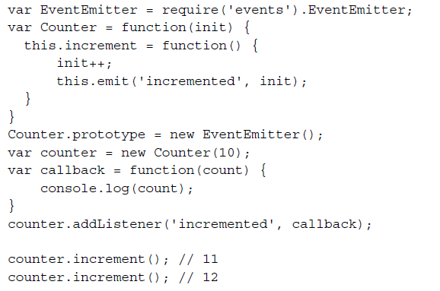
EventEmitter
Many of the JavaScript objects in Node emit events. These events are instances of events.EventEmitter. Any object can extend EventEmitter.

Slide 32
Process object
provides information on and control over the current running process. It is an instance of EventEmitter, is accessible from any scope, and exposes very useful low-level information.
https://nodejs.org/api/process.html

Slide 33
Core Modules - Utilities
Provides utility methods
Available Modules
console
util

Slide 34
Working with the File System
__filename and __dirname
Any file in a Node application can determine its absolute location using the __filename
and __dirname variables.

