Slide 1
Actuator

Slide 2
Agenda
Overview
Endpoints
Metrics

Slide 3
Overview
Spring Boot includes a number of additional production-ready features to help you monitor and manage your application when it’s pushed to production.
Notes:
You can choose to manage and monitor your application using HTTP endpoints, with JMX or even by remote shell (SSH or Telnet). Auditing, health and metrics gathering can be automatically applied to your application

Slide 4
Overview
Use spring-boot-starter-actuator to get up and running quickly.

Slide 5
Overview
Actuator HTTP endpoints are only available with a Spring MVC-based application.

Slide 6
Overview
You can customize endpoints in the application.properties.
Customizable properties include:
Id
Enabled
sensitive
Notes:
Or application.yml

Slide 7
Overview

Slide 8
Agenda
Overview
Endpoints
Metrics
Notes:
Depending on how an endpoint is exposed, the sensitive property may be used as a security hint. For example, sensitive endpoints will require a username/password when they are accessed over HTTP (or simply disabled if web security is not enabled)
http://docs.spring.io/spring-boot/docs/current/reference/html/production-ready-endpoints.html

Slide 9
Endpoints
/actuator - Provides a hypermedia-based discovery page for the other endpoints. Requires Spring HATEOAS to be on the classpath.
Notes:
Sensitive = true

Slide 10
Endpoints
/autoconfig - Displays an auto-configuration report showing all auto-configuration candidates and the reason they were or were not applied.
Notes:
Sensitive = true

Slide 11
Endpoints
/beans - Displays a complete list of all the Spring beans in your application.
Notes:
Sensitive = true

Slide 12
Endpoints
/configprops - Displays a collated list of all @ConfigurationProperties.
Notes:
Sensitive = true

Slide 13
Endpoints
/dump - Performs a thread dump.
Notes:
Sensitive = true

Slide 14
Endpoints
/env - Exposes properties from Spring’s ConfigurableEnvironment.
Notes:
Sensitive = true

Slide 15
Endpoints
/health - Shows application health information (when the application is secure, shows simple ‘status’ when accessed over an unauthenticated connection or full message details when authenticated).
Notes:
Sensitive = false

Slide 16
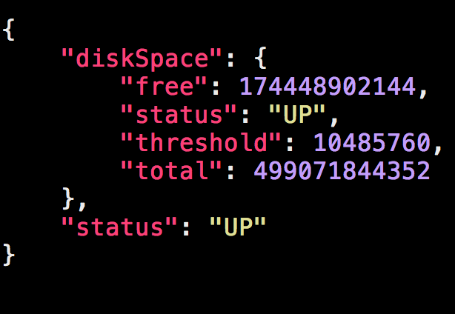
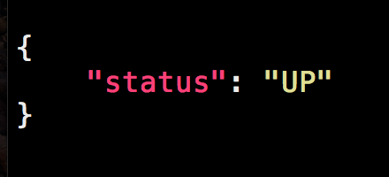
Endpoints - /health
Unsecured
Secured
Notes:
Unsecured shows more information.

Slide 17
Endpoints
/info – Displays arbitrary application information.
Notes:
Sensitive = false

Slide 18
Endpoints
/mappings - Displays a collated list of all @RequestMapping paths.
Notes:
Sensitive = true

Slide 19
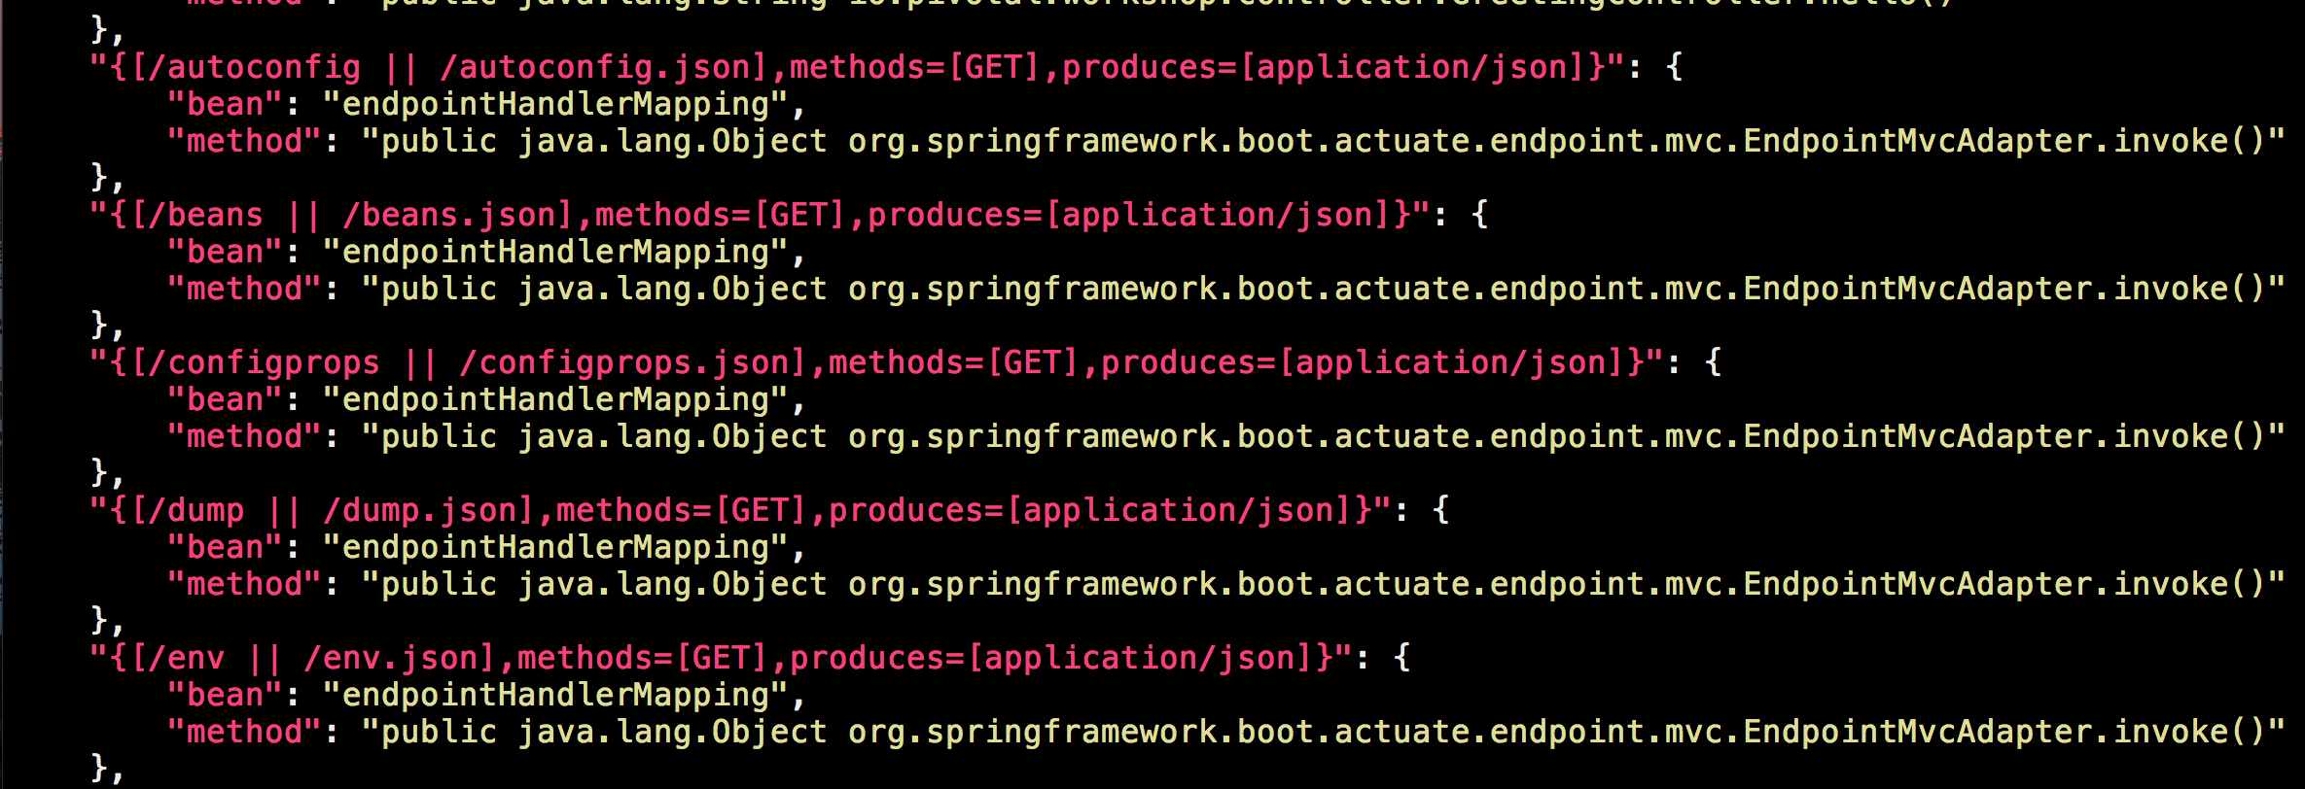
Endpoints - /mappings
Notes:
Example of some mappings you can see.
Talk about how you can see the Different HTTP methods that can be called on an endpoint (GET, POST etc…)
Notice how they call a method.

Slide 20
Endpoints
/shutdown - Allows the application to be gracefully shutdown (not enabled by default).
Notes:
Sensitive = true

Slide 21
Endpoints
/trace - Displays trace information (by default the last few HTTP requests)
Notes:
Sensitive = true

Slide 22
LAB: Create a Simple Web Application and enable the Spring Boot Actuator endpoints.

Slide 23
Agenda
Overview
Endpoints
Metrics

Slide 24
Metrics
Spring Boot Actuator includes a Metrics service.
The default endpoint is /metrics.

Slide 25
Metrics
Out of the box metrics are stored in-memory.
Notes:
You can write export and aggregate metrics to other data stores.

Slide 26
Metrics
The metrics exposed support:
System metrics
DataSource metrics
Cache metrics
Tomcat metrics
Notes:
System metrics exposed are things like total system memory, amount of free memory, uptime and more
http://docs.spring.io/spring-boot/docs/current/reference/html/production-ready-metrics.html#production-ready-system-metrics
DataSource metrics include the number of active connections and the current ussage of the connection pool. DataSource metrics share the datasource. Prefix.
http://docs.spring.io/spring-boot/docs/current/reference/html/production-ready-metrics.html#production-ready-datasource-metrics
Cache Metrics – size of cache, hit and miss. Caching metrics will vary depending on the caching provider…eg. Aggregated value versus temporal value.
http://docs.spring.io/spring-boot/docs/current/reference/html/production-ready-metrics.html#production-ready-datasource-cache
If using tomcat you will be able to get metrics around sessions.
http://docs.spring.io/spring-boot/docs/current/reference/html/production-ready-metrics.html#production-ready-session-metrics

Slide 27
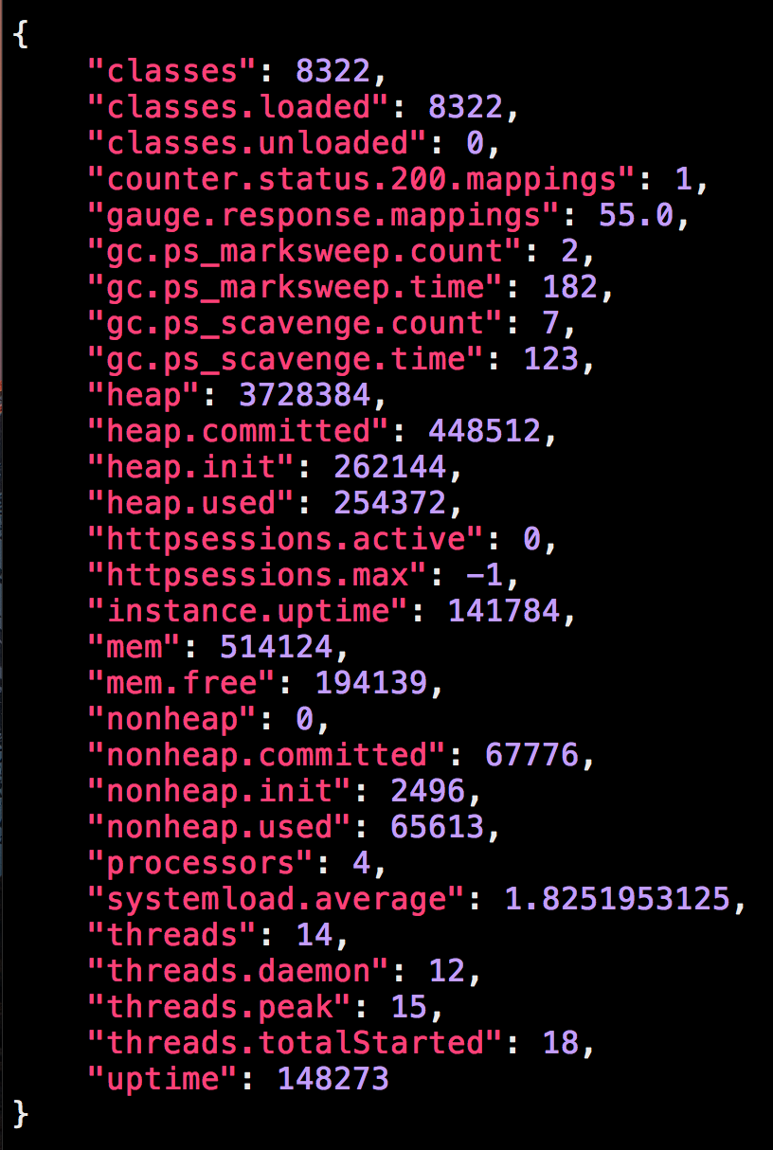
Notes:
Example from metrics endpoint.

Slide 28
Metrics
Custom metrics are supported via CounterService and GaugeService.
Notes:
http://docs.spring.io/spring-boot/docs/current/reference/html/production-ready-metrics.html
http://docs.spring.io/spring-boot/docs/current/api/org/springframework/boot/actuate/metrics/GaugeService.html
http://docs.spring.io/spring-boot/docs/current/api/org/springframework/boot/actuate/metrics/CounterService.html
For any metric that cannot be completed by using either a GaugeService or a CounterService there is a PublicMetrics interface that you can implement to expose metrics.

Slide 29
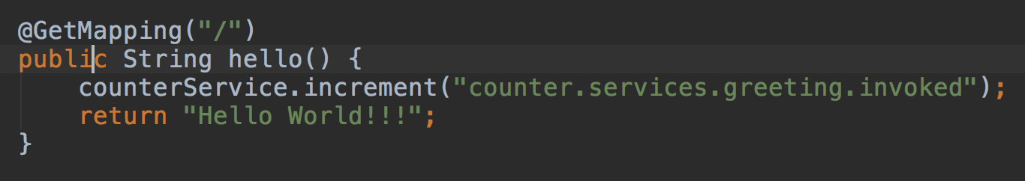
Metrics

Slide 30
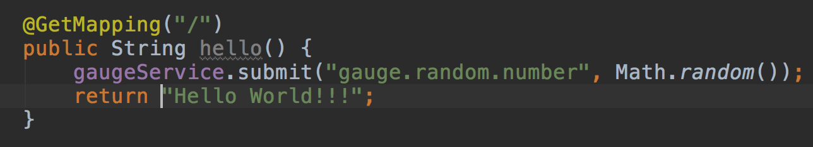
Metrics

Slide 31
Metrics
LAB: Record custom metrics using an Actuator provided counter service.

Slide 32


