Slide 1

Building Serverless Applications with Amazon
DynamoDB, AWS Lambda

Slide 2
Agenda
Service Overviews + Hands-On Labs
Advanced Concepts
Prerequisites – Basic Knowledge of Amazon DynamoDB, AWS Lambda, Amazon S3,

Slide 3
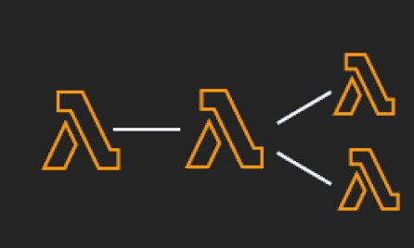
Why Serverless?
Pay By Usage
No Server management
Flexible scaling
Automated High Availability
Ease of getting started
“Build and run applications without thinking about servers”

Slide 4


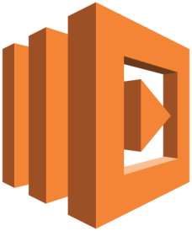



Solution Overview ( Enterprise)
Amazon S3
Amazon API Gateway
AWS Lambda
Amazon DynamoDB
Amazon
S3
API
Gateway
Lambda
DynamoDB
© 2018, Amazon Web Services, Inc. or its affiliates. All rights reserved.
© 2018, Amazon Web Services, Inc. or its Affiliates. All rights reserved.

Slide 5


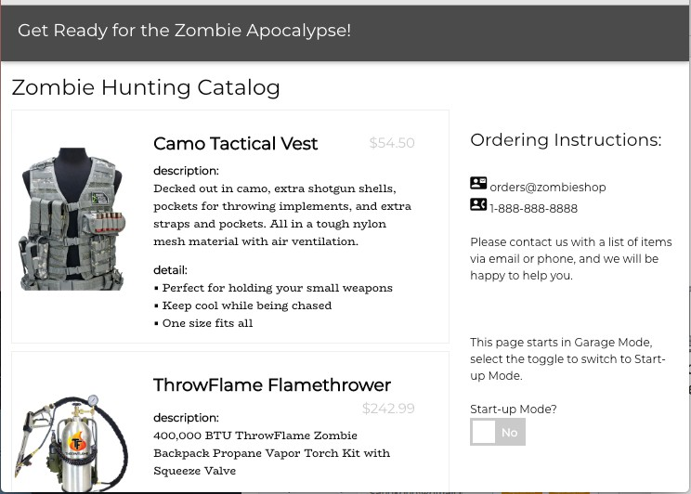


Amazon S3
Use Amazon S3 to host serverless websites
HTML, CSS, Javascript, etc.
Web Browser
Amazon S3
Files need to be public. Bucket does not.
Distribute with Amazon CloudFront
Make dynamic with Lambda@Edge
Protect site with AWS Shield Advanced and AWS WAF

Slide 6



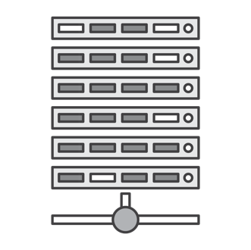



Amazon API Gateway
Create a unified API frontend for multiple micro- services
DDoS
protection and throttling for your backend
Authenticate and authorize requests to a backend
Throttle, meter, and monetize API usage by 3rd party developers
“Create, maintain, and secure APIs at any scale”

Slide 7
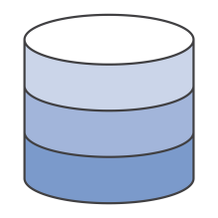




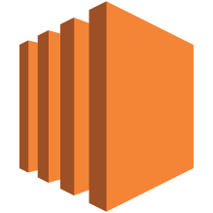



Amazon API Gateway – API Call Flow
AWS
API Gateway
Cache
AWS
Lambda functions
Mobile Apps
Websites
Internet
Amazon CloudFront (optional)
Amazon API Gateway
Endpoints on Amazon EC2
Services
Any other accessible endpoint
Amazon CloudWatch
Monitoring

Slide 8
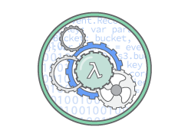
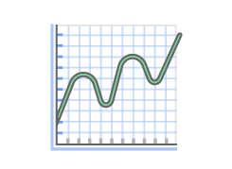
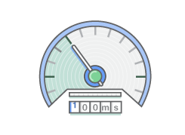
AWS Lambda
No servers to manage
Focus on code
Continuous Scaling
Configure concurrency
Sub Second Metering
Pay for only what you use
“Compute service that lets you run code without managing servers: Scale, monitor, and, trigger on your behalf”

Slide 9




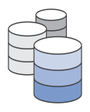





AWS Lambda
Bring your own code
Node.js, Java, Python, C#, Go, Ruby, …
Simple resource model
Select power rating from 128 MB to 1.5 GB
CPU and network allocated proportionately
Stateless
Persist data using external storage
No affinity or access to underlying infrastructure
Flexible use
Synchronous or asynchronous
Integrated with other AWS services

Slide 10

AWS Lambda – Good Practices
Minimize package size to only what is necessary
Separate the Lambda handler from core logic
Leverage container reuse
Use Environment Variables to modify operational behavior
Self-contain dependencies in your function package
Leverage “Max Memory Used” to right-size your functions
Understand, set, and monitor concurrency
Delete large unused functions (75GB limit)
Leverage ecosystem - AWS Serverless Application Model, AWS CodePipeline, AWS CodeDeploy, AWS X-Ray, AWS Cloud9

Slide 11


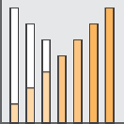



Amazon DynamoDB
Attributes
Table
Fully Managed NoSQL
Document or Key-Value
Items
Scales to Any Workload
Fast and Consistent
Partition Sort Key Key
Access Control
Event-Driven Programming
Local Secondary Index
Global Secondary Index
“Amazon DynamoDB is a nonrelational database that delivers reliable performance at any scale.”

Slide 12
Amazon DynamoDB - Tenets
Understand the use case
Identify the access patterns
Read/Write workloads
Query dimensions and aggregations
Data-modeling
Using NoSQL design patterns
DDB Streams, Single table Design, Sparse Index, Overloading, etc.
https://docs.aws.amazon.com/amazondynamodb/latest/developerguide/ best-practices.html

Slide 13

Thank you!

