Slide 1
Developing Cross-Platform Apps in Flutter
~

Slide 2




“Cross-platform development is the ability to build and deliver apps that can run across multiple device platforms.”

Slide 3
Agenda
Challenges
How Flutter helps ?
What is Flutter ?
Cross-platform Flutter project
Anatomy of Flutter app
Deployment options

Slide 4
Challenges

Slide 5
Cross-platform development is Hard.

Slide 6

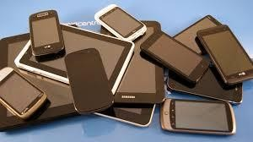
Screen-form factors + Devices + Platforms = Interesting developers’ life :)

Slide 7
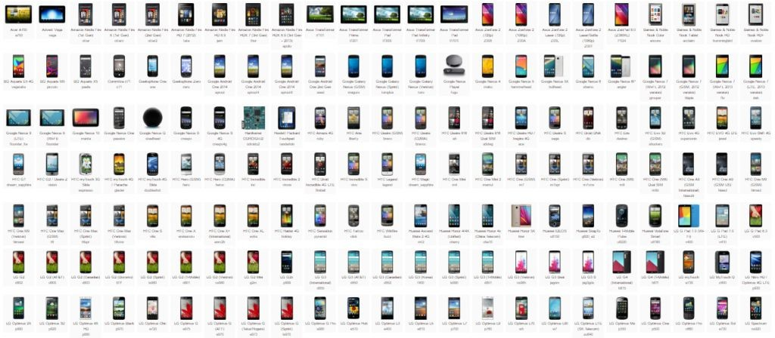
Credits

Slide 8

Hard for Solo developer to reach out to all platforms

Slide 9






Slide 10
How Flutter helps ?

Slide 11
Code sharing
One code editor
Own widgets, not dependent on OEM Widgets
Great for Custom designs
Decent built-in widget library of Material Design and Cupertino (iOS) widgets
Code once, Deploy thrice !

Slide 12
What is Flutter ?

Slide 13
Open-sourced SDK to develop cross-platform applications (by Google)
Flutter apps are written in Dart language
Flutter is a complete framework which provides:
UI rendering & Widgets
State Management
Hardware APIs
Navigation
Testing

Slide 14
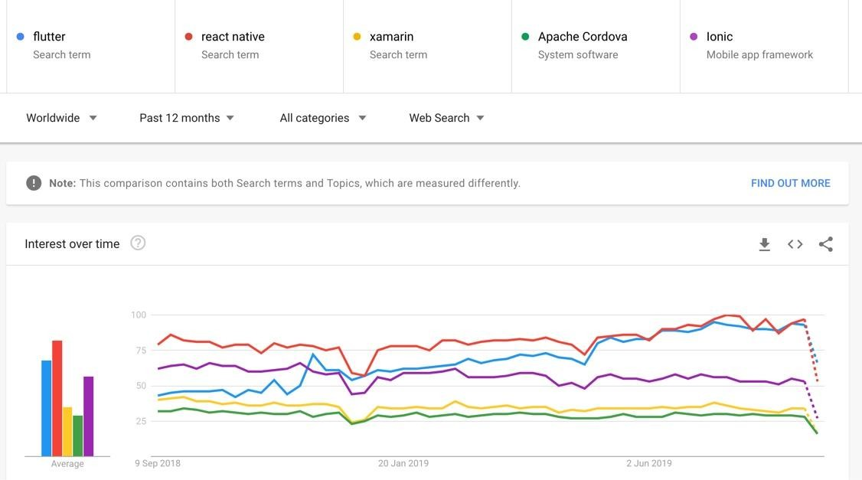
Popular
cross-platform solutions
Google Trends link

Slide 15
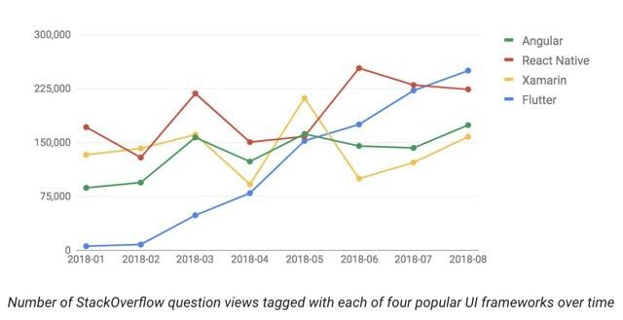
StackOverﬂow : ~23K questions
Github issues : ~7.5K open issues
Github stars : ~74K
Gitter : ~9K
Reddit FlutterDev : 20.5K
Flutter community Stats
Google Blog

Slide 16
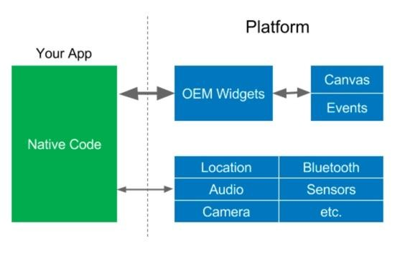




Native SDKs
Separate apps for each platform
Platform speciﬁc Widgets
Different languages
Hackernoon

Slide 17
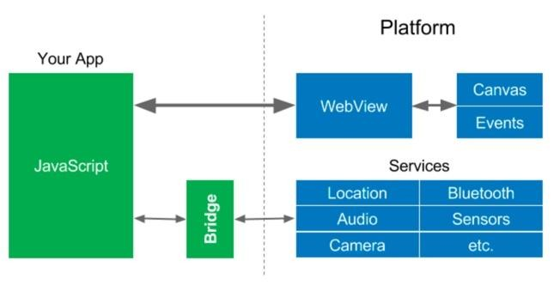
JS +
WebViews
PhoneGap (Adobe)
Apache Cordova Ionic
Hackernoon

Slide 18
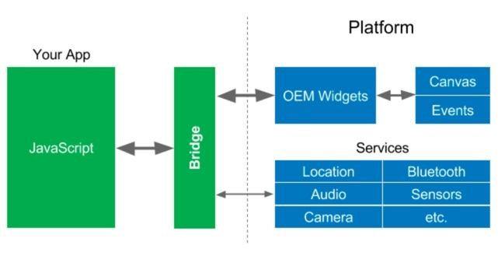
Reactive Views
React Native (2015)
Reactive-style views for mobile apps
Context switching: JS realm ⇔ Native realm
Hackernoon

Slide 19
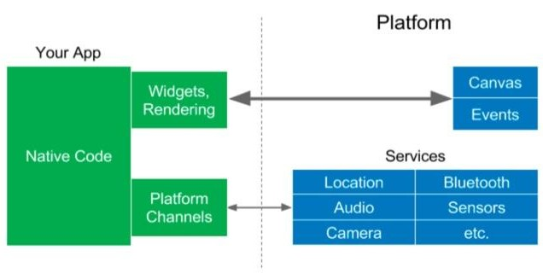

Flutter (2017)
Reactive-style views
Dart compiles AOT into native code for multiple platforms
No JS Bridge needed
Hackernoon

Slide 20
Cross-platform Flutter Project

Slide 21
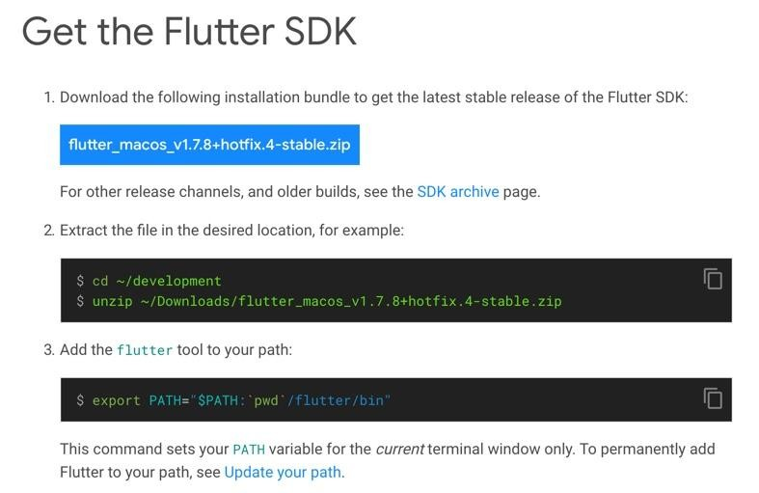
Download & Setup Flutter
Source

Slide 22



Choose your environment

Slide 24
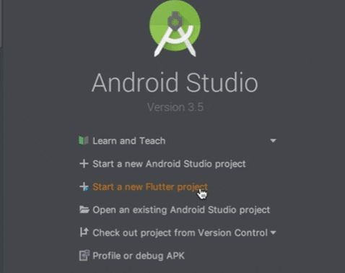

Slide 25
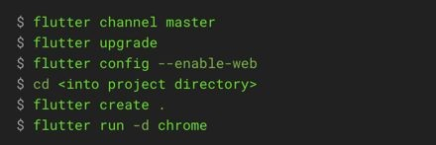
CLI (Command Line Interface)

Slide 26
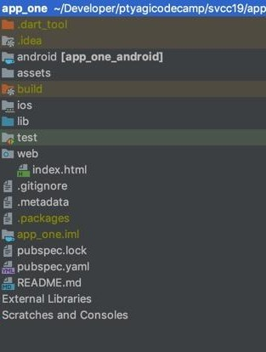
Cross-platform Flutter Project Structure
Android
iOS
Shared code
Web

Slide 27
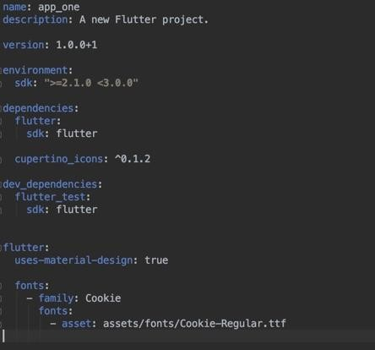
Dependency management
`pubspec.yaml`

Slide 28
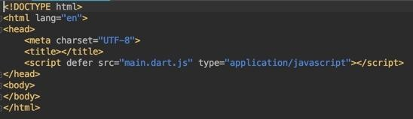
web/index.html

Slide 29
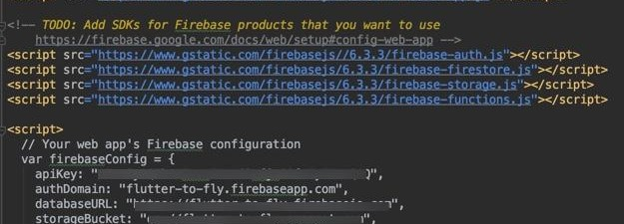
web/index.html (Firebase)
Tutorial

Slide 30
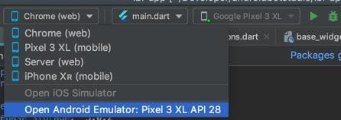
Running Flutter project
Android Studio
CLI
flutter run
flutter run -d Chrome

Slide 31
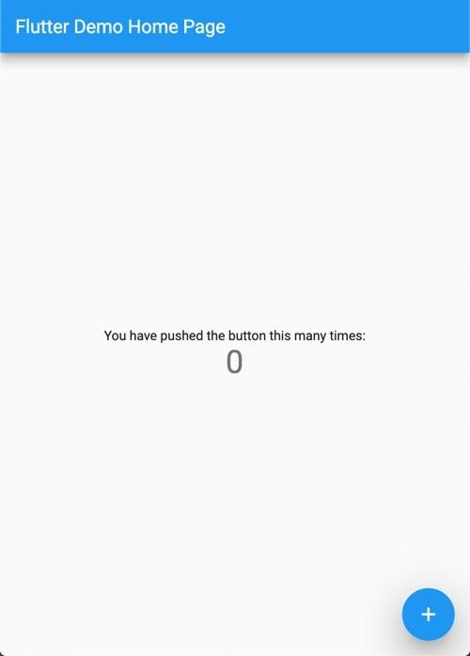
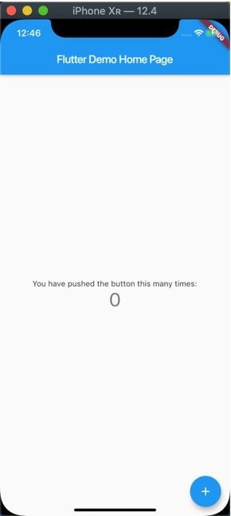
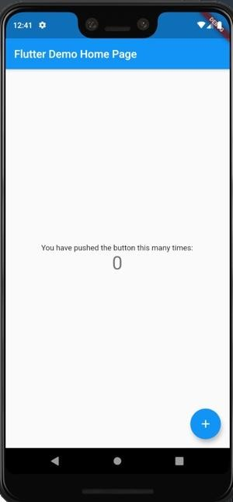
Chrome
iOS simulator
Android emulator

Slide 32
Anatomy of Flutter App

Slide 33

Scaffold
A
A
C
B
AppBar
Center
FAB
C
Icon
Text
Column
title
Text
Text
You have pushed the button...
Counter
B

Slide 34
Stateless Widget
Stateful Widget
Text
Icon
Card
Checkbox
Radio
TextField
Immutable
Widgets can not be redrawn
`build()` method is called only once
Mutable.
Rebuilds several time over its lifetime
`build()` method is called multiple times

Slide 35
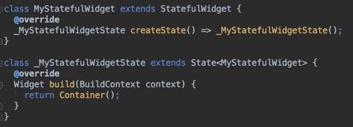
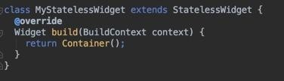
Stateless Widget
Stateful Widget
Immutable
Widgets can not be redrawn
`build()` method is called only once
Mutable.
Rebuilds several time over its lifetime
`build()` method is called multiple times

Slide 36
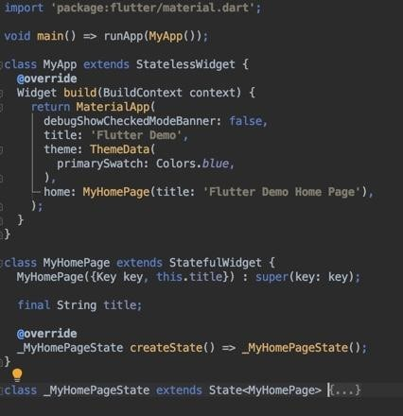
`main.dart`

Slide 37
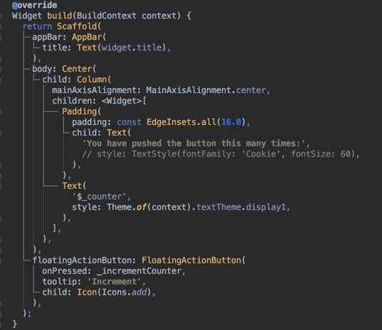
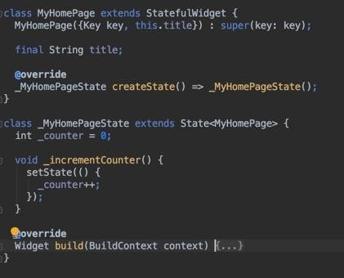

Slide 38
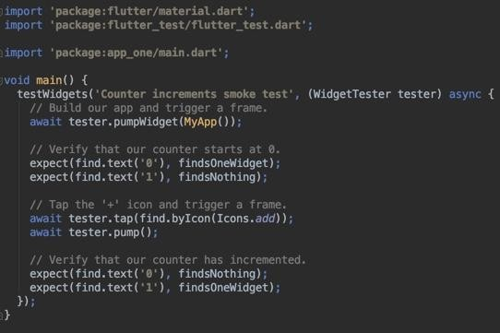
Unit Testing
Running test:
flutter test test/widget_test.dart

Slide 39


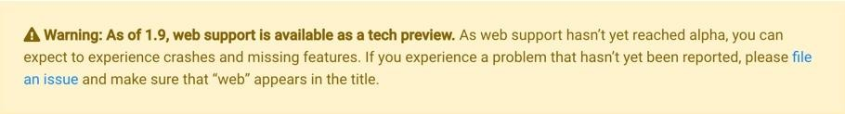
Flutter Web : In technical preview
Until Sept- 1st week
Updated: Sept- 2nd week
Source: https://ﬂutter.dev/web

Slide 40
Caveats
Flutter Web is (~was) a fork of Flutter Repo
Not all plugins are available for Web in Dart Packages repo: pub like FlutterFire
A set of libraries are platform speciﬁc
dart:html: DOM manipulation for web apps.
dart:io: I/O for non-web apps.

Slide 41
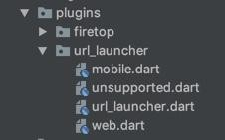
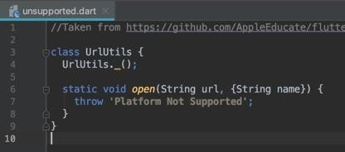
Launching URL
Code Organization
Handling Unsupported Platforms
Recommendation

Slide 42
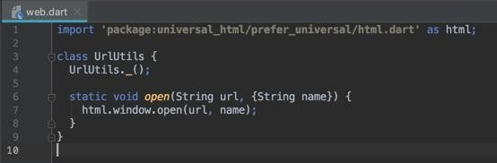

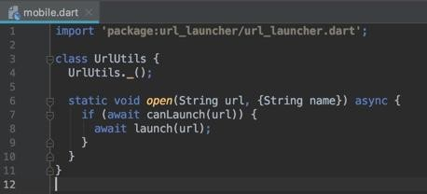
Source code

Slide 43
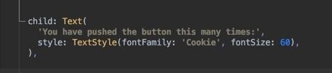
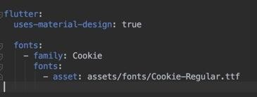
Custom Fonts
Download font
`pubspec.yaml`
Using custom font

Slide 44
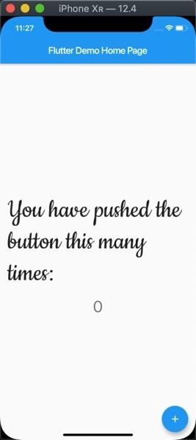
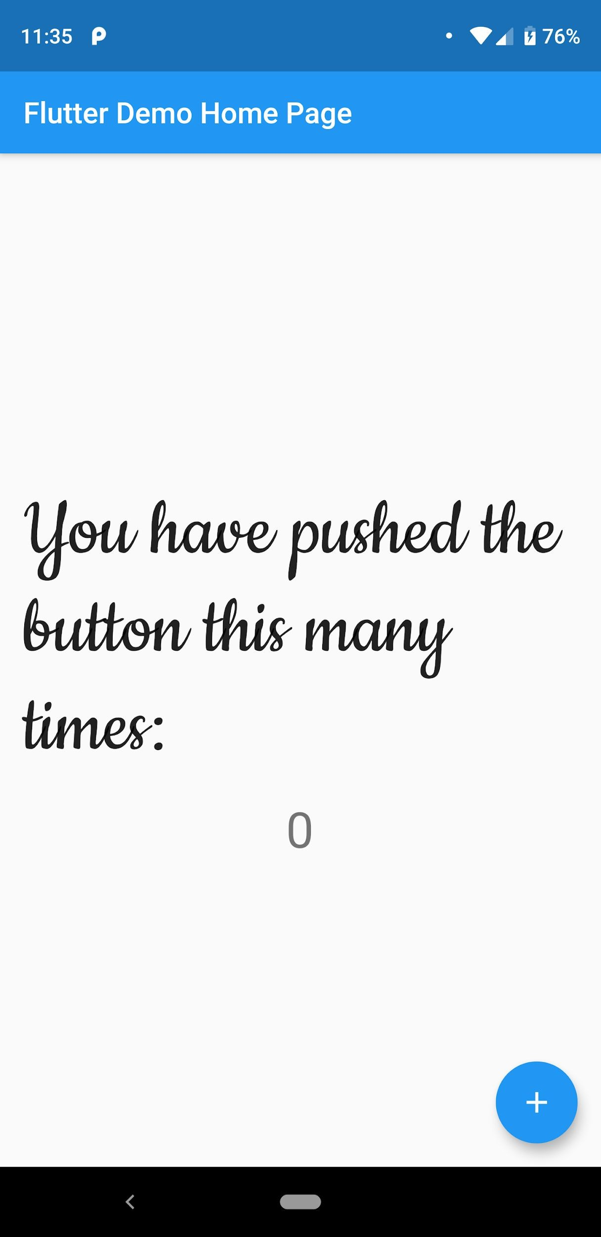
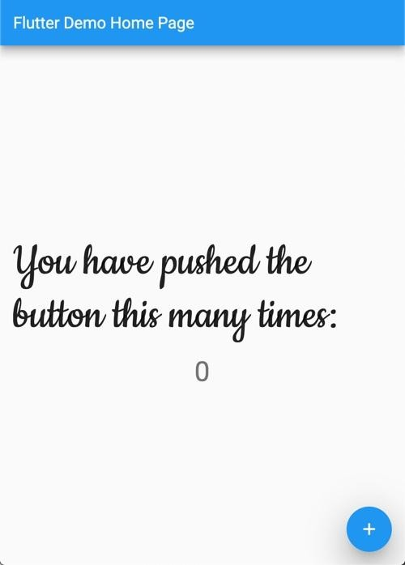

Slide 45
Developer Tooling

Slide 46
Command Line Tools
flutter doctor:
Checks if your machine has all the needed packages and software to build ﬂutter apps.
flutter create:
Generates new ﬂutter app
flutter build:
Builds ﬂutter app
flutter run:
Run ﬂutter app on attached device

Slide 47
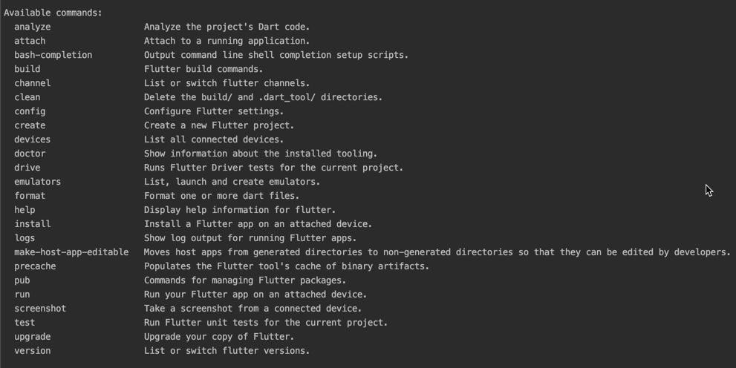
Available Commands: `flutter help`

Slide 48
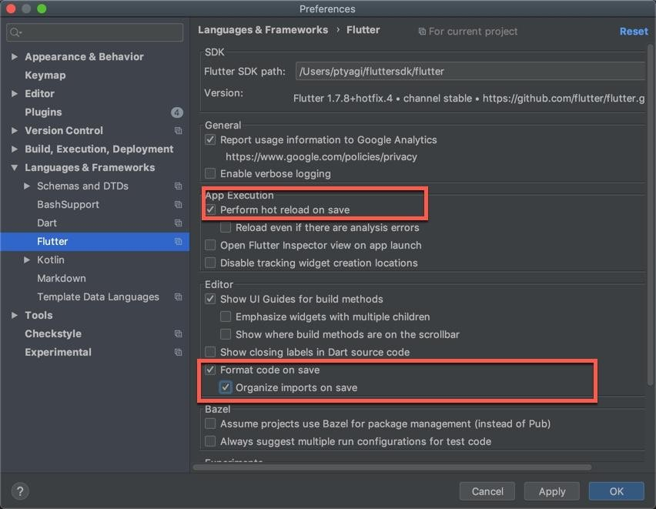
Android Studio: Flutter plugin

Slide 49
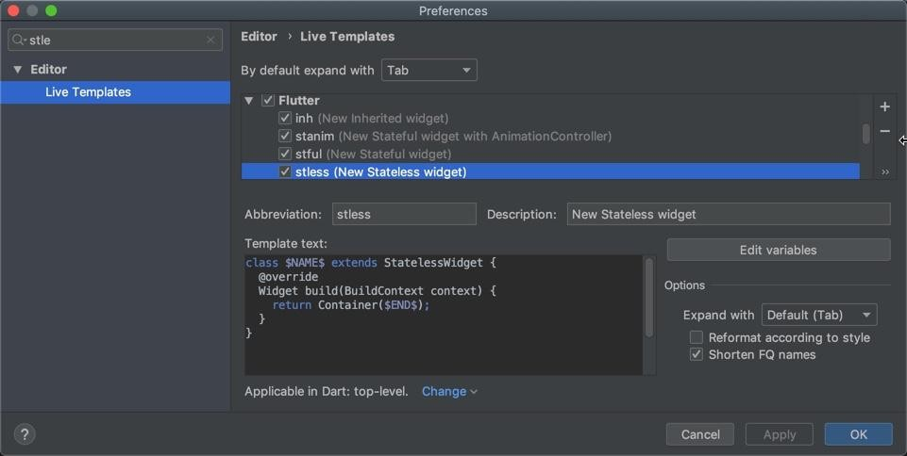
Android Studio: Live Templates

Slide 50
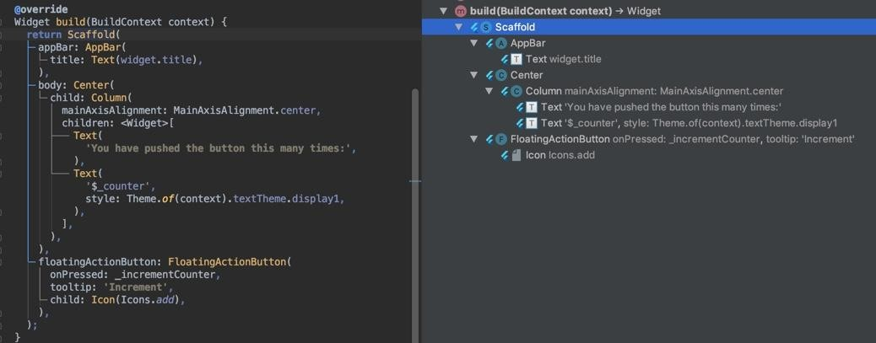
Flutter Outline Tool

Slide 51
Exploring Flutter Samples code

Slide 52
Creating app from Flutter samples
flutter create --sample=<id> <your_app_name>
lowercase_with_underscores

Slide 53
How to get sample ids ?
flutter create --list-samples=samples.json
{
"sourcePath": "lib/src/material/switch_list_tile.dart", "sourceLine": 255,
"serial": "2", "package": "flutter", "library": "material",
"element": "SwitchListTile",
"id": "material.SwitchListTile.2",
"file": "material.SwitchListTile.2.dart", "description": "![Switch list tile semantics
sample](https://flutter.github.io/assets-for-api-docs/assets/mat erial/switch_list_tile_semantics.png)\n\nHere is an example of a custom labeled radio widget, called\nLinkedLabelRadio, that includes an interactive [RichText] widget that\nhandles tap gestures."
},

Slide 54

Creating app from Flutter sample id
flutter create --sample=material.SwitchListTile.2 svcc19_switch_list_tile
1
Run "flutter doctor" for information about installing additional components.
In order to run your sample application, type:
2
3
$ cd svcc19_switch_list_tile
$ flutter run
Your sample application code is in svcc19_switch_list_tile/lib/main.dart.

Slide 55
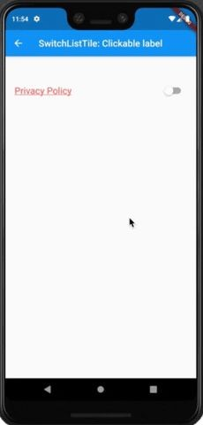
Checkout tutorial

Slide 56
Demo

Slide 57
Debugger & Proﬁler

Slide 58
Observatory debugger / proﬁler
$ flutter run -d all
An Observatory debugger and proﬁler on Android SDK built for x86 is available at: http://127.0.0.1:52118/b2c0_v_ywns=/
An Observatory debugger and proﬁler on iPhone Xʀ is available at: http://127.0.0.1:52161/MDl88nhIz78=/

Slide 59
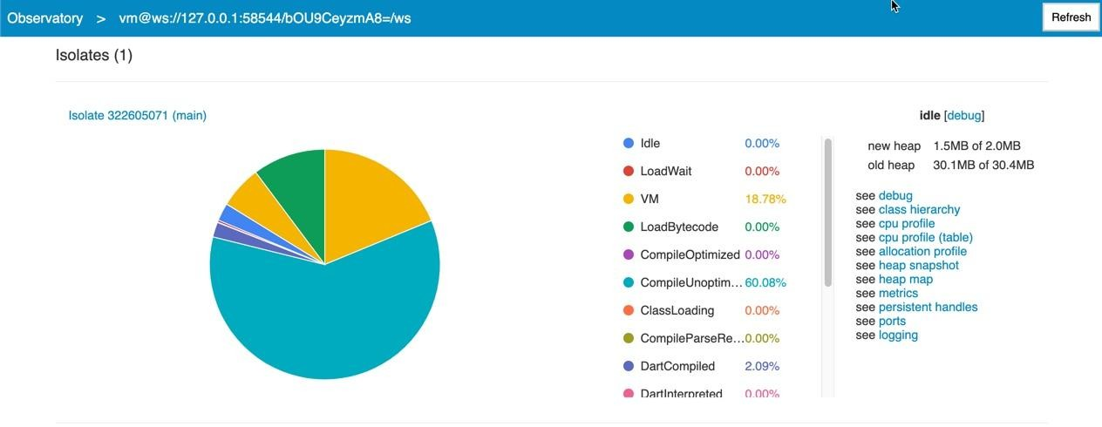
Android emulator observatory debugger/ proﬁler

Slide 60
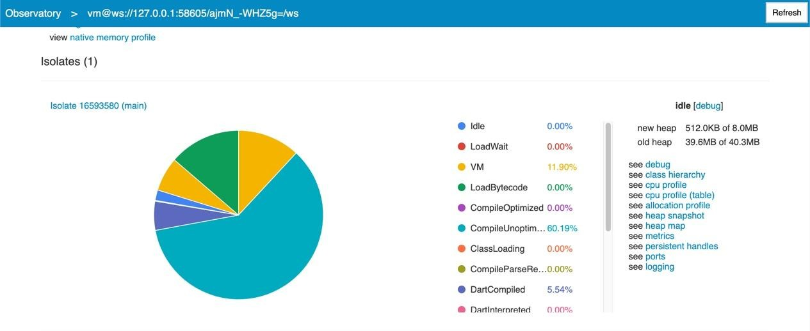
iOS simulator observatory debugger/ proﬁler

Slide 61
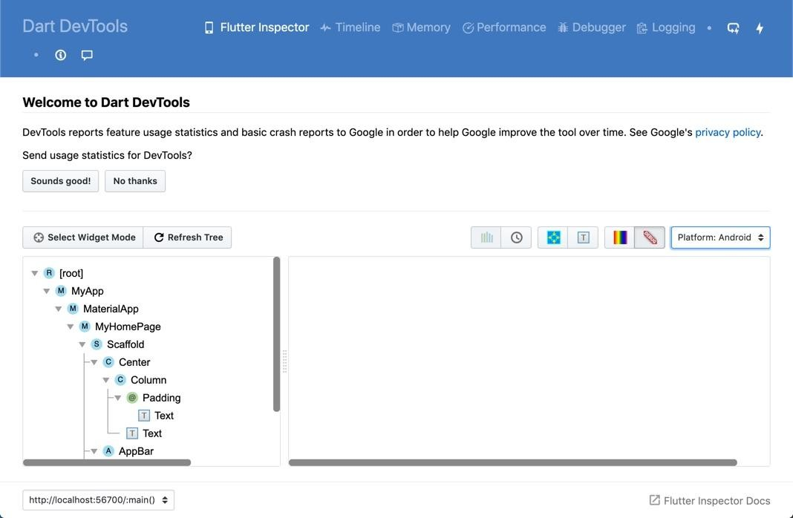
Dart DevTools
Flutter Inspector -> More Actions -> Open DevTools

Slide 62

Check-out
Contact
Email: Pariwesh.gupta@gmail.com
Designing Cross platform Flutter prototype for Landing Page (Web-Hummingbird, Android, iOS)

Slide 63
Useful links
Installing Flutter
Setting up Flutter-Web project
https://api.ﬂutter.dev/
Dart Packages for Flutter
Flutter for Web
Testing
Getting started with Custom Fonts
Google Fonts
Flutter Inspector
Declarative UI
Why Dart ?
CircleCI setup, Fastlane deployment

Slide 64
Imagery credits
Android, iOS icons , Web icon, Android Studio icon
iOS devices, and Android devices
Visual Studio icon, IntelliJ Studio icon
Team image, money image

Slide 65
Thank you !

