Slide 1
Social Network Analysis
IS 324
January 30, 2024
Jaihyun Park
jaihyun2@Illinois.edu

Slide 2
So far we’ve talked about networks
We are surrounded by social networks: networks of friends, communication, telecommunication, the Web, and transportation.
The social network analysis will help us identify who is playing an important role in spreading information or connecting other people.

Slide 3
Computational social science
What is connecting us? : Real-life network
  Family
  Hobby (e.g., Sports)
  Friends
  Co-workers or mentor-mentee
  Neighbors
What is connecting us? : Virtual/Online network
  Social media
  Online games
The lines between real-life network and online network
have become blurry.

Slide 4
Computational social science
How do we know we are connected? : Real-life
  What is being connected?
    Entities (e.g., Humans, companies, or geographic locations)
  How are they connected?
    Relations (e.g., Friends, co-workers, or neighbors)
How do we know we are connected? : Virtual/Online
  What is being connected?
    Entities (e.g., User accounts)
  How are they connected?
    Relations (e.g., Follow, likes, or teams)

Slide 5
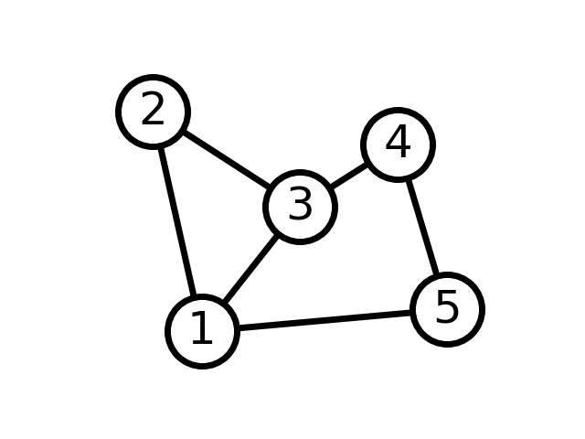
Basic concepts in network analysis
Nodes (i.e., vertices, agents, or points) = Entities
  Nodes are what are being connected in the network.
Edges (i.e., links, ties, or arcs) = Relations
  Edges represent the connection.

Slide 6
Basic concepts in network analysis
Attributes
  Attributes are additional information associated with nodes or edges.
  Attributes can be categorical, numerical, or textual.
Node attributes
  Age, gender, or location
  Centralities (e.g., degree, betweenness, or eigenvector)
Edge attributes (i.e., Edge weights)
  Frequency of connection
Notes:
Frequency of connection can show the strength of communication between two nodes. Attributes can be represented in colors in the visualization.

Slide 7
Basic concepts in network analysis
Types of graph
  Directions
    Undirected graph
    Directed graph (Diagraph)
  Attributes
    Weighted graph
    Unweighted graph

Slide 8
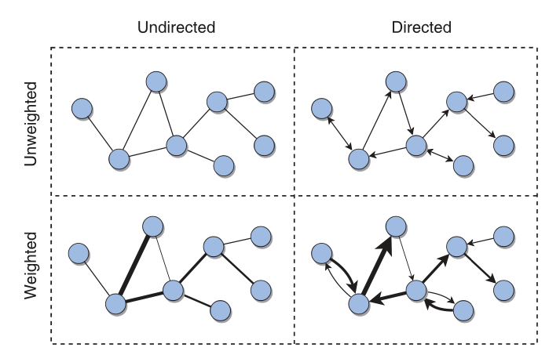
Basic concepts in network analysis

Slide 9
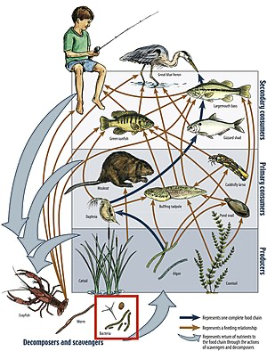
Directed networks
Food chains: links connect from prey to predator
There is a certain hierarchy and the direction would not go backward, creating a reciprocal relationship.

Slide 10
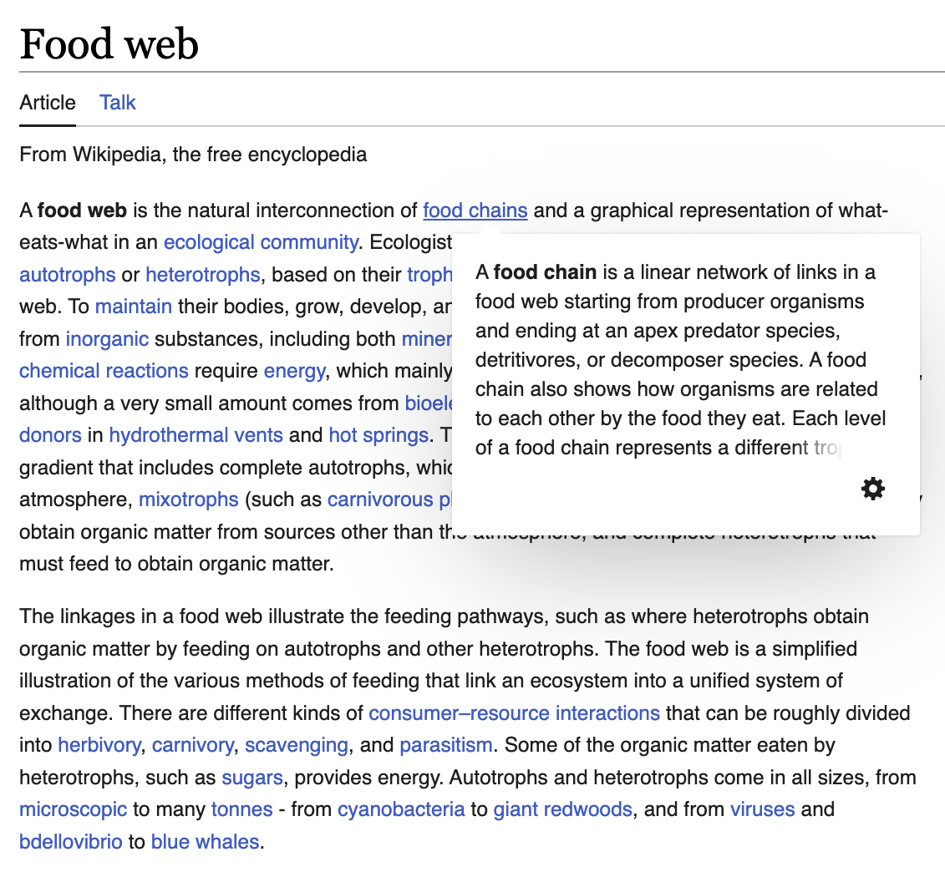
Directed networks
Hyperlinks exemplifies one of directed networks.
Hyperlinks enable the network from source to targe page.

Slide 11
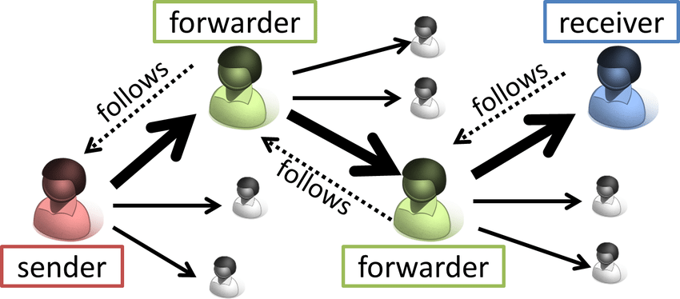
Directed networks
Social media shows directed networks
The directionality can be found in following, liking, reposting (retweeting), replying, mentioning, and messaging.

Slide 12
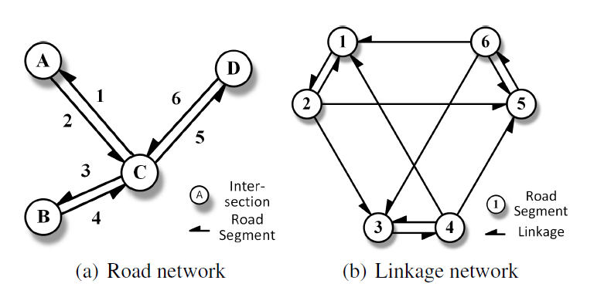
Directed networks
Transportation networks
Each road can represent the direction (e.g., Eastbound) and edge attributes can have the amount of time it takes from each node.

Slide 13
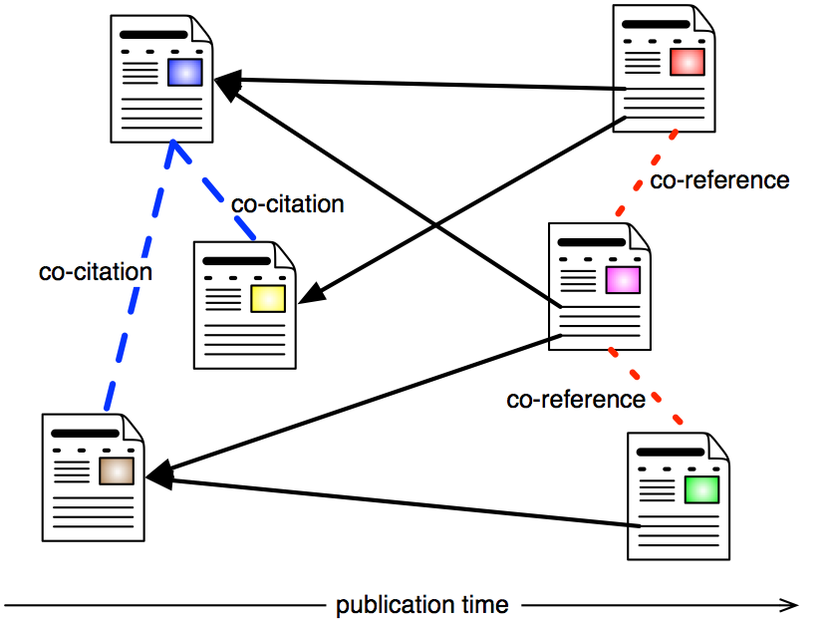
Directed networks
Citation networks
Nodes are research articles and links represent citations.
What about a co-authorship network? Which type of network do you think it will be? (e.g., directed or undirected)

Slide 14
Metrics in network analysis
What are three centrality metrics?
When you want to measure the popularity of the node, what is a good metric?
When you want to measure who is playing a role as a broker, what is a good metric?

Slide 15
Social network theory
Homophily (individual traits VS. contextual influence)
  Echo chamber
  Filter bubble
Reciprocity
  Give and take
Structural hole
  The node connecting two or more clusters
The strength of weak ties
  Weak ties can provide me with more information/opportunities
Structural balance theory
  The friend of my friend is my friend
  The enemy of my enemy is my friend

Slide 16
Pandas
Many data science-level datasets are available in spreadsheet-like format.
We are going to learn built-in functions in Pandas to get familiar with the datasets we are going to use for the practice.
After learning pandas, we are going to learn text processing libraries to (1) extract nodes and (2) analyze text to build network objects in Python.

Slide 17
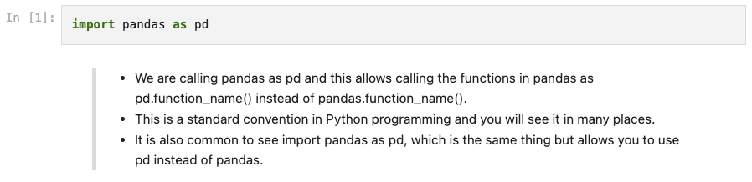
Import

Slide 18
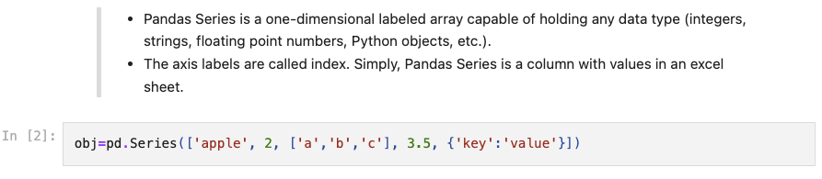
Series

Slide 19
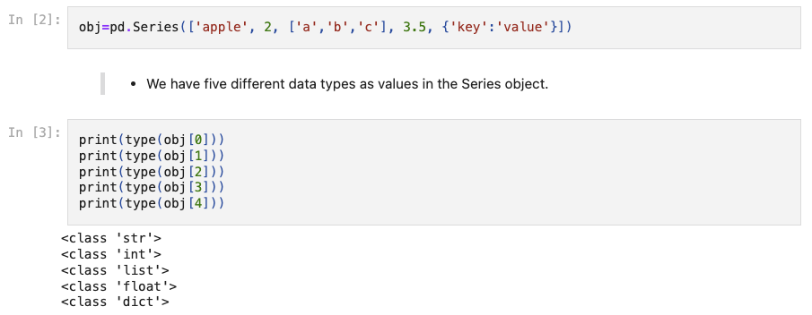
Series

Slide 20
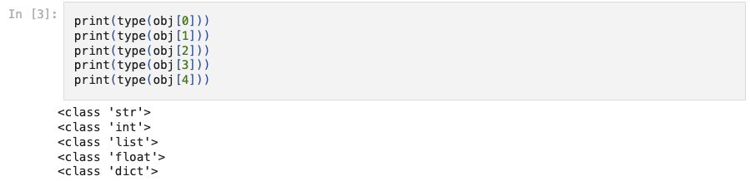
Series

Slide 21
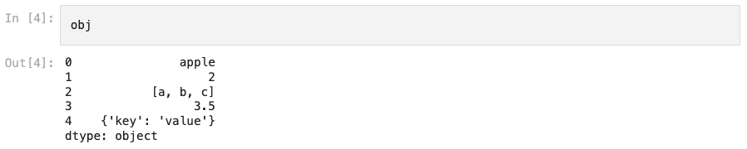
Series

Slide 22
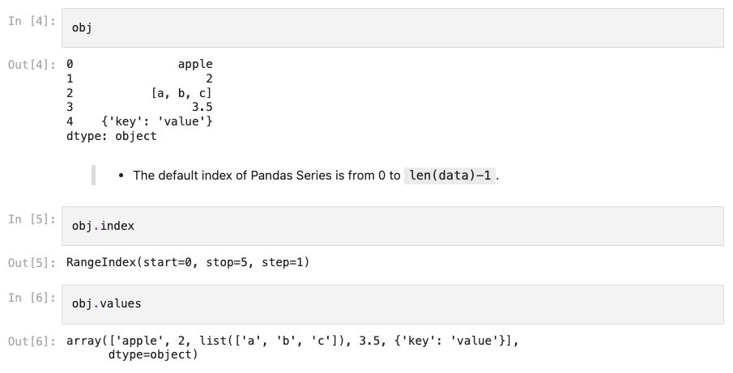
Series

Slide 23
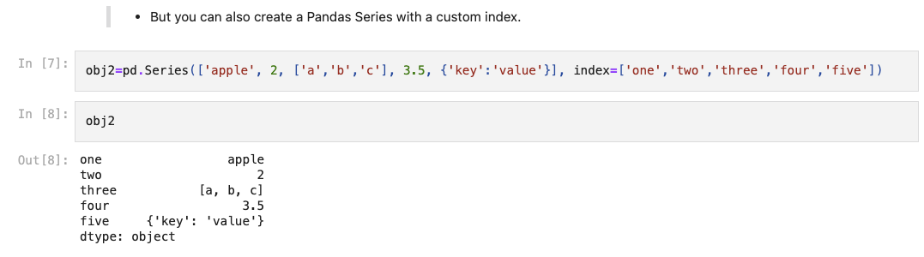
Series

Slide 24
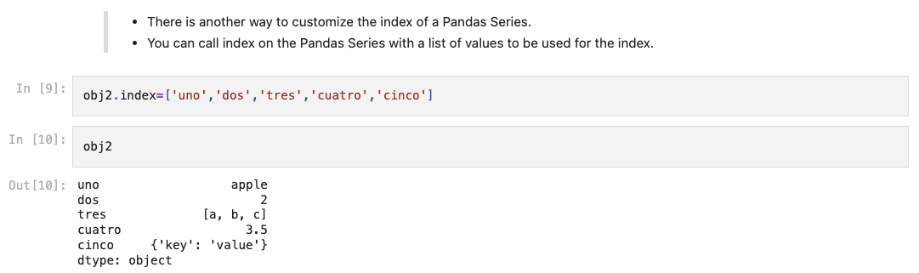
Series

Slide 25
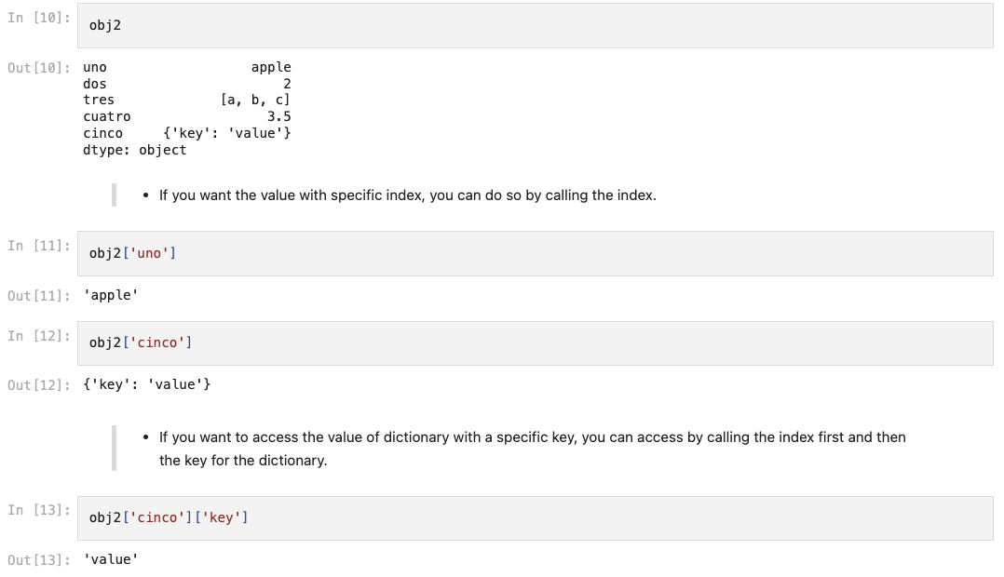
Series

Slide 26
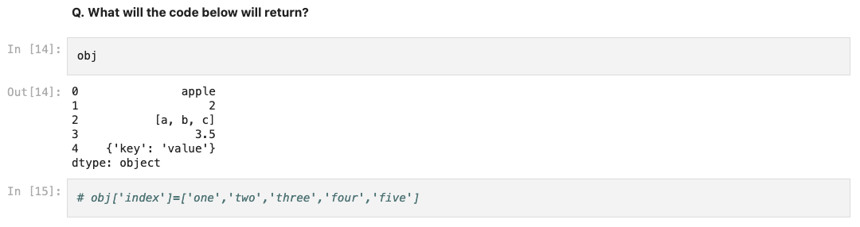
Series

Slide 27
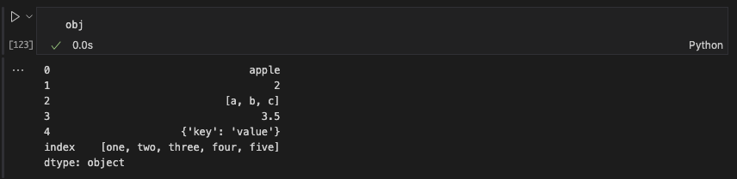
Series

Slide 28
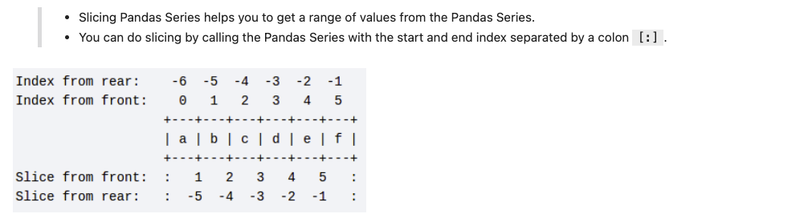
Series

Slide 29
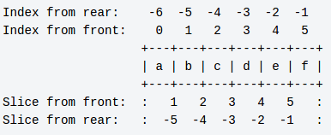
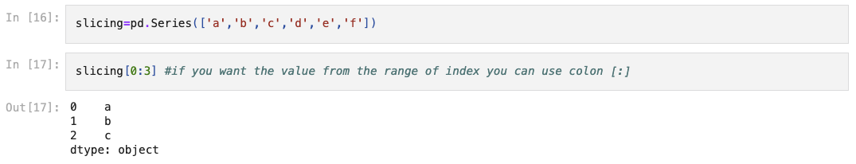
Series

Slide 30
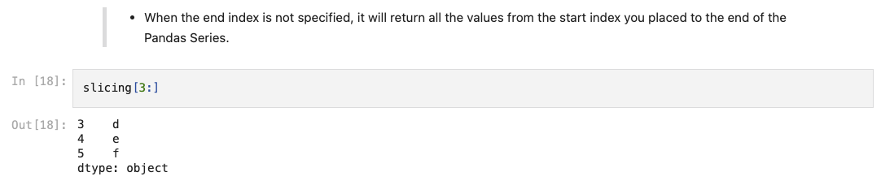
Series

Slide 31
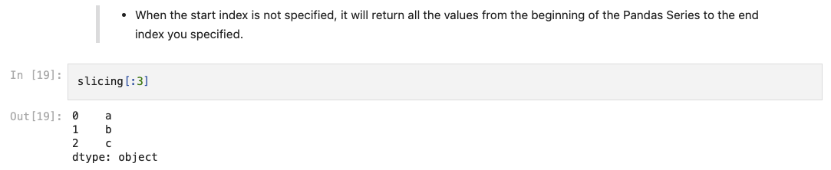
Series

Slide 32
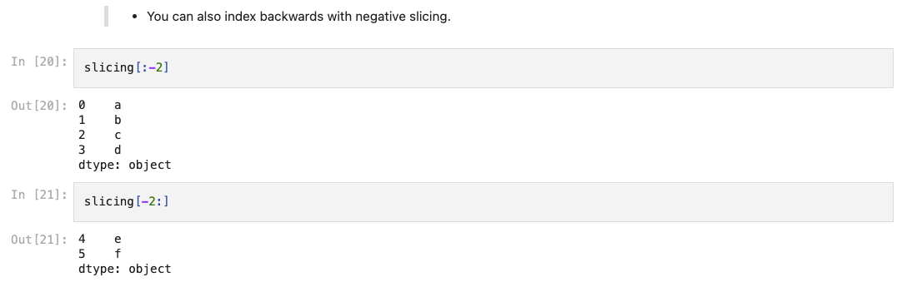
Series

Slide 33
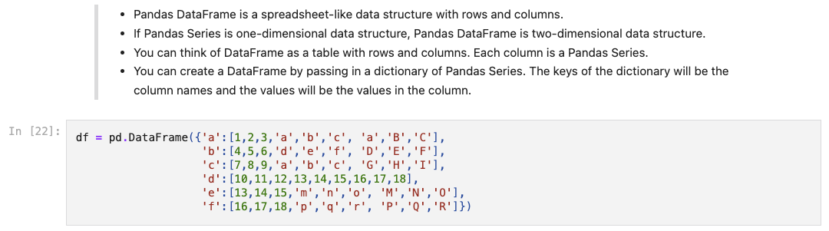
DataFrame

Slide 34
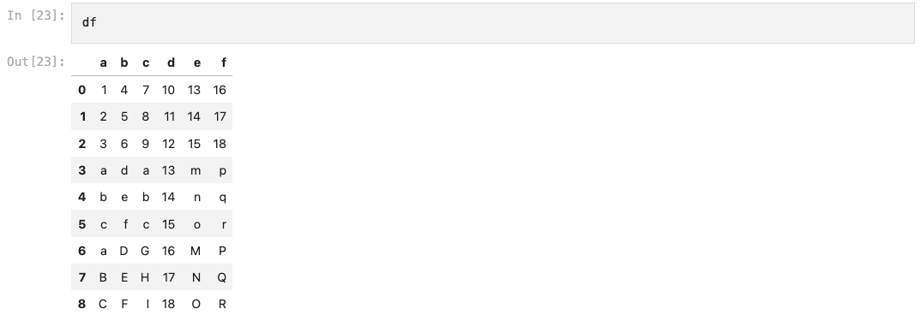
DataFrame

Slide 35
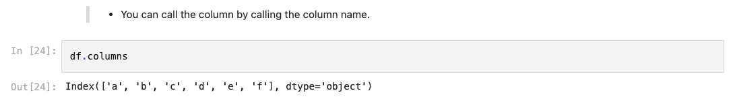
DataFrame

Slide 36
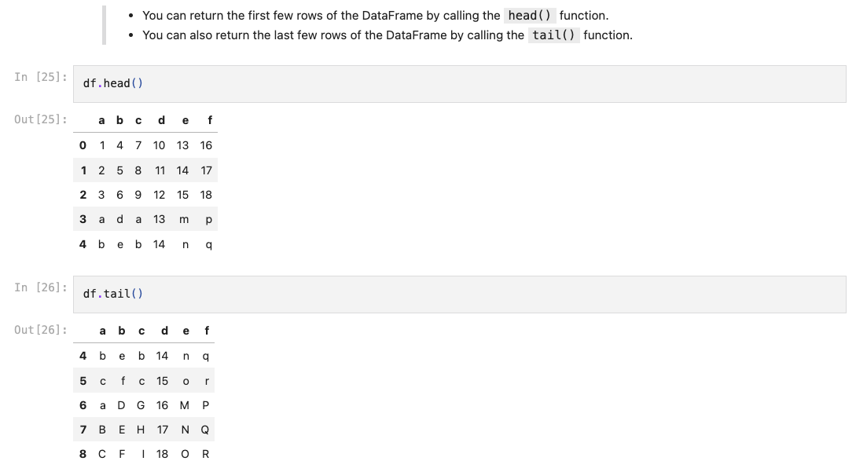
DataFrame

Slide 37
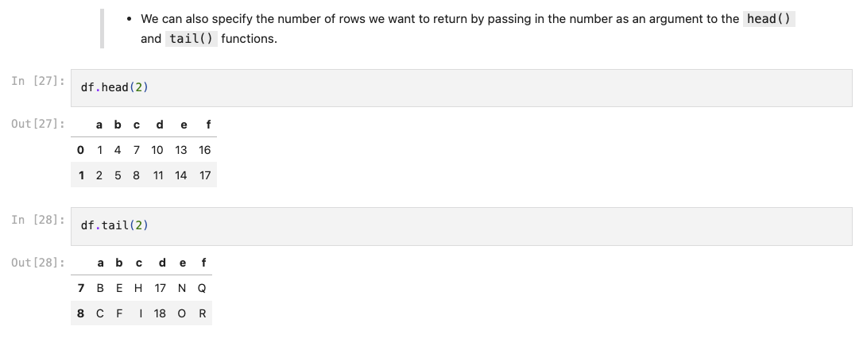
DataFrame

Slide 38
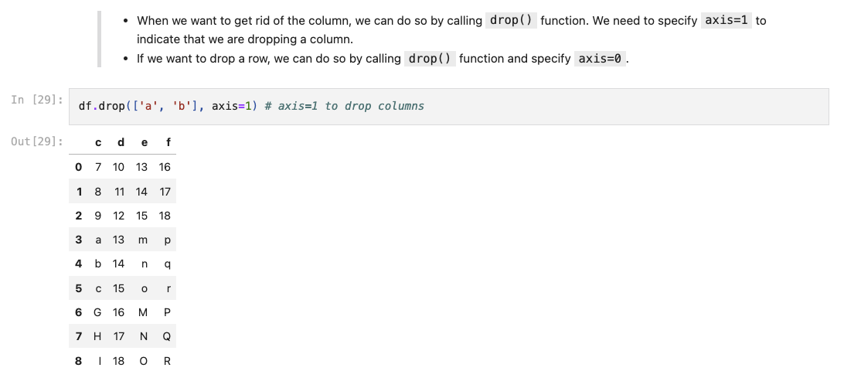
DataFrame

Slide 39
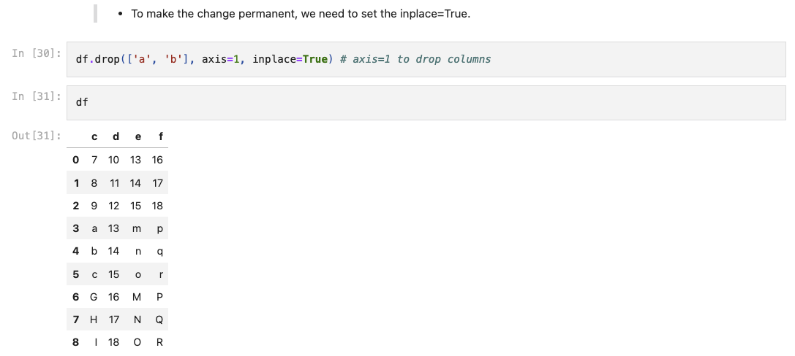
DataFrame

Slide 40
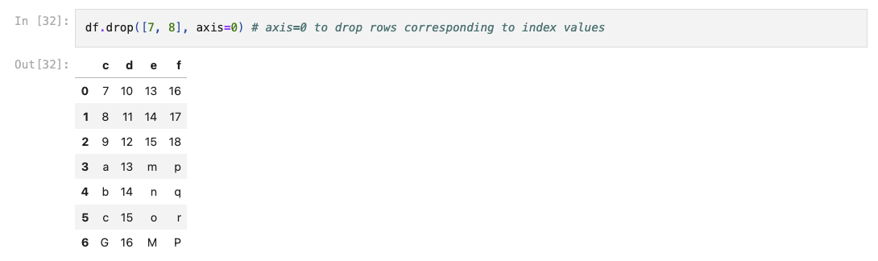
DataFrame

Slide 41
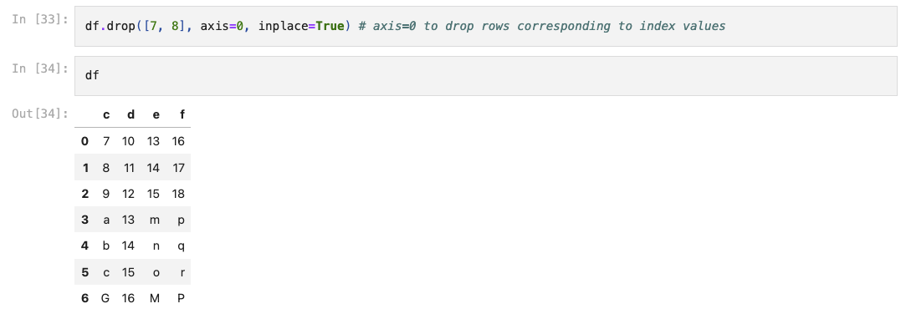
DataFrame

Slide 42
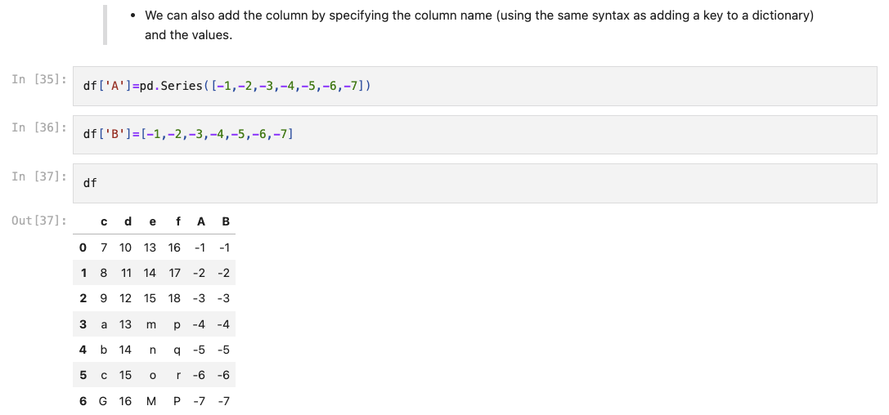
DataFrame

Slide 43
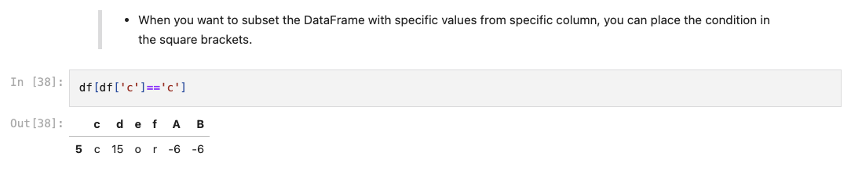
DataFrame

Slide 44
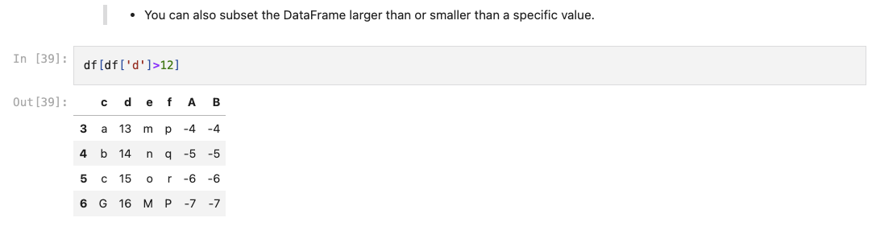
DataFrame

Slide 45
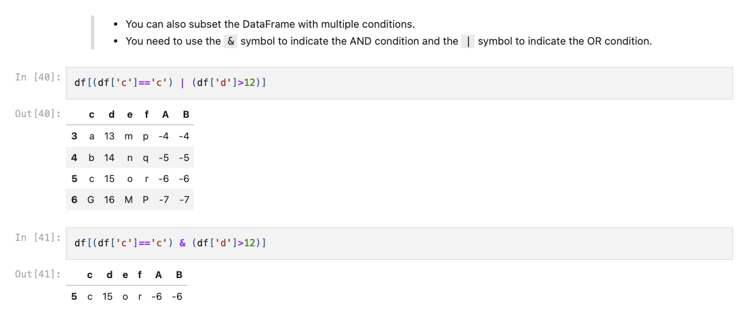
DataFrame

Slide 46
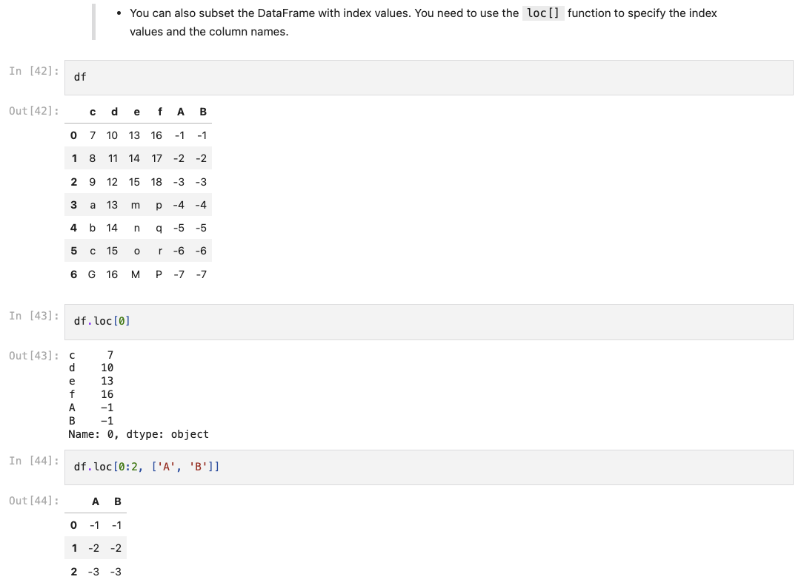
DataFrame

Slide 47
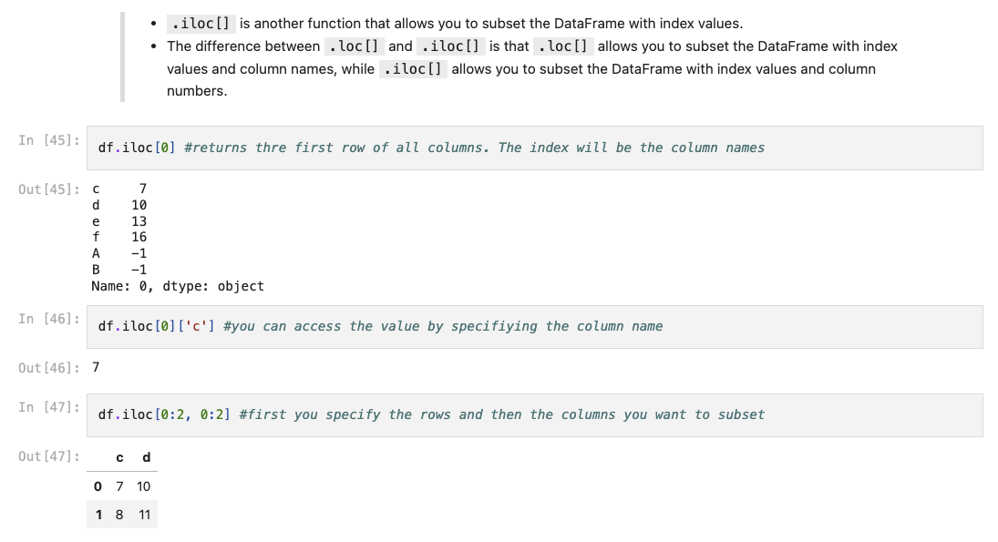
DataFrame

Slide 48
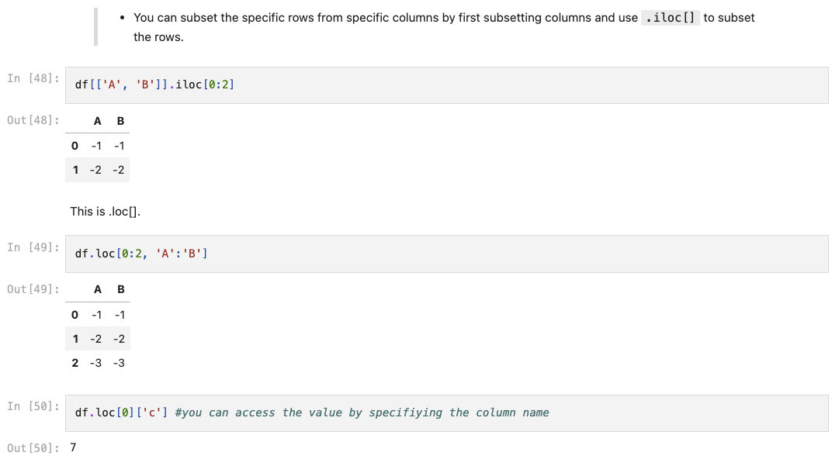
DataFrame

Slide 49
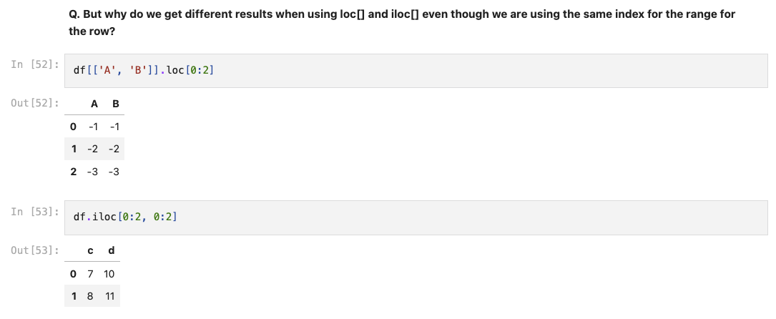
DataFrame

Slide 50
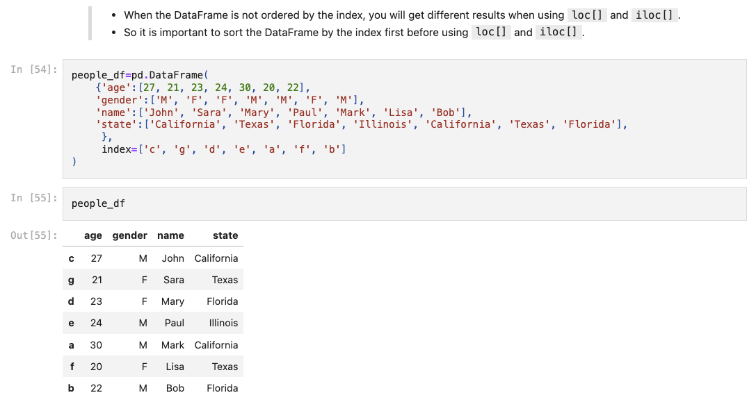
DataFrame

Slide 51
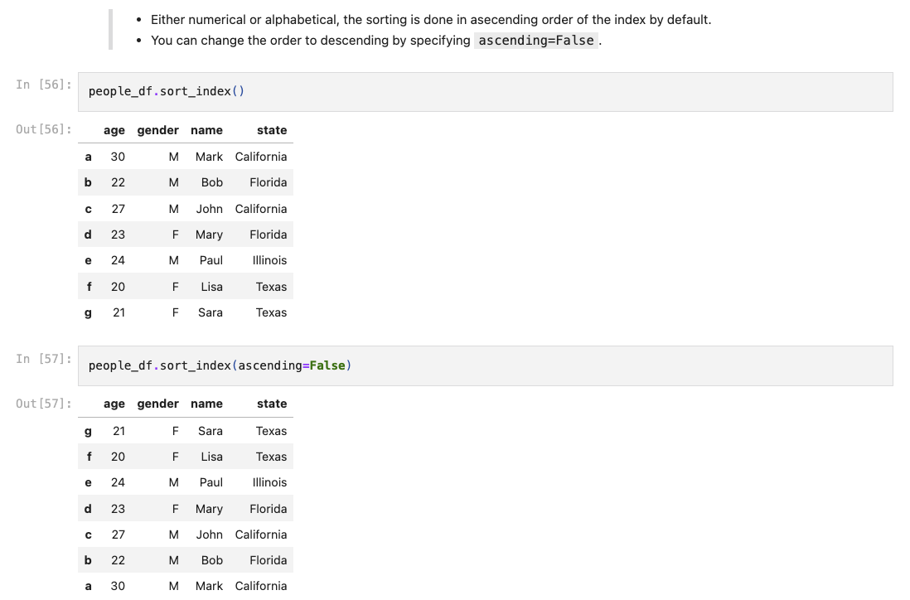
DataFrame

Slide 52
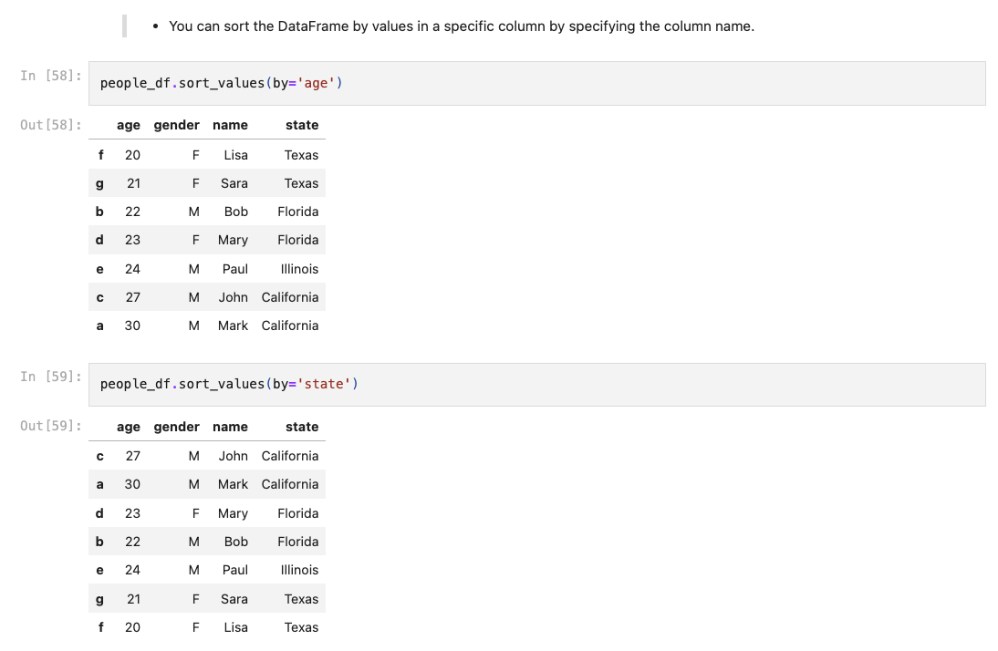
DataFrame

Slide 53
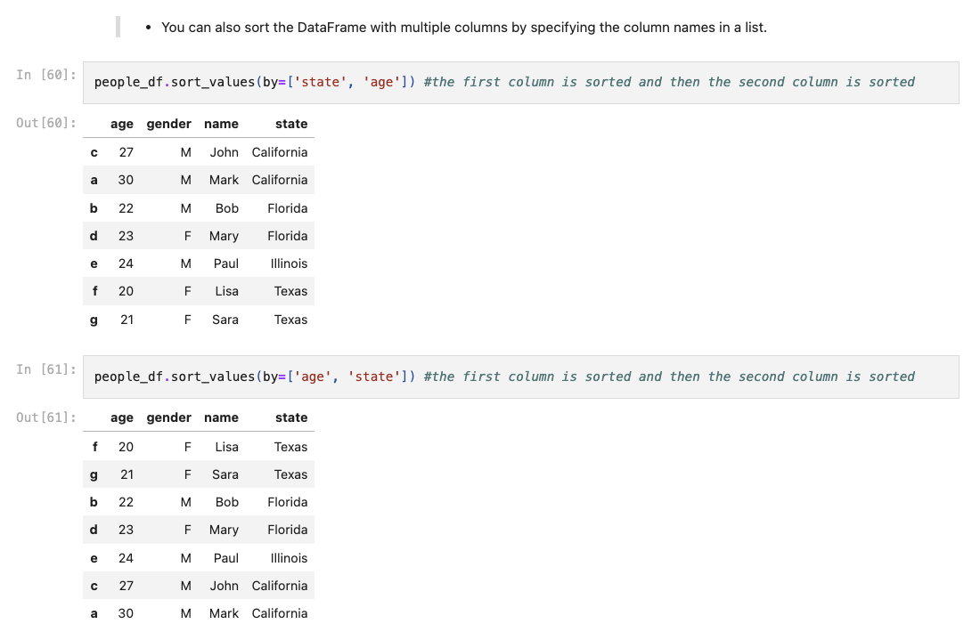
DataFrame

Slide 54
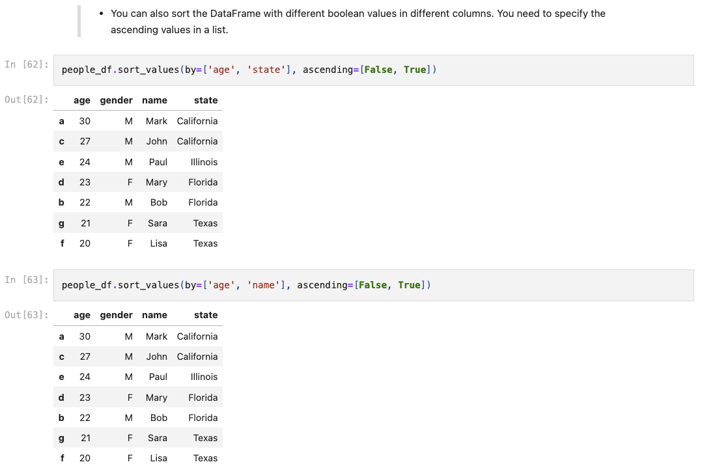
DataFrame

Slide 55
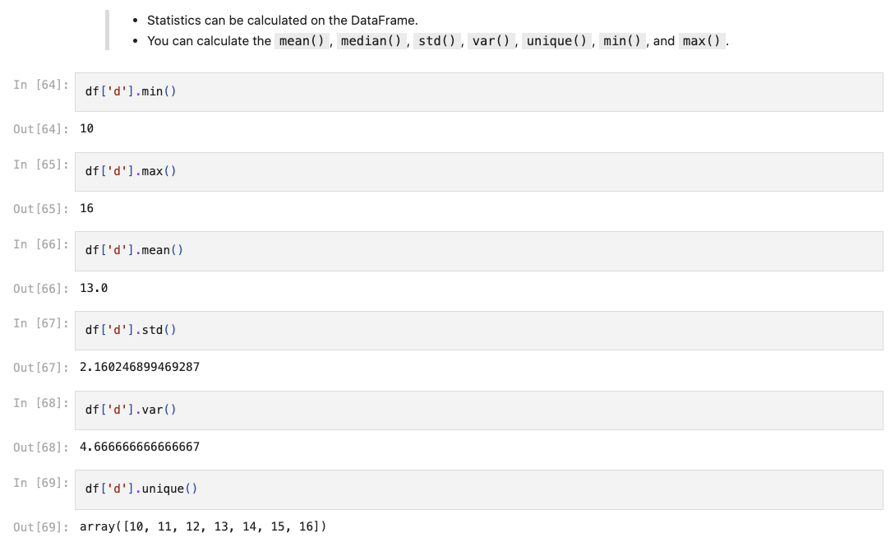
DataFrame

Slide 56
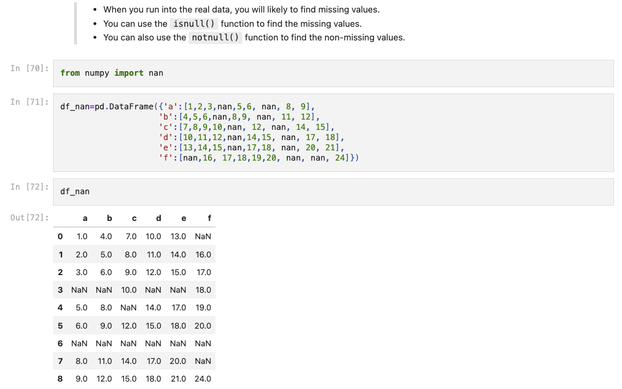
DataFrame

Slide 57
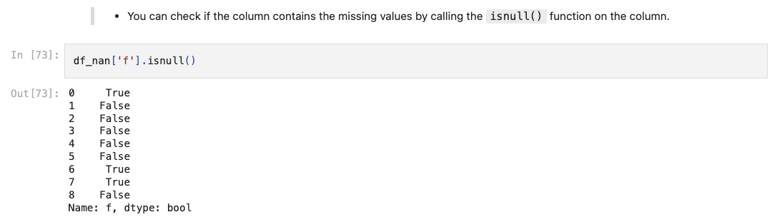
DataFrame

Slide 58
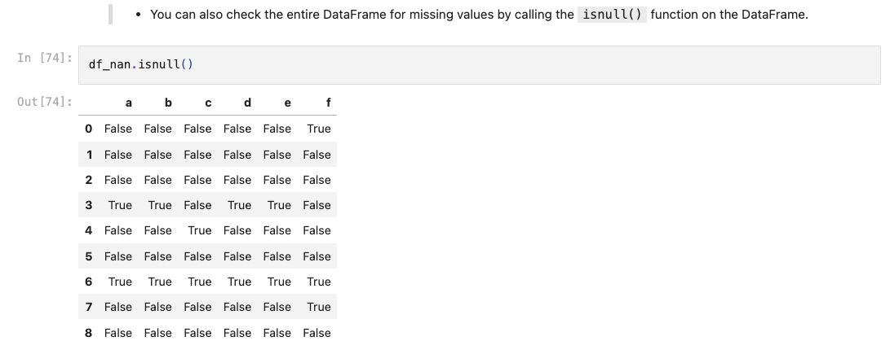
DataFrame

Slide 59

DataFrame

Slide 60

DataFrame

Slide 61

DataFrame

Slide 62

DataFrame

Slide 63

DataFrame

Slide 64

DataFrame

Slide 65

DataFrame

Slide 66

DataFrame

Slide 67

DataFrame

Slide 68

DataFrame

Slide 69

DataFrame

Slide 70

DataFrame

Slide 71

DataFrame

Slide 72

DataFrame

