Slide 1


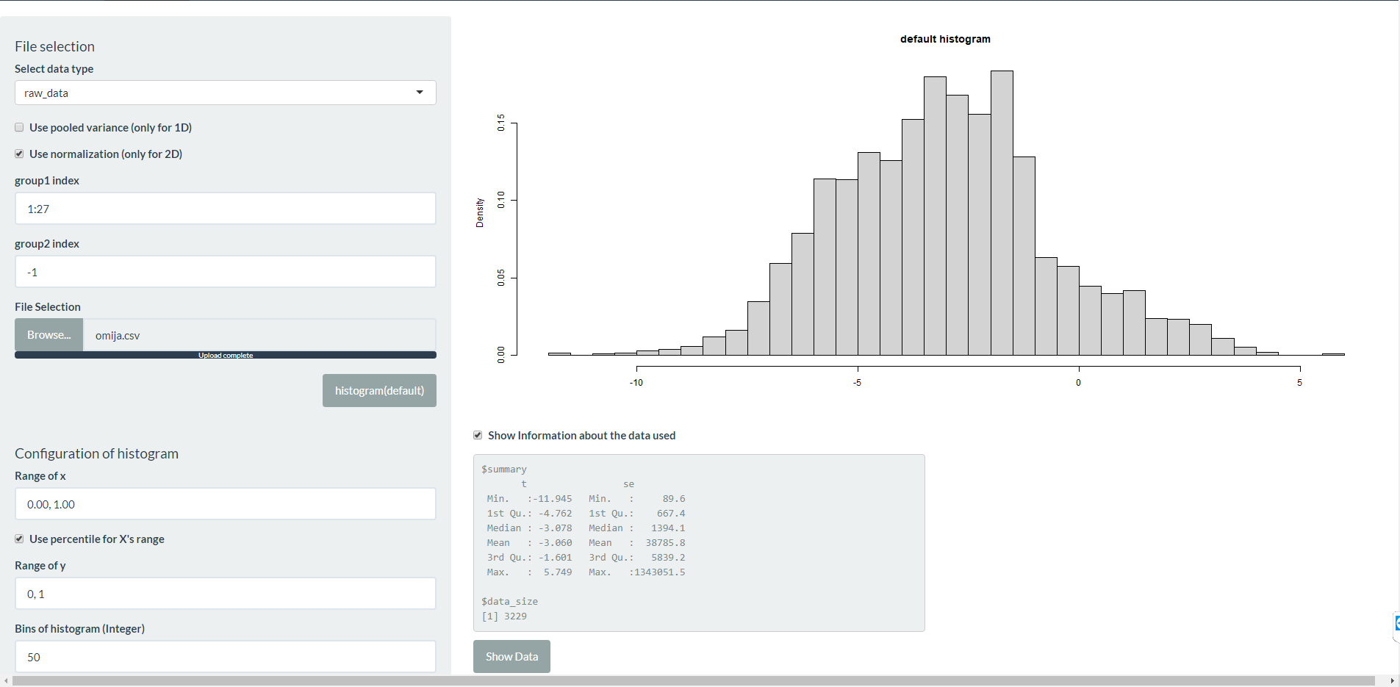
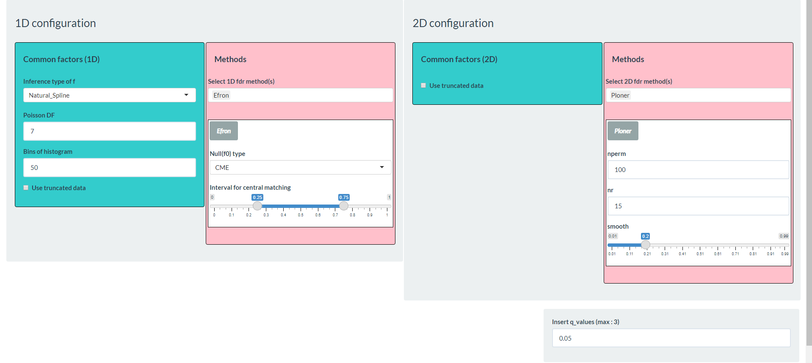
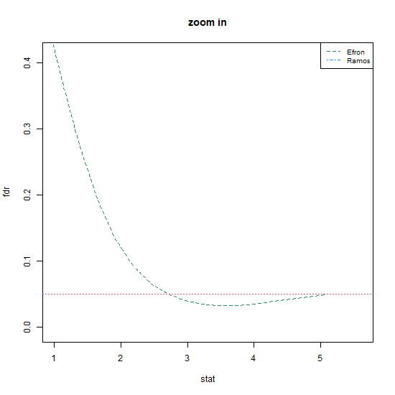
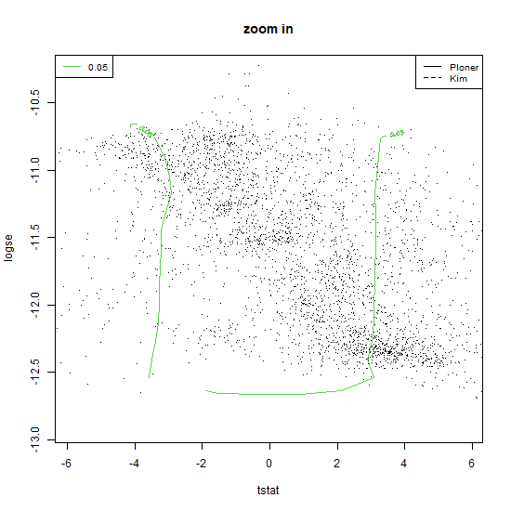
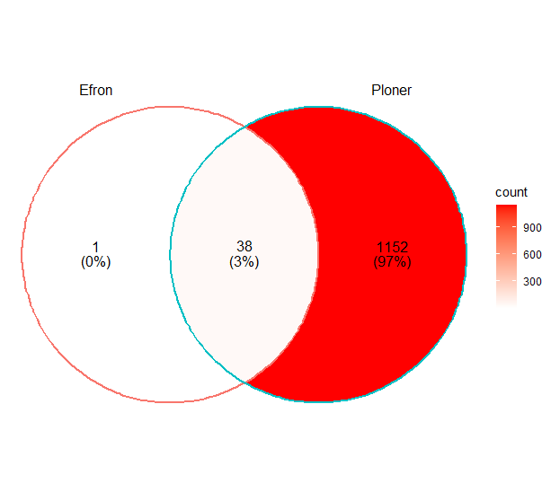
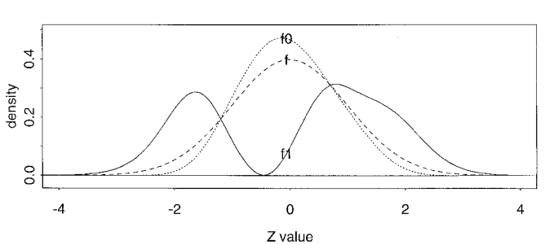

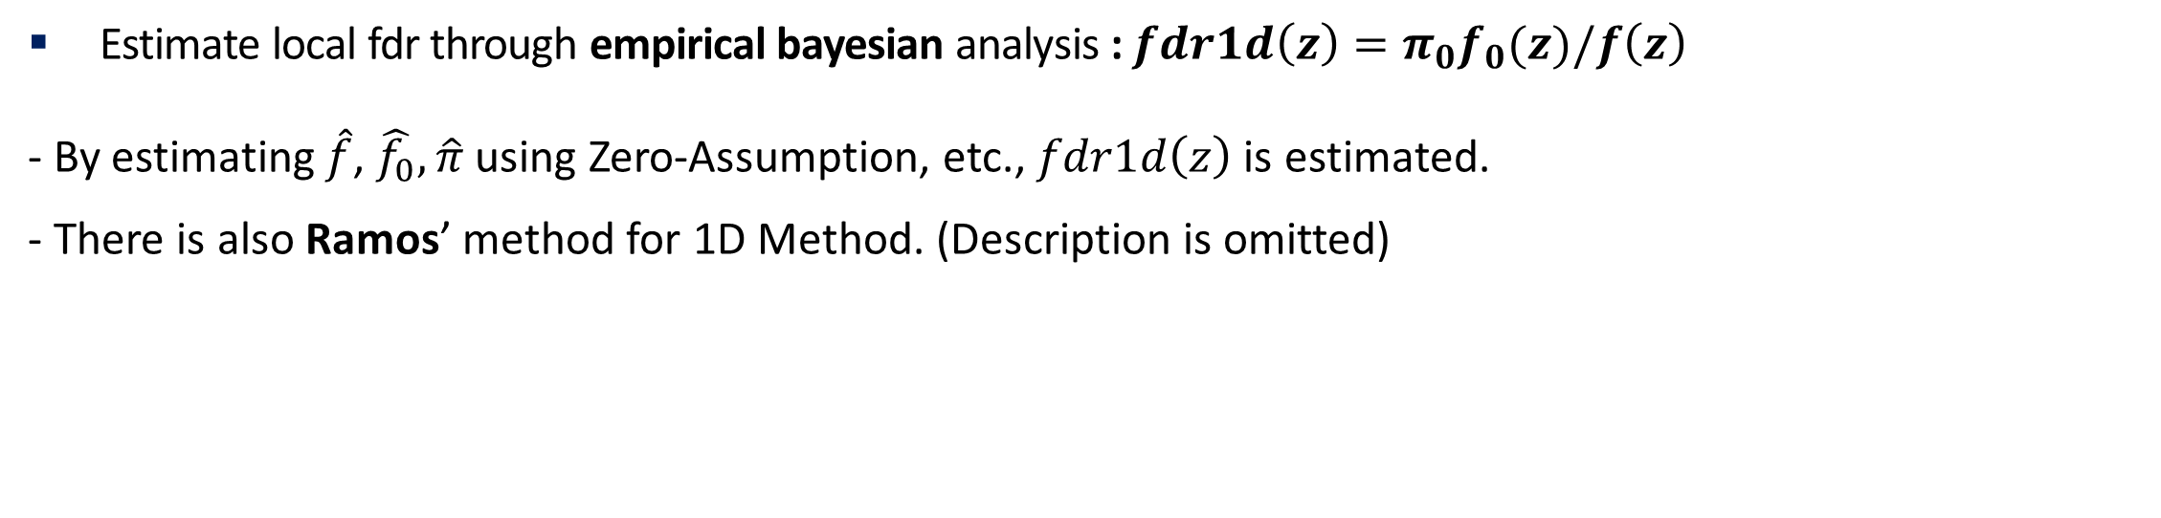
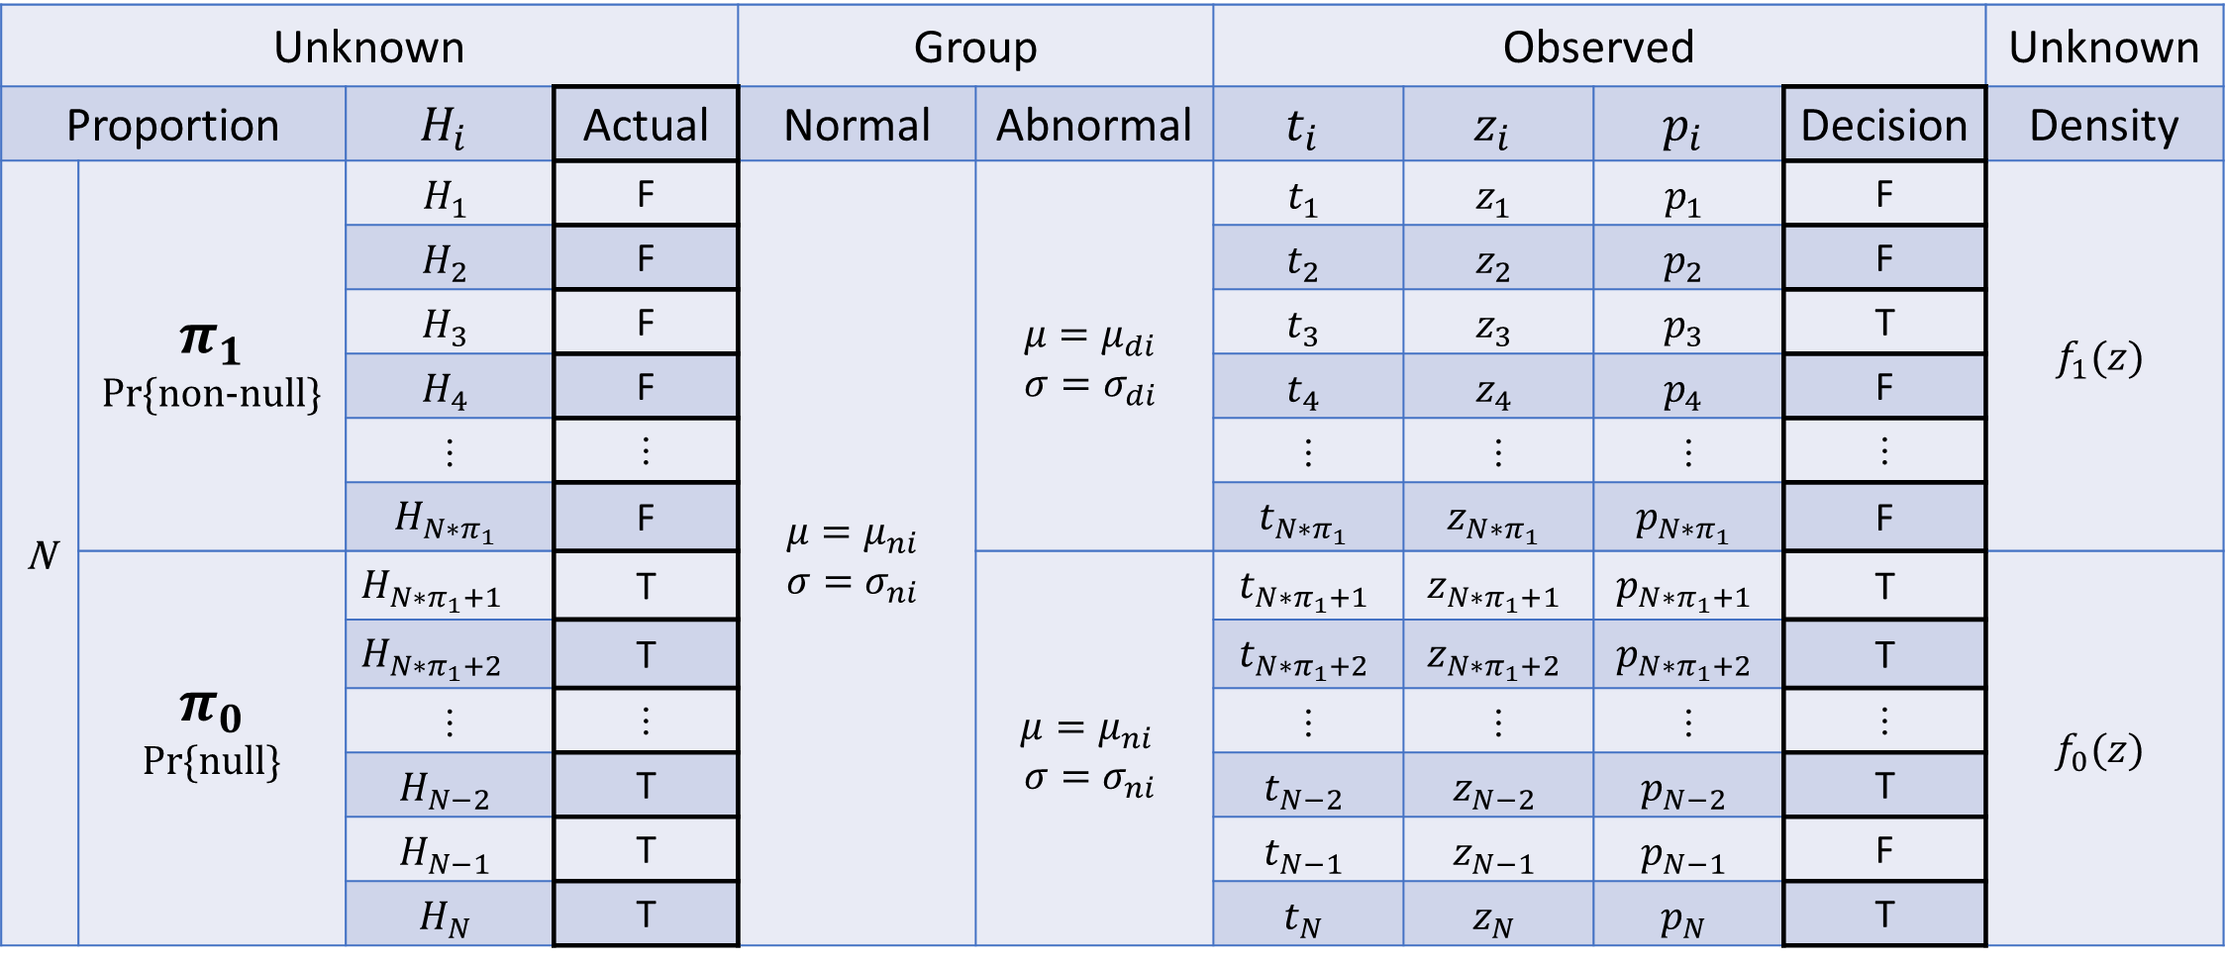
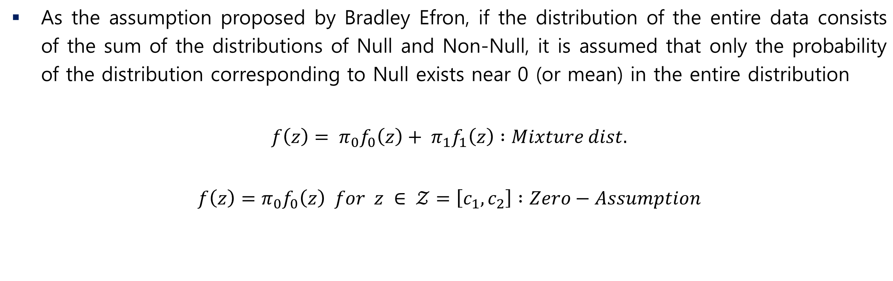
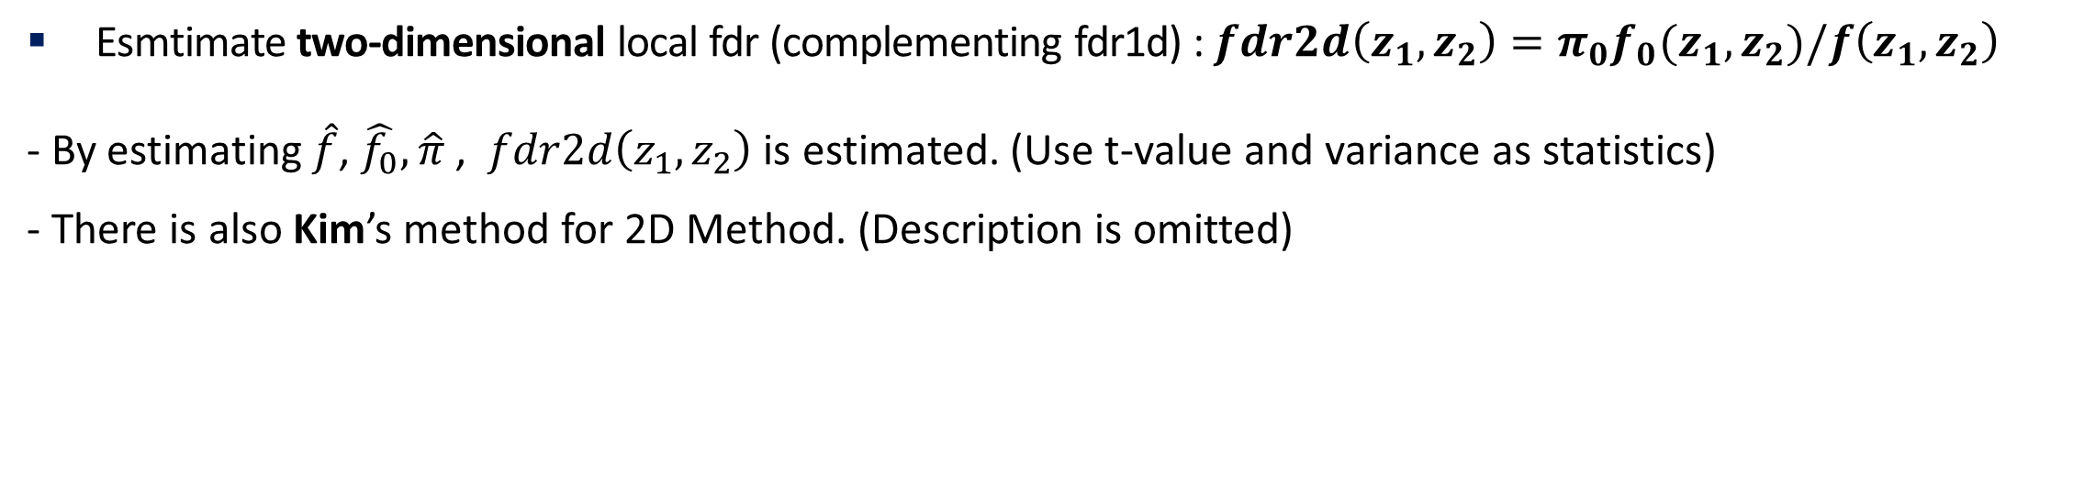
R Shiny based interface for multiple testing
Cheonnam National University(Republic of Korea), Juseong Park
Participants
Use the R Shiny interface
FDR Control Method
Presenter : Juseong Park
Authors :
Juseong Park (CNU, Master’s course of Statistics)
Shinjune Kim (KREI)
Youngjae Oh (Korea Statistics)
Corresponding author : Jaesik Jeong (CNU, Prof. of Statistics)
Data : schisandra data
About 3200 gene intensities are matched by a mixture of 27 Chinese and 30 Korean data.
We named raw data where all observations exist for each gene (feature).
Steps to use the interface
Data Load : Import data in csv file
Method selection : Methodology and parameter setting to be analyzed
Result : Visualization information and significant gene (feature) search
Abstract
① Data Load
To find the difference between metabolites in two groups in bioinformatics, multiple tests should be used, and one of the corresponding methods is to use FDR (False Discovery Rate) Control Methods.
In order to obtain significant differences using the FDR Control Method in the field of metabolic data research, it is necessary to seek help from people in the field of statistics or to study statistics directly. This can be thought of as costly in some ways. We hope that these costs will be reduced with the R Shiny interface we created.
Let’s simulate the Schisandra data (mixed Chinese and Korean) with R Shiny interface for one representative example of 1D Method and 2D Method of FDR Control Method.
Background
Large-Scale Hypothesis table
② Method selection
Unknown |  |  |  | Group |  | Observed |  |  |  | Unknown
Proportion |  | $$H_{i}$$ | Actual | Normal | Abnormal | $$t_{i}$$ | $$z_{i}$$ | $$p_{i}$$ | Decision | Density
N | $$π_{1}$$ Pr{non-null} | $$H_{1}$$ | F | $$μ=μ_{ni}$$ $$σ=σ_{ni}$$ | $$μ=μ_{di}$$ $$σ=σ_{di}$$ | $$t_{1}$$ | $$z_{1}$$ | $$p_{1}$$ | F | $$f_{1}(z)$$
 |  | $$H_{2}$$ | F |  |  | $$t_{2}$$ | $$z_{2}$$ | $$p_{2}$$ | F
 |  | $$H_{3}$$ | F |  |  | $$t_{3}$$ | $$z_{3}$$ | $$p_{3}$$ | T
 |  | $$H_{4}$$ | F |  |  | $$t_{4}$$ | $$z_{4}$$ | $$p_{4}$$ | F
 |  | ⫶ | ⫶ |  |  | ⫶ | ⫶ | ⫶ | ⫶
 |  | $$H_{{N∗π}_{1}}$$ | F |  |  | $$t_{{N∗π}_{1}}$$ | $$z_{{N∗π}_{1}}$$ | $$p_{{N∗π}_{1}}$$ | F
 | $$π_{0}$$ Pr{null} | $$H_{{N∗π}_{1}+1}$$ | T |  | $$μ=μ_{ni }$$ $$σ=σ_{ni}$$ | $$t_{{N∗π}_{1}+1}$$ | $$z_{{N∗π}_{1}+1}$$ | $$p_{{N∗π}_{1}+1}$$ | T | $$f_{0}(z)$$
 |  | $$H_{{N∗π}_{1}+2}$$ | T |  |  | $$t_{{N∗π}_{1}+2}$$ | $$z_{{N∗π}_{1}+2}$$ | $$p_{{N∗π}_{1}+2}$$ | T
 |  | ⫶ | ⫶ |  |  | ⫶ | ⫶ | ⫶ | ⫶
 |  | $$H_{N−2}$$ | T |  |  | $$t_{N−2}$$ | $$z_{N−2}$$ | $$p_{N−2}$$ | T
 |  | $$H_{N−1}$$ | T |  |  | $$t_{N−1}$$ | $$z_{N−1}$$ | $$p_{N−1}$$ | F
 |  | $$H_{N}$$ | T |  |  | $$t_{N}$$ | $$z_{N}$$ | $$p_{N}$$ | T
Mixture dist. & Zero-Assumption
③ Result
As the assumption proposed by Bradley Efron, if the distribution of the entire data consists of the sum of the distributions of Null and Non-Null, it is assumed that only the probability of the distribution corresponding to Null exists near 0 (or mean) in the entire distribution
$$f\left(z\right)= π_{0}f_{0}\left(z\right)+ π_{1}f_{1}\left(z\right) :Mixture dist.$$
$$f\left(z\right)=π_{0}f_{0}\left(z\right) for z ∈ 𝒵=\left[c_{1}, c_{2}\right] :Zero−Assumption$$
- Efron etal. 2001 p.1155
- Example of Zero-Assumption
1D: Efron
2D : Ploner
Venn Diagram
Output : Plots and index of result.csv
Reference
FDR Control Method
[1] Yoav Benjamini and Yosef Hochberg. Controlling the false discovery rate: a practical and powerful approach to multiple testing. Journal of the Royal statistical society: series B (Methodological), 57(1):289–300, 1995.
[2] Bradley Efron, Robert Tibshirani, John D Storey, and Virginia Tusher. Empirical bayes analysis of a microarray experiment. Journal of the American statistical association, 96(456):1151–1160, 2001.
[3] Alexander Ploner, Stefano Calza, Arief Gusnanto, Yudi Pawitan. Bioinformatics, Volume 22, Issue 5, 1 March 2006, Pages 556–565
In R Shiny, you can make the created app accessible through the Internet.
Here is my link QR code. (It may disappear later)
1D fdr : Bradley Efron etal.
Estimate local fdr through empirical bayesian analysis : $fdr1d\left(z\right)=π_{0}f_{0}(z)/f\left(z\right)$
- By estimating $\hat{f}$, $\hat{f_{0}},\hat{π}$ using Zero-Assumption, etc., $fdr1d\left(z\right)$ is estimated.
- There is also Ramos’ method for 1D Method. (Description is omitted)
2D fdr : Alexander Ploner etal.
Esmtimate two-dimensional local fdr (complementing fdr1d) : $fdr2d\left(z_{1},z_{2}\right)=π_{0}f_{0}(z_{1},z_{2})/f\left(z_{1},z_{2}\right)$
- By estimating $\hat{f}$, $\hat{f_{0}},\hat{π}$ , $fdr2d\left(z_{1},z_{2}\right)$ is estimated. (Use t-value and variance as statistics)
- There is also Kim’s method for 2D Method. (Description is omitted)
This research was supported by the BK21 FOUR (Fostering Outstanding Universities for Research, NO.5120200913674) funded by the Ministry of Education(MOE, Korea) and National Research Foundation of Korea(NRF)

