Slide 1

caPstOneGroup, Team #29
Almen Ng, Albert Zhou, David Yao, Gary Gong, Jonathan Yapeter, Kabishan Suvendran

Slide 2
Project Overview
parking in busy areas can be hassle and waste a lot of time
develop a system that can show the user the location of available parking spots
the system uses cameras and machine learning to detect which spots are available and occupied
app shows the user the location of where spots are available

Slide 3
Development Plan
Polling the state of the parking space at regular intervals
Updating user interface as car enters parking space
Running simple machine learning model on developer’s laptop

Slide 4
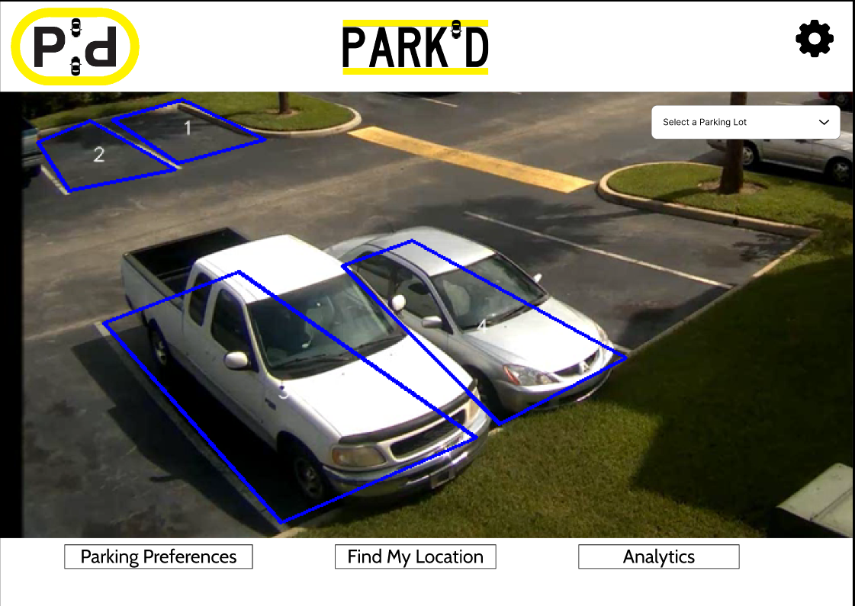
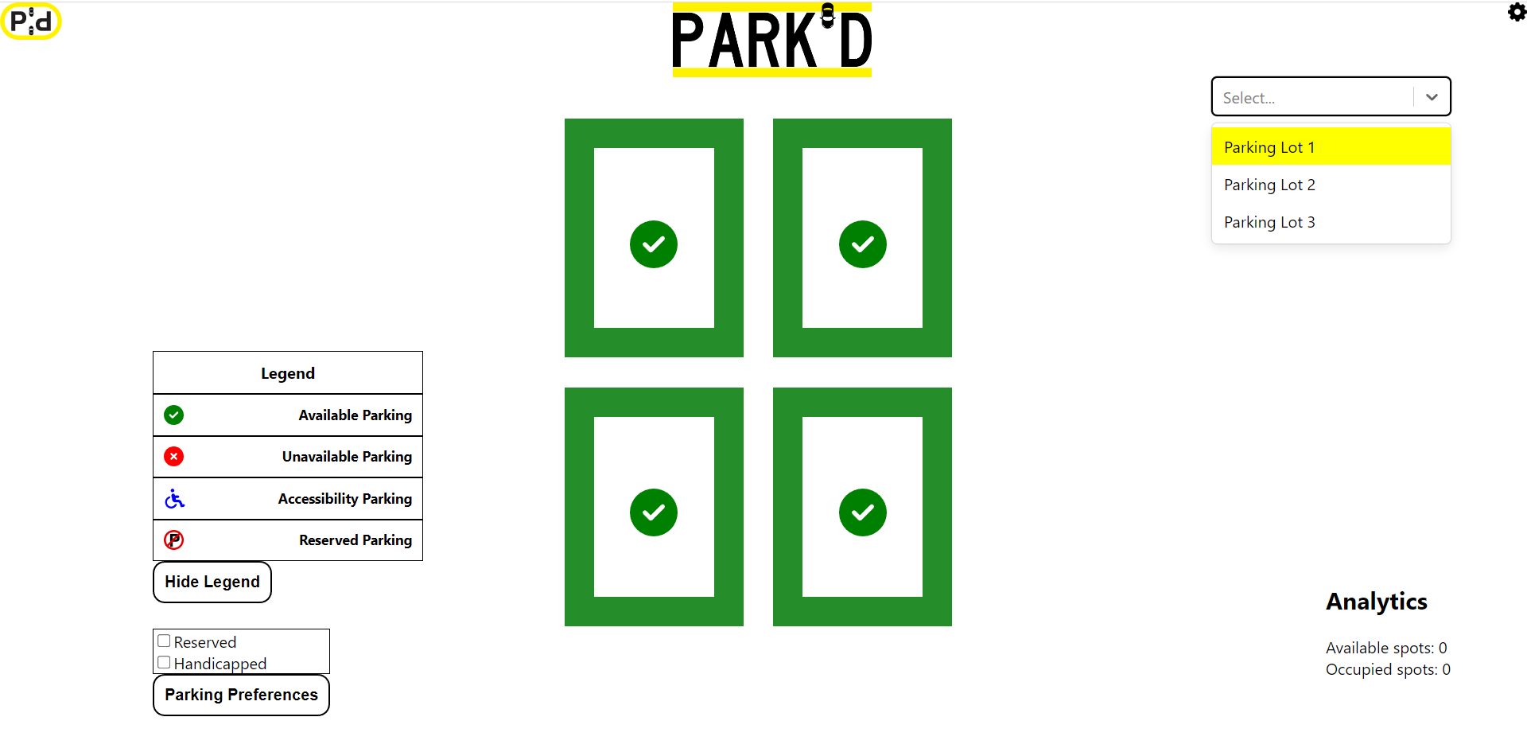
Frontend

Slide 5
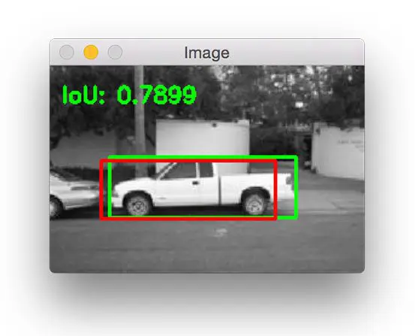
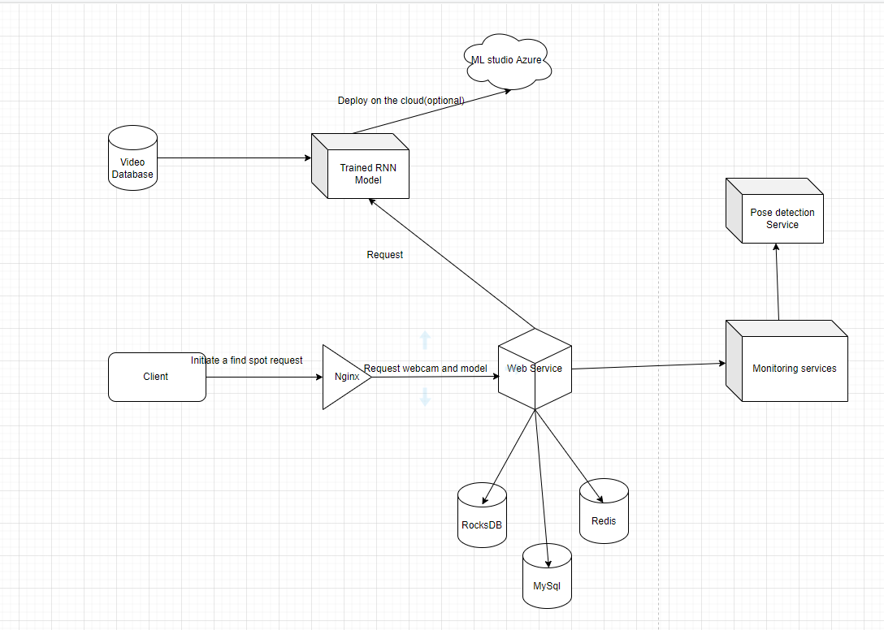
Backend

Slide 6
DEMO OF

Slide 7
Next Steps
Scaling up
Larger parking lots with more spaces
Multiple parking lot options
Expanding functionality
Reserved parking spaces
Handicapped parking spaces
Directions to spots

