Slide 1


caPstOneGroup, Team #29
Almen Ng, Albert Zhou, David Yao, Gary Gong, Jonathan Yapeter, Kabishan Suvendran

Slide 2

Impressive Features
Google API usage and labelling of parking spaces
Spots overlaid on top of the map and are updated dynamically, supports navigation within most parking lots
Works on top down and birds eye view
Admin View vs User View

Slide 3
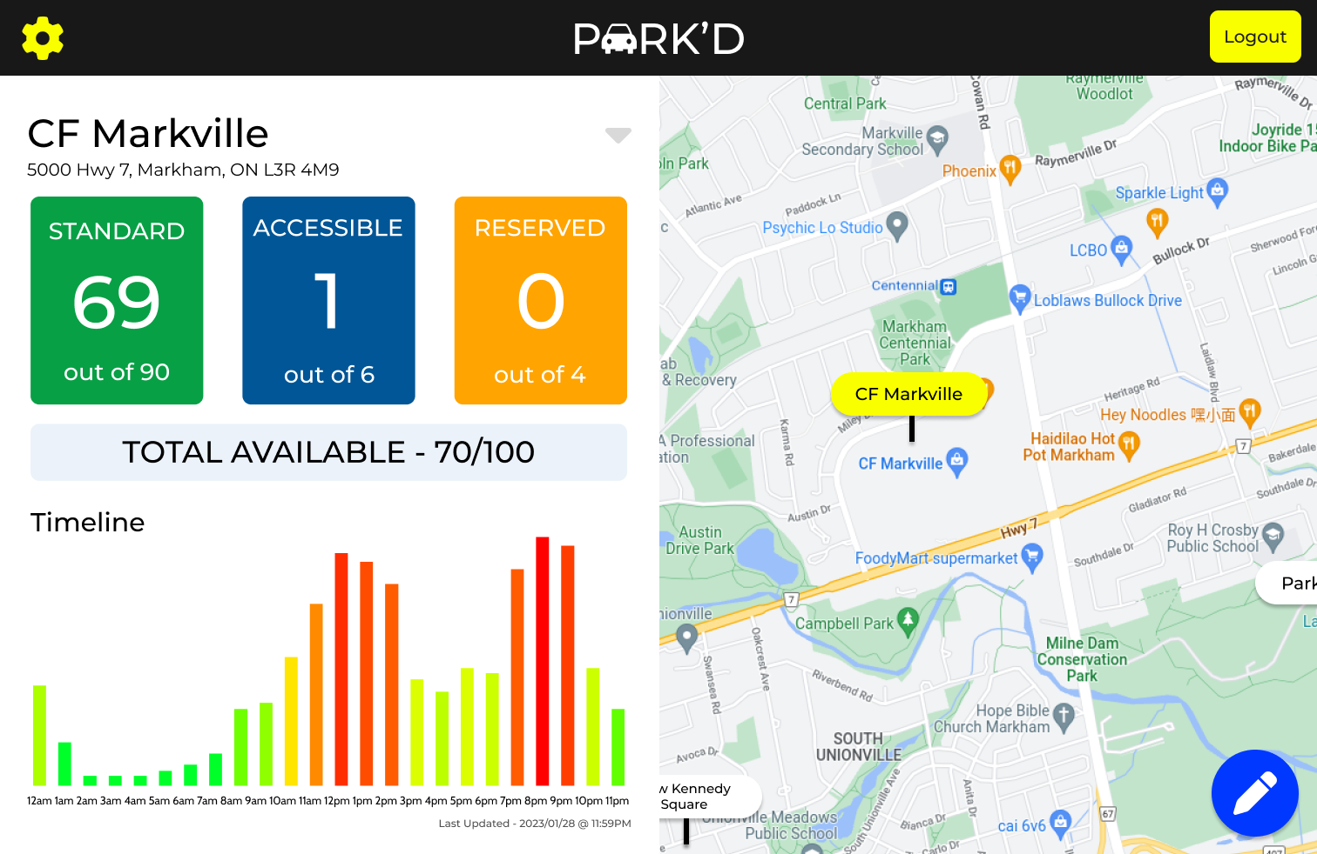
Not Implemented
Use location services for live location and directions
Different parking spot types
Navigation reaction to spot being taken
Functional settings
(long-term) Analytics

Slide 4
Verification and Validation
Obtaining a group of individuals who have cars to test out the functionality of the user portion of the application
Lots of manual testing and recording of data
Asking parking lot managers to test out the admin portal
Multiple users accessing the application at the same time
Mostly manual testing

Slide 5
Improvements in Final System and Documentation
Final System
Firebase always up database
Creating a responsive UI for the phone
Hosting it on an actual website
Implementing the remaining requirements
Documentation
Review all the comments and issues on GitHub as well as given by the TA
Look over the documentation and make changes to portions that were changed (i.e. scope change, adding subtracting features)

Slide 6
Demo of

