Slide 1
RACS
PSJ

Slide 2
RACS: A Case for Cloud Storage Diversity
Hussam Abu-Libdeh, Lonnie Princehouse, Hakim Weatherspoon, Cornel University

Slide 3
About this paper
Introduce a proxy RACS
avoid vendor lock-in (reduce the cost of switching providers)
better tolerate provider outages or failures
Evaluate a prototype of RACS
Estimate the costs incurred and benefits

Slide 4

Clouds
Current trends show an increasing number of companies migrating their data to cloud
Recently, the United State Library of Congress moved its digitized content to the cloud

Slide 5


Lock-in
However, to depend solely on a cloud has its risks
Vendor Lock-in
can be prohibitively expensive for clients to switch from one to another
“data inertia”

Slide 6
Data loss or Outages
In addition, provider may go out of business or suffers a catastrophe
Microsoft Sidekick: March 13, 2009
outage: 6 days
Google GMail: Ortober 16, 2008
outage: 30 hours
Google GMail, Google Apps: August 15, 2008
outage: 24 hours
Microsoft Azure: March 13, 2009
outage: 22 hours

Slide 7
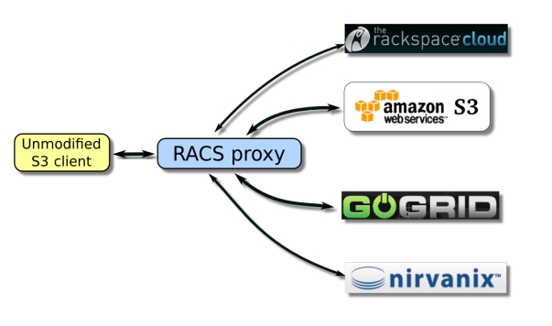
RACS: Redundant Array of Cloud Storage
RACS operates on the same principle as RAID-5
It stripes data across cloud storage repositories

Slide 8
RAID 0: Performance
Stripping
Advantages
Performance
All storage capacity can be used
Disadvantages
Not fault tolerant
Disk 0
Disk 1
Block 0
Block 1
Block 2
Block 3
Block 4
Block 5

Slide 9
RAID 1: HA
Mirroring
Advantages
Double read speed
No rebuild necessary if a disk fails: just copy
Disadvantage
Only half the space
Disk 0
Disk 1
Block 0
Block 0
Block 1
Block 1
Block 2
Block 2

Slide 10
RAID 5: HA
Interleaved parity
Advantages
Very fast reads
High efficiency: low ratio of parity/data
Disadvantages
Slow writes
Complex controller
Disk 0
Disk 1
Disk 2
Disk 3
Block 0a
Block 0b
Block 0c
Parity 0
Block 1a
Block 1b
Parity 1
Block 1c
Block 2a
Parity 2
Block 2b
Block 2c

Slide 11
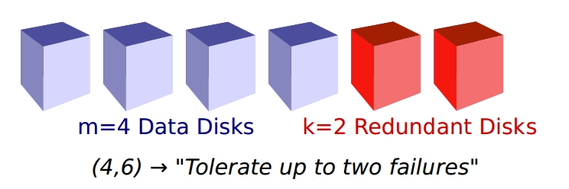
Error Correcting Codes
RACS uses Reed-Solomon error correcting codes
to tolerate failures with out data loss
Starting with m equal-size disks of original data
We fill k additional disks with redundant data
We write (m, n) to indicate that there are n = m + k total disks
Any combination of m disks is sufficient to reconstruct the original data

Slide 12
Goal of RACS
Data loss prevention is a much less compelling reason to use ECC
RACS lowers the cost of switching providers (a result of economic failure)
only 1/m of all data needs to be moved to leave a vendor

Slide 13
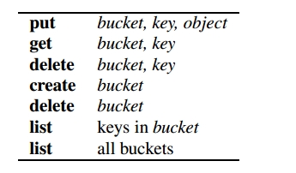
Design
RACS mimics the interface of Amazon S3
Amazon S3
stores data in named buckets
contains keys associated with objects
Objects can be of arbitrary size, up to 5 GB
partial writes to objects are not allowed
Why we choose Amazon S3 interface?
simplicity
popularity
Amazon S3 operations

Slide 14
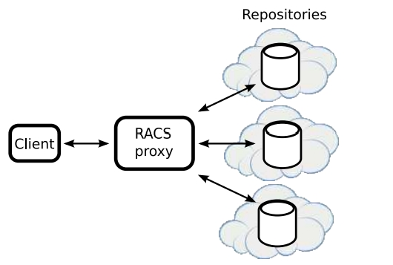
RACS as a proxy
N repositories
cloud storage location ideally hosted by different providers
Put request
RACS splits the object into m(configurable) data shares of equal size
RACS then uses erasure coding to create an additional (n-m) redundant shares
Any subset of m shares is sufficient to reconstruct the original object

Slide 15
RACS as a proxy (cont.)
Get request
RACS fetches m shares
reassembles the data
Metadata are replicated across all servers (small)
bucket and key names, modification times, MIME types
RACS also stores a small amount of its own metadata with each share
the size of the original object and its content hash
because of the list request

Slide 16
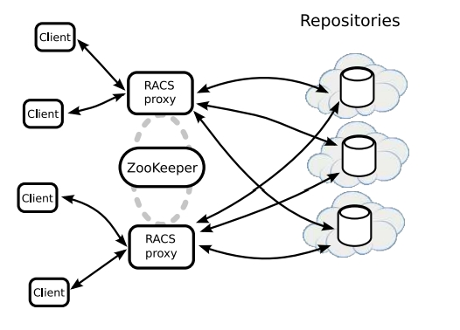
Distributed RACS
RACS is intended to be run as a distributed system (why?)
with concurrently communicating with the same set of repositories
RACS relies on ZooKeeper for distributed synchronization primitives

Slide 17
Performance Overhead
Storage
RACS uses a factor of n/m more storage, plus some additional overhead
Number of requests
RACS issues a factor of n more requests to repo for put, create, and delete operations
Bandwidth
RACS increases the bandwidth used by put operations by a factor of n/m
Latency
put operations must wait for the slowest of the repo to complete the request

Slide 18
Evaluation
We will first estimate the vendor lock-in cost associated with switching storage providers
trace-driven
Then, we will estimate the cost of avoiding vendor lock-in by using RACS

Slide 19
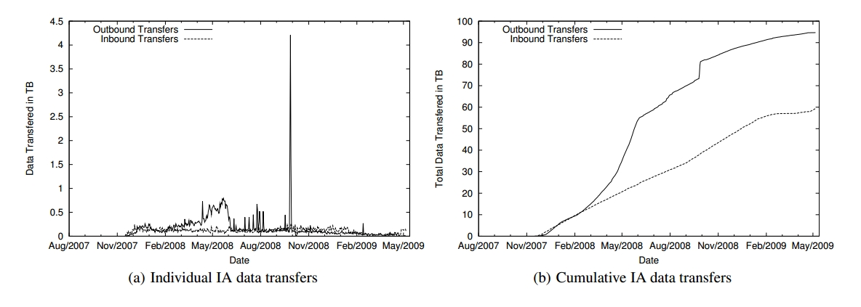
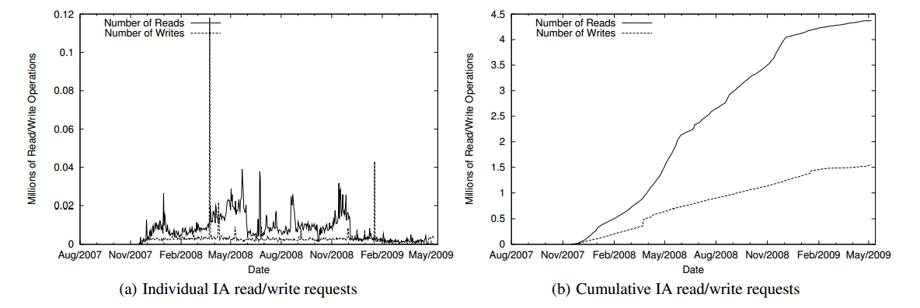
An Internet Archive in the Cloud
Our trace covers 18 months of activity on the Inter Archive(IA) servers
HTTP & FTP interactions

Slide 20
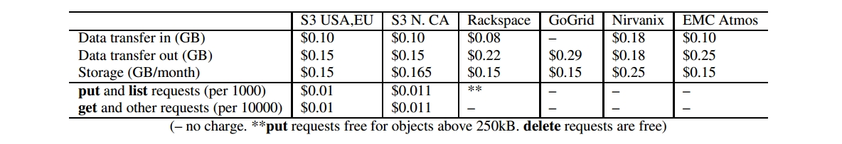
Cost of Moving to the Cloud
We estimated the monetary cost of moving the IA to the cloud
using up-to-date pricing schemes
In addition to bandwidth and storage, providers exposing a REST API also charge per operation

Slide 21
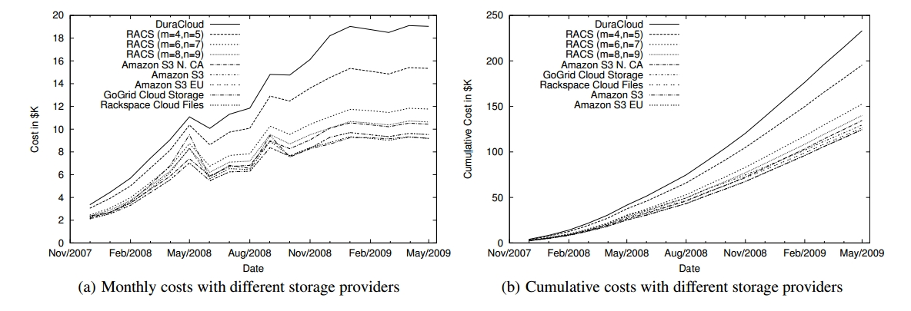
Cost of Moving to the Cloud
We estimated the cost of servicing the Internet Archive
a single provider, DuraCloud (full replication to two providers)
RACS using multiple erasure coding configurations
the added overhead cost of RACS depends on the coding configurations
9 providers? we believe it is a valid estimate in anticipation of expected growth

Slide 22
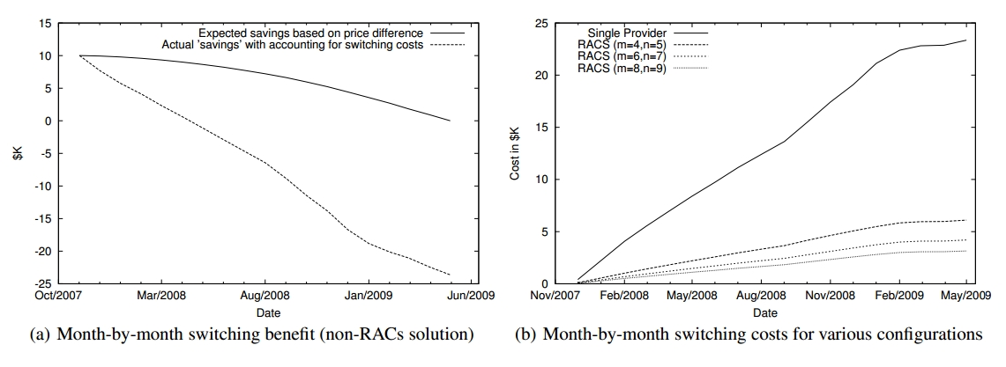
Cost of Vendor Lock-in
We assumed that the IA is currently hosted on a single priced provider
S3 Northern California
and they wish to switch to another leading competitor
RaceSpace
RACS is severely reduced to just below $3K (a factor of seven)

Slide 23
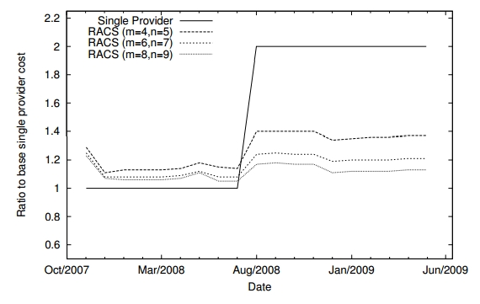
Tolerating Price Hikes
A hypothetical scenario
a single provider doubles its pricing scheme halfway
In such a scenario, RACS can be used to serve read operations from cheaper providers

Slide 24
PROTOTYPE EVALUATION
We ran several benchmarks with various (m,n) values
To determine the operational overhead incurred by RACS
We also tested the response time of RACS against Rackspace
To confirm that RACS doesn’t introduce unacceptable latency

Slide 25
Benchmarks
We use a single RACS proxy running on the client machine
We use the backup tool Cumulus to back up a user’s home dir to the cloud
All repositories were backed by Amazon S3
In real world, of course, using the same provider negates the purpose of RACS
But, to move objects between repositories, we downloaded and re-uploaded them
The benchmarks
Upload snapshot
Cumulus packs files into large segments
About 4 giga home dir -> 238 segments, for a total of 1.2 giga
Vendor Migration
Restore snapshot

Slide 26
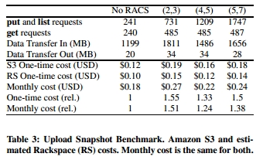
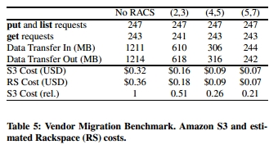
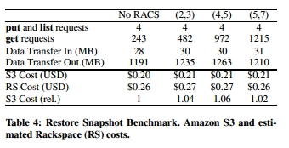
Benchmarks

Slide 27
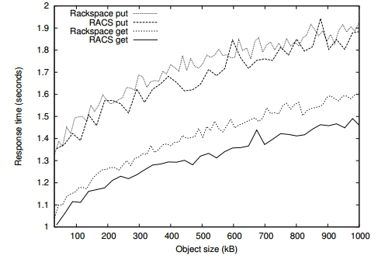
Performance
Surprisingly, RACS does not lag behind
Because of parallelism?
Erasure coding is not likely to become a bottleneck
Until gigabit Ethernet speeds are involved

Slide 28
Conclusion
Cloud computing issues
lock-in
RACS
a proxy
use multi-clouds as a set of repositories
use erasure coding
RACS enables cloud storage customers to explore trade-offs between overhead and mobility

Slide 29
2012 공개 sw 개발자 대회
대회기간
2012년 4월 19일 ~ 2012년 11월 27일
일정
신청 접수: ~6월 3일
산출물 접수 마감일: ~9월 23일
심사
서류 검토: 6월 5일 (개발 계획서 검토)
1차 심사: 9/26 ~ 10/12 (산출물 1차 서류 심사)
기술 테스트: 10/5 ~ 11/2 (산출물 최종 기숥스트)
2차 심사: 11/3
결과 공지: 11/7
공개 sw 데이: 11/27 (시상 및 행사)

Slide 30
주제
주제
여러 클라우드를 이용한 Proxy 스토리지 어플리케이션
특징
Multi clouds 가정
타겟에 따라 다른 특징 제공

Slide 31
타겟
타겟1
일반 사용자
일반적으로 강한 보안을 필요하지 않음
여러 클라우드를 이용하여 하나의 논리적인 클라우드 제공
사용자는 어떤 클라우드를 사용하는 것에 알 필요 없이 하나의 논리적인 공간을 이용
한국에선, 여러 회사에서 무료로 30~50GB 제공하는 것을 이용
타겟 2
기업, 회사, 군부대 같은 강한 보안을 필요로 하는 사용자
여러 클라우드를 이용하여 강한 보안을 보장
Lock-in 문제 해결
RACS + DepSky + @ (maybe -@)

Slide 32



Team
박승제와 아이들
왼손
리더
오른손

Slide 33



Architecture
Cloud of Clouds
Proxy
Client

Slide 34
Q&A
Thank you for your attention

