Slide 1
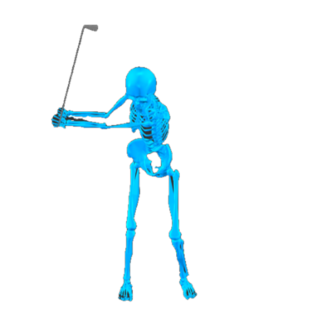
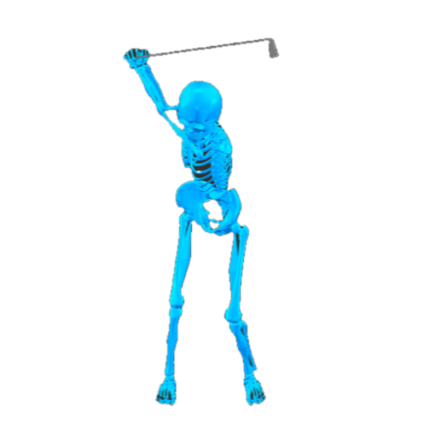
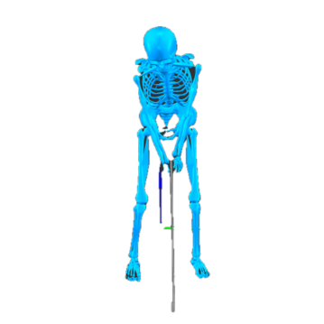
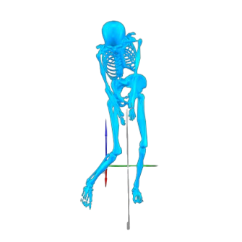
Address
(ADD)
Half Backswing
(HB)
Backswing Top
(BST)
Half Downswing
(HD)
Impact
(IMP)
Backswing
(BS)
Downswing
(DS)
Follow-through
(FT)
|
|
|

Slide 2
PELVIS-TORSO SHIFT DIFFERENCE
PELVIS LIFT
TORSO LIFT
PELVIS SWAY
PELVIS LIFT
TRUNK LIFT
PELVIS SWAY
PELVIS LIFT
TRUNK LIFT
X-FACTOR
BACK KNEE
X-FACTOR
FRONT KNEE
BACK KNEE
X-FACTOR
FRONT KNEE
BACK KNEE
FRONT KNEE
PELVIS LIFT
TRUNK LIFT
PELVIS SWAY
PELVIS LIFT
TRUNK LIFT
PELVIS SWAY
X-FACTOR
FRONT KNEE
BACK KNEE
X-FACTOR
FRONT KNEE
BACK KNEE
PELVIS LIFT
TRUNK LIFT
PELVIS SWAY
X-FACTOR
FRONT KNEE
BACK KNEE

Slide 3
PELVIS LIFT
FRONT KNEE
X-FACTOR
TORSO LIFT
BACK KNEE
PELVIS LIFT

Slide 4
PELVIS LIFT
FRONT KNEE
X-FACTOR
TORSO LIFT
BACK KNEE
PELVIS LIFT

Slide 5
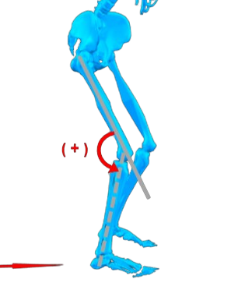
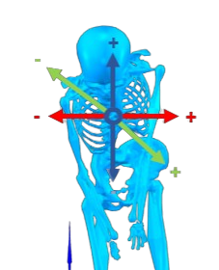
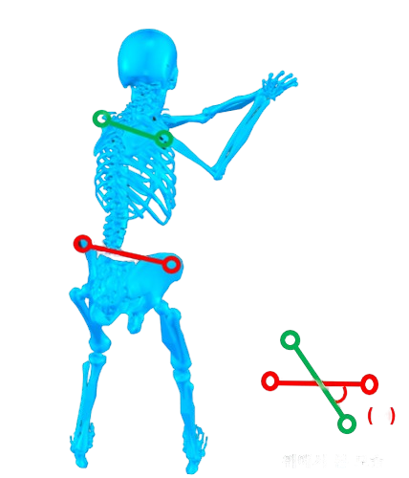
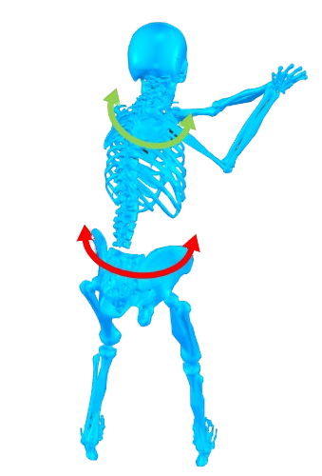
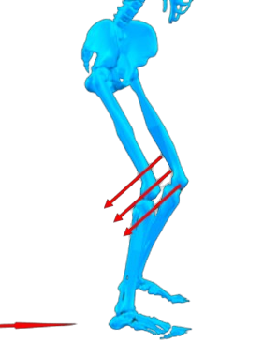
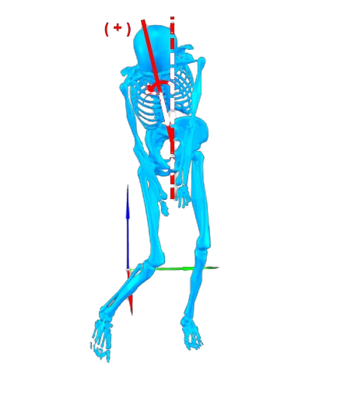
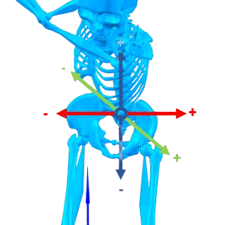
(+)
(-)
-
(-)

Slide 6



