Slide 1


Who We Are
Ceiling Fan App
The Product:
The Consumer:
The Edge:
Young adults
New homeowners
Design-oriented
United States (no int’l shipping)
Sleek interface
High-end looks for budget price
Always-free shipping
Wide variety of styles

Slide 2


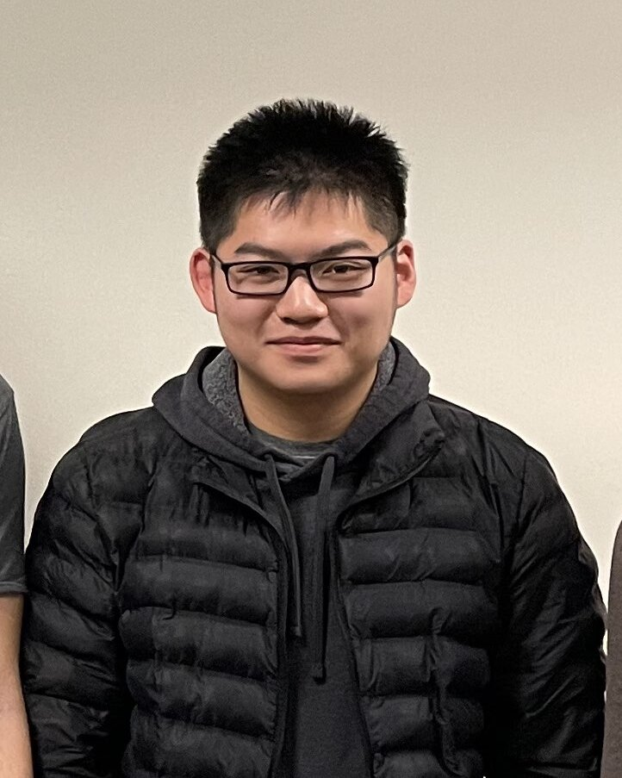
Meet the team
Ceiling Fan App
Aidan Wills
Chief Financial Officer
Cole Parker
Chief Executive Officer
Ricky Wu
Chief Technical Officer
CSE Bachelor’s Final Semester
Business finance
Hobbies: juggling, reading
CSE Master’s Final Semester
Data analytics
Hobbies: volleyball, watching the Buckeyes
CSE Bachelor’s Senior
Game design and application development
Hobbies: speedcubing

Slide 3

Architecture
Ceiling Fan App
Inventory Checker (ID, Item Name, Overall)
External Partner
Payment Processor (B2B)
Payment DB
SQL
HTTP
HTTP
HTTP
Webpage Front-end
HTTP Reverse Proxy
Order Processing Module
CFA DB
HTTP
HTTP
SQL
Async JSON
External Partner
Messaging Service
Shipment Processor (B2B)
Shipper DB
Async JSON
SQL

Slide 4





Tech Stack
Ceiling Fan App
VPC
Inventory Check
Payment Proc
Payment DB
SQL
AWS Amplify
HTTP
HTTP
HTTP
API Gateway
Order Proc
CFA DB
React + Vite
HTTP
HTTP
SQL
Async JSON
EventBridge
Shipment Proc
Shipper DB
Async JSON
SQL

Slide 5


takeaways
Ceiling Fan App
Gained confidence in developing solutions for business problems.
Learned how to utilize common AWS services for cloud deployment.
Creating a professional-looking web application is harder than we thought!

Slide 6



challenges
Ceiling Fan App
Translating business requirements into technical solutions.
Proper AWS service configuration (VPC, roles, security groups, etc.)
Synchronizing team efforts and ensuring integrability of separate functions.

Slide 7
Architecture Diagram – Work in progress
Inventory Check
Payment Proc
Payment DB
SQL
AWS Amplify
HTTP
HTTP
HTTP
API Gateway
Order Proc
CFA DB
React
HTTP
HTTP
SQL
Async JSON
EventBridge
Shipment Proc
Shipper DB
Async JSON
SQL

