Slide 1
WRITING TO PERSUADE

Slide 2
Overview
Rhetorical Appeals
Communicating ethically

Slide 3
Persuasion in Technical Writing
Remember that as technical writing is transactional, you are generally attempting to convince your audience that your solution/idea/concept is best.
To do this, we use rhetorical appeals.

Slide 4
Writing to Persuade
There are 4 rhetorical appeals:
Ethos
Pathos
Logos
Kairos
In all likelihood, you’ll use a combination of any number of these appeals.

Slide 5
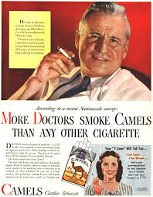
Ethos: Appeal to Credibility/Authority
This element of persuasion involves establishing your credibility, expertise, or authority to be making the argument.
What experience or expertise do you have?
What knowledge or skills do you possess? What’s your role within the organization, and/or in relation to the reader?
Why should the reader trust you as a reliable, knowledgeable, authoritative, and ethical source of information?

Slide 6
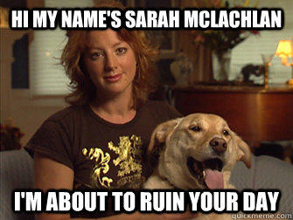
Pathos: Appeal to Emotion/Interest Values
This element involves appealing to the emotions, values, and/or interests of the reader.
How does your proposal benefit them?
Why should they care about it? How does it relate to the goals of the organization?
How can you build “common ground” with your reader?
What will make your reader feel “good” about your project?
How can you evoke emotions such as pride or outrage?

Slide 7
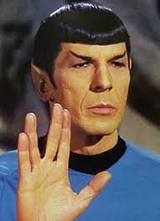
Logos: Appeal to Reason/Logic
This element involves grounding your argument in logic, reason, and evidence.
What evidence supports your claims?
On what facts and data is your reasoning based?
Arguments grounded in reason and evidence are often considered the strongest. Government organizations and companies alike generally like to make “evidence-based decisions.”

Slide 8
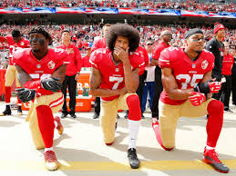

Kairos: Appeal to Timeliness/Appropriateness
Using this appeal means being aware of what is appropriate and timely in a given rhetorical situation.
Sometimes, a well-crafted argument can fail because it comes at the wrong time.
Kairos involves knowing what is “in” or “hot” right now, what is an important topic or issue, and how best to discuss it; knowing when it is the “right time” to broach a topic or propose an idea; knowing how to use the appropriate tone, level of formality and decorum for the specific situation.

Slide 9
What does all this have to do with technical writing?
Logos: using data and evidence to provide proof of concept, WOC
Ethos: situational ethos of using document design effectively, building credibility through research and citational practices, demonstrating expertise in your field
Pathos: proving to the client you are invested in solving their problem

Slide 10

Ad-speak
Kind of language used in advertisements, frequently employing one or more of the following:
Emotional manipulation
Logical fallacies
Hyperbole
Exaggeration or dishonesty
Vague claims
Incomplete or cherry-picked data
Biased viewpoints
Hired actors rather than professionals or experts as spokespeople.
While you are writing to persuade, you must not embellish or misrepresent yourself or your concept/solution/idea.

Slide 11

How to avoid ad-speak in technical descriptions
Use quantifiable, objective, and measurable terms, such as
efficient
reliable
Avoid vague buzzwords, such as
awesome
unique
excellent

Slide 12
In summary
You will likely use a combination of the 4 rhetorical appeals
Communicate ethically by avoiding ad-speak

