Slide 1
Final Project Wine Rating Predictions with Azure Machine Learning
Parker May
Deep Azure@McKesson
Dr. Zoran B. Djordjević

Slide 2
Problem Statement
There are few problems facing modern society as pressing as predicting the quality of a bottle of wine. With the rising popularity of wine, prices rise as well. Finding a good bottle at a good price seems more like luck than anything else. This project will combine the Azure Machine Learning service and wine rating data to create a model for predicting wine quality based on several factors. It will use an Azure SQL Database to store the data and Azure API Management Services to make a REST API available to a browser based client.

Slide 3
What Can Machine Learning Do?
Classification Algorithms
Answers Is this A or B?
Anomaly Detection
Answers Is this weird?
Regression Algorithms
Answers How Much? or How Many?
Clustering Algorithms
Answers How is this organized?
Reinforcement Algorithms
Answers What should I do next?

Slide 4
Data Set
This dataset was obtained from Kaggle at https://www.kaggle.com/zynicide/wine-reviews
The data was accumulated from wine reviews originally published in Wine Enthusiast magazine.
There are 10 data points for each review. In the end, I used:
Province
Variety
Price
To determine
Point rating (scale 1 – 100)
The dataset began with 150936 rows, 48.6 MB
I removed troublesome columns I wasn’t using and replaced diacritics to make loading and showing the data easier.
The final dataset contains 149145 rows, 13.2 MB

Slide 5
Technology and Software
Main Azure Service:
Azure Machine Learning Studio
Support Azure Services:
Azure SQL Database
Azure API Management Services
Utilities to upload data to SQL Database:
bcp, sqlcmd, ODBC driver
Utilities to manipulate the data file:
Linux shell and utilities from Cygwin
Browser based client application:
nodejs / npm
Angular.io

Slide 6
Hardware Environment
Home computer: Lenovo laptop running Windows 10
Work computer: Dell laptop running Windows 7

Slide 7
Technical Hurdles
I discovered the hard way that while it is very easy to deploy web services from the Azure Machine Learning Studio, there is no way to set CORS settings for those services.
This means that while standalone programs can hit the REST endpoints, a browser based application like the one I created cannot.
This caused a little detour into the world of Azure API Management Services to create a frontend endpoint that would allow Cross-Origin Resource Sharing.
I was not able to expose REST endpoints directly on queries in my SQL Database as I had originally intended. From what I read, this is possible, but I could not get this to work.

Slide 8
Code Overview
The code for this project is my client application which calls the REST endpoints exposed through Azure API Management Services to Azure Machine Learning Studio web services.
The client application was built using the Angular.io JavaScript framework.
I implemented a main application component to drive the UI and the user interaction with application.
I implemented an estimation service that takes a province, variety and price entered by the user and calls the REST endpoint to obtain an estimated rating from the ML model.
I implemented an estimation model used to deserialize the results returned from the REST call and display the estimate on the screen.

Slide 9
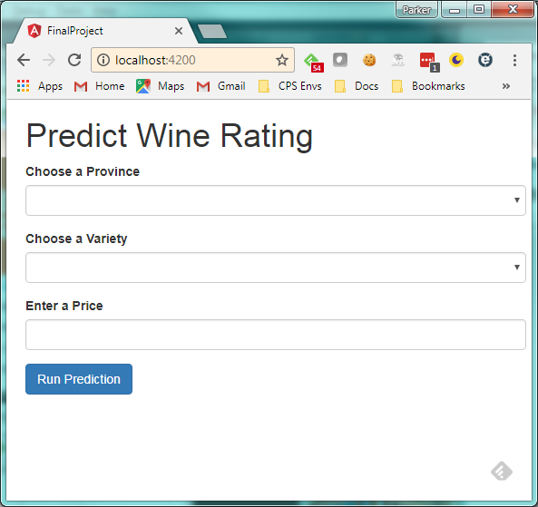
Client Application When First Loaded

Slide 10
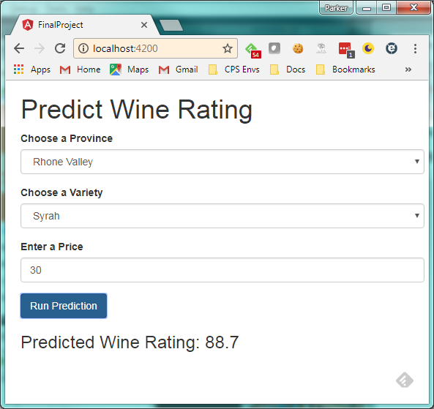
Client Application After Performing an Estimation Run

Slide 11
Lessons Learned
The biggest takeaway I had with this exercise is that it takes a lot more understanding and hard work to create useful machine learning models than I realized. I find the inner workings of these statistical algorithms very interesting and intend on spending more time digging in after this class is over.
I had originally planned to pull data to seed the options in the UI from the database. I'd like to learn how to expose REST endpoints that query the database.
I would like to have had time to do an anomaly detection version of this where you give all the information including the rating and it tells you if that's an unusual rating based on the other factors.

Slide 12
YouTube URLs, GitHub URL, Last Page
Two minute (short): https://youtu.be/Fi_lH-p_n4M
15 minutes (long): https://youtu.be/Y4gIIUNv0a0
GitHub Repository with all artifacts: https://github.com/parkermay/final-project

