Slide 1
구석기시대 유적의 기능과 성격이해를 위한 정량적 연구방법 시론
박가영 • Ben Marwick

Slide 2
문제 제기
한국의 구석기유적에는 유구의 흔적이 거의 남아있지 않음
발굴된 유적의 면적과 수량이 유구의 부재 및 당시의 발굴 상황 등과 같은 이유로 인류의 행위를 분석하기에 한계가 있음
기존의 유적 기능 연구는 개별유적을 대상으로 한정되어 있음
본 연구에서는 기존의 구석기유적 기능 및 공간분석에 관한 연구를 총정리하고, 이를 바탕으로 각 유적에 공통적으로 적용할 수 있는 정량적 분석요소를 제시하고자 함

Slide 3
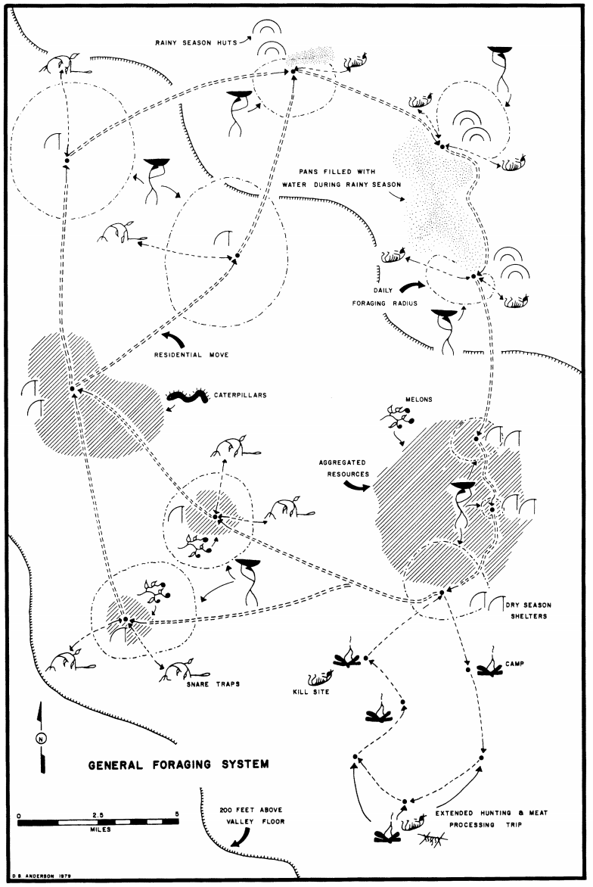
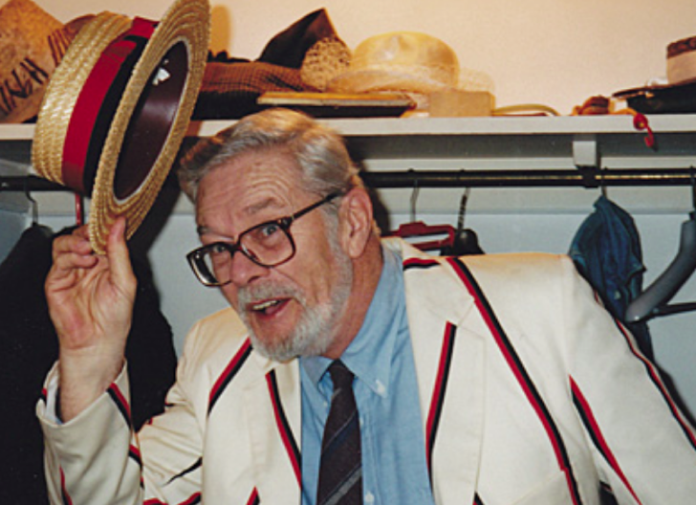
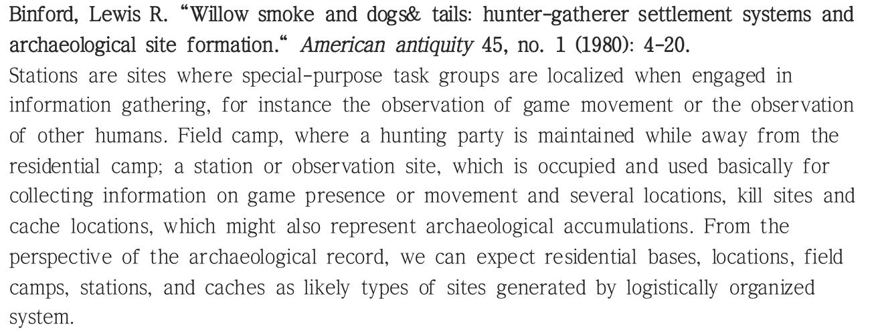
연구사: 서양의 연구

Slide 4
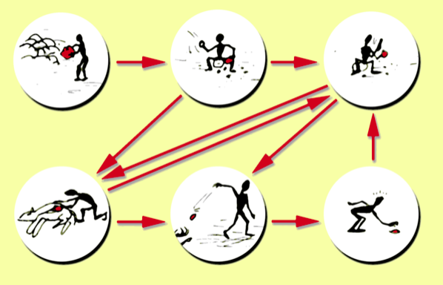
연구사: 서양의 연구
Chaîne opératoire

Slide 5
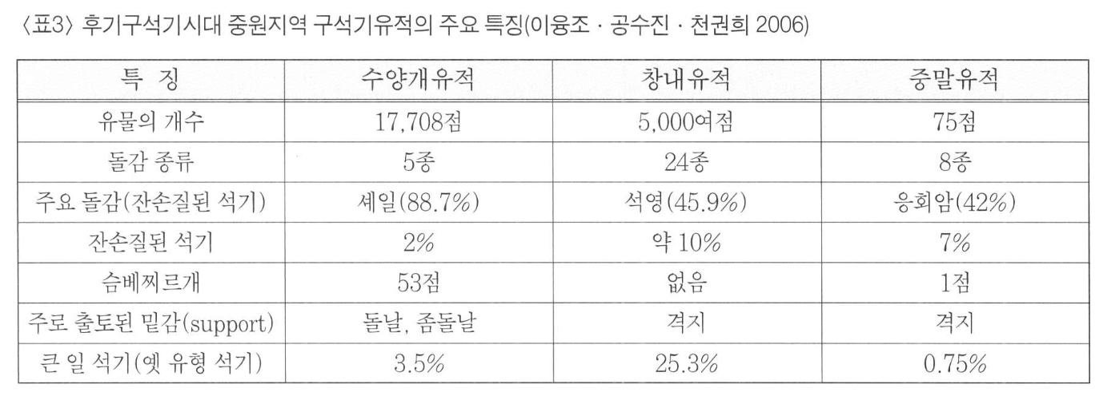
연구사: 한국의 연구

Slide 6
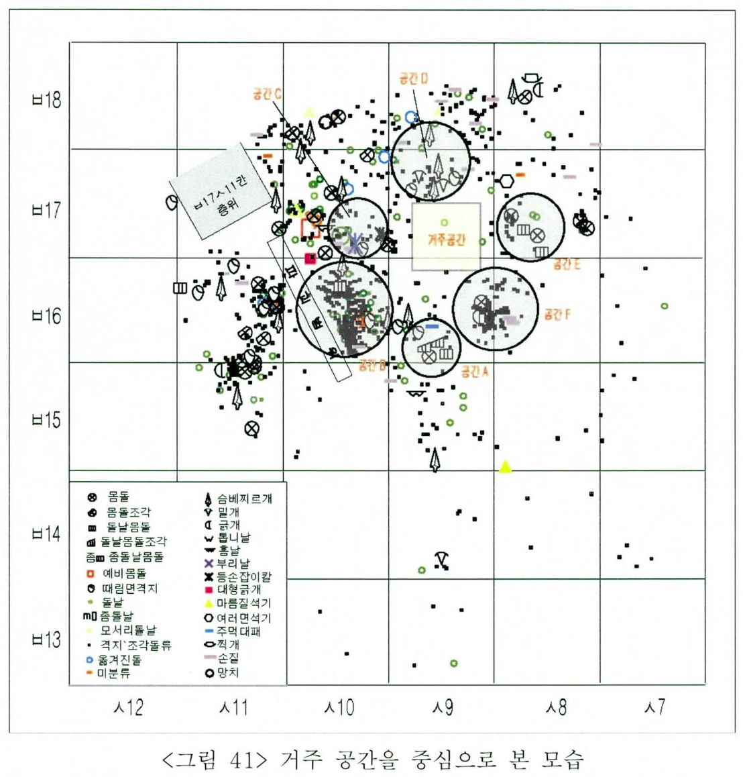
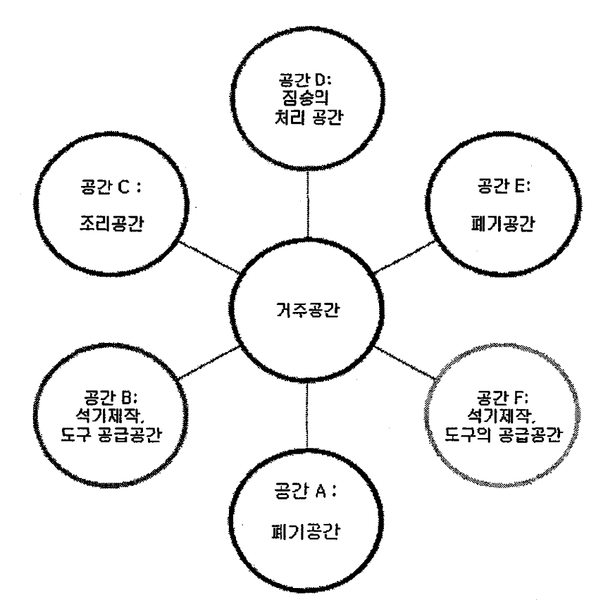
연구사: 한국의 연구

Slide 7
THIS POWERPOINT THEME
A UW color palette is built into this theme.
There are three layout styles and three designs in this theme: Purple, Gold and White
The graphic elements, like the bar and the logos are in the Master Sheets. To edit them go to view > master > slide master.

Slide 8
THIS POWERPOINT THEME
A UW color palette is built into this theme.
There are three layout styles and three designs in this theme: Purple, Gold and White
The graphic elements, like the bar and the logos are in the Master Sheets. To edit them go to view > master > slide master.

Slide 9
THIS POWERPOINT THEME
A UW color palette is built into this theme.
There are three layout styles and three designs in this theme: Purple, Gold and White
The graphic elements, like the bar and the logos are in the Master Sheets. To edit them go to view > master > slide master.

Slide 10
THIS POWERPOINT THEME
A UW color palette is built into this theme.
There are three layout styles and three designs in this theme: Purple, Gold and White
The graphic elements, like the bar and the logos are in the Master Sheets. To edit them go to view > master > slide master.

Slide 11
THIS POWERPOINT THEME
A UW color palette is built into this theme.
There are three layout styles and three designs in this theme: Purple, Gold and White
The graphic elements, like the bar and the logos are in the Master Sheets. To edit them go to view > master > slide master.

Slide 12
THIS POWERPOINT THEME
A UW color palette is built into this theme.
There are three layout styles and three designs in this theme: Purple, Gold and White
The graphic elements, like the bar and the logos are in the Master Sheets. To edit them go to view > master > slide master.

Slide 13
THIS POWERPOINT THEME
A UW color palette is built into this theme.
There are three layout styles and three designs in this theme: Purple, Gold and White
The graphic elements, like the bar and the logos are in the Master Sheets. To edit them go to view > master > slide master.

Slide 14
THIS POWERPOINT THEME
A UW color palette is built into this theme.
There are three layout styles and three designs in this theme: Purple, Gold and White
The graphic elements, like the bar and the logos are in the Master Sheets. To edit them go to view > master > slide master.

Slide 15
THIS POWERPOINT THEME
A UW color palette is built into this theme.
There are three layout styles and three designs in this theme: Purple, Gold and White
The graphic elements, like the bar and the logos are in the Master Sheets. To edit them go to view > master > slide master.

Slide 16
THIS POWERPOINT THEME
A UW color palette is built into this theme.
There are three layout styles and three designs in this theme: Purple, Gold and White
The graphic elements, like the bar and the logos are in the Master Sheets. To edit them go to view > master > slide master.

Slide 17
THIS POWERPOINT THEME
A UW color palette is built into this theme.
There are three layout styles and three designs in this theme: Purple, Gold and White
The graphic elements, like the bar and the logos are in the Master Sheets. To edit them go to view > master > slide master.

Slide 18
THIS POWERPOINT THEME
A UW color palette is built into this theme.
There are three layout styles and three designs in this theme: Purple, Gold and White
The graphic elements, like the bar and the logos are in the Master Sheets. To edit them go to view > master > slide master.

Slide 19
THIS POWERPOINT THEME
A UW color palette is built into this theme.
There are three layout styles and three designs in this theme: Purple, Gold and White
The graphic elements, like the bar and the logos are in the Master Sheets. To edit them go to view > master > slide master.

Slide 20
THIS POWERPOINT THEME
A UW color palette is built into this theme.
There are three layout styles and three designs in this theme: Purple, Gold and White
The graphic elements, like the bar and the logos are in the Master Sheets. To edit them go to view > master > slide master.

Slide 21
THIS POWERPOINT THEME
A UW color palette is built into this theme.
There are three layout styles and three designs in this theme: Purple, Gold and White
The graphic elements, like the bar and the logos are in the Master Sheets. To edit them go to view > master > slide master.

Slide 22
사례연구: 유구가 있는 유적
A UW color palette is built into this theme.
There are three layout styles and three designs in this theme: Purple, Gold and White
The graphic elements, like the bar and the logos are in the Master Sheets. To edit them go to view > master > slide master.

Slide 23
유적 내 석기집중부가 구분되는 경우
석기집중부의 해석

Slide 24
유적 내 화덕자리가 존재하는 경우
A UW color palette is built into this theme.
There are three layout styles and three designs in this theme: Purple, Gold and White
The graphic elements, like the bar and the logos are in the Master Sheets. To edit them go to view > master > slide master.

Slide 25
사례연구
A UW color palette is built into this theme.
There are three layout styles and three designs in this theme: Purple, Gold and White
The graphic elements, like the bar and the logos are in the Master Sheets. To edit them go to view > master > slide master.

Slide 26
ON-BRAND STATEMENT
FOR GENERAL USE
What defines the students and faculty of the University of Washington? Above all, it’s our belief in possibility and our unshakable optimism. It’s a connection to others, both near and far. It’s a hunger that pushes us to tackle challenges and pursue progress. It’s the conviction that together we can create a world of good. And it’s our determination to Be Boundless. Join the journey at uw.edu.

