Slide 1
Dropout 추가
박고은

Slide 2
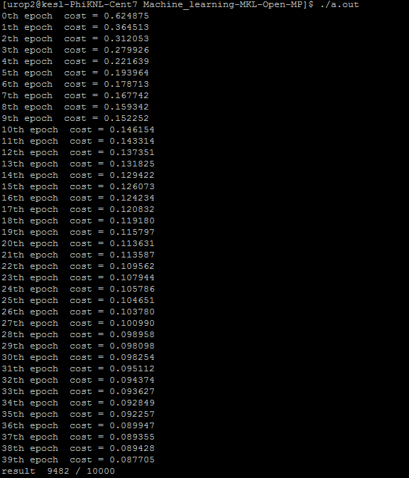
Dropout before

Slide 3
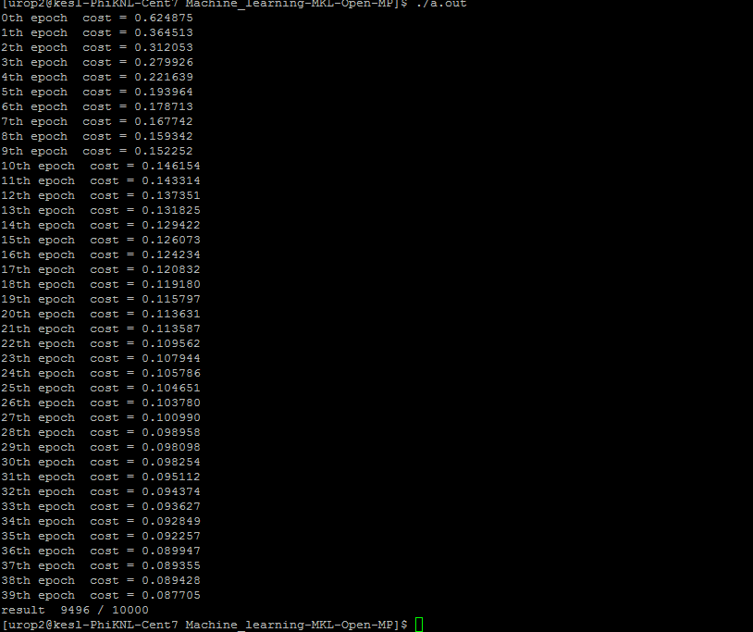
Dropout after p=0.5

Slide 4
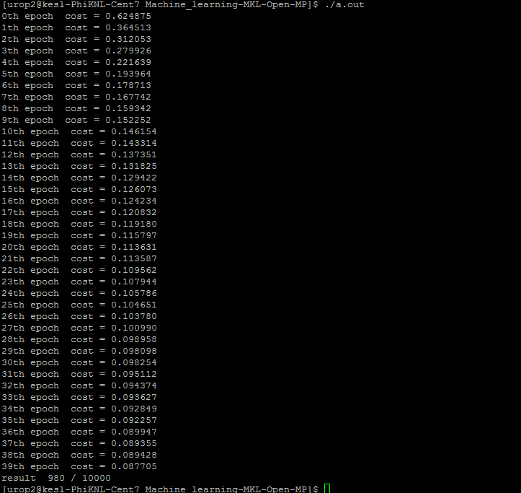
Dropout after p=0.0

Slide 5
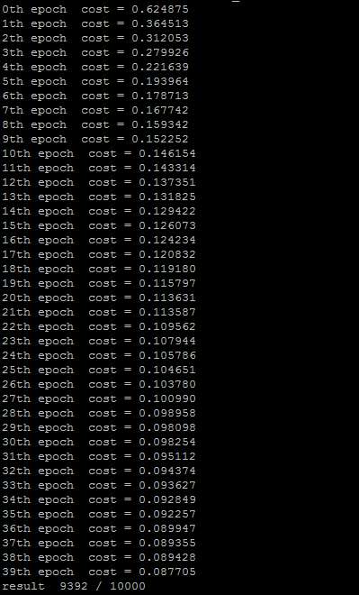
Dropout after p=0.3

Slide 6
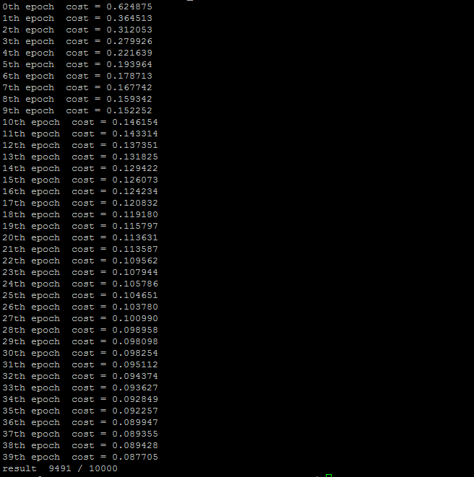
Dropout after p=0.7

Slide 7
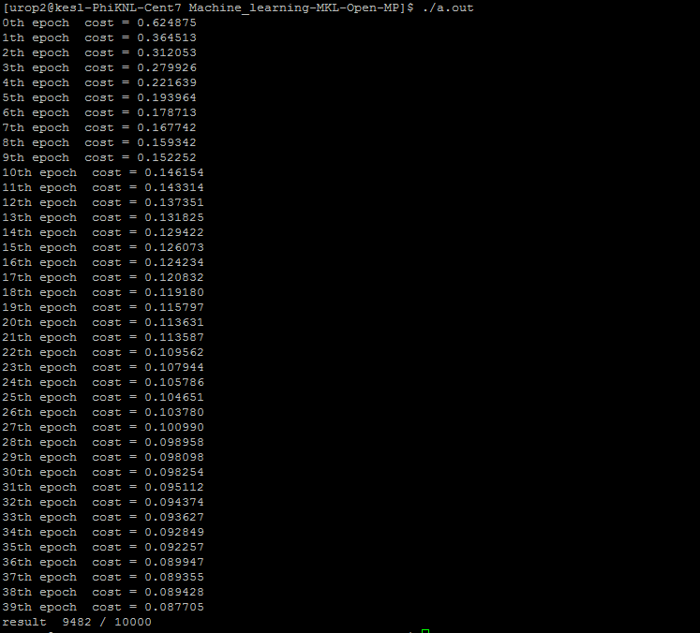
Dropout after p=1.0

Slide 8
Graph
0.0 | 0.3 | 0.5 | 0.7 | 1.0
980 | 9392 | 9696 | 9451 | 9482

