Slide 1
Space Website: 6 Hours on the 6 Train
By Holly Parkin

Slide 2
Concept: A website that shows 6 different time periods of the day on the 6 subway line, the functionality and navigation of each page reflecting the ease of real-life navigation during these hours on the subway.

Slide 3
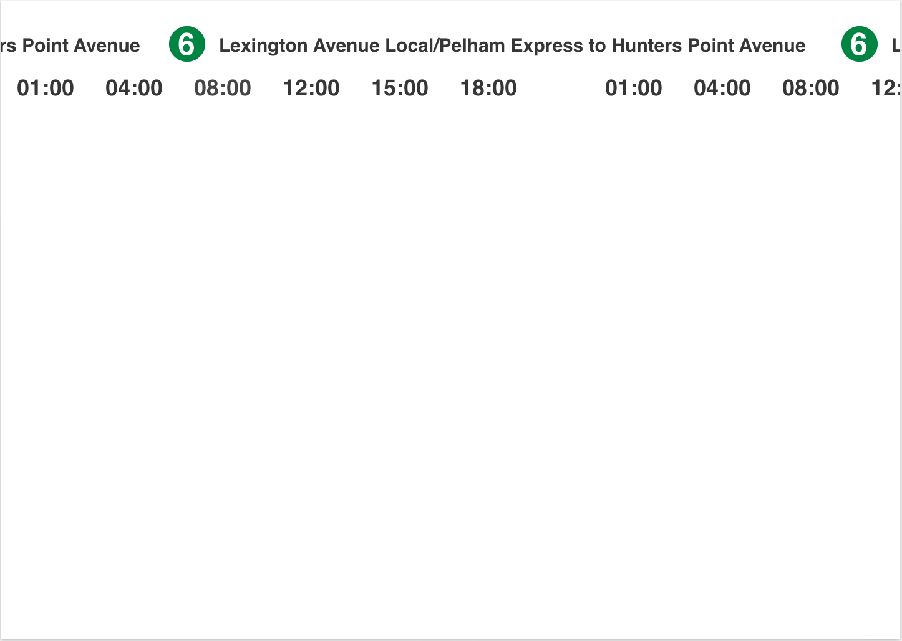
•Marquee tag for scrolling effect – two lines in opposite directions
•Linked to 6 separate webpages (green hover link)
•Return to home page – 6 train icon

Slide 4
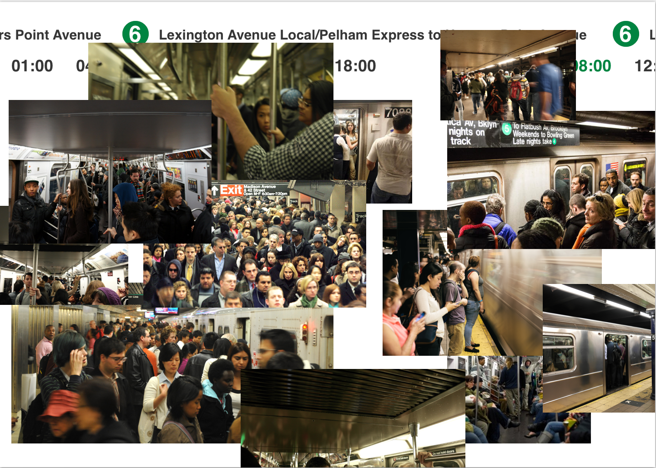
•Photos could be static or moving with marquee tag (opposite directions) – faster movement (if movement is used)
•Navigation difficult, blockage of links at times by photos
•Crowded/claustrophobic

Slide 5
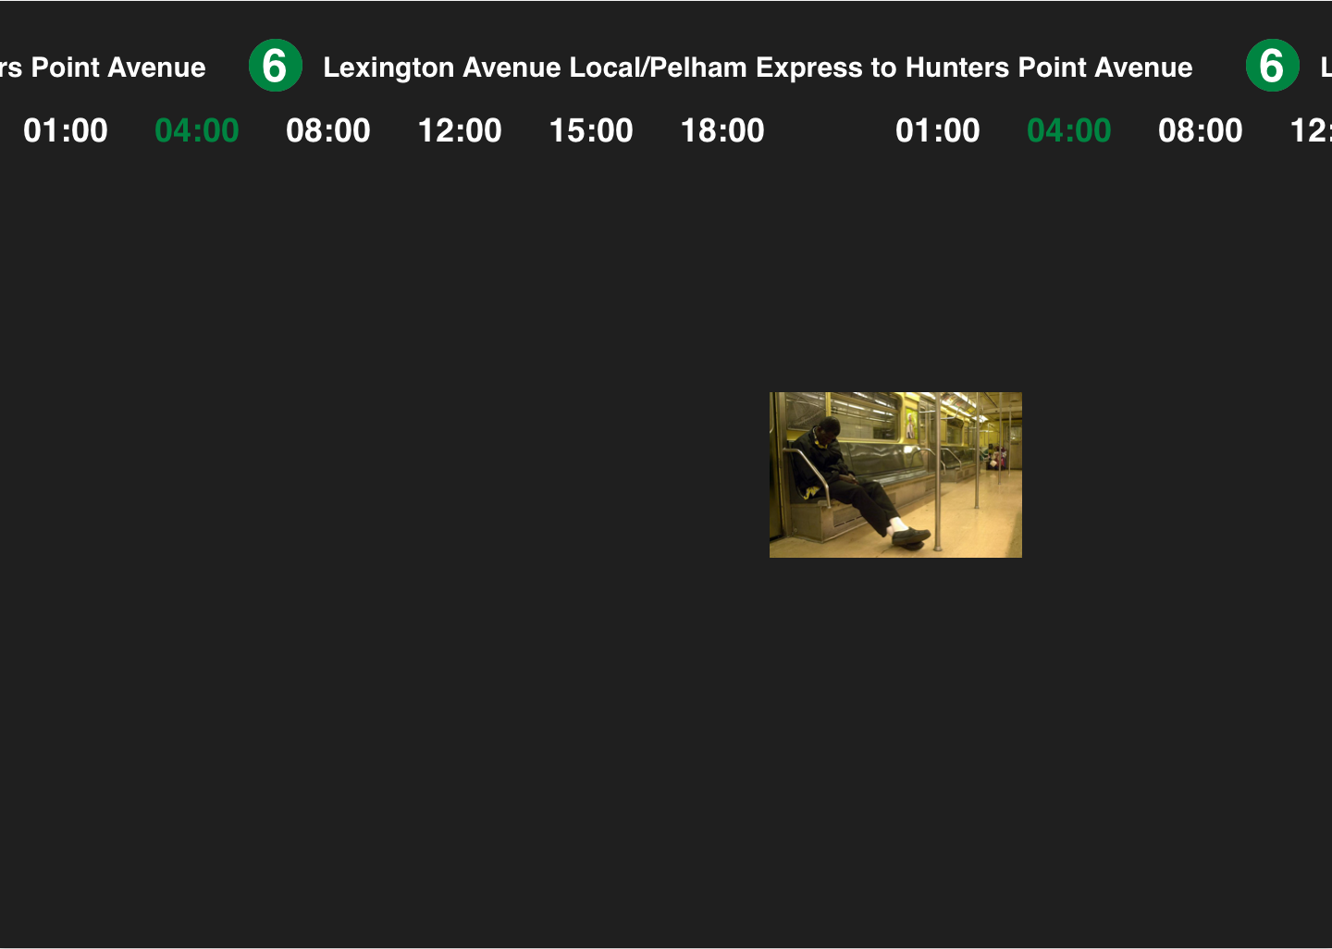
•Time of day identifies background change (dark for night hours, white for day hours)
•Minimal photos/slower movement (if movement is used)
•Empty/eerie (especially at later hours)

