Slide 1
CSC207 Final Project Presentation Template
Group Number ###
Reminder 1: Make sure to rehearse and time your presentation to ensure you can get through it within
the allotted 15 minutes!
Reminder 2: Your presentation needs to provide convincing evidence that you have satisfied the rubric elements.
Reminder 3: Every member of the team must speak during the presentation.

Slide 2
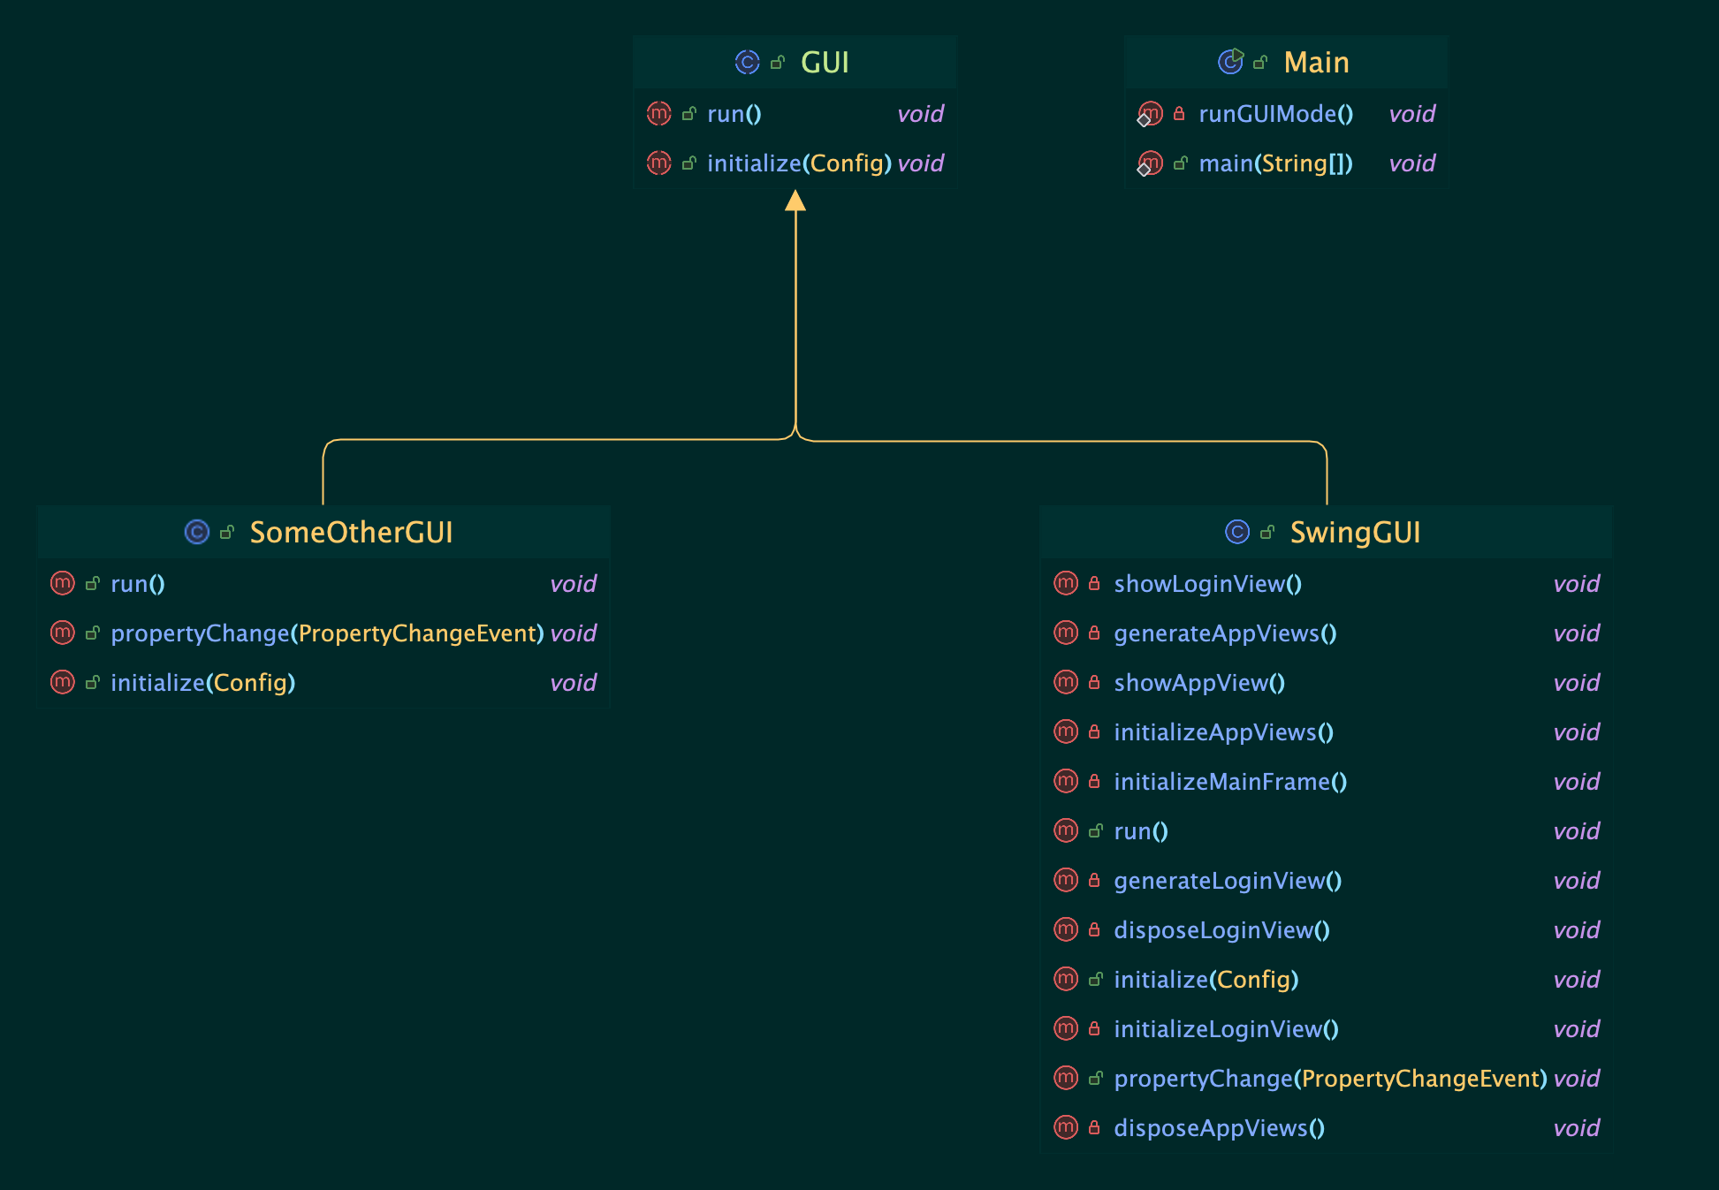
OCP

Slide 3
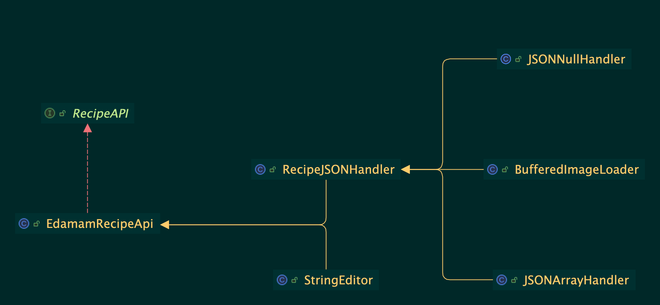
SRP

Slide 4
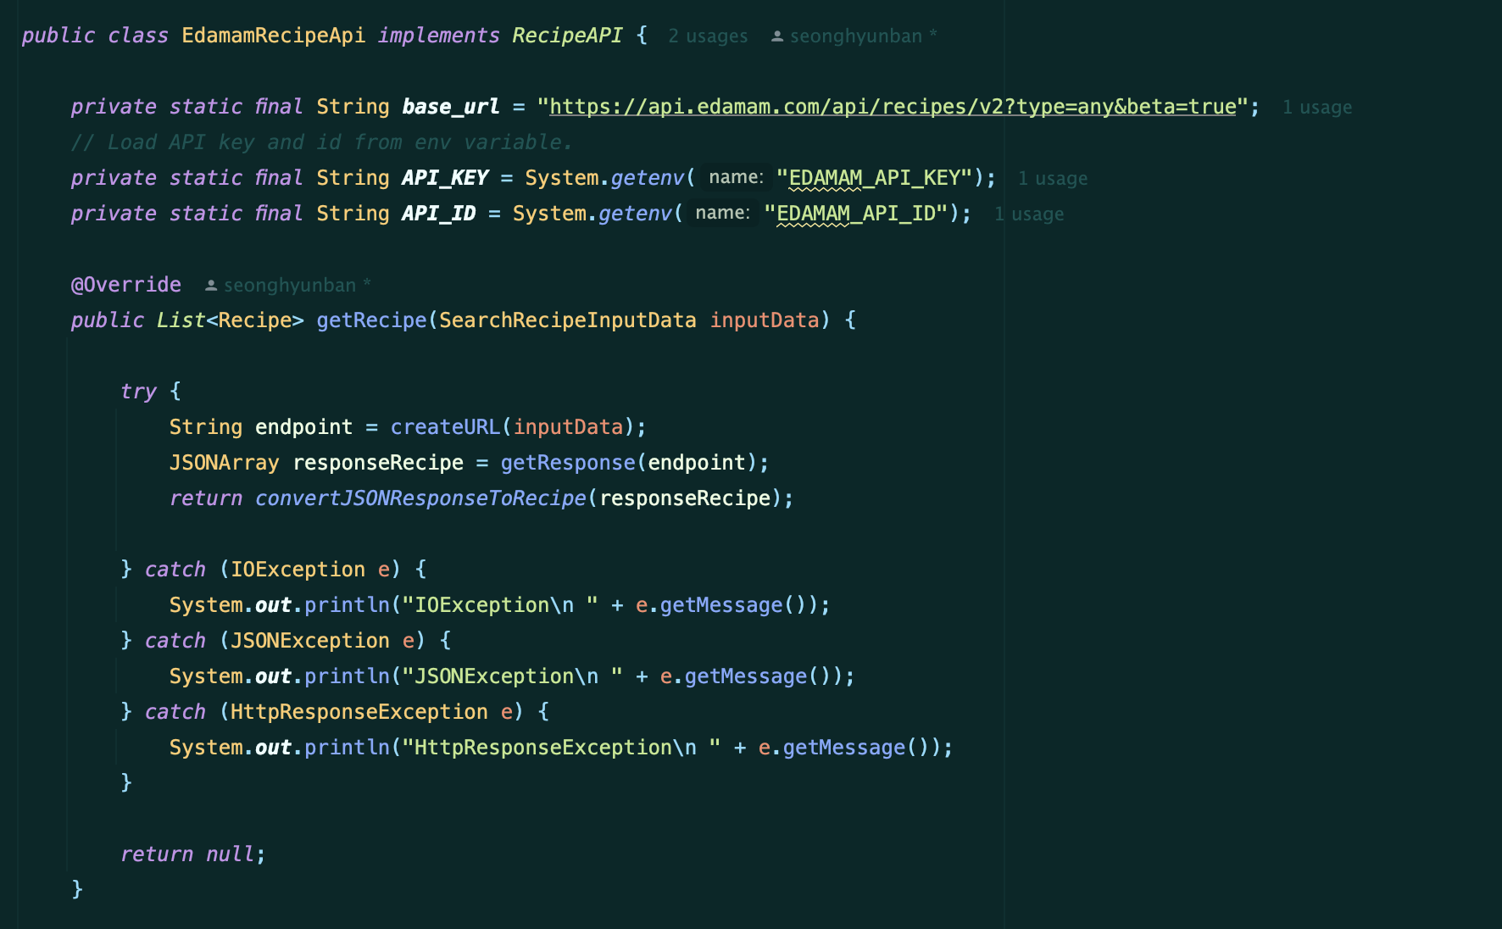

SRP

Slide 5
SRP

Slide 6
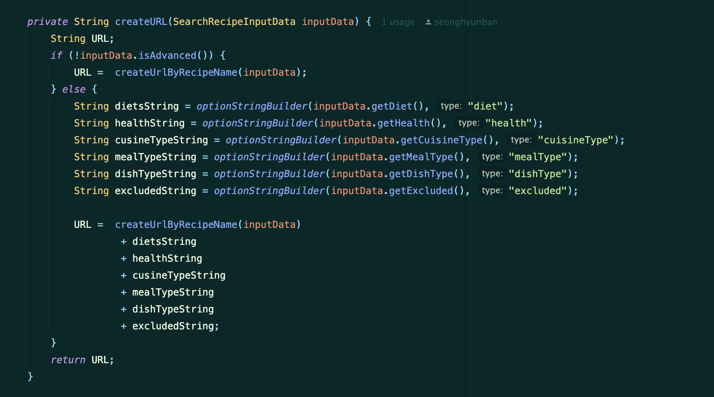
SRP

Slide 7
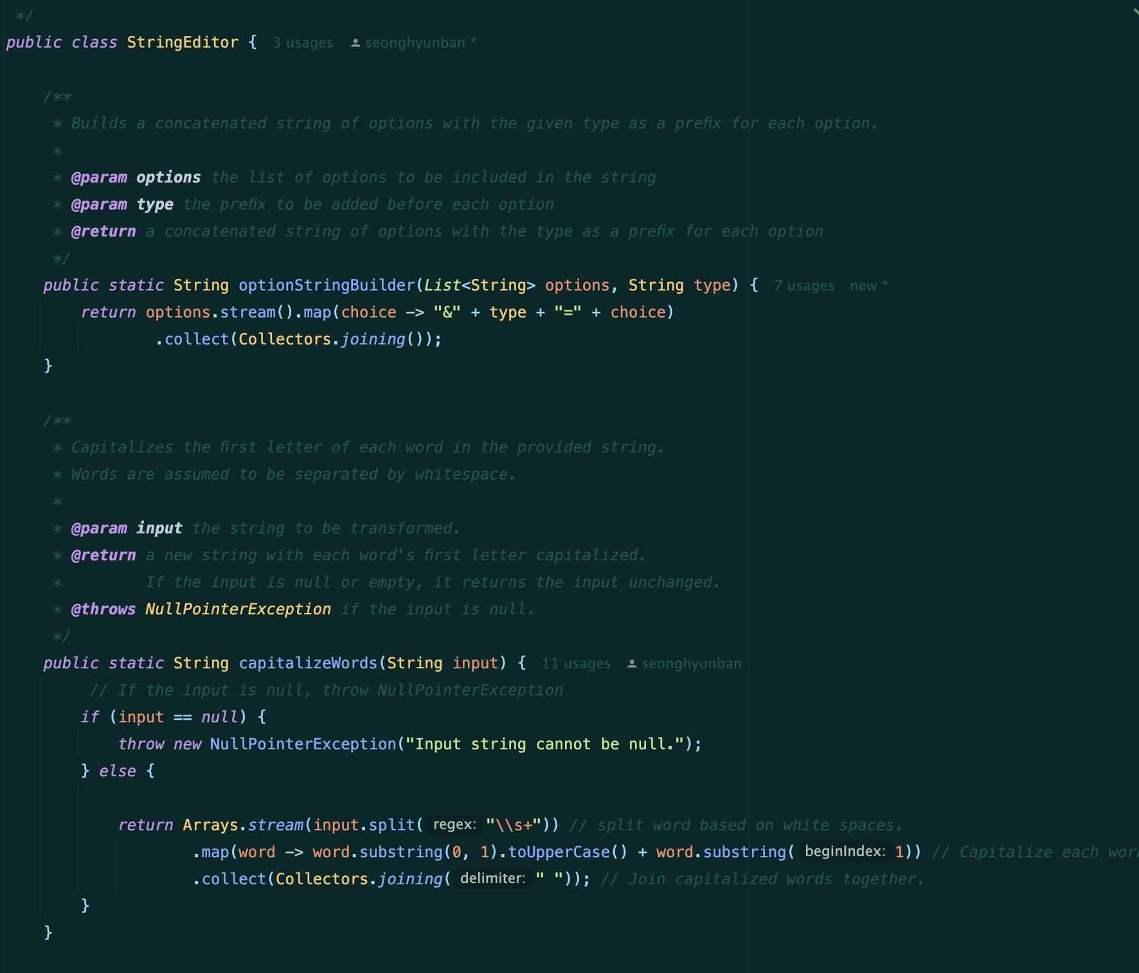
SRP

Slide 8
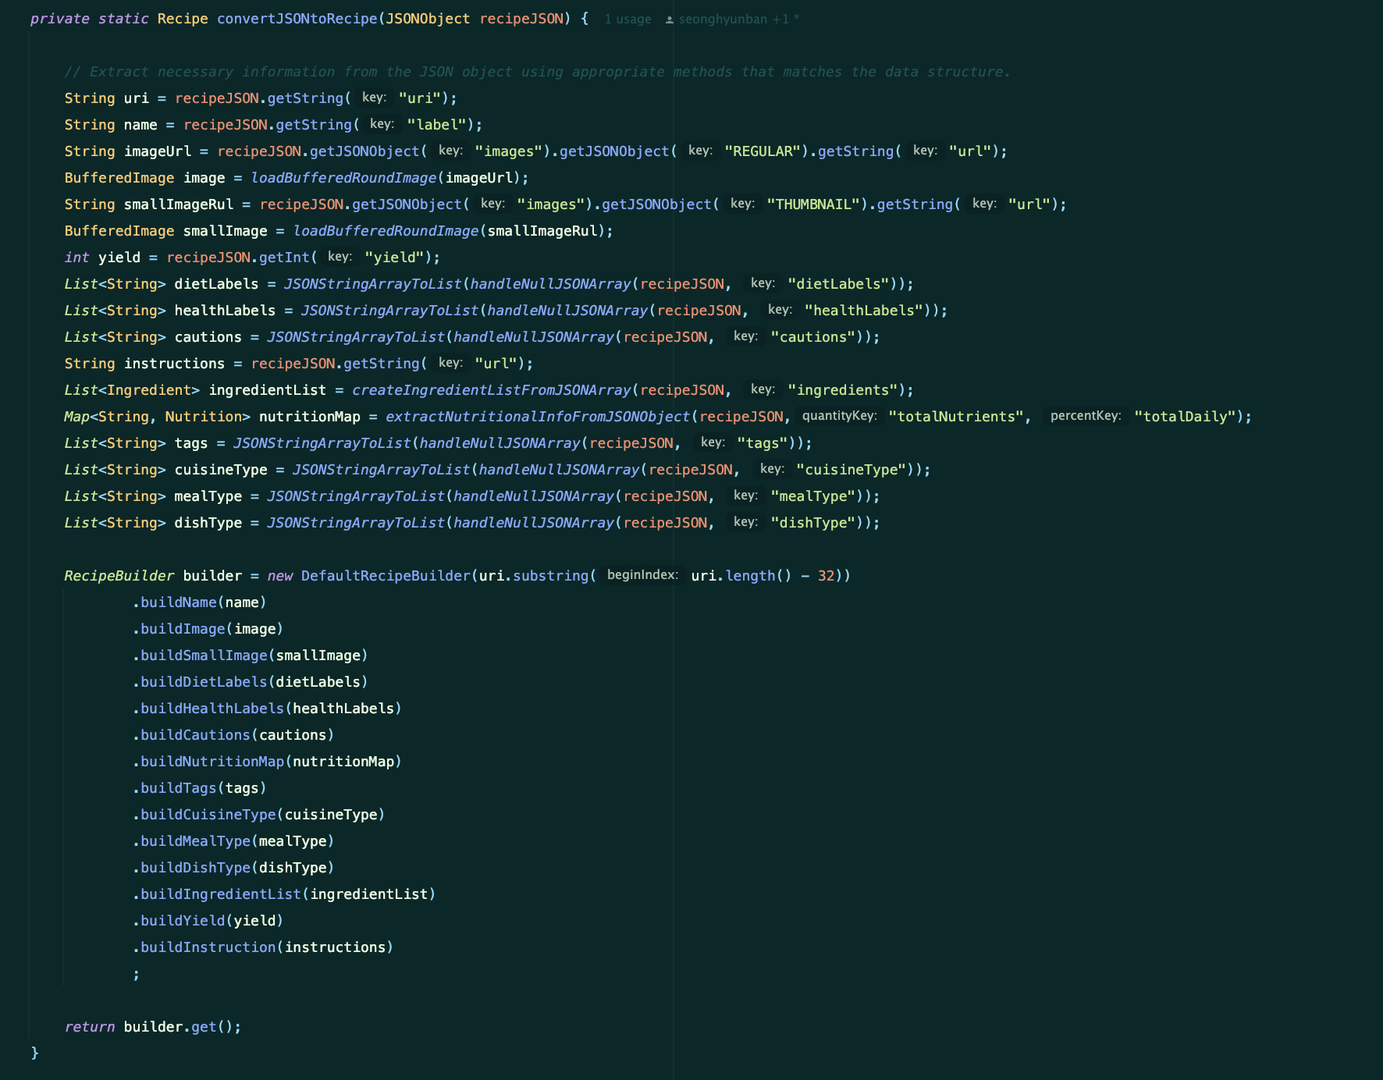
SRP

Slide 9
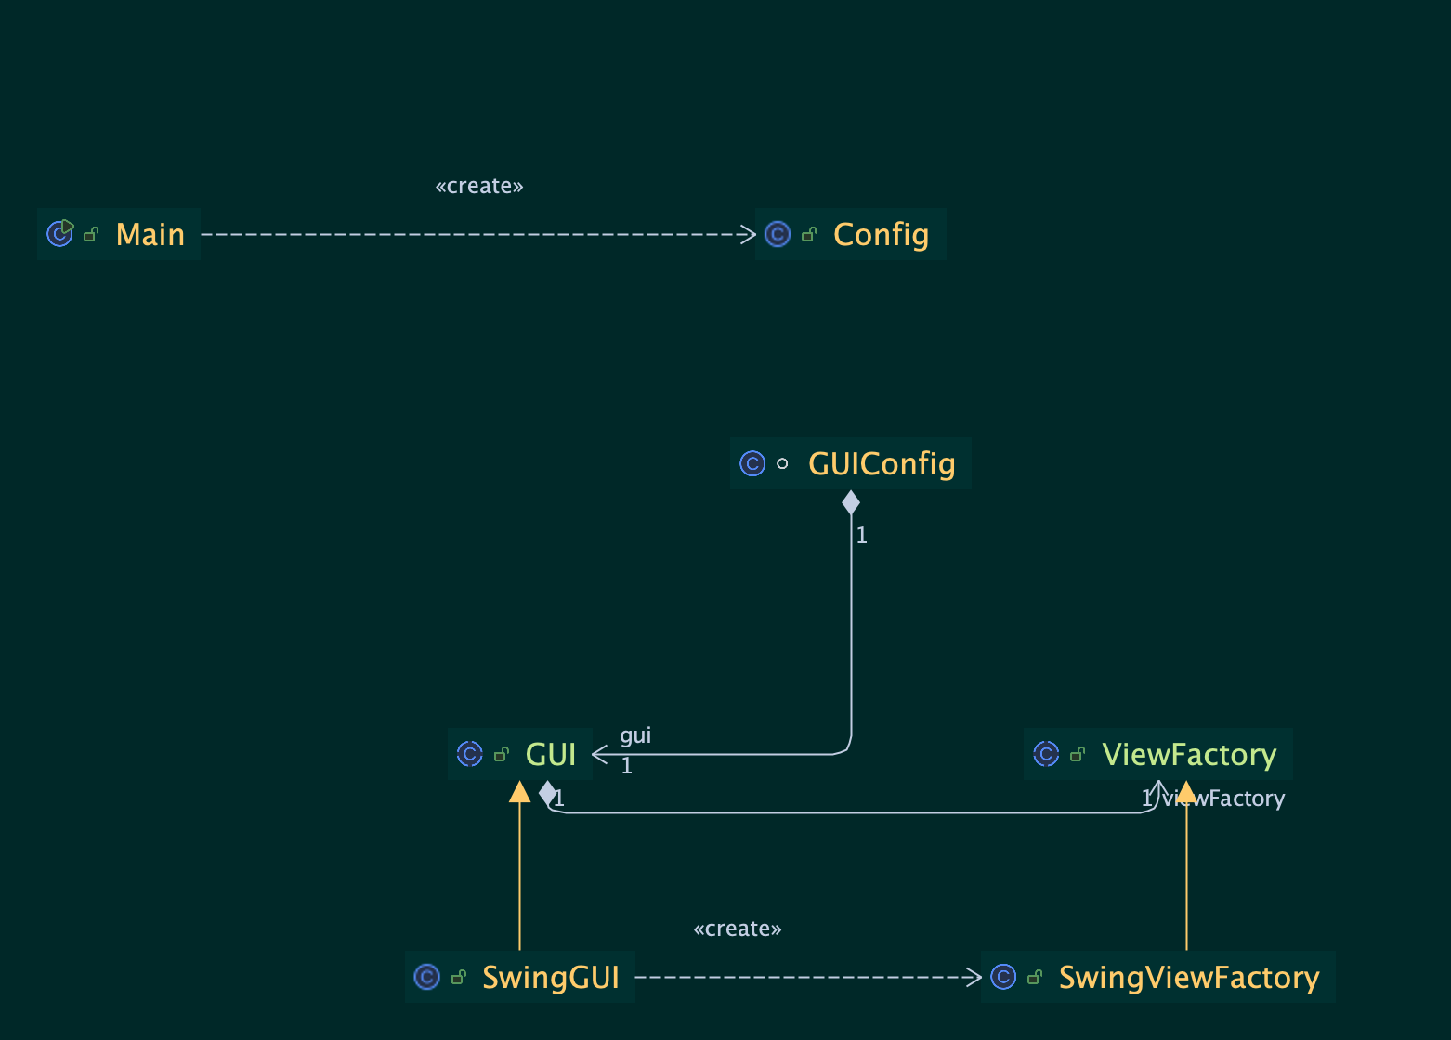
DIP

Slide 10
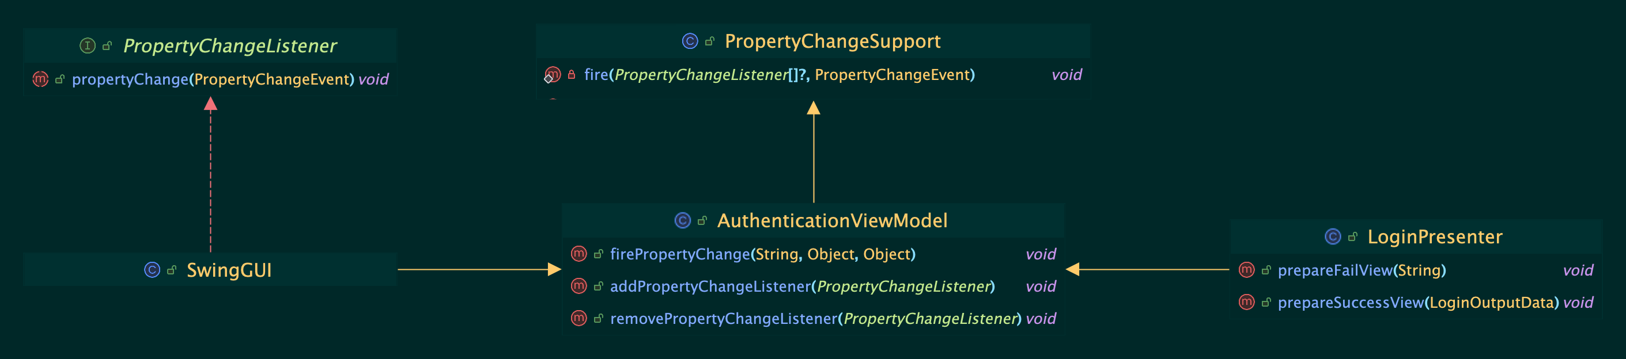
Observer

Slide 11
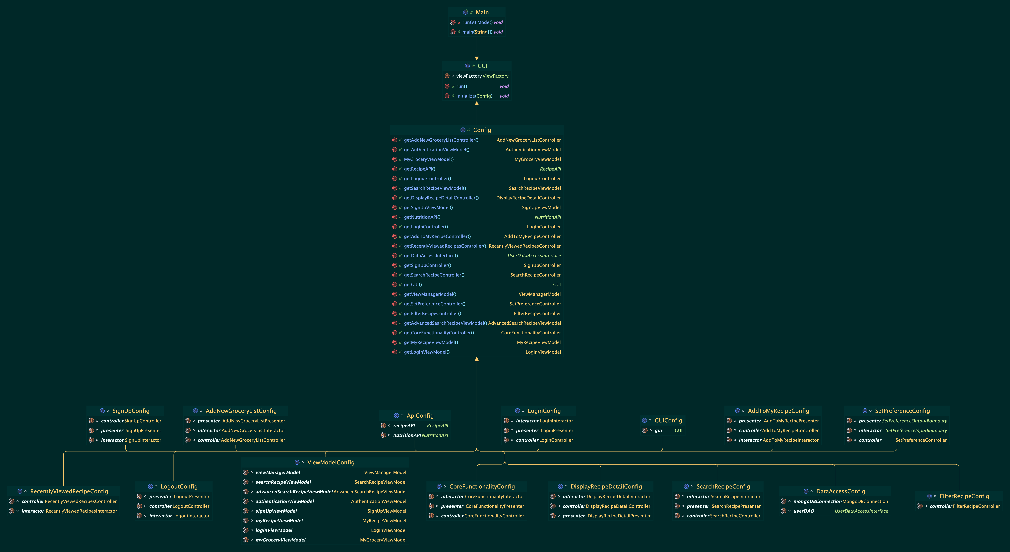
Facade

Slide 12
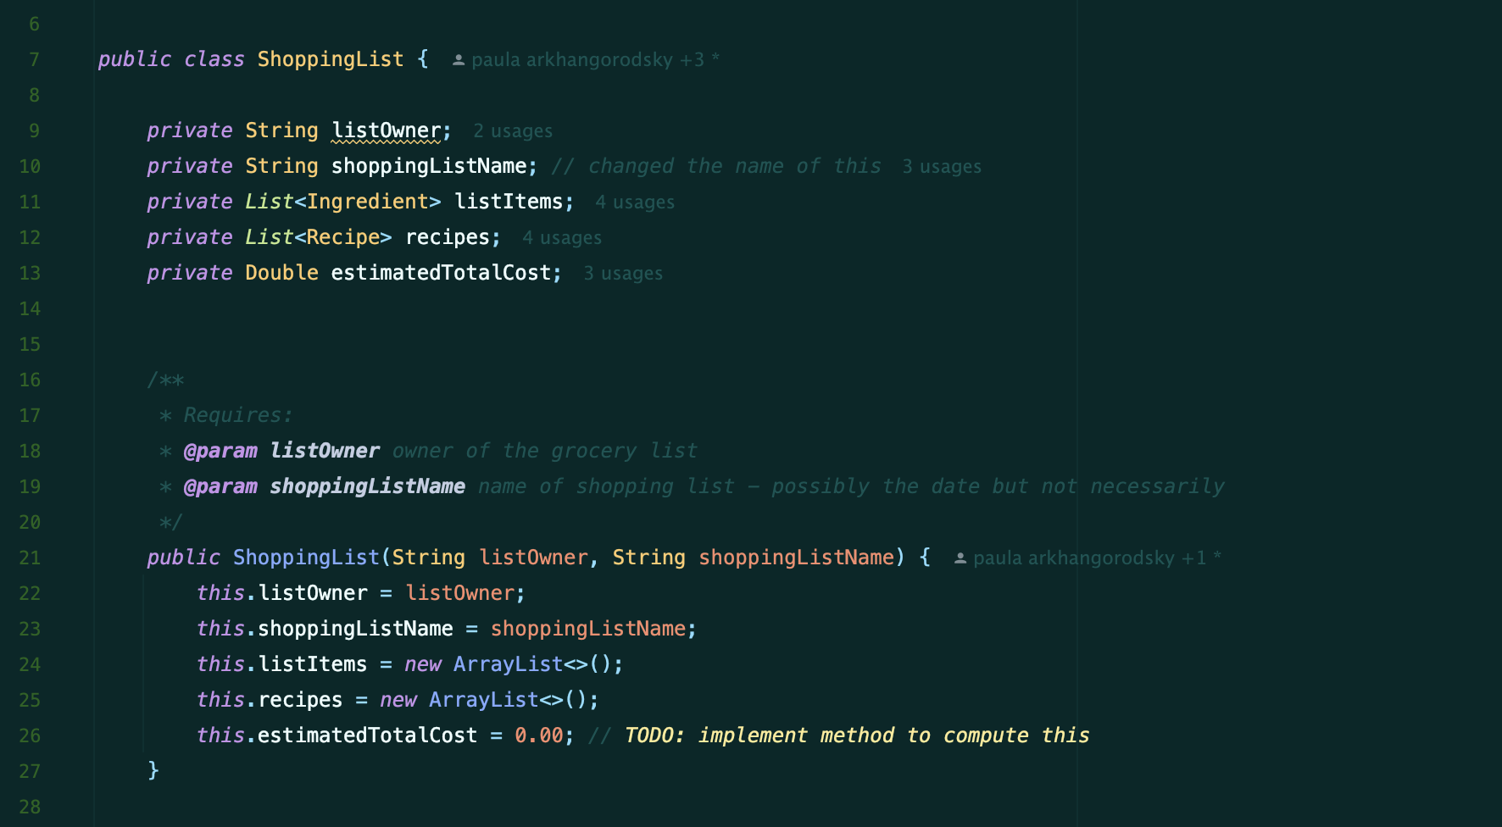
Dependency
Injection

Slide 13
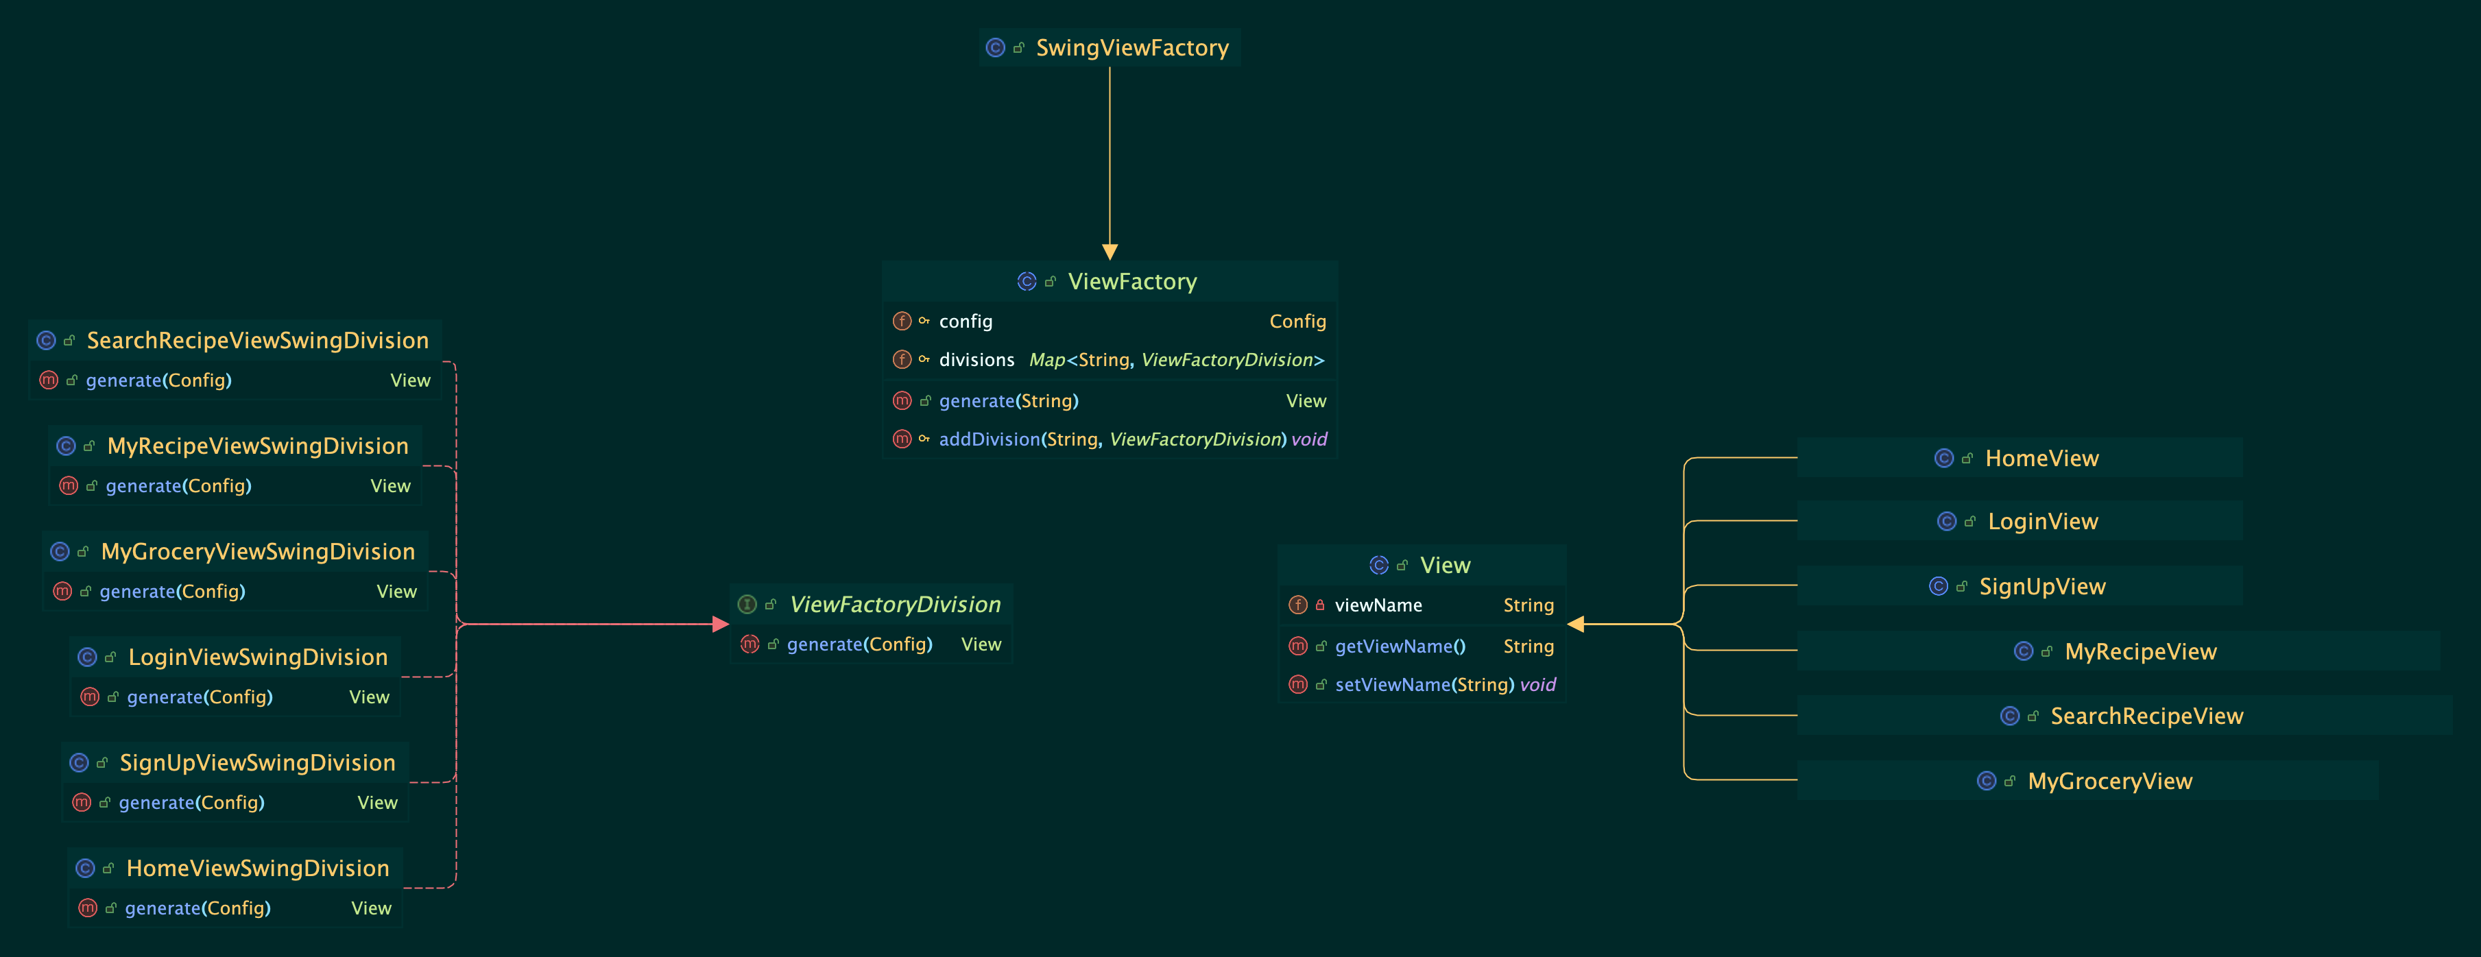
Factory

Slide 14
Factory

Slide 15
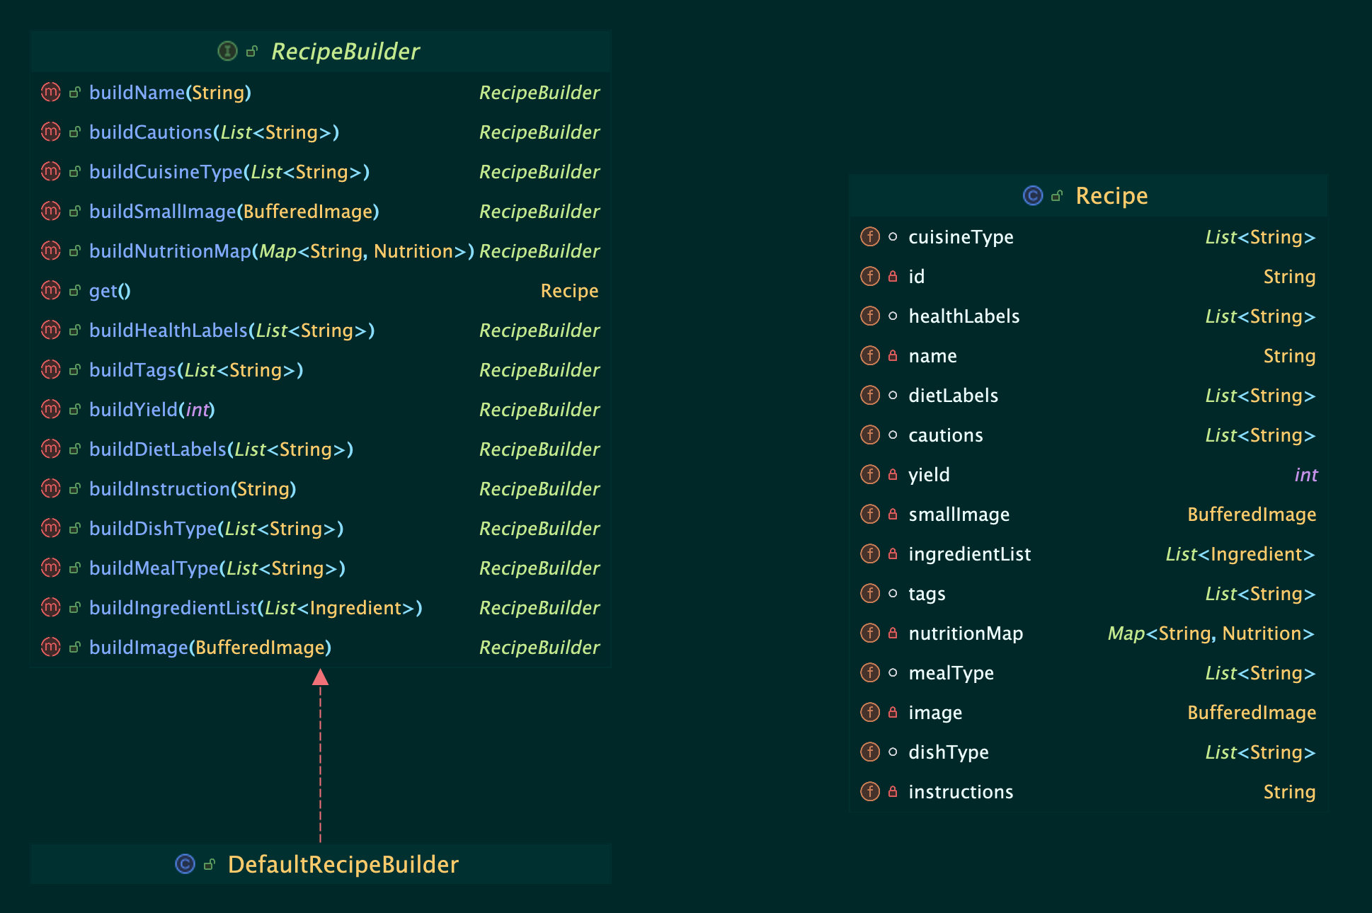
Builder

Slide 16
API usage
What API did you use?
Make sure to show appropriate information (briefly) about up to two API endpoints.
Recommended time limit: [30 seconds]

Slide 17
Specification
Explain what functionality your program provides.
You can use whatever format you want — just make sure to clearly and concisely convey this information.
  Advice: avoid too many words here and don’t plan to read a full paragraph of text on the slide when presenting — just highlight the key points.
Reminder to focus on the WHAT and not the HOW!
Recommended time limit: [1 minute]

Slide 18
Functionality Demonstration
Make sure to time things out so you can demonstrate at least the core functionality of your team’s program.
Each group member’s primary use case should be demonstrated if possible within the time provided.
Feel free to demo live or show recordings, but you should have a working version of the program available to demo specific functionality live during the questions after you present if we have questions.
Recommended time limit: [5 minutes]
  Make sure to especially rehearse the demo, as it can be easy to spend too much time here!
NOTE: depending on how your team decides to present, it might be appropriate to wait until the end to do your demo.

Slide 19
Design
How does your program adhere to SOLID?
  Should aim to talk about three specific examples present in your project.
How does your program adhere to Clean Architecture?
  You won’t likely have time to talk about every class in your design, so choose examples that best highlight the overall architecture. A generic “CA Engine” diagram wouldn’t be appropriate — make sure any diagrams are specific to your project (contain names / relevant information about the classes and interfaces in your design)
What design patterns are used in your program?
  Should aim to talk about two design patterns present in your project.
As appropriate, your team should make use of diagrams and other visuals to convey this information.
Almost always, diagrams will be more effective than showing the details of the code.
Roughly, your team might aim for something like 2 slides per design topic, so 6 in total about design, but the exact number can vary depending on how you are presenting the information.
Recommended time limit: [6 minutes]

Slide 20
Testing
Include some kind of table or screenshot showing the code coverage of your project.
  Make sure it clearly indicates line coverage.
Talk about how your team approached testing / why you didn’t test specific parts.
Recommended time limit: [1 minute]

Slide 21
Code Organization
Talk about how your team organized your code.
How did you package your code?
Recommended time limit: [30 seconds]

Slide 22
The End
Time permitting, your team can highlight anything else about the project which you want to share.
You’ll likely fill the time with covering the required rubric elements, so only use this slide if you have extra time to fill.
The recommended time limits would put your presentation at 14 minutes, so you’ll have about 1 minute of time to allocate as needed to parts of the presentation you want to emphasize.

