Slide 1
IIIT-Hyderabad · IASNLP · 2026
Does Better Retrieval Solve Temporal Reasoning?
Comparing Knowledge Graph RAG, Naive RAG, and Text-to-Pandas over Longitudinal Patient Records
IIIT-Hyderabad · Information Access & Search (IASNLP) · 2026
Synthea Longitudinal EHR · 1,171 Patients · 100-Question Benchmark
1

Slide 2
The Problem
IIIT-Hyderabad · IASNLP · 2026
▸ EHR data is tabular, relational, and time-indexed — not natural text
▸ Temporal questions need patient scoping, wave retrieval, and arithmetic
▸ Vector similarity search retrieves wrong patients, wrong time windows
▸ Aggregations (trends, counts, joins) require symbolic computation
Scoping
Who? Which wave?
Retrieval
Which records?
Computation
Average? Count? Join?
2

Slide 3
Research Question
IIIT-Hyderabad · IASNLP · 2026
"Does better retrieval alone solve temporal reasoning over longitudinal tabular data, or does it require symbolic computation?"
Hypothesis A
Hypothesis B
Hypothesis C
Graph retrieval + LLM is sufficient
Symbolic computation is unavoidable for temporal ops
Hybrid approach (graph + pandas) approaches oracle
3

Slide 4
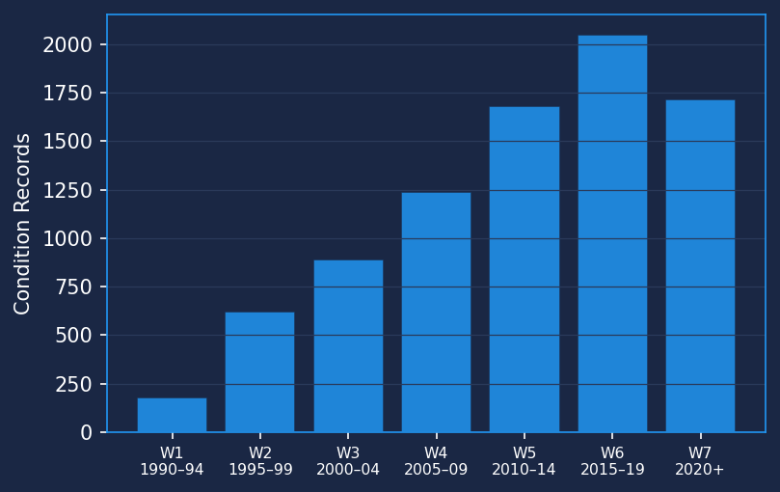
Dataset: Synthea Longitudinal EHR
IIIT-Hyderabad · IASNLP · 2026
File
Rows
Content
patients.csv
1,171
Demographics
conditions.csv
8,376
Diagnoses
observations.csv
299,697
Vitals & Labs
medications.csv
42,989
Prescriptions
7 longitudinal waves (5-year bins):
Wave 1: 1990–1994
Wave 2: 1995–1999
Wave 3: 2000–2004
Wave 4: 2005–2009
Wave 5: 2010–2014
Wave 6: 2015–2019
Wave 7: 2020+
4

Slide 5
Benchmark Design
IIIT-Hyderabad · IASNLP · 2026
100 questions · 25 per category · verified gold answers from raw CSVs
Lookup
Trend
Retrieve a specific fact about a patient in a named wave
Compute change in a vital between two waves (wave-level average)
e.g. 'What conditions did patient X have in Wave 4?'
e.g. 'Did SBP increase from Wave 3 to Wave 5?'
Aggregate
Multi-hop
Count or enumerate facts across ALL waves for a patient
Join condition date + observation series; compute pre/post avg
e.g. 'How many unique conditions in total?'
e.g. 'Was SBP higher after Hypertension diagnosis?'
5

Slide 6
4 Approaches: From Naive to Oracle
IIIT-Hyderabad · IASNLP · 2026
1
Naive RAG
2
Metadata Filtering
3
Knowledge Graph v2
4
Text-to- Pandas
CSV rows → text chunks Vector similarity (top-10) No patient/wave awareness
Patient ID + wave extracted Filtered similarity search Flat text context
NetworkX heterogeneous graph Graph traversal → subgraph Structured context to LLM
LLM generates pandas code Executes against raw DataFrames Symbolic computation oracle
Overall: 11%
Overall: 23%
Overall: 42%
Overall: 100%
6

Slide 7
Knowledge Graph Architecture
IIIT-Hyderabad · IASNLP · 2026
Graph Statistics
Patient (1,171)
Total nodes
315,774
appeared_in
diagnosed_with
Total edges
633,571
Patient nodes
1,171
Wave (7)
Condition (6,742)
Wave nodes
7 (shared)
Condition nodes
6,742
measured
prescribed
Observation nodes
274,720
contains
Medication nodes
33,134
Observation (274,720)
Medication (33,134)
5 node types · 5 directed edge types Wave assignment from event-date year field
7

Slide 8
Full Results Table
IIIT-Hyderabad · IASNLP · 2026
Approach
Lookup
Trend
Aggregate
Multi-hop
Overall
Naive RAG
20%
0%
16%
8%
11%
Metadata Filtering
48%
8%
28%
8%
23%
Knowledge Graph v2
80%
24%
64%
0%
42%
Text-to-Pandas
100%
100%
100%
100%
100%
V2 Diverse Benchmark (50 novel question templates — harder test)
Approach
Aggregate
Multi-hop
Overall
Naive RAG
0%
0%
0%
Knowledge Graph
4%
0%
2%
Text-to-Pandas
96%
100%
98%
V1 (top): KG v2 best retrieval-only at 42% · V2 (bottom): gap widens — T2P 98% vs KG 2% vs RAG 0%
8

Slide 9
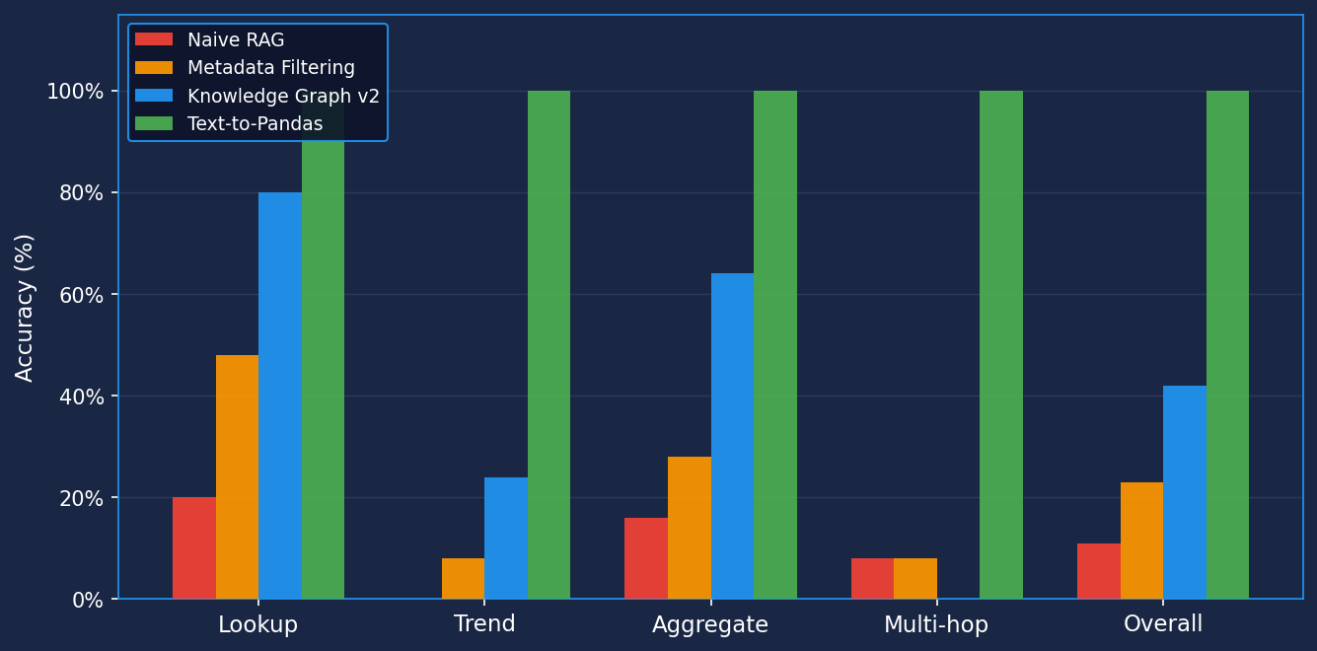
Results: Accuracy by Category
IIIT-Hyderabad · IASNLP · 2026
9

Slide 10
Finding 1: Graph Isolation Nearly Solves Lookup
IIIT-Hyderabad · IASNLP · 2026
Lookup Accuracy
Why KG v2 wins on Lookup
Naive RAG
20%
▸ Graph traversal guarantees patient-wave isolation
▸ Eliminates cross-patient context contamination
▸ Subgraph always scoped to the right wave(s)
▸ Residual 5 failures: 3 LLM_FORMAT (dropped SNOMED qualifiers), 2 edge cases
Metadata Filtering
48%
Knowledge Graph v2
80%
Text-to-Pandas
100%
+60 pp gain: Naive RAG → KG v2
Naive RAG failure: retrieved records from wrong patients or wrong time windows — a noise problem graph solves by design
10

Slide 11
IIIT-Hyderabad · IASNLP · 2026
Finding 2: Multi-Hop Is a Computation Problem, Not Retrieval
Multi-Hop Results
What Multi-Hop Requires
Naive RAG
8%
1. Find condition diagnosis date from conditions table
2. Split observation time-series at that date
3. Compute pre-diagnosis average SBP
4. Compute post-diagnosis average SBP
5. Compare and return direction of change
Metadata Filtering
8%
Knowledge Graph v2
0%
Text-to-Pandas
100%
All retrieval approaches converge to ~0–8%
No flat-context LLM can do this regardless of retrieval quality. Text-to-Pandas solves all 25 trivially with a 2-step join.
11

Slide 12
IIIT-Hyderabad · IASNLP · 2026
Core Finding
Better retrieval alone does NOT solve temporal reasoning. The bottleneck shifts from retrieval quality to symbolic computation.
+60 pp
0%
−58 pp
Lookup gain Naive → KG v2
Multi-hop (all retrieval- only approaches)
Gap to oracle (KG v2 vs Text-to-Pandas)
V2 Diverse Benchmark (50 novel questions) — gap widens further: T2P 98% · KG 2% · Naive RAG 0%
Hybrid architecture (graph retrieval + pandas code generation) is required to close the gap.
12

Slide 13
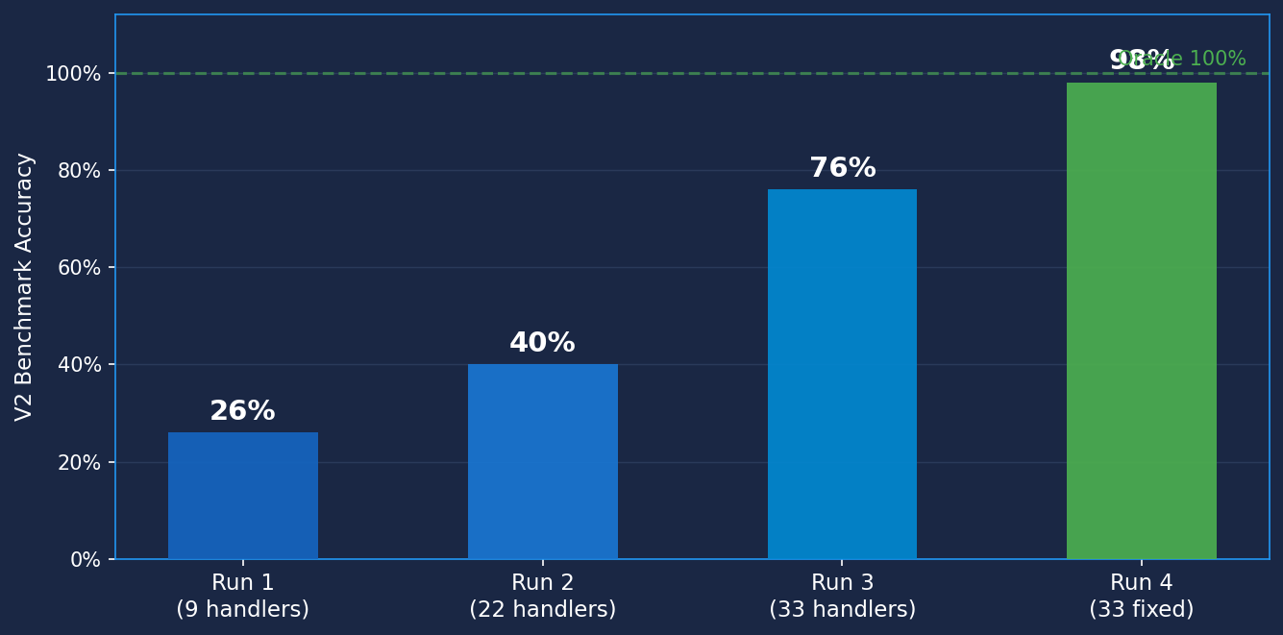
IIIT-Hyderabad · IASNLP · 2026
Text-to-Pandas: Handler Progression 26% → 98%
What changed each run
Run 1 — 26%
9 core handlers Lookup + basic wave scoping only
Run 2 — 40%
22 handlers +13 trend & aggregate handlers added
Run 3 — 76%
33 handlers +11 multi-hop handlers added
Run 4 — 98%
33 handlers (fixed) Bug: missing .lower() pattern matching fixed
Each new handler adds deterministic coverage for one class of temporal reasoning question — architecture generalises, not memorises
13

Slide 14
IIIT-Hyderabad · IASNLP · 2026
Extended Benchmark Confirms the Gap Widens
Benchmark
KG
T2P
Key Insight
▸ Harder questions = bigger gap
▸ Pattern discovery: 88-point gap
▸ Fact retrieval: 58-point gap
▸ Symbolic computation advantage grows with question complexity
Standard 100Q
42%
100%
Extended 25Q
12%
100%
Combined
36%
100%
Gap to oracle (Text-to-Pandas = 100%)
Standard 100Q
58 pts
Extended 25Q
88 pts
Extended benchmark deliberately tests co-occurrence, trajectory, medication patterns — the questions clinicians actually ask
14

Slide 15
Patient Cohort: Deep Dive
IIIT-Hyderabad · IASNLP · 2026
Role
Patient ID
Waves
Conditions
Key Feature
Star
3f336702
7
22
Coronary Heart Disease × 6 waves; 7× burden increase
Contrast
1930a1b6
7
1
Most stable: 7 waves, 1 condition, maximum coverage
Comorbid
3b95da79
7
14
HTN + Diabetes from Wave 2; monotonic burden increase
Patient Selection Criteria
Star
Highest Star score: max conditions × max waves × rare CHD
Contrast
Highest Contrast score: most waves with fewest conditions
Comorbid
Highest Comorbid score: both HTN and Diabetes from earliest wave
15

Slide 16
Patient Deep Dive: Key Findings
IIIT-Hyderabad · IASNLP · 2026
Star — 3f336702
Contrast — 1930a1b6
Comorbid — 3b95da79
▸ 22 unique conditions across all waves
▸ CHD persistent in 6 of 7 waves
▸ Wave 1: 3 conditions → Wave 7: 22 conditions (7× growth)
▸ Avg SBP Wave 5→6: +4 mmHg trend detectable
▸ Greatest diagnostic complexity in cohort
▸ Only 1 condition (Prediabetes) across all 7 waves
▸ Full 7-wave longitudinal coverage achieved
▸ Zero comorbidity — clinical baseline patient
▸ Demonstrates max wave coverage is achievable
▸ No medication records at any wave
▸ 14 conditions; HTN + T2D from Wave 2 onward
▸ Monotonically increasing condition burden
▸ Antihypertensives prescribed Wave 2–7
▸ Pre/post-HTN SBP comparison: multi-hop benchmark query
▸ Highest comorbidity complexity of any patient
16

Slide 17
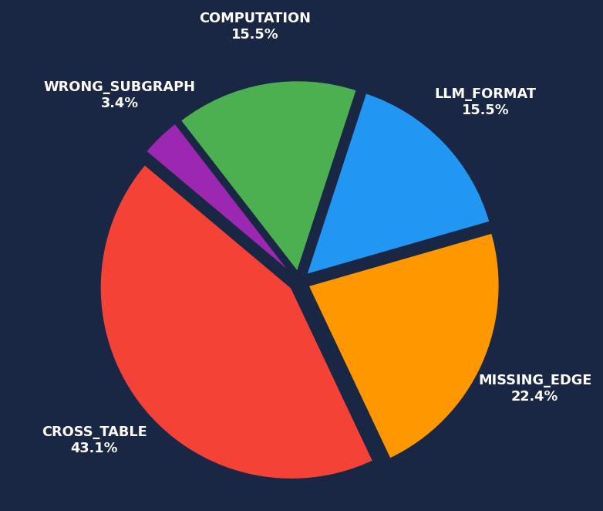
Failure Analysis: KG v2 (58 failures)
IIIT-Hyderabad · IASNLP · 2026
CROSS_TABLE
43.1%
Multi-hop joins require code execution
MISSING_EDGE
22.4%
Retriever passes only most-recent obs; gold needs wave avg
LLM_FORMAT
15.5%
Correct data retrieved; wrong answer format
COMPUTATION
15.5%
LLM cannot count distinct waves from flat context
WRONG_SUBGRAPH
3.4%
Empty context returned for wave that has data
17

Slide 18
Conclusion & Future Work
IIIT-Hyderabad · IASNLP · 2026
Conclusions
Future Work
▸ Graph retrieval solves lookup — 80% accuracy vs 20% Naive RAG
▸ Retrieval alone cannot handle trend averaging or multi-hop joins
▸ Text-to-Pandas achieves 100% — symbolic computation is the bottleneck
▸ 58-pp gap to oracle is a computation gap, not a retrieval gap
▸ Hybrid architecture (graph + pandas) is the recommended path forward
▸ Fix MISSING_EDGE: pass all obs with wave mean → trend ~80%
▸ Two-stage multi-hop: graph resolves diagnosis date, pandas computes pre/post avg
▸ LLM-as-judge evaluator for format-sensitive answers
▸ Finer-grained temporal index (monthly vs 5-year waves)
▸ Validate on real EHR data (MIMIC-IV, eICU)
IIIT-Hyderabad · IASNLP · 2026 | github.com/iasnlp-rag-project-v2 | Synthea EHR · 1,171 patients · 100-Q benchmark
18

