Slide 1
DDR5

Slide 2
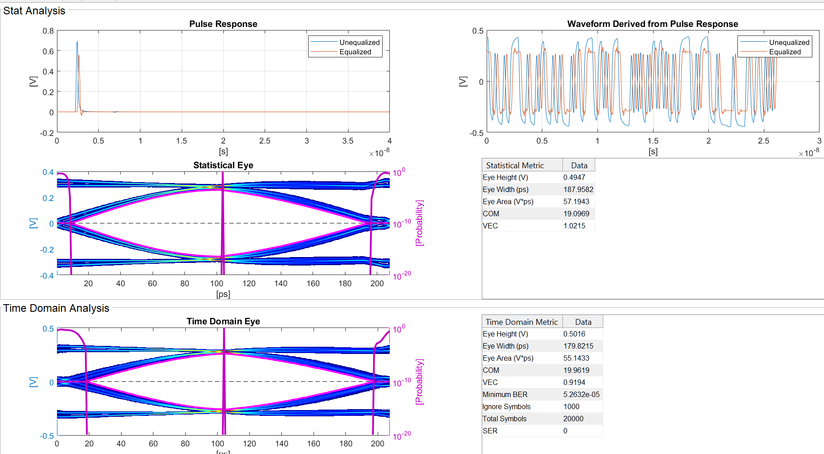
DDR5 Controller

Slide 3
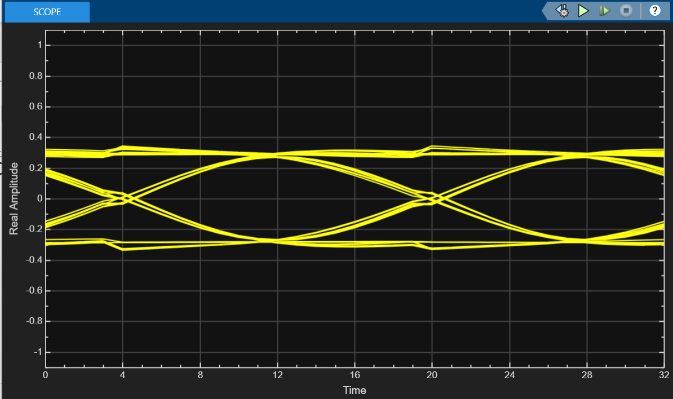

Slide 4
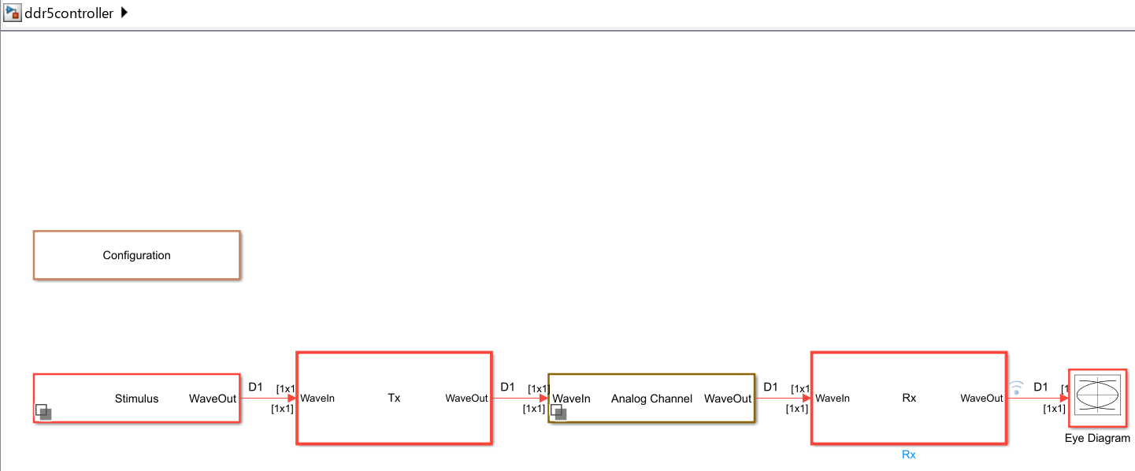

Slide 5
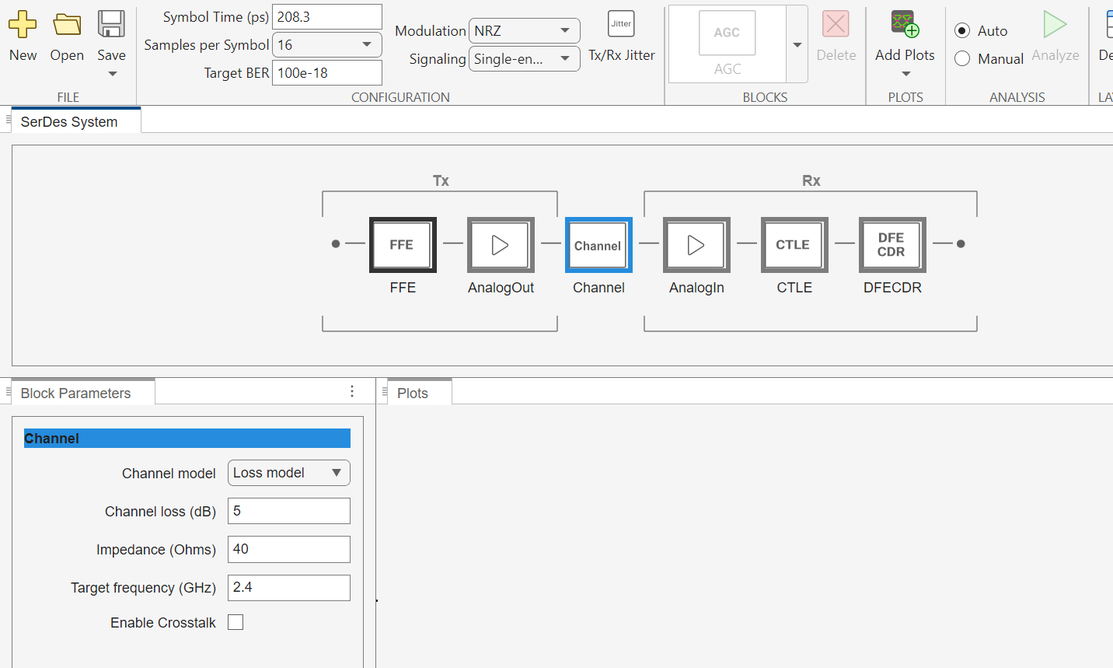

Slide 6
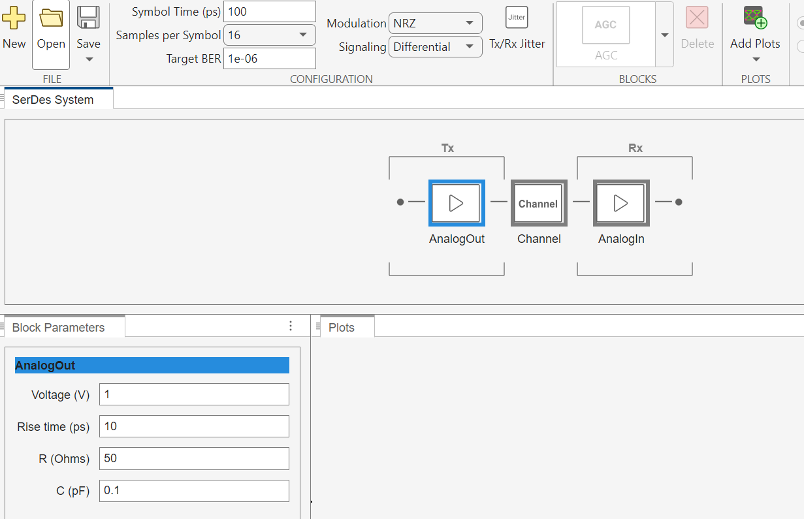
DDR with TX/RX AMI Support Back-Channel Link Training

Slide 7
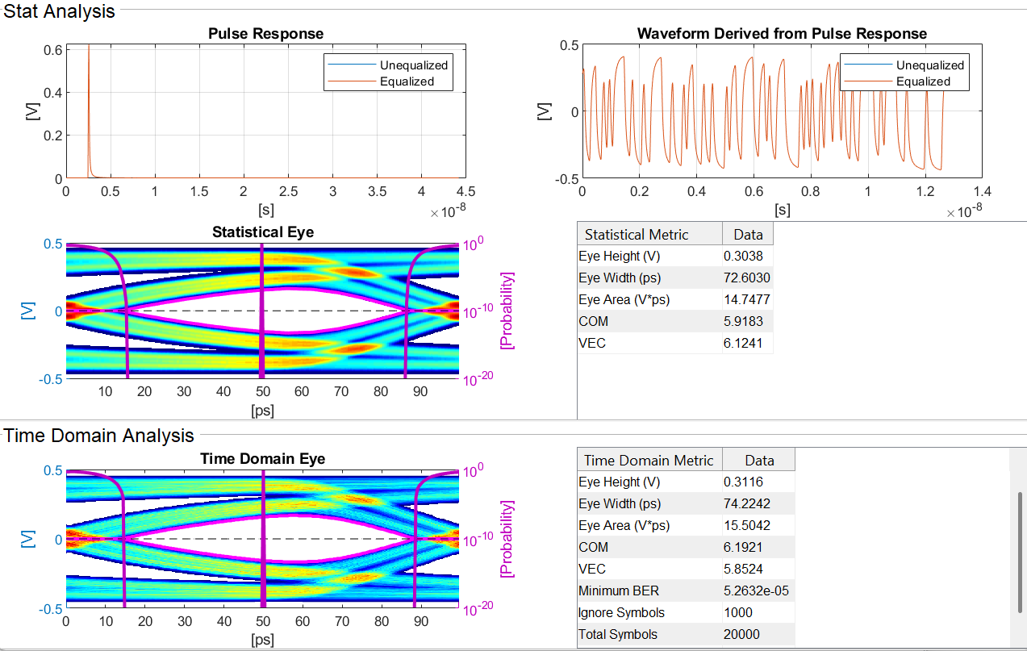
DDR with TX/RX AMI Support Back-Channel Link Training

Slide 8
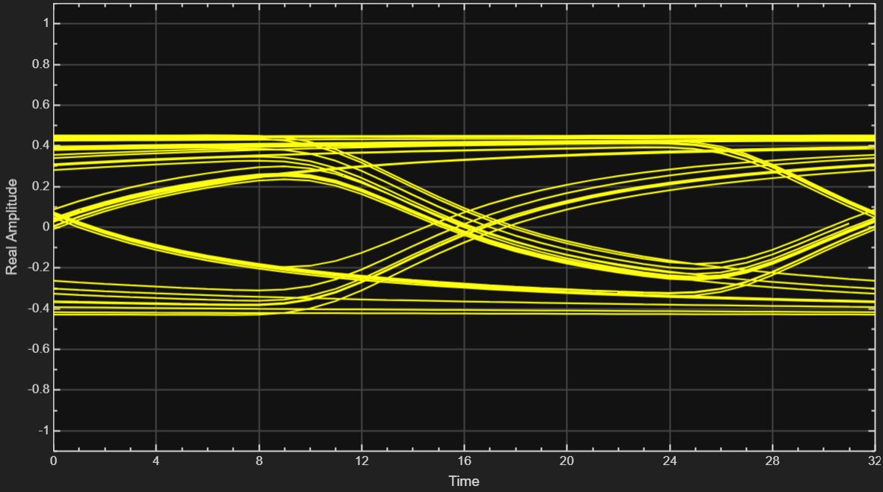
DDR with TX/RX AMI Support Back-Channel Link Training

